Slide 1
Vector Representation of sparse data
Ivelin G Angelov

Slide 2
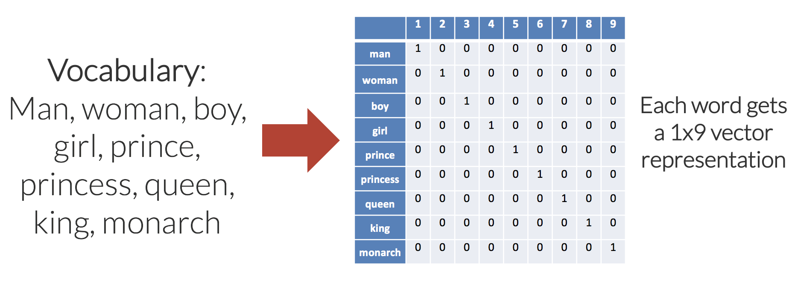
What is sparse data?
High-dimensional data where high percentage of the dimensions do not contain actual data

Slide 3
Problems with sparse data
The curse of dimensionality
Sparse data is memory inefficient
Sparse data is inefficient in terms of calculations
Most ML algorithms produce better results with dense inputs

Slide 4
Santander Value Prediction Challenge
Kaggle competition, ends August 20
Predict the value of transactions for potential customers.
Dataset is extremely sparse
Root Mean Squared Logarithmic Error

Slide 5
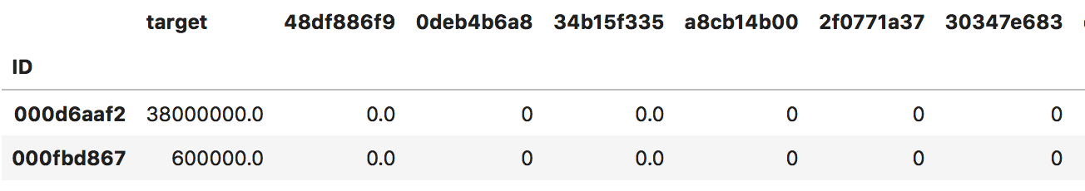
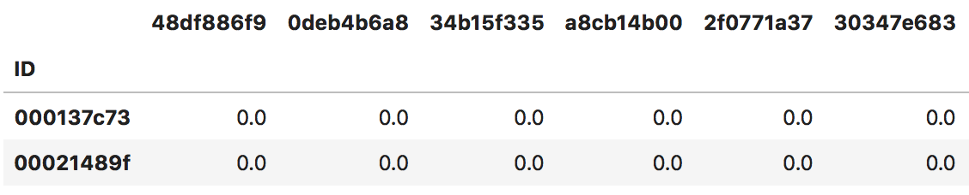
Santander Group Dataset
Training dataset: 4459 rows, 4992 columns
Testing dataset: 49342 rows, 4991 columns
https://www.kaggle.com/c/santander-value-prediction-challenge/data

Slide 6
Santander Group Dataset
Training Dataset
Testing Dataset
Inputs
Y
Inputs
5000 x 5000
(rounded diminution size)
97% Missing Values
Y
50,000 x 5000
(rounded diminution size)

Slide 7
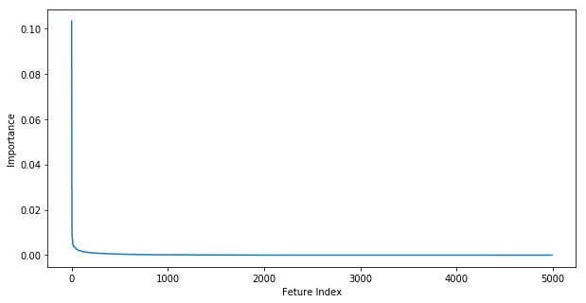
Feature Selection
Top 1000 selected

Slide 8
Dimensionality Reduction
Dimensionality Reduction
PCA
Autoencoder
500 x 1000
500 x 10

Slide 9
Dimensionality Reduction
Training Dataset
Testing Dataset
Training

Slide 10
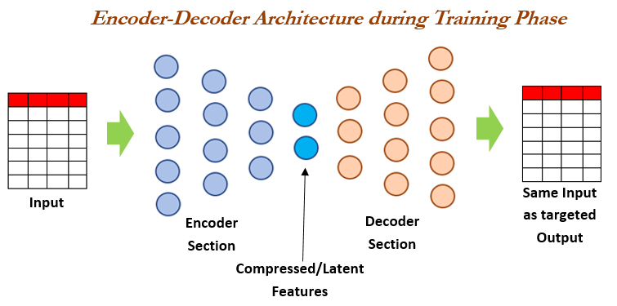
Encoder Decoder

Slide 11
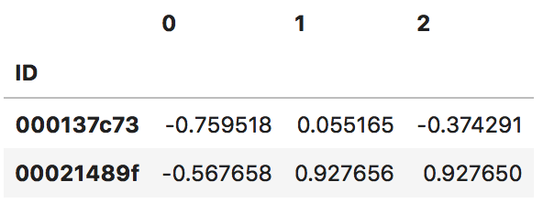

Slide 12
Dimensionality Reduction
Training Dataset
Transform
Information
Loss
Dense (Z)
Inverse Transform
Reconstruction

Slide 13
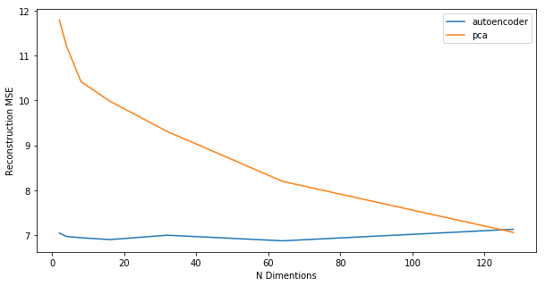
PCA vs Autoencoder (Reconstruction Error)

Slide 14
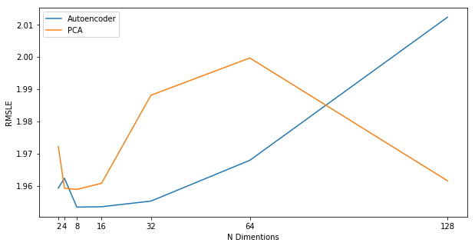
PCA vs Autoencoder (Linear Regression Performance)

Slide 15
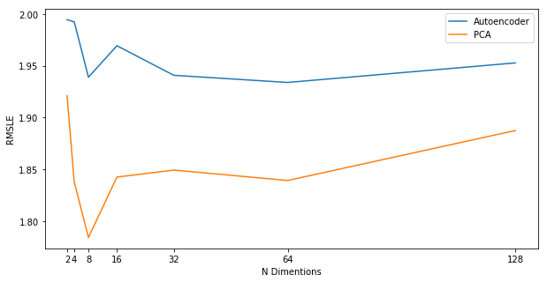
PCA vs Autoencoder (Random Forest Performance)

Slide 16
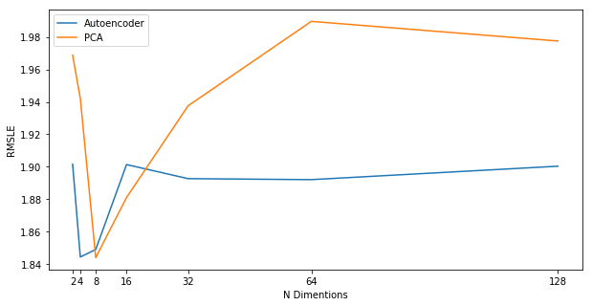
PCA vs Autoencoder (Neural Network Performance)

Slide 17
Feature Selection
Evaluation
Dimensionality Reduction
Supervised Regression

Slide 18
Lessons learned
Autoencoders are hard to train
Start with a simple model
Extremely Difficult Dataset

Slide 19
Questions?

