Slide 1
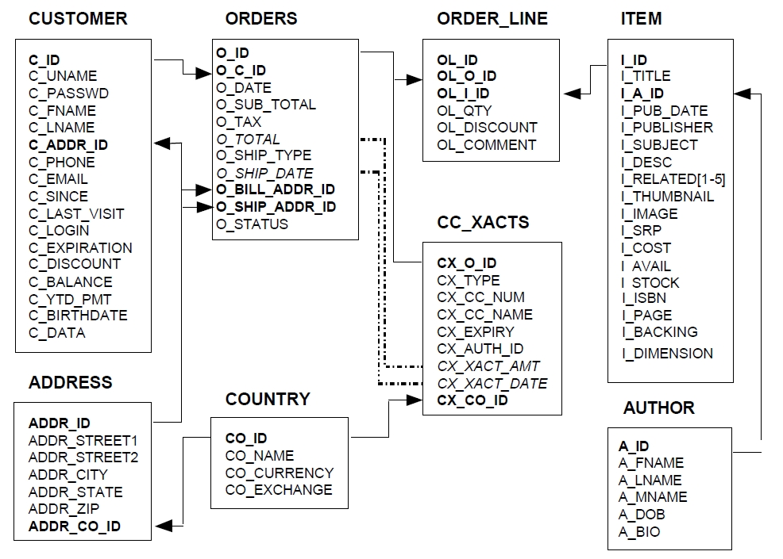
Partitioned with Item ID
Partitioned with customer ID
replicated

