Slide 1
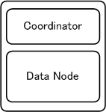
External Network
Loader
Network Segment-1(1Gbps)
GTM
Coordinator/
Data Node
Network Segment-2 (1Gbps)
Infiniband(10Gbps) … Not really used.

