Slide 1
High Availability in Postgres-XC
The symmetric PostgreSQL cluster
Koichi Suzuki
Postgres-XC Development Group
PostgreSQL Conference Europe, 2012
October 24th, 2012
Prague, Czech Republic

Slide 2
Outline of the Talk
Postgres-XC overview
  What it is
  Architecture and scalability
SPOF analysis
Failure characteristics
  Comparison with a commercial one
Failure handling and HA
Current status and future schedule

Slide 3
Self Introduction
Postgres-XC leader and core architect, as well as a core developer
  Whole architecture design
  Global transaction management and data distribution as a key for write-scalability
Work for NTT DATA Intellilink
  Subsidiary of NTT DATA corporation dedicated for system platform
  Member of NTT group company
Resources
  koichi.clarinet@gmail.com (facebook, linkedin)
  @koichiclarinet (twitter)

Slide 4
Postgres-XC Overview

Slide 5
What is Postgres-XC
Symmetric PostgerSQL cluster
  No master/slave replication
  No read-only clusters
  Every node can issue both read/write
  Every node provides single consistent database view
  Transparent transaction management
Not just a replication
  Each table can be replicated/distributed by sharding
  Parallel transaction/query execution
    So both read/write scalability

Slide 6

Master/Slave with Log Shipping

Slide 7

Postgres-XC Symmetric Cluster

Slide 8
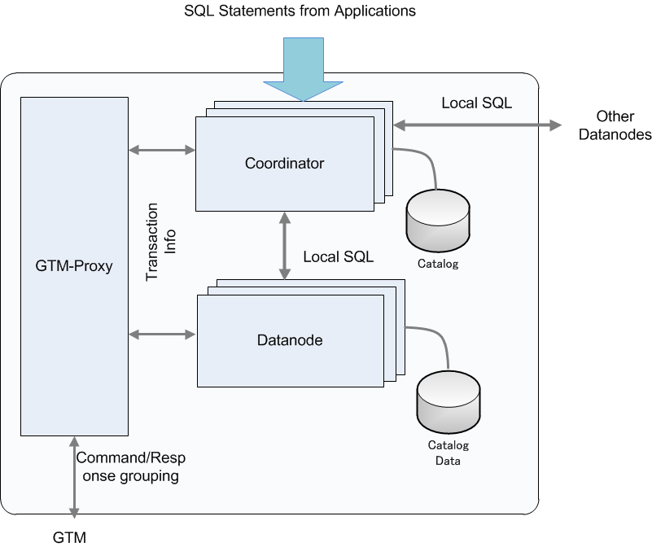

Architecture and Configuration

Slide 9
Outline of Components
GTM (Global Transaction Manager)
  Distributed MVCC
    Provide global transaction ID (GXID) to all the transactions
    Provide global snapshot to all the transactions
  Sequence
GTM_Proxy
  Group communications to GTM and reduce amount of GTM network workload
Coordinator
  Handles incoming SQL statements
    Parse, plan, conduct execution in datanodes and the coordinator.
    Integrate local results from each datanode involved.
Datanode
  Actual data storage
    Almost vanilla PostgreSQL
Share the binary

Slide 10
Flexible Configuration of Comonents
Each coordinator/datanode can be configured in any servers, same or different, as log as
  Each component does not share the following set of resources
    Listening IP addresses
    Listening port
    Work Directories
For simplicity and better workload balance, the following is advised:
  Have separate GTM server
  Each of others should have
    One GTM proxy (for network workload improvement)
    One Coordinator
      Some transactions may benefit from data located at local datanode (preferred node)
    One Datanode
      Automatic workload balance between coordinator and datanode

Slide 11
Flexible Configuration of Comonents
Each coordinator/datanode can be configured in any servers, same or different, as log as
  Each component does not share the following set of resources
    Listening IP addresses
    Listening port
    Work Directories
For simplicity and better workload balance, the following is advised:
  Have separate GTM server
  Each of others should have
    One GTM proxy (for network workload improvement)
    One Coordinator
      Some transactions may benefit from data located at local datanode (preferred node)
    One Datanode
      Automatic workload balance between coordinator and datanode

Slide 12

Scalability
DBT-1 (Rev)

Slide 13
Combining sharding and replication
DBT-1 example
CUSTOMER
ORDERS
ORDER_LINE
ITEM
SHOPPING_CART
C_ID
C_UNAME
C_PASSWD
C_FNAME
C_LNAME
C_ADDR_ID
C_PHONE
C_EMAIL
C_SINCE
C_LAST_VISIT
C_LOGIN
C_EXPIRATION
C_DISCOUNT
C_BALANCE
C_YTD_PMT
C_BIRTHDATE
C_DATA
O_ID
O_C_ID
O_DATE
O_SUB_TOTAL
O_TAX
O_TOTAL
O_SHIP_TYPE
O_BILL_ADDR_ID
O_SHIP_ADDR_ID
O_STATUS
OL_ID
OL_O_ID
OL_I_ID
OL_QTY
OL_DISCOUNT
OL_COMMENTS
OL_C_ID
I_ID
I_TITLE
I_A_ID
I_PUB_DATE
I_PUBLISHER
I_SUBJECT
I_DESC
I_RELATED1
I_RELATED2
I_RELATED3
I_RELATED4
I_RELATED5
I_THUMBNAIL
I_IMAGE
I_SRP
I_COST
I_AVAIL
I_ISBN
I_PAGE
I_BACKING
I_DIMENASIONS
SC_ID
SC_C_ID
SC_DATE
SC_SUB_TOTAL
SC_TAX
SC_SHIPPING_COST
SC_TOTAL
SC_C_FNAME
SC_C_LNAME
SC_C>DISCOUNT
CC_XACTS
CX_I_ID
CX_TYPE
CX_NUM
CX_NAME
CX_EXPIRY
CX_AUTH_ID
CX_XACT_AMT
CX_XACT_DATE
CX_CO_ID
CX_C_ID
Distributed with Shopping Cart ID
Distributed with Customer ID
SHOPPING_CART_LINE
ADDRESS
SCL_SC_ID
SCL_I_ID
SCL_QTY
SCL_COST
SCL_SRP
SCL_TITLE
SCL_BACKING
SCL_C_ID
STOCK
ADDR_ID
ADDR_STREET1
ADDR_STREET2
ADDR_CITY
ADDR_STATE
ADDR_ZIP
ADDR_CO_ID
ADDR_C_ID
Replicated
ST_I_ID
ST_STOCK
COUNTRY
AUTHOR
CO_ID
CO_NAME
CO_EXCHANGE
CO_CURRENCY
OL_ID
OL_O_ID
OL_I_ID
OL_QTY
OL_DISCOUNT
OL_COMMENTS
OL_C_ID
Distributed with ItemID

Slide 14
How XC Scales both Read/Write
Transaction Tables → Sharding
  Only one write
  Parallel writes in datanodes
Master Tables → Replication
  Relatively static: Not significant many-writes overhead
  Local join with transaction tables → Most join operation can be done locally in datanodes

Slide 15
Postgres-XC API
Binary compatible with PostgreSQL
  Limited support for ODBC
  JDBC may have a couple of restrictions
Compatible statements to PostgreSQL
  Slight difference
    CREATE TABLE, etc.
    Constraints can be enforced only locally in each datanodes.
  Extra
    Coordinator/datanode membership management, etc.
      CREATE/ALTER/DROP NODE, EXECUTE DIRECT...
    Extension in aggregates
      Combiner functions
    Maintain consistency in point-in-time-recovery
      CREATE BARRIER
No load balancing so far
You should notice
  OID is local to each node

Slide 16
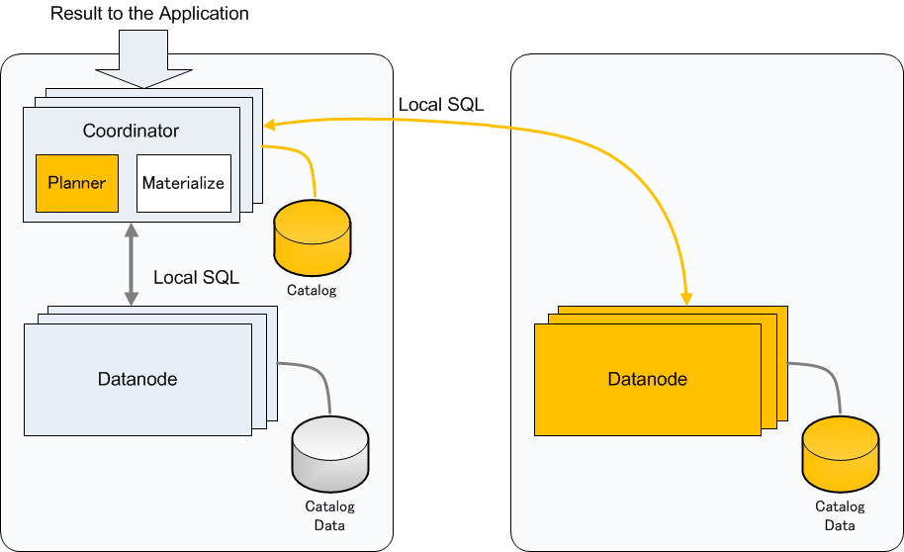
Join Example (1)
Replicated Table and Partitioned Table
  Can determine which datanode to go from WHERE clause

Slide 17
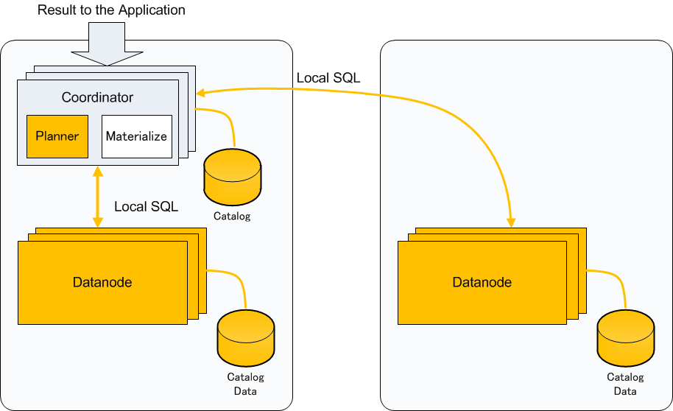
Join Example (2)
Replicated Table and Partitioned Table
  Cannot determine which datanode to go

Slide 18
Join Example (3)
Partitioned Table and Partitioned Table
  Both Join columns are distribution (partitioning) column

Slide 19
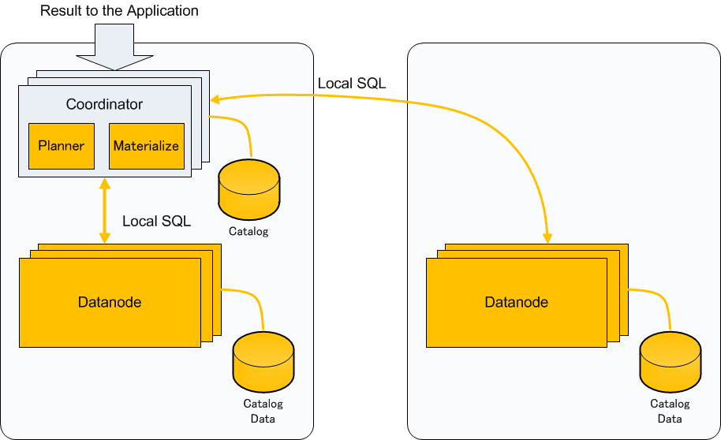
Join Example (4)
Partitioned Table and Partitioned Table
  One of Join columns are not distribution (partitioning) column

Slide 20
SPOF Analysis

Slide 21
Postgres-XC Single Point of Failure
GTM
  Obviously SPOF
GTM-Proxy
  No persistent data hold
  Just restart when fail
Coordinator
  Every coordinator is essentially a copy
  When fails, other coordinators work
Datanode
  SPOF for sharded table

Slide 22
Backup for SPOF component
GTM
  Specific backup for GTM (GTM Standby)
    Most information are kept on-memory
      Open TXNs
        Only the next GXID is needed to restart whole cluster, kept on disk.
    Copies every internal status change to the backup
      Similar to the log shipping in PostgreSQL
    Can promote to the master
      GTM-Proxy help this failover
Datanode
  Need backup
  Can use PostgreSQL's means
    Log Shipping
    Shared disk
Coordinator
  Not critical but may want to have backups
  Can use similar means as Datanodes.

Slide 23
GTM Slave (GTM Standby)
Same binary to GTM
  Backs up everything on the fly.
  Can promote to the master (gtm_ctl promote)
  Configure using gtm.conf
    startup = ACT|STANDBY
    active_host = 'active_gtm_host'
    active_port = 8765
GTM
Slave
Recocnnect at failure
Recocnnect at failure
Backup status
change
GTM Proxy
GTM
Master
Coordinator
Datanode

Slide 24
Datanodes
Almost all the techniques for PostgreSQL backup/failover are available
  Streaming replication
  Shared disk re-mount
Subject to coordinators
  Coordinators should reconfigure failed datanode at failover
  Coordinators should clean connections to failed datanode before reconfiguration
GTM
  Reconnect to (new) local GTM proxy

Slide 25
Coordinators
Only catalog is stored
  Very stable and static
  All the coordinators are essentially the same copy
Datanode HA technique can be applied
  Streaming replication
  Shared disk remount
One more option at a failure
  No failover
  Remaining coordinators will take care of TXNs
  Failed coordinator can be restored offline
    Backup/restore
    Copy catalogue from a remaining coordinator

Slide 26
Failure Characteristics

Slide 27
General
PostgreSQL
Postgres-XC
Promote one of the slaves
Application connect to promoted PostgreSQL
Everything stops and then restarts
Promote the slave of the failed component
Reconfigure with new master
Whole cluster continues to run, only affected TXNs fail
Just one component failure may not lead to whole cluster fail.
Can configure appropriate slaves for each component to continue XC operation.

Slide 28
Outline of XC failure characteristics
When one of the XC component fails, others are still running
Some of the running transactions may be damaged (forced to abort), but others may be able to keep running
Storage is not SPOF
  Distributed among components.

Slide 29
Impact of each component failure (1)
GTM
  Failover to GTM slave
  No TXN loss
GTM-Proxy
  Restart GTM-Proxy
  Reconnect to other GTM-Proxy
  Involved TXN may fail
Coordinator
  Involved TXN fails
  Failover
  or Use remaining coordinators

Slide 30
Impact of each component failure (2)
Datanode
  Failover to the slave
    Streaming replication
    Shared disk remount
      Much less resources
      Shared disk could be a SPOF

Slide 31
XC vs. O*R*
Feature | Postgres-XC | O____ R__
Background Databsae | PostgreSQL | O_____
Architecture | Shared Nothing | Shared Everything
Number of Servers | Experience: 10 Maybe 20 or more | ?? (Most deployments are two server configuration)
Hardware Requirement | None | Shared Disk
Read Scale | Yes | Yes
Write Scale | Yes | Depends (Application level partitioning)
Storage Failure | Limited impact Component failover Cluster keeps running | Whole cluster fails Cluster-wide failover
Server Failure | Affected components needs failover Others keep running | Remaining servers continues service

Slide 32
Failure Handling and HA

Slide 33
General
XC is not a simple replication
  When a component fails, other components is still alive and can continue to provide database service.
  Remaining components may need reconfiguration to accommodate new master of the failed component.
This section shows what to do to prepare slaves and failover each component
Useful shell scripts will be found in pgxc_ctl directory in
https://github.com/koichi-szk/PGXC-Tools

Slide 34
Coordinator Handling Options
Use coordinator slave
  Additional resource for slaves
No backup
  Use remaining coordinator at failure
  Restore offline with backups

Slide 35
Postgres-XC HA Configuration (1)
Circular Configuration
GTM (M)
GTM (S)
GTM Proxy
GTM Proxy
GTM Proxy
Coordinator1(M)
Coordinator2(M)
CoordinatorN(M)
Datanode1(M)
Datanode2(M)
DatanodeN(M)
CoordinatorN(S)
Coordinator1(S)
Coordinator(N-1)(S)
DatanodeN(S)
Datanode1(S)
Datanode(N-1)(S)

Slide 36
Postgres-XC HA Configuration (2)
Pair Configuration
GTM (M)
GTM (S)
GTM Proxy
GTM Proxy
Coordinator1(M)
Coordinator2(M)
Datanode1(M)
Datanode2(M)
Coordinator2(S)
Coordinator1(S)
Datanode2(S)
Datanode1(S)
Easier integration with Pacemaker

Slide 37
Failure handling outline – GTM(1)
Recocnnect at failure
5. Configure GTM Proxy
6. Start GTM Proxy
1. Configure GTM Master
2. Start GTM Master
Coordinator
GTM
Master
GTM Proxy
Datanode
GTM
Slave
3. Configure GTM Slave
4. Start GTM Slave

Slide 38
Failure handling outline – GTM(2)
9. Reconnect each GTM-Proxy to the new Master
(reconfigure for further restart)
7. GTM crashes
Coordinator
GTM
Master
GTM Proxy
Datanode
GTM
Slave
Coordinator/Datanode continues
to run. No transaction loss.
8. Promote GTM Slave
(reconfigure for further restart)

Slide 39
GTM failure handling steps (1)
Configure GTM master
Start GTM master
$ ssh gtm_master_host initgtm -Z gtm -D gtm_master_dir
$ ssh gtm_master_host cat >> gtm_master_dir/gtm.conf << EOF
listen_addresses = 'listen_addresses'
port = gtmMasterPort
nodename = 'gtmName'
startup = ACT
EOF
$
$ ssh gtm_master_host gtm_ctl start -Z gtm -D gtm_master_dir
$

Slide 40
GTM failure handling steps (2)
Configure GTM slave
Start GTM slave
$ ssh gtm_slave_host initgtm -Z gtm -D gtm_slave_dir
$ ssh gtm_slave_host cat >> gtm_slave_dir/gtm.conf << EOF
listen_addresses = 'listen_addresses'
port = gtmMasterPort
nodename = 'gtmName'
startup = STANDBY
active_host = 'gtmMasterServer'
active_port = gtmMasterPort
EOF
$
$ ssh gtm_slave_host gtm_ctl start -Z gtm -D gtm_slave_dir
$

Slide 41
GTM failure handling steps (3)
Configure GTM proxy
Start GTM proxy
$ ssh $ii initgtm -Z gtm -D gtm_proxy_dir
$ ssh $ii cat >> gtm_proxy_dir/gtm_proxy.conf << EOF
listen_addresses = 'listen_addresses'
port = gtmProxyPort
nodename = 'gtm_proxy_Name'
startup = STANDBY
active_host = 'gtmMasterServer'
active_port = gtmMasterPort
gtm_host = gtmMasterServer
gtm_port = gtmMasterPort
gtm_connect_retry_interval = 1
EOF
$
Do for all the gtm proxies you're configuring
$ ssh gtm_slave_host gtm_ctl start -Z gtm -D gtm_slave_dir
$
Do for all the gtm proxies you're configuring

Slide 42
GTM failure handling steps (4)
Promote GTM slave to master
Reconfigure for further restart
$ ssh gtm_slave_host gtm_ctl promote -Z gtm -D gtm_slave_dir
$
$ ssh gtm_slave_host cat >> gtm_slave_dir/gtm.conf << EOF
startup = STANDBY
EOF
$

Slide 43
GTM failure handling steps (5)
Reconnect each GTM-Proxy to the new Master
Reconfigure for further restart
$ ssh gtmProxyServer gtm_ctl reconnect -Z gtm_proxy \
-D gtmProxyDir -o "-s gtmMasterServer -t gtmMasterPort"
$
Do for all the gtm proxies you're configuring
$ ssh gtmProxyServer cat >> gtmProxyDir/gtm_proxy.conf << EOF
gtm_host = 'gtmMasterServer'
gtm_port = gtmMasterPort
EOF
$
Do for all the gtm proxies you're configuring

Slide 44
Failure Handling Outline - Coordinator(1)
GTM Proxy
GTM Proxy
Configure coordinator master
Start coordinator master
Configure nodes
Coordinator
Master
Coordinator
Slave
Configure coordinator slave
Start coordinator slave
Datanode

Slide 45
Failure Handling Outline - Coordinator(2)
GTM Proxy
GTM Proxy
Coordinator master crash!
Coordinator
Master
Coordinator
Slave
Master
Coordinator slave promote
Datanode
Reconfigure new coordinator master

Slide 46
Coordinator failure handling steps (1)
Configure coordinator masters
$ ssh coordMasterServer initdb --nodename coordName -D coordMasterDir
$ ssh coordMasterServer “cat >> coordMasterDir/postgresql.conf” << EOF
listen_addresses = 'listen_addresses'
port = coordPort
pooler_port = poolerPort
gtm_host = 'GTMProxyHost'
gtm_port = GTMProxyPort
wal_level = hot_standby
archive_mode = on
archive_command = 'rsync %p CoordSlaveServer:coordArchLogDir/%f'
max_wal_senders = coordMaxWalSender
EOF
$ ssh coordMasterServer cat >> coordMasterDir/pg_hba.conf << EOF
host replication pgxcOwner CIDR-addresses trust
EOF
$
Do for all the coordinators you're configuring

Slide 47
Coordinator failure handling steps (2)
Start coordinator masters
Configure nodes
$ ssh coordMasterServer pg_ctl start -Z coordinator -D coordMasterDir
Do for all the coordinators you're configuring
$ psql -p coordPort -h coordMasterServer postgres
CREATE NODE …
CREATE NODE …
ALER NODE …
\q
$
All other coordinators/datanodes
Myself
Do for all the coordinators you're configuring

Slide 48
Coordinator failure handling steps (3)
Configure coordinator slaves
Start coordinator slaves
$ ssh coordSlaveServer pg_basebackup -p coordPort -h coordMasterServer \
-D coordSlaveDir -x
$ ssh coordSlaveServer “cat >> coordSlaveDir/recovery.conf” <EOF
standby_mode = on
primary_conninfo = 'host = coordMasterServer port = coordPort user = pgxcOwner application_name = 'coordName'
restore_command = 'cp coordArchLogDir/%f %p'
archive_cleanup_command = 'pg_archivecleanup coordArchLogDir %r'
EOF
$ ssh coordSlaveServer "cat >> coordSlaveDir/postgresql.conf" <<EOF
hot_standby = on
port = coordPort
EOF
Do for all the coordinators you're configuring
$ ssh coordSlaveServer pg_ctl start -Z coordinator -D coordSlaveDir
$ ssh coordMasterServer “cat >> coordMasterDir/postgresql.conf” <EOF
synchronous_commit = on
synchronous_standby_names = 'coordName'
EOF
$ ssh coordSlaveServer "cat >> coordSlaveDir/postgresql.conf" <<EOF
hot_standby = on
port = coordPort
EOF
$ ssh coordMasterServer pg_ctl reload -Z coordinator -D coordMasterDir
$
Do for all the coordinators you're configuring

Slide 49
Coordinator failure handling steps (4)
Coordinator slave promote
Reconfigure new coordinator master
$ ssh coordSlaveServer pg_ctl promote -Z coordinator -D coordSlaveDir
$ ssh coordSlaveServer "cat >> coordSlaveDir/postgresql.conf" <<EOF
gtm_host = 'targetGTMhost'
gtm_port = targetGTMport
EOF
$ ssh coordSlaveServer pg_ctl restart -Z coordinator -D coordSlaveDir
$
$ cat > cmdfile <<EOF
ALTER NODE coordName WITH (HOST='coordSlaveServer', PORT=coordPort);
SELECT pgxc_pool_reload();
\q
EOF $ psql -p coordPort -h coordMasterServer dbname pgxcOwner -f cmdfile
$
Do for all coordinators

Slide 50
Failure Handling Outline - Datanode(1)
GTM Proxy
GTM Proxy
Configure datanode master
Start datanode master
Configure nodes
Coordinator
Datanode
Slave
Configure datanode slave
Start datanode slave
Datanode
Master

Slide 51
Failure Handling Outline - Coordinator(2)
GTM Proxy
GTM Proxy
Coordinator
Datanode
Slave
Master
Datanode slave promote
Reconfigure new datanode master
Datanode master crash!
Datanode
Master

Slide 52
Datanode failure handling steps (1)
Configure Datanode masters
$ ssh datanodeMasterServer initdb --nodename datanodeName -D datanodeMasterDir
$ ssh datanodeMasterServer “cat >> datanodeMasterDir/postgresql.conf” << EOF
listen_addresses = 'listen_addresses'
port = datanodePort
pooler_port = poolerPort
gtm_host = 'GTMProxyHost'
gtm_port = GTMProxyPort
wal_level = hot_standby
archive_mode = on
archive_command = 'rsync %p datanodeSlaveServer:datanodeArchLogDir/%f'
max_wal_senders = datanodeMaxWalSender
EOF
$ ssh datanodeMasterServer cat >> datanodeMasterDir/pg_hba.conf << EOF
host replication pgxcOwner CIDR-addresses trust
EOF
$
Do for all the coordinators you're configuring

Slide 53
Datanode failure handling steps (2)
Start datanode masters
Configure nodes – Has already been done!
$ ssh datanodeMasterServer pg_ctl start -Z datanode -D datanodeMasterDir
Do for all the datanodes you're configuring

Slide 54
Datanode failure handling steps (3)
Configure datanode slaves
Start datanode slaves
$ ssh datanodeSlaveServer pg_basebackup -p datanodePort -h datanodeMasterServer \
-D datanodeSlaveDir
$ ssh datanodeSlaveServer “cat >> datanodeSlaveDir/recovery.conf” <EOF
standby_mode = on
primary_conninfo = 'host = datanodeMasterServer port = datanodePort user = pgxcOwner application_name = 'datanodeName'
restore_command = 'cp datanodeArchLogDir/%f %p'
archive_cleanup_command = 'pg_archivecleanup datanodeArchLogDir %r'
EOF
$ ssh datanodeSlaveServer "cat >> datanodeSlaveDir/postgresql.conf" <<EOF
hot_standby = on
port = datanodePort
EOF
Do for all the datanodes you're configuring
$ ssh datanodeSlaveServer pg_ctl start -Z datanode -D datanodeSlaveDir
$ ssh datanodeMasterServer “cat >> datanodeMasterDir/postgresql.conf” <EOF
synchronous_commit = on
synchronous_standby_names = 'coordName'
EOF
$ ssh datanodeSlaveServer "cat >> datanodeSlaveDir/postgresql.conf" <<EOF
hot_standby = on
port = datnodePort
EOF
$ ssh datanodeMasterServer pg_ctl reload -Z datanode -D datanodeMasterDir
$
Do for all the datanodes you're configuring

Slide 55
Datanode failure handling steps (4)
Datanode slave promote
Reconfigure new datanode master
$ ssh datanodeSlaveServer pg_ctl promote -Z datanode -D datanodeSlaveDir
$ ssh datanodeSlaveServer "cat >> datanodeSlaveDir/postgresql.conf" <<EOF
gtm_host = 'targetGTMhost'
gtm_port = targetGTMport
EOF
$ ssh datanodeSlaveServer pg_ctl restart -Z datanode -D datanodeSlaveDir
$
$ cat > cmdfile <<EOF
ALTER NODE datanodeName WITH (HOST='datanodeSlaveServer', PORT=datanodePort);
SELECT pgxc_pool_reload();
\q
EOF $ psql -p coordPort -h coordMasterServer dbname pgxcOwner -f cmdfile
$
Do for all the coordinators

Slide 56
When a Server is Gone?
Both Coordinator and Datanode fail
  They have to be failed-over
  Combination of the cases above
  Don't need to fail-over GTM-Proxy
    Use it running at the target server.

Slide 57
Complicated Scripts ...
Tools will be available soon from separate team
  RA for Pacemaker
  Installation/configuration
  Backup/Restore
  Cluster-wide stats info
Now writing pgxc_ctl scripts
  Various useful bash scripts for various scenes
    Deployment/configuration/start/stop/failover
    Configuration
    Reconfigure at fault handling
    Log (hopefully)
    Cluster operation commands
    Export current status for backup (hopefully)
  Only works at linux/bash
  Useful to write scripts for other HA middleware and operating system
Coming soon too!!

Slide 58
Postgres-XC Core Status
Version 1.0.1: Sept., 2012
  Based upon PostgreSQL 9.1
  Major SQL statements
  GTM standby (slave)
  Coordinator/Datanode streaming replication

Slide 59
Postgres-XC Core Development Underway
Trigger
Returning
WHERE CURRENT OF
Online node management
  Node addition/removal
Table redistribution
  Foreground
  Concurrent
Utilities
  GTM stats/housekeeping
Planner improvement
Error handling improvement
  Features out of transaction block in PG (could not handle using 2PC)
  Error handling from multiple datanodes in single operation

Slide 60
Postgres-XC release cycle
Annual major release
  Merge PostgreSQL major release
  Additional Feature
  Next release will be around April, 2013
Quarterly minor release
  Bug
  Security
  Catch up PostgreSQL minor releases

Slide 61
Join the Community
As a tester - bug report
As a packager
  Debian, RPM, pkg...
As a coder
  Why not writing new stuff? => Feature requests in SF tracker
  Bug correction and stabilization? => Bug tracker in SF
As a documentation reviewer
Anything I am forgetting here...

Slide 62
Resources
Useful pages
  http://postgres-xc.sourceforge.net/
  https://sourceforge.net/projects/postgres-xc/
  http://postgresxc.wikia.com/wiki/Postgres-XC_Wiki
Mailing lists: please subscribe
  developers
  committers
  bugs
  announce
  general

Slide 63
Another Postgres-XC efforts
Installer
Operation stats collection
Backup/Restore
RAs for Pacemaker/Heartbeat
Being done by separate development team
Sorry, now close effort
Will be made open soon

Slide 64
Useful Materials
Postgres-XC
  http://postgres-xc.sourceforge.net/ (project web site)
  http://sourceforge.net/projects/postgres-xc/ (development site)
  http://postgresxc.wikia.com/wiki/Postgres-XC_Wiki (Wiki site)
  https://github.com/koichi-szk/PGXC-Tools (pgxc_ctl, gtm_util tools)
PostgreSQL resource agents for Pacemaker/Heartbeat
  sf-ex : mount filesystem exclusively
    https://github.com/ClusterLabs/resource-agents/blob/master/heartbeat/sfex
  postgres – streaming replication
    https://github.com/ClusterLabs/resource-agents/blob/master/heartbeat/pgsql

Slide 65



Thank you very much!!

