Slide 1
Overview of Postgres-XC
Koichi Suzuki
Postgres-XC Development Group
Postgres Conference China 2014
December 12th, 2014
Shenzhen, China

Slide 2
What is Postgres-XC
Symmetric PostgerSQL cluster
  No master/slave replication
  No read-only clusters
  Every node can issue both read/write
  Every node provides single consistent database view
  Transparent transaction management
Not just a replication
  Each table can be replicated/distributed by sharding
  Parallel transaction/query execution
    So both read/write scalability

Slide 3

Master/Slave with Log Shipping

Slide 4

Postgres-XC Symmetric Cluster

Slide 5
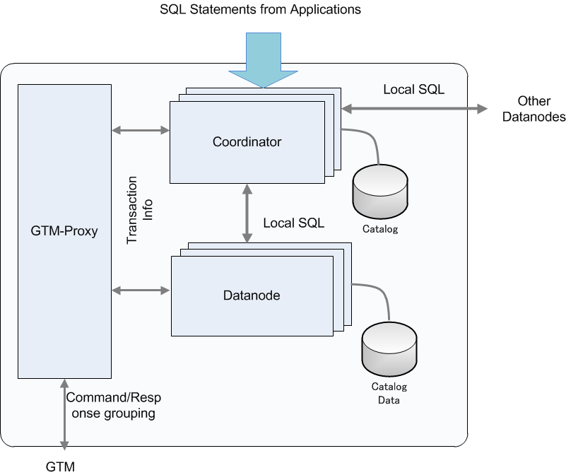

Architecture and Configuration

Slide 6
Outline of Components
GTM (Global Transaction Manager)
  Distributed MVCC
    Provide global transaction ID (GXID) to all the transactions
    Provide global snapshot to all the transactions
  Sequence
GTM_Proxy
  Group communications to GTM and reduce amount of GTM network workload
Coordinator
  Handles incoming SQL statements
    Parse, plan, conduct execution in datanodes and the coordinator.
    Integrate local results from each datanode involved.
Datanode
  Actual data storage
    Almost vanilla PostgreSQL
Share the binary

Slide 7

Scalability
DBT-1 (Rev)

Slide 8
Scaling-out architecture
Postgres-XC is designed for throughput scale-out.
Additional duration for coordinator – datanode communication required.
Can handle more connection/transaction in parallel.
For data load, you separate the data to be fed from different coordinators.
  Key for data load scale-out.
  Data load from single coordinator may not scale.
    XC scales up when multiple coordinators/datanodes are involved.

Slide 9
Combining sharding and replication
DBT-1 example
CUSTOMER
ORDERS
ORDER_LINE
ITEM
SHOPPING_CART
C_ID
C_UNAME
C_PASSWD
C_FNAME
C_LNAME
C_ADDR_ID
C_PHONE
C_EMAIL
C_SINCE
C_LAST_VISIT
C_LOGIN
C_EXPIRATION
C_DISCOUNT
C_BALANCE
C_YTD_PMT
C_BIRTHDATE
C_DATA
O_ID
O_C_ID
O_DATE
O_SUB_TOTAL
O_TAX
O_TOTAL
O_SHIP_TYPE
O_BILL_ADDR_ID
O_SHIP_ADDR_ID
O_STATUS
OL_ID
OL_O_ID
OL_I_ID
OL_QTY
OL_DISCOUNT
OL_COMMENTS
OL_C_ID
I_ID
I_TITLE
I_A_ID
I_PUB_DATE
I_PUBLISHER
I_SUBJECT
I_DESC
I_RELATED1
I_RELATED2
I_RELATED3
I_RELATED4
I_RELATED5
I_THUMBNAIL
I_IMAGE
I_SRP
I_COST
I_AVAIL
I_ISBN
I_PAGE
I_BACKING
I_DIMENASIONS
SC_ID
SC_C_ID
SC_DATE
SC_SUB_TOTAL
SC_TAX
SC_SHIPPING_COST
SC_TOTAL
SC_C_FNAME
SC_C_LNAME
SC_C>DISCOUNT
CC_XACTS
CX_I_ID
CX_TYPE
CX_NUM
CX_NAME
CX_EXPIRY
CX_AUTH_ID
CX_XACT_AMT
CX_XACT_DATE
CX_CO_ID
CX_C_ID
Distributed with Shopping Cart ID
Distributed with Customer ID
SHOPPING_CART_LINE
ADDRESS
SCL_SC_ID
SCL_I_ID
SCL_QTY
SCL_COST
SCL_SRP
SCL_TITLE
SCL_BACKING
SCL_C_ID
STOCK
ADDR_ID
ADDR_STREET1
ADDR_STREET2
ADDR_CITY
ADDR_STATE
ADDR_ZIP
ADDR_CO_ID
ADDR_C_ID
Replicated
ST_I_ID
ST_STOCK
COUNTRY
AUTHOR
CO_ID
CO_NAME
CO_EXCHANGE
CO_CURRENCY
OL_ID
OL_O_ID
OL_I_ID
OL_QTY
OL_DISCOUNT
OL_COMMENTS
OL_C_ID
Distributed with ItemID

Slide 10
How XC Scales both Read/Write
Transaction Tables → Sharding
  Only one write
  Parallel writes in datanodes
Master Tables → Replication
  Relatively static: Not significant many-writes overhead
  Local join with transaction tables → Most join operation can be done locally in datanodes

Slide 11
Postgres-XC API
Binary compatible with PostgreSQL
  Limited support for ODBC
  JDBC may have a couple of restrictions
Compatible statements to PostgreSQL
  Slight difference
    CREATE TABLE, etc.
    Constraints can be enforced only locally in each datanodes.
  Extra
    Coordinator/datanode membership management, etc.
      CREATE/ALTER/DROP NODE, EXECUTE DIRECT...
    Extension in aggregates
      Combiner functions
    Maintain consistency in point-in-time-recovery
      CREATE BARRIER
No load balancing so far
You should notice
  OID is local to each node

Slide 12
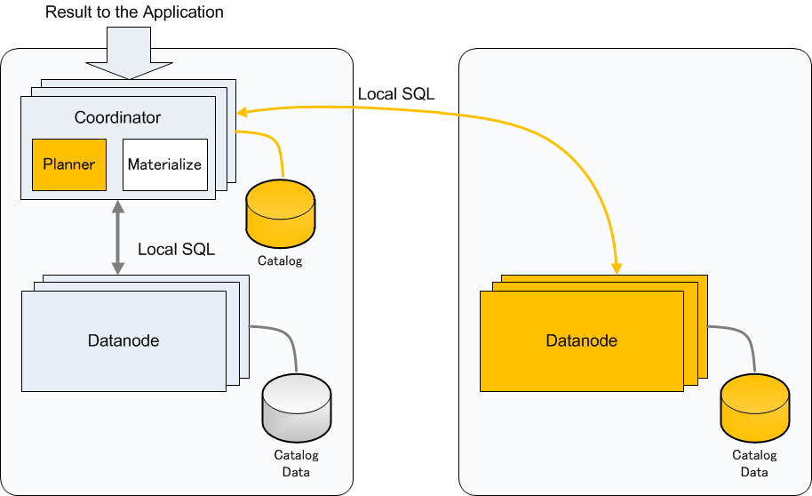
Join Example (1)
Replicated Table and Partitioned Table
  Can determine which datanode to go from WHERE clause

Slide 13
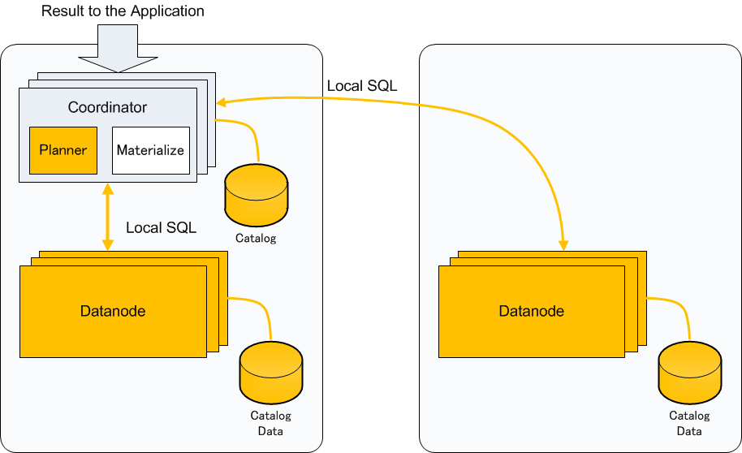
Join Example (2)
Replicated Table and Partitioned Table
  Cannot determine which datanode to go

Slide 14
Thank You Very Much!
koichi@dbms.gmail.com

