Slide 1
Postgres-XC, write-scalable PostgreSQL Cluster
PostgreSQL usage in NTT group
PGConfChina 2012
June 16th, 2012
Koichi Suzuki
NTT DATA Intellilink Corporation

Slide 2
Agenda
Postgres-XC
  What is Postgres-XC
  Core architecture overview
  Statement Handling
  High-availability
  Release Status
PostgreSQL in NTT
  Open source software center
  Effort to improve PostgreSQL
  Application Characteristics and Deployment

Slide 3
Self Introduction
Postgres-XC leader and core architect, as well as a core developer
  Whole architecture design
    Global transaction management and data distribution as a key for write-scalability
Work for NTT DATA Intellilink
  Subsidiary of NTT DATA corporation dedicated for system platform
  Member of NTT group company
  Providing open-source engineering for NTT Open Source Software Center
Resources
  koichi.clarinet@gmail.com (facebook, linkedin)
  @koichiclarinet (twitter)

Slide 4
What is Postgres-XC

Slide 5
Postgres-XC Highlights
Cluster software focused on write-scalability
Based on PostgreSQL (at present, 9.1.4)
  World's most advanced open source database
  PostgreSQL license
Same client APIs as PostgreSQL
  Ease of application migration from existing PostgreSQL deployment
  Same drivers, same front end, same SQL queries
Licensing
  PostgreSQL license (more or less BSD)
  Free to use, modify and redistribute for commercial purposes

Slide 6
In short ….
Symetric cluster of PostgreSQL
  No Slave and no Master
  Read and write scalability
  Transparent Transaction Management
  Shared-nothing structure
  3 types of nodes: GTM, Coordinator, Datanode

Slide 7
Postgres-XC History
Work begun in 2003 as research project
  NTT DATA, NTT DATA Intellilink
  Co-worked with ISCAS (Beijing) at the final stage of research
Restarted at 2009 as development work
  NTT Open Source Software Center and EnterpriseDB
  Goal to build a PostgreSQL based clustering solution which can serve as an alternative to Oracle RAC
  Development is community-based, with resources gathered from NTT and EnterpriseDB
  Licensing terms changed from GPL to PostgreSQL license (same as Postgres) in 2011

Slide 8

PostgreSQL Master/Slave with Log Shipping

Slide 9

Postgres-XC Symmetric Cluster

Slide 10
Scalability
Somewhat old. Latest measurement will be published elsewhere.
So far, no different in the scalability.

Slide 11
Current Status
Version 1.0 was released
  Supports 64bit Linux
    Tested under Cent OS 5.3 and ubuntu 10.4
    Community members are testing in other platform
      Open BSD
      MacOS
  Some restriction though
    Trigger
    WHERE CURRENT OF
    Savepoint …
  PostgreSQL license

Slide 12
Architecture Overview

Slide 13
Server Configuration and GTM-Proxy
GTM, coordinator and datanode are key components.

Slide 14

GTM: Key for Transaction Transparency
Consistent Transaction ID (GXID) throughout the system
Provide global snapshot for consistent visibility from any server

Slide 15
Coordinator: Global SQL processor
Point of contact for the application/client
Management of remote node data
  Parse and partially plan the statements
  Determine the data to be fetched from remote nodes at planning or execution
  Fetch the required data by issuing queries to dedicated Datanodes
  Combine and process the data to evaluate the results of the query (if needed)
  Pass the results to the applications
Manages two-phase commit
Stores catalog data: cluster-related information
Needs and manages space for materializing results from remote nodes
Binary based on the latest PostgreSQL release

Slide 16
Datanode: actual data store
More or less a PostgreSQL instance (remote node)
Stores tables and catalogs
Executes the queries from client Coordinator and returns results to it
Data nodes can be made fault tolerant by Hot-Standby and Synchronous Replication technologies available of standard PostgreSQL
Binary same as Coordinator, based on latest PostgreSQL release

Slide 17
Data Management
Table types
  Replicated table
    Each row replicated to Datanodes
    Statement based replication
  Distributed table
    Each row of the table is stored on one datanode, decided by one of following strategies
      Hash
      Round Robin
      Modulo
Managed by SQL extensions (CREATE TABLE)
Possible to define subset of nodes

Slide 18

Replicated Tables
Writes
Reads
parallel
Read
Write
Write
Write
col1 | col2
1 | 45
2 | 23
3 | 34
col1 | col2
1 | 45
2 | 23
3 | 34
col1 | col2
1 | 45
2 | 23
3 | 34
col1 | col2
1 | 45
2 | 23
3 | 34
col1 | col2
1 | 45
2 | 23
3 | 34
col1 | col2
1 | 45
2 | 23
3 | 34

Slide 19
Distributed tables
Writes
Reads
Read
Write
col1 | col2
1 | 45
2 | 23
3 | 34
col1 | col2
101 | 654
201 | 8
301 | 124
col1 | col2
102 | 26
202 | 98
302 | 6
col1 | col2
1 | 45
2 | 23
3 | 34
col1 | col2
101 | 654
201 | 8
301 | 124
col1 | col2
102 | 26
202 | 98
302 | 6

Slide 20
Statement Handling

Slide 21
Node configuration, again

Slide 22
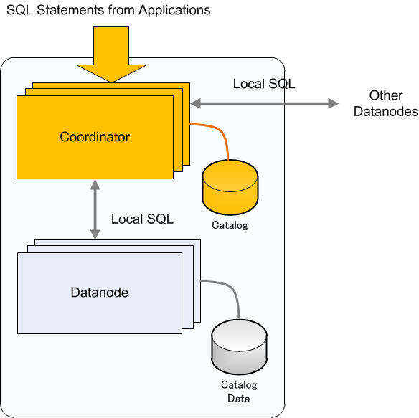
Query processing (1)
Query
Analysis
Locate
Datanode
Local
Execution
Materialization,
calculation

Slide 23
Query processing (1)
Query
Analysis
Locate
Datanode
Local
Execution
Materialization,
calculation

Slide 24
Query processing (1)
Query
Analysis
Locate
Datanode
Local
Execution
Materialization,
calculation

Slide 25
Query processing (1)
Query
Analysis
Locate
Datanode
Local
Execution
Materialization,
calculation

Slide 26
Query optimization
Clause push down
  Join
  WHERE
  Aggregate
  Functions (immutable only)
  Column Projection
Utilize info
  Table distribution
  Distribution key
  Shading algorithm
First Query Shipping (FQS)
  Determine simple query
  Ship to datanodes quickly

Slide 27
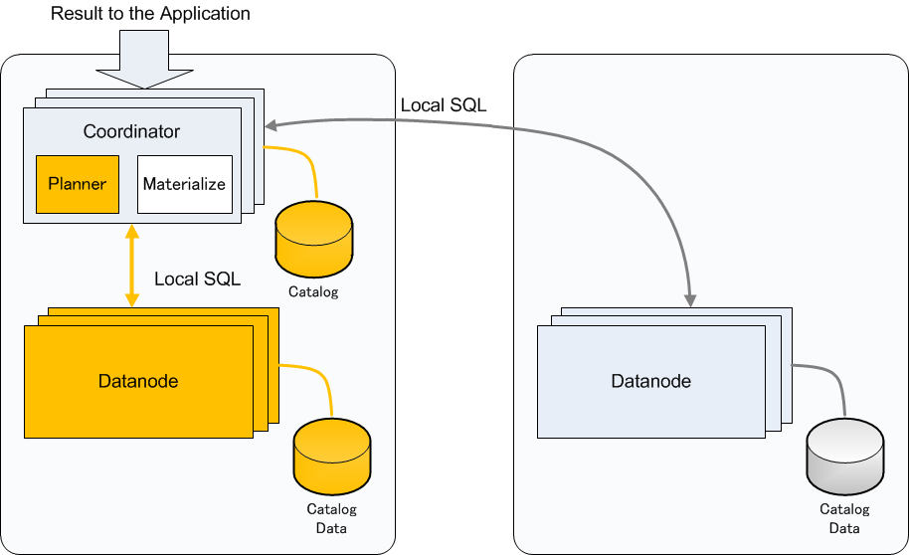
Optimization example (Join-1)
Both tables are replicated

Slide 28
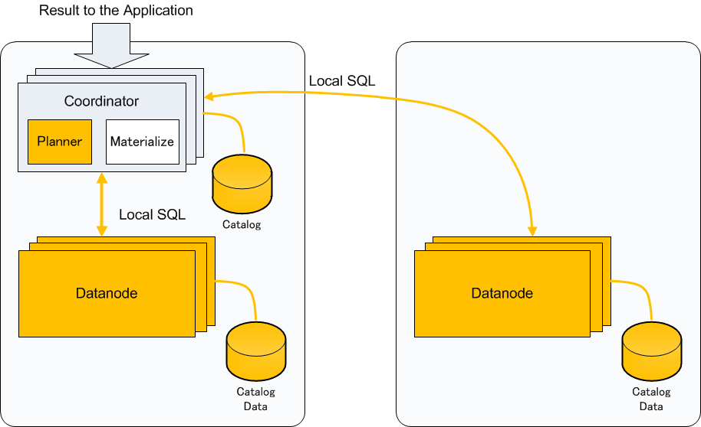
Optimization Example (Join-2)
Replicated Table and Partitioned Table
  Cannot determine which datanode to go

Slide 29
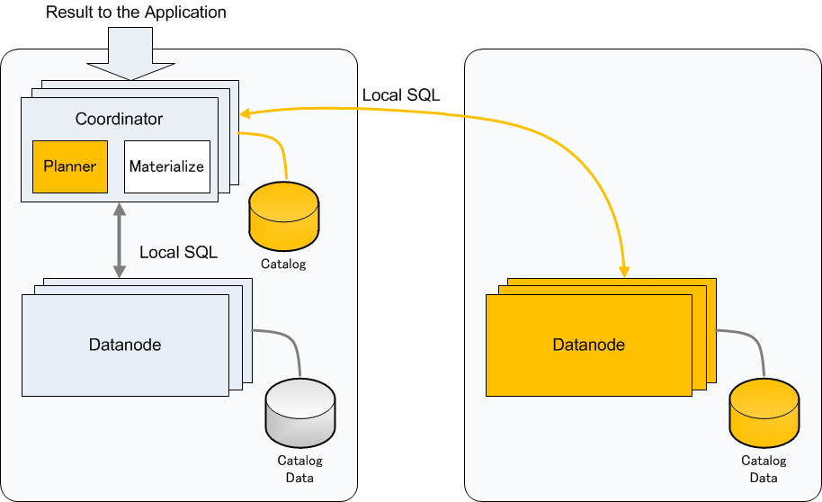
Optimization Example (Join-3)
Replicated Table and Partitioned Table
  Can determine which datanode to go from WHERE clause

Slide 30
Optimization Example (Join-4)
Partitioned Table and Partitioned Table
  Both Join columns are distribution (partitioning) column
  Where clause can determine which datanode to go

Slide 31
Optimization Example (Join-5)
Partitioned Table and Partitioned Table
  Both Join columns are distribution (partitioning) column

Slide 32
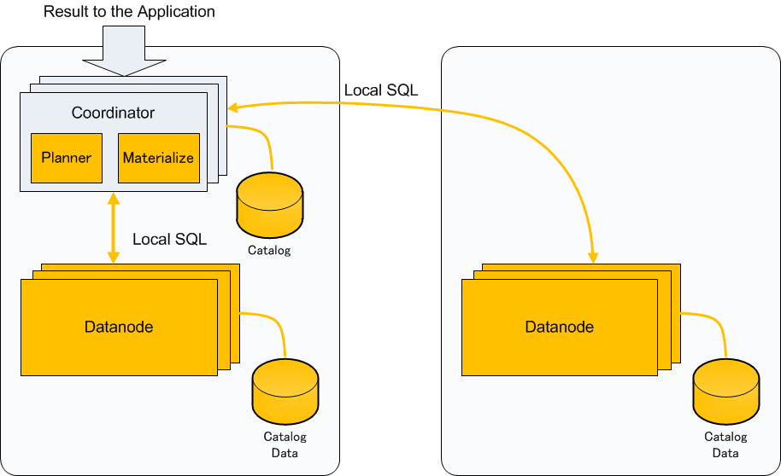
Optimization Example (Join-5)
Partitioned Table and Partitioned Table
  One of Join columns are not distribution (partitioning) column

Slide 33
High Availability

Slide 34


Cluster SPOF problem
Datanode is a SPOF if it has a portion of distributed table.
GTM case
GTM
Cluster nodes
GTM
Cluster nodes

Slide 35
Datanode SPOF resolution (1)
PostgreSQL 9.1 synchronous stream-rep
Coordinator
Cluster nodes
Catalog
Datanode
master
Catalog
data
Log shipping
Log shipping
Datanode
slave
Catalog
data

Slide 36
Datanode SPOF resolution (2)
Fallback slave node
Coordinator
Cluster nodes
Catalog
Datanode
master
Catalog
data
Fallback
Log shipping
Log shipping
Datanode
master
Catalog
data

Slide 37
GTM SPOF resolution (1)
Use of a standby for GTM
Cluster nodes
GTM
Status backup
GTM-Standby

Slide 38
GTM SPOF resolution (2)
Fallback to standby and reconnect nodes
Cluster nodes
Online reconnection
GTM
Status backup
GTM-Standby

Slide 39
PITR – requirements (1)
PITR, Point in-time recovery
  Rollback the database to a given past state
  Need consistent points to restore shared-nothing nodes
T
Coordinator 1
t
T
Coordinator 2
t
T
Datanode 1
t
T
Datanode 2
t
Pt 1
Pt 2

Slide 40
PITR – requirements (2)
Transaction status has to be consistent in the cluster
Each transaction must be either:
  Committed/Prepared/Aborted/Running on all the involved nodes
  We must avoid cases where transaction is prepared and committed partially, or prepared and rollbacked partially
Write record in WALs of all the coordinators and datanodes at a moment when all the transaction statuses are consistents.
External Application can provide such timing as with BARRIER
  CREATE BARRIER barrier_id
BARRIER:
  Waits that partially committed or aborted transactions commit (2PC)
  Blocks all transaction commit when running a barrier
  Still needs a timeout functionality
When running PITR, specify recovery_target_barrier in recovery.conf

Slide 41
Recovery pgxc_clean
Datanode crash may result in inconsistent 2PC status
pgxc_clean finds such inconsistencies and cleans them up
Super-user maintenance tool.

Slide 42
Release Status

Slide 43
Version 1.0 released
Released at June 8th, 2012
  Source tarball
  GIT download
Comes with most of SQL feature
Basic HA feature
Still some restriction such as
  Trigger
  WHERE CURRENT OF
  Savepoint
Community members are working to provide binary packages

Slide 44
Version 2.0 expected
Node addition/removal
Table redistribution
Trigger
WHERE CURRENT OF
Planner improvement
PostgreSQL 9.2 merge
More HA-related feature
  Component watchdog

Slide 45
Project Resources and Contacts

Slide 46
Project home
  http://postgres-xc.sourceforge.net
  https://sourceforge.net/projects/postgres-xc/
Developer mailing list
  postgres-xc-developers@lists.sourceforge.net
  postgres-xc-general@lists.sourceforge.net
Contacts
  koichi.clarinet@gmail.com
  michael.paquier@gmail.com
Twitter: @koichiclarinet

Slide 47
PostgreSQL usage in NTT group
PGConfChina 2012

Slide 48

NTT Overview
Japanese Giant Carrier
  Revenue: 10.2 trillion yen ($120 billion)
    World's second largest telecommunication company
  Employees: 200,000
  Business
    Consolidated Subsidiaries: 536 (may be more now …)
    Telecommunication subscribers: 93 million
      Regional, long distance, mobile
    System Integration
      Customers including large companies and government organizations
    Others
      Construction, medical, publishing, florists, etc.

Slide 49
NTT System Characteristics
Telecommunication operation system (OpS)
  Large-scale
    Each DB is large (e.g., 100GB or more) and some communicate each other.
  High availability and reliability
    More than 99.999% availability
  Long-life
    Expected lifetime is 7 years.
Issues
  Proprietary DBMS are widely used.
    High-cost, short support duration
    Vendor lock-in
We expect Open
Source Software to
solve these issues

Slide 50
Open Source Software Center
Mission
  Reduce TCO with OSS, by replacing proprietary software
    Support NTT Group companies' OSS usage
      Q and A
      Consultation
    Develop/Improve OSS
  Center of OSS competence in NTT Group
Established in Apr.2006
Location: Shinagawa, Tokyo.

Slide 51
Understanding User Needs
How to encourage PostgreSQL use?
Information on performance
  Show good and stable performance
  Availability/reliability
    Downtime to recovery (e.g. annually 5min, for five-9s)
  Hardware (HDDs, CPUs, etc.)
Operation Capability
  Compatibility with other operation tools
  Usability
Improve performance and usability
Technical support

Slide 52
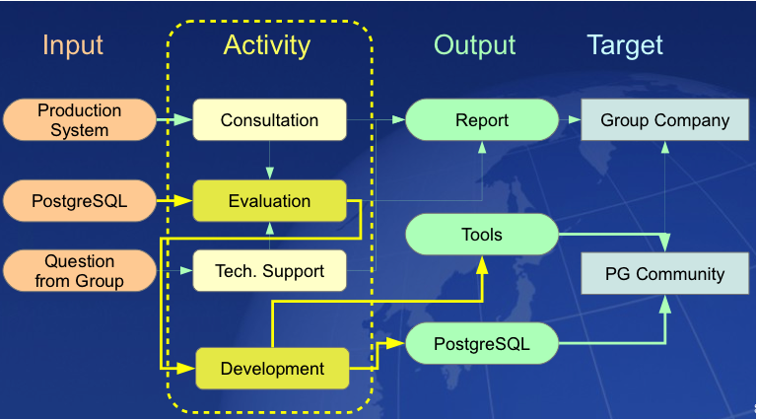
Activities

Slide 53
Needs evaluations
System characteristics
  Most sytems are OLTP, not OLAP
  Types of transactions: read/write intensive
TPC-C and TPC-W models are used.
  DBT-2 (TPC-C): write, I/O itensive
  DBT-1 (TPC-W): read, CPU intensive
  Other: pgbench, DBT-3
Throughput and stability
  Peak performance test (3hr., workload > 90%)
    CPU scalability evaluated
  Long-run test (72hr., 70% workload)
    Observe stability during vacuum and checkpoint

Slide 54
NTT's effort for PostgreSQL improvement
Fix context switch storm (8.2)
Smoothing performance during checkpoint (8.3)
High-speed data loader (8.1)
Archive WAL compression (8.3)
Log-shipping replication
  9.0: Asynchronous
  9.1: Synchronous
  9.2: Cascade
Background cluster/vacuum full – pg_reorg
Automated backup/restoration – pg_rman
PostgreSQL status monitoring – pg_statsinfo
And many others...

Slide 55
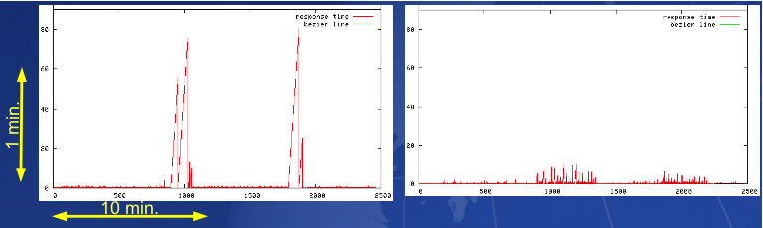
Performance during checkpoint
Eliminated most serious performance problems during the checkpoint
8.2
8.3

Slide 56
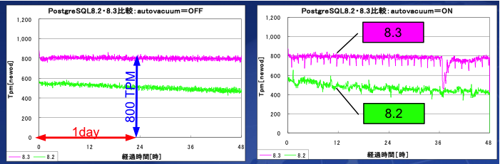
Stability Evaluation
Effect of HOT and Autovacuum
http://lets.postgres.jp/documents/case/ntt_comware/2

Slide 57
Support Activities
Technical Q and A
  A couple of hundreds of question answered in a year. Each answered within three business days
  Various question
    Usage, trouble issues
Consultation
  Migration from proprietary DBMS
    About 50 or more know-hows are accumulated.
  Performance tuning aids
    Evaluate particular workloads and suggest tuning
  Recovery
    Recover corrupted database

Slide 58
NTT's experience
Introduced more than PostgreSQL to more than 200 systems. Highlight of database specs are as follows:
  Size: Largest 3TB
  Throughputs: 1000 TPS (or more)
  HA: failover in less than 1min (15sec., measured)

Slide 59
View of NTT Production Systems
Target of OSS in NTT in-house systems
  NTT runs several hundreds of systems
  Survey shows PostgreSQL can be applied to 80% of them.
Trend of PostgreSQL deployment
  Beggining from small-scall, less available system to large-scale, high availabile system
10TB
Subscriber manage
顧客料金系システム
Sale assistance
1TB
Database Size
Personnel,
Allowance
Facilities manage
100GB
Back
office
99.99% avaliable
DB fail over 10 min.
99.999% available
DB fail over within 1 min.
Availablity

Slide 60
PostgreSQL tools from NTT
All open source
  pg_bulkload (fast data loader)
  pg_rman (backup and restore tool)
  pg_statsinfo (monitors PostgreSQL database activities
  pg_reorg (concurrent vacuum full and cluster)
  pg_rex (automatic failover with log-shipping replication)
  pg_lesslog (archive WAL compression)

Slide 61
PostgreSQL deployment
pg_rex
(new ed.)
pg_rman
pg_statsinfo
pg_bulkload
pg_rex
(early ed.)

Slide 62
PostgreSQL Application Map
Eyes Only

Slide 63
Thank you very much!!
koichi.clarinet@gmail.com
koichi@intellilink.co.jp

