Slide 1
Postgres-XC クラスタにおける
高可用機能
鈴木幸市
Postgres-XC Development Group
PgDay 2012 Japan
November 30th, 2012
Tokyo, Japan

Slide 2
Outline of the Talk
Postgres-XC overview
  What it is
  Architecture and scalability
SPOF analysis
Failure characteristics
  Comparison with a commercial one
Failure handling and HA
Current status and future schedule

Slide 3
Postgres-XC Overview

Slide 4
What is Postgres-XC
Symmetric PostgerSQL cluster
  No master/slave replication
  No read-only clusters
  Every node can issue both read/write
  Every node provides single consistent database view
  Transparent transaction management
Not just a replication
  Each table can be replicated/distributed by sharding
  Parallel transaction/query execution
    So both read/write scalability

Slide 5

Master/Slave with Log Shipping

Slide 6

Postgres-XC Symmetric Cluster

Slide 7
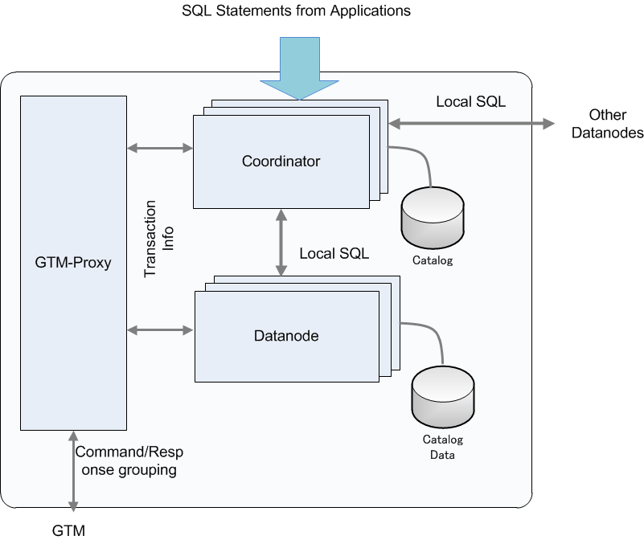

Architecture and Configuration

Slide 8
Outline of Components
GTM (Global Transaction Manager)
  Distributed MVCC
    Provide global transaction ID (GXID) to all the transactions
    Provide global snapshot to all the transactions
  Sequence
GTM_Proxy
  Group communications to GTM and reduce amount of GTM network workload
Coordinator
  Handles incoming SQL statements
    Parse, plan, conduct execution in datanodes and the coordinator.
    Integrate local results from each datanode involved.
Datanode
  Actual data storage
    Almost vanilla PostgreSQL
Share the binary

Slide 9

Scalability
DBT-1 (Rev)

Slide 10
Combining sharding and replication
DBT-1 example
CUSTOMER
ORDERS
ORDER_LINE
ITEM
SHOPPING_CART
C_ID
C_UNAME
C_PASSWD
C_FNAME
C_LNAME
C_ADDR_ID
C_PHONE
C_EMAIL
C_SINCE
C_LAST_VISIT
C_LOGIN
C_EXPIRATION
C_DISCOUNT
C_BALANCE
C_YTD_PMT
C_BIRTHDATE
C_DATA
O_ID
O_C_ID
O_DATE
O_SUB_TOTAL
O_TAX
O_TOTAL
O_SHIP_TYPE
O_BILL_ADDR_ID
O_SHIP_ADDR_ID
O_STATUS
OL_ID
OL_O_ID
OL_I_ID
OL_QTY
OL_DISCOUNT
OL_COMMENTS
OL_C_ID
I_ID
I_TITLE
I_A_ID
I_PUB_DATE
I_PUBLISHER
I_SUBJECT
I_DESC
I_RELATED1
I_RELATED2
I_RELATED3
I_RELATED4
I_RELATED5
I_THUMBNAIL
I_IMAGE
I_SRP
I_COST
I_AVAIL
I_ISBN
I_PAGE
I_BACKING
I_DIMENASIONS
SC_ID
SC_C_ID
SC_DATE
SC_SUB_TOTAL
SC_TAX
SC_SHIPPING_COST
SC_TOTAL
SC_C_FNAME
SC_C_LNAME
SC_C>DISCOUNT
CC_XACTS
CX_I_ID
CX_TYPE
CX_NUM
CX_NAME
CX_EXPIRY
CX_AUTH_ID
CX_XACT_AMT
CX_XACT_DATE
CX_CO_ID
CX_C_ID
Distributed with Shopping Cart ID
Distributed with Customer ID
SHOPPING_CART_LINE
ADDRESS
SCL_SC_ID
SCL_I_ID
SCL_QTY
SCL_COST
SCL_SRP
SCL_TITLE
SCL_BACKING
SCL_C_ID
STOCK
ADDR_ID
ADDR_STREET1
ADDR_STREET2
ADDR_CITY
ADDR_STATE
ADDR_ZIP
ADDR_CO_ID
ADDR_C_ID
Replicated
ST_I_ID
ST_STOCK
COUNTRY
AUTHOR
CO_ID
CO_NAME
CO_EXCHANGE
CO_CURRENCY
OL_ID
OL_O_ID
OL_I_ID
OL_QTY
OL_DISCOUNT
OL_COMMENTS
OL_C_ID
Distributed with ItemID

Slide 11
How XC Scales both Read/Write
Transaction Tables → Sharding
  Only one write
  Parallel writes in datanodes
Master Tables → Replication
  Relatively static: Not significant many-writes overhead
  Local join with transaction tables → Most join operation can be done locally in datanodes

Slide 12
Postgres-XC API
Binary compatible with PostgreSQL
  Limited support for ODBC
  JDBC may have a couple of restrictions
Compatible statements to PostgreSQL
  Slight difference
    CREATE TABLE, etc.
    Constraints can be enforced only locally in each datanodes.
  Extra
    Coordinator/datanode membership management, etc.
      CREATE/ALTER/DROP NODE, EXECUTE DIRECT...
    Extension in aggregates
      Combiner functions
    Maintain consistency in point-in-time-recovery
      CREATE BARRIER
No load balancing so far
You should notice
  OID is local to each node

Slide 13
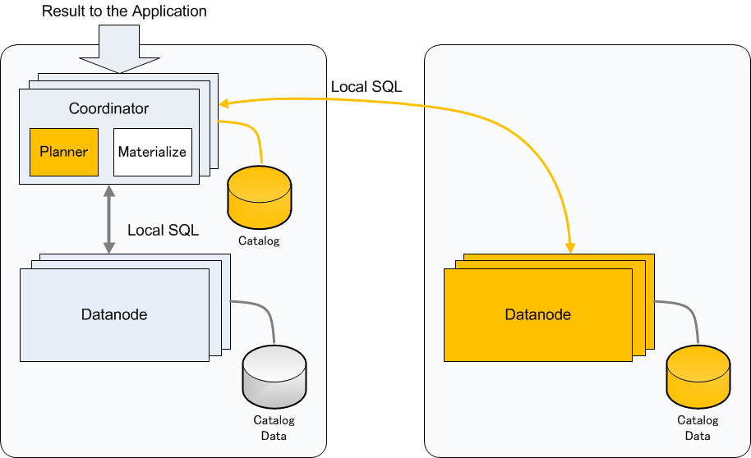
Join Example (1)
Replicated Table and Partitioned Table
  Can determine which datanode to go from WHERE clause

Slide 14
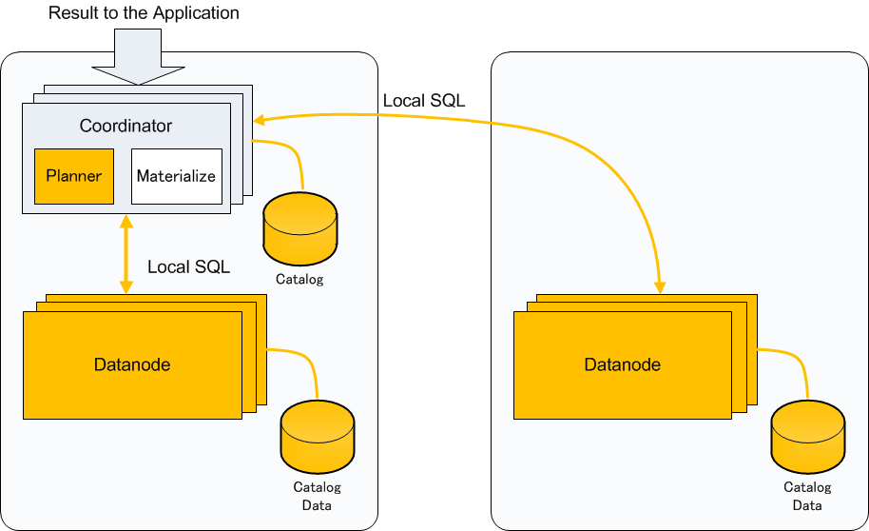
Join Example (2)
Replicated Table and Partitioned Table
  Cannot determine which datanode to go

Slide 15
SPOF Analysis

Slide 16
Postgres-XC Single Point of Failure
GTM
  Obviously SPOF
GTM-Proxy
  No persistent data hold
  Just restart when fail
Coordinator
  Every coordinator is essentially a copy
  When fails, other coordinators work
Datanode
  SPOF for sharded table

Slide 17
Backup for SPOF component
GTM
  Specific backup for GTM (GTM Standby)
    Most information are kept on-memory
      Open TXNs
        Only the next GXID is needed to restart whole cluster, kept on disk.
    Copies every internal status change to the backup
      Similar to the log shipping in PostgreSQL
    Can promote to the master
      GTM-Proxy help this failover
Datanode
  Need backup
  Can use PostgreSQL's means
    Log Shipping
    Shared disk
Coordinator
  Not critical but may want to have backups
  Can use similar means as Datanodes.

Slide 18
GTM Slave (GTM Standby)
Same binary to GTM
  Backs up everything on the fly.
  Can promote to the master (gtm_ctl promote)
  Configure using gtm.conf
    startup = ACT|STANDBY
    active_host = 'active_gtm_host'
    active_port = 8765
GTM
Slave
Recocnnect at failure
Recocnnect at failure
Backup status
change
GTM Proxy
GTM
Master
Coordinator
Datanode

Slide 19
Datanodes
Almost all the techniques for PostgreSQL backup/failover are available
  Streaming replication
  Shared disk re-mount
Subject to coordinators
  Coordinators should reconfigure failed datanode at failover
  Coordinators should clean connections to failed datanode before reconfiguration
GTM
  Reconnect to (new) local GTM proxy

Slide 20
Coordinators
Only catalog is stored
  Very stable and static
  All the coordinators are essentially the same copy
Datanode HA technique can be applied
  Streaming replication
  Shared disk remount
One more option at a failure
  No failover
  Remaining coordinators will take care of TXNs
  Failed coordinator can be restored offline
    Backup/restore
    Copy catalogue from a remaining coordinator

Slide 21
Failure Characteristics

Slide 22
General
PostgreSQL
Postgres-XC
Promote one of the slaves
Application connect to promoted PostgreSQL
Everything stops and then restarts
Promote the slave of the failed component
Reconfigure with new master
Whole cluster continues to run, only affected TXNs fail
Just one component failure may not lead to whole cluster fail.
Can configure appropriate slaves for each component to continue XC operation.

Slide 23
XC vs. O*R*
Feature | Postgres-XC | O____ R__
Background Databsae | PostgreSQL | O_____
Architecture | Shared Nothing | Shared Everything
Number of Servers | Experience: 10 Maybe 20 or more | ?? (Most deployments are two server configuration)
Hardware Requirement | None | Shared Disk
Read Scale | Yes | Yes
Write Scale | Yes | Depends (Application level partitioning)
Storage Failure | Limited impact Component failover Cluster keeps running | Whole cluster fails Cluster-wide failover
Server Failure | Affected components needs failover Others keep running | Remaining servers continues service

Slide 24
Failure Handling and HA

Slide 25
General
XC is not a simple replication
  When a component fails, other components is still alive and can continue to provide database service.
  Remaining components may need reconfiguration to accommodate new master of the failed component.
This section shows what to do to prepare slaves and failover each component
Useful shell scripts will be found in pgxc_ctl directory in
https://github.com/koichi-szk/PGXC-Tools

Slide 26
Postgres-XC HA Configuration (1)
Circular Configuration
GTM (M)
GTM (S)
GTM Proxy
GTM Proxy
GTM Proxy
Coordinator1(M)
Coordinator2(M)
CoordinatorN(M)
Datanode1(M)
Datanode2(M)
DatanodeN(M)
CoordinatorN(S)
Coordinator1(S)
Coordinator(N-1)(S)
DatanodeN(S)
Datanode1(S)
Datanode(N-1)(S)

Slide 27
Postgres-XC HA Configuration (2)
Pair Configuration
GTM (M)
GTM (S)
GTM Proxy
GTM Proxy
Coordinator1(M)
Coordinator2(M)
Datanode1(M)
Datanode2(M)
Coordinator2(S)
Coordinator1(S)
Datanode2(S)
Datanode1(S)
Easier integration with Pacemaker

Slide 28
Failure handling outline – GTM(1)
Recocnnect at failure
5. Configure GTM Proxy
6. Start GTM Proxy
1. Configure GTM Master
2. Start GTM Master
Coordinator
GTM
Master
GTM Proxy
Datanode
GTM
Slave
3. Configure GTM Slave
4. Start GTM Slave

Slide 29
Failure handling outline – GTM(2)
9. Reconnect each GTM-Proxy to the new Master
(reconfigure for further restart)
7. GTM crashes
Coordinator
GTM
Master
GTM Proxy
Datanode
GTM
Slave
Coordinator/Datanode continues
to run. No transaction loss.
8. Promote GTM Slave
(reconfigure for further restart)

Slide 30
Failure Handling Outline - Datanode(1)
GTM Proxy
GTM Proxy
Configure datanode master
Start datanode master
Configure nodes
Coordinator
Datanode
Slave
Configure datanode slave
Start datanode slave
Datanode
Master

Slide 31
Failure Handling Outline - Coordinator(2)
GTM Proxy
GTM Proxy
Coordinator
Datanode
Slave
Master
Datanode slave promote
Reconfigure new datanode master
Datanode master crash!
Datanode
Master

Slide 32
Useful Materials
Postgres-XC
  http://postgres-xc.sourceforge.net/ (project web site)
  http://sourceforge.net/projects/postgres-xc/ (development site)
  http://postgresxc.wikia.com/wiki/Postgres-XC_Wiki (Wiki site)
  https://github.com/koichi-szk/PGXC-Tools (pgxc_ctl, gtm_util tools)
PostgreSQL resource agents for Pacemaker/Heartbeat
  sf-ex : mount filesystem exclusively
    https://github.com/ClusterLabs/resource-agents/blob/master/heartbeat/sfex
  postgres – streaming replication
    https://github.com/ClusterLabs/resource-agents/blob/master/heartbeat/pgsql

