Slide 1


Distributed Transaction Manager
Distributed Transaction Manager

Slide 2
Pluggable transaction API
CSP
UDT
FDW
Core
AM
TM?

Slide 3
eXtensible Transaction API
XidStatus (*GetTransactionStatus)(TransactionId xid, XLogRecPtr *lsn);
void (*SetTransactionStatus)(TransactionId xid, int nsubxids, TransactionId *subxids, XidStatus status, XLogRecPtr lsn);
Snapshot (*GetSnapshot)(Snapshot snapshot);
TransactionId (*GetNewTransactionId)(bool isSubXact);
TransactionId (*GetOldestXmin)(Relation rel, bool ignoreVacuum);
bool (*IsInProgress)(TransactionId xid);
TransactionId (*GetGlobalTransactionId)(void);
bool (*IsInSnapshot)(TransactionId xid, Snapshot snapshot);

Slide 4
New commit callback events
XACT_EVENT_START,
XACT_EVENT_COMMIT,
XACT_EVENT_PARALLEL_COMMIT,
XACT_EVENT_ABORT,
XACT_EVENT_PARALLEL_ABORT,
XACT_EVENT_PREPARE,
XACT_EVENT_PRE_COMMIT,
XACT_EVENT_PARALLEL_PRE_COMMIT,
XACT_EVENT_PRE_PREPARE,
XACT_EVENT_COMMIT_PREPARED,
XACT_EVENT_ABORT_PREPARED

Slide 5
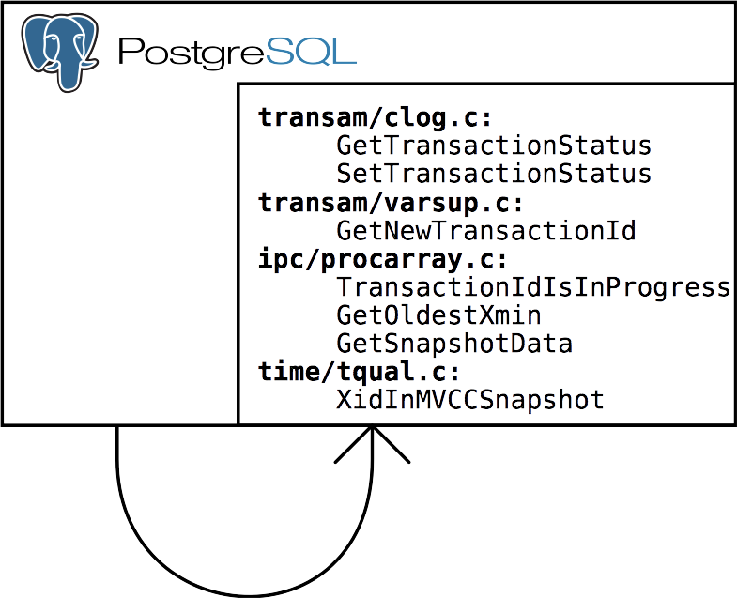
Transaction Manager before patch

Slide 6
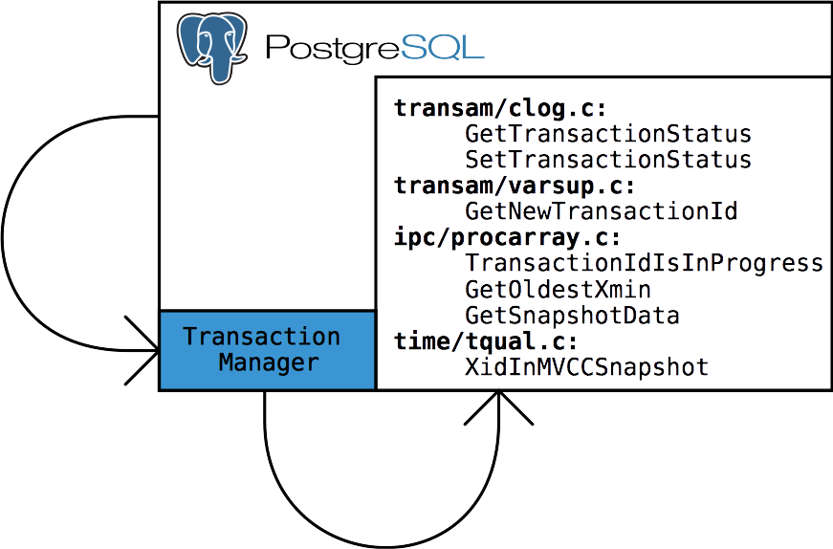
Transaction Manager after patch

Slide 7
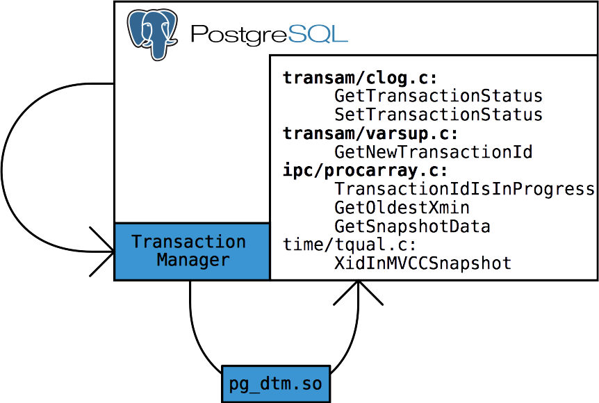
Distributed Transaction Manager

Slide 8
Different DTM implementations
 | Local transactions | 2PC | Arbiter | Examples
Snapshot sharing |  |  |  | XL, DTM
Timestamp |  |  |  | Spanner, Cockroach, tsDTM
Incremental |  |  |  | SAP HANA

Slide 9
DTM architecture
PostgreSQL
Instance 1
Arbiter
slave 1
asynchronous
replication
PostgreSQL
Instance 2
Coordinator
Arbiter
master
synchronous
replication
PostgreSQL
Instance 3
Arbiter
slave 2

Slide 10
DTM from client's point of view
Primary server | Secondary server
create extension pg_dtm; | create extension pg_dtm;
select dtm_begin_transaction(); begin transaction; update...; commit; | select dtm_join_transaction(xid); begin transaction; update...; commit;

Slide 11
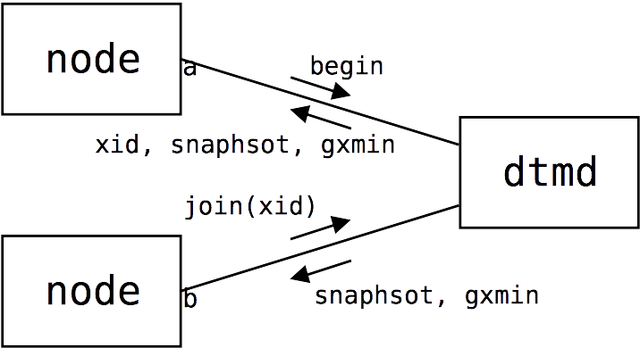
Arbiter protocol (begin)

Slide 12
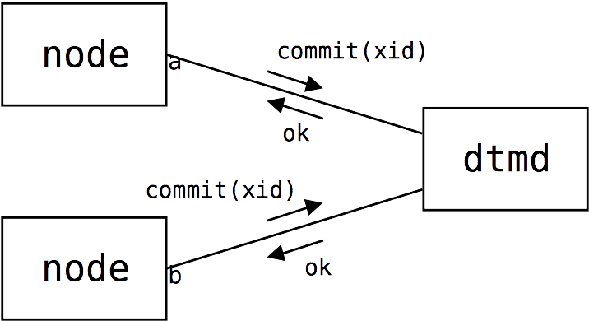
Arbiter protocol (end)

Slide 13
DTM transaction control flow
Assign XID
Vote
Arbiter
dtm_begin_
transaction
begin
transaction
commit
transaction
Node 1
dtm_join_
transaction
begin
transaction
commit
transaction
XID
Node 2
dtm_join_
transaction
begin
transaction
commit
transaction
Node 3

Slide 14
tsDTM architecture
PostgreSQL
Instance 1
PostgreSQL
Instance 2
Coordinator
PostgreSQL
Instance 3

Slide 15
tsDTM transaction control flow
dtm_extend
prepare
transaction
dtm_begin_
prepare
dtm_prepare
commit
prepared
dtm_end_
prepare
Node 1
dtm_access
prepare
transaction
dtm_begin_
prepare
dtm_prepare
max
CSN
dtm_end_
preparea
commit
prepared
snapshot
Node 2
dtm_access
prepare
transaction
dtm_begin_
prepare
dtm_prepare
commit
prepared
dtm_end_
prepare
Node 3

Slide 16
Lightweight two-phase commit
XactLogCommitRecord
(flush changes in WAL)
Transaction status
TransactionTreeSetCommitTsData
(set transaction status
in CLOG)
Arbiter
ProcArrayEndTransaction
(mark transaction as
completed)
ResourceOwnerRelease
(release transaction locks)

Slide 17
Multiplexing
Node 1
backends
sockhub
TCP sockets
Unix domain
sockets
Arbiter
Node 2
backends
Unix domain
sockets

Slide 18
Example of interaction with DTM
xid := execQuery(con1, "select dtm_begin_transaction()")
exec(con2, "select dtm_join_transaction($1)", xid)
exec(con1, "begin transaction")
exec(con2, "begin transaction")
exec(con1, "update t set v = v + $1 where u=$2", amount, account1)
exec(con2, "update t set v = v - $1 where u=$2", amount, account2)
var wg sync.WaitGroup
wg.Add(2)
asyncExec(con1, “commit”, &wg)
asyncExec(cnn2, “commit”, &wg)
wg.Wait()

Slide 19
Example of interaction with tsDTM
exec(con1, "begin transaction")
exec(con2, "begin transaction")
snapshot = execQuery(con1, "select dtm_extend($1)", gtid)
snapshot = execQuery(con2, "select dtm_access($1, $2)", snapshot, gtid)
exec(con1, "update t set v = v + $1 where u=$2", amount, account1)
exec(con2, "update t set v = v - $1 where u=$2", amount, account2)
exec(con1, "prepare transaction '" + gtid + "'")
exec(con2, "prepare transaction '" + gtid + "'")
exec(con1, "select dtm_begin_prepare($1)", gtid)
exec(con2, "select dtm_begin_prepare($1)", gtid)
csn = execQuery(con1, "select dtm_prepare($1, 0)", gtid)
csn = execQuery(con2, "select dtm_prepare($1, $2)", gtid, csn)
exec(con1, "select dtm_end_prepare($1, $2)", gtid, csn)
exec(con2, "select dtm_end_prepare($1, $2)", gtid, csn)
exec(con1, "commit prepared '" + gtid + "'")
exec(con2, "commit prepared '" + gtid + "'")

Slide 20
Example of using FDW
exec(con, "select dtm_begin_transaction()")
exec(con, "begin transaction")
exec(con, "update t set v = v + $1 where u=$2", amount, account1)
exec(con, "update t set v = v - $1 where u=$2", amount, account2)
exec(con, “commit”)

Slide 21
Example of using pg_shard
exec(con, "begin transaction")
exec(con, "update t set v = v + $1 where u=$2", amount, account1)
exec(con, "update t set v = v - $1 where u=$2", amount, account2)
exec(con, “commit”)

Slide 22
Test configuration
Client 1
Client 2
Client 2
Client 2
Client 2
Worker 1
Worker 2
Worker 1
Worker 1
Arbiter

Slide 23
Performance measurement
Simple bank debit/credit benchmark (a-la TPC-A)
Two clients with 60 writers
kTPS
Nodes

Slide 24
Multimaster performance
Simple update/select queries
Three clients with 140 readers
kTPS
Nodes

Slide 25
Roadmap
Add XTM patch to PostgreSQL 6
Experiment with different DTM implementations
Provide integration of DTM with different cluster solutions (pg_shard, FDW, XL,...)
Implement multimaster on top of DTM

