Slide 1
00
04
08
0C
10
14
18
1C
20
24
28
2C
30
34
A SHORT HISTORY OF MUSIC GENERATION ON COMPUTERS
MAKING MUSIC
ON COMPUTERS.
From OctaMED on the Amiga to ChipWave Studio — how the tracker taught home computers to sing.
1987 → 2025 · MOD · S3M · XM · IT · CWT

Slide 2
01 · BEFORE THE GRID
MUSIC ON COMPUTERS · 1951 → 1985
Computers sang before trackers
1951
1982
1983
1985
CSIRAC, Melbourne
The first computer known to play music hums “Colonel Bogey” through a loudspeaker.
The SID chip
The Commodore 64 puts a real synthesizer — three voices, filters, envelopes — into a home computer.
MIDI
One cable, one language: keyboards, drum machines and computers finally talk to each other.
Amiga + Paula
Four channels of sampled 8-bit sound — the hardware the tracker was invented for.
Sources: Wikipedia — CSIRAC · MOS Technology 6581 · MIDI · Amiga
02 / 10

Slide 3
02 · THE PATTERN IS BORN
MUSIC ON COMPUTERS · 1987
1987
ROW CH 1 CH 2 CH 3 CH 4
00 C-3 01 000 --- -- --- G-2 02 000 --- -- ---
01 --- -- --- --- -- --- --- -- --- --- -- ---
02 E-3 01 000 --- -- --- --- -- --- --- -- ---
03 --- -- --- --- -- --- A#2 02 000 --- -- ---
04 G-2 01 C40 C-3 03 000 --- -- --- F-2 04 F03
05 --- -- --- --- -- --- --- -- --- --- -- ---
06 C-3 01 000 --- -- --- G-2 02 000 --- -- ---
07 --- -- --- D-3 03 000 --- -- --- --- -- ---
08 A#2 01 000 --- -- --- --- -- --- A#2 04 000
09 --- -- --- --- -- --- --- -- --- --- -- ---
THE ULTIMATE SOUNDTRACKER · KARSTEN OBARSKI
Commercially it flopped. As an idea, it went everywhere. Obarski's program arranged short samples into scrolling patterns: four channels, one for each voice of the Amiga's Paula sound chip.
Cracked, shared and cloned within months, it became the MOD format — free music software before free music software had a name, and the seed of the demoscene. Every tracker since, OctaMED included, is built on this grid.
A tracker pattern: note · instrument · effect, per channel.
Source: Wikipedia — Ultimate Soundtracker · MOD (file format)
03 / 10

Slide 4
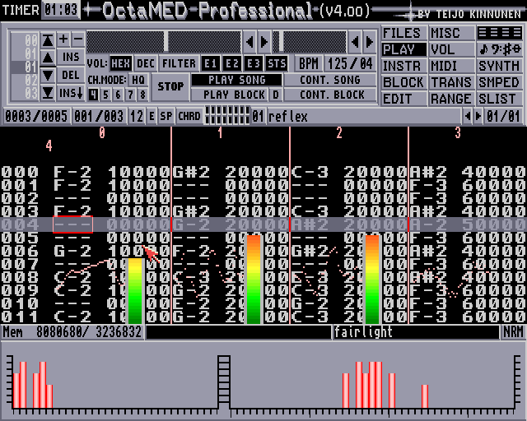
03 · EIGHT FROM FOUR
MUSIC ON COMPUTERS · 1991
OctaMED squeezes eight channels out of four
SOFTWARE MIXING
Teijo Kinnunen's MED (Music EDitor, 1989) became OctaMED in 1991: two software-mixed voices in each of Paula's four hardware channels — eight tracks on a stock Amiga.
MIDI FROM THE START
Unlike its rivals, MED drove external synths over the serial port — one Amiga could sequence a rack of studio gear and play its own samples at the same time.
THE SOUND OF JUNGLE
Aphrodite, Bizzy B, Omni Trio and DJ Zinc cut early drum & bass on it. Calvin Harris made I Created Disco on an A1200 — and brought the Amiga on stage at the BRIT Awards 2024.
OctaMED Professional v4 on the Amiga · shot: nostalgicplayer.dk
Source: Wikipedia — OctaMED
04 / 10

Slide 5
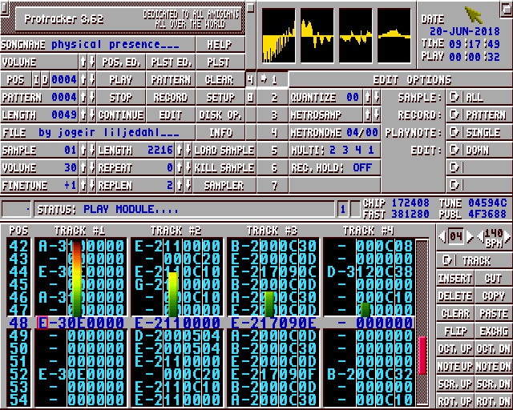
04 · THE CLONES TAKE OVER
MUSIC ON COMPUTERS · 1990 → 1995
The tracker explosion
1990
ProTracker — free, fast and fixed; the Amiga scene standard that took MOD worldwide.
1994
Scream Tracker 3 — the PC joins in; S3M powers a wave of demoscene classics.
1994
FastTracker II — XM adds instruments, envelopes and up to 32 channels.
1995
Impulse Tracker — IT pushes the PC to 64 channels with resonant filters.
MOD → S3M → XM → IT
ProTracker 3.52 on the Amiga · image: Wikipedia
Sources: Wikipedia — ProTracker · Scream Tracker · FastTracker 2 · Impulse Tracker
05 / 10

Slide 6
05 · THE PIANO ROLL TAKES OVER
MUSIC ON COMPUTERS · 1996 → 2005
The timeline replaces
the pattern list.
1996 · CUBASE VST
Software instruments and effects move into the box.
1997 · FRUITYLOOPS
Step sequencing and loops for everyone, on any PC.
2001 · ABLETON LIVE
Clips and scenes turn arranging into performance.
As PCs grew faster, arranging moved to the piano roll and the horizontal timeline: record, comp, automate. Trackers never died — they went back underground, kept alive by the demoscene and a stubborn few who thought in rows, not bars.
2002 · RENOISE
The tracker, modernised — the grid survives the DAW era.
06 / 10

Slide 7
06 · THE CHIP NEVER LEFT
MUSIC ON COMPUTERS · 2000 → 2021
Chiptune: limitation becomes style
The constraint that forced the tracker's invention turns into an aesthetic of its own.
2000
LSDJ — a cartridge turns the Nintendo Game Boy into a four-channel groovebox.
2005
FamiTracker — composing for the NES sound chip, free on the PC.
2012
DefleMask — one tracker for a dozen classic chips, Mega Drive to C64.
2021
Furnace — open source, and every sound chip you remember, in one grid.
Square waves at parties. Pattern rows on stage. The tracker was never nostalgia — it stayed a working tool.
07 / 10

Slide 8
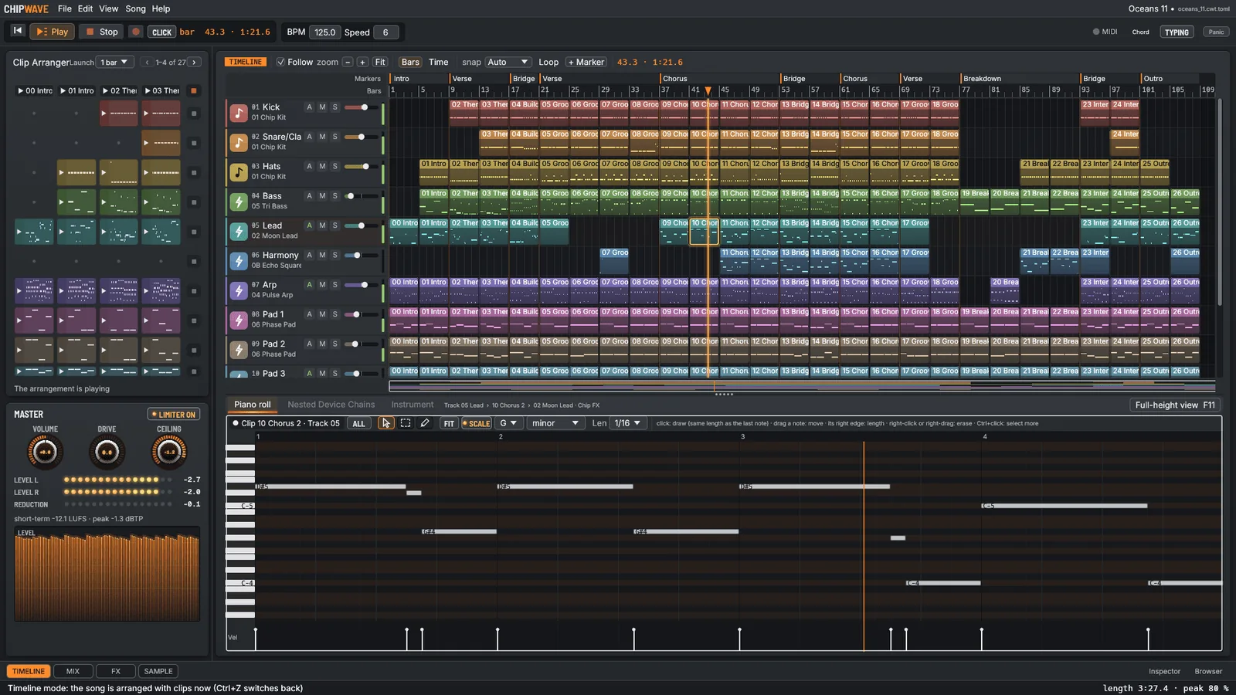
07 · TODAY
MUSIC ON COMPUTERS · 2024 →
ChipWave Studio — a free studio with a retro heart
FREE & OPEN SOURCE
GPL-3.0. No account, no telemetry, no subscription. Windows, macOS and Linux, written in Rust.
ONE WINDOW
Timeline and clip launcher, piano roll, drum kit, 32 tracks, a mixer with a true-peak limiter — and, yes, a pattern editor.
SOUNDS FROM SCRATCH
WaveForge, StringWave, FM-4, Analog and Chip FX, plus CLAP and VST3 plugins. Renders WAV and MP3.
ChipWave Studio 0.2.18, the Timeline and piano roll · real capture, chipwavestudio.com
08 / 10

Slide 9
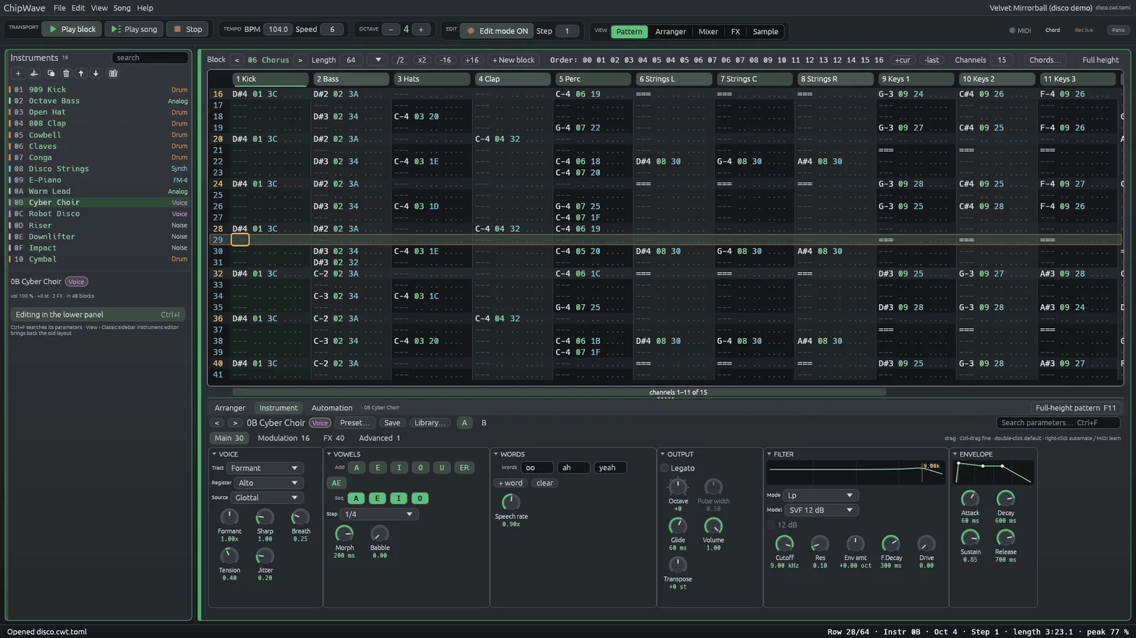
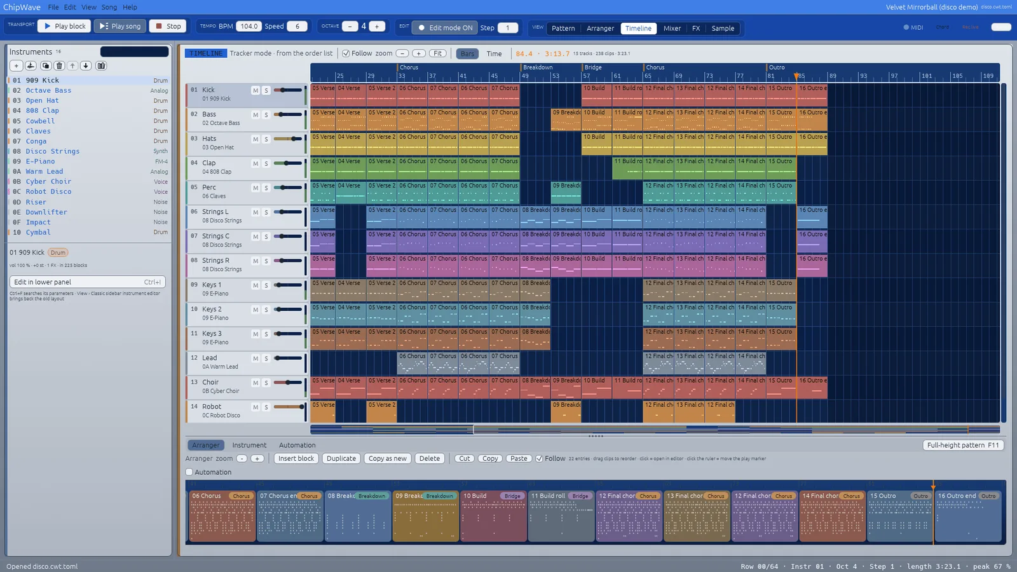
08 · THE LINEAGE
MUSIC ON COMPUTERS · OCTAMED → CHIPWAVE
The old way is still in there
The Pattern Editor: OctaMED-style blocks, note and effect columns.
The Amiga theme: Workbench blue title bars, orange cursor.
BLOCKS & COLUMNS
64-row blocks, the Z–M keyboard, selection, transpose and named undo — the 1991 workflow, intact.
TRACKER EFFECTS
Slides, decays, tempo and filter commands — plus 303 glide and accent (3C / 3D) for acid lines.
CHIP FX
An sfxr-style generator: pickups, lasers and blips that play in tune with the pattern note.
09 / 10

Slide 10
00
04
08
0C
10
14
18
1C
20
24
28
2C
30
34
1987 → TODAY · SAME GRID, SAME IDEA
The pattern
still scrolls.
Four hardware channels in 1987. Thirty-two tracks, synths and a true-peak limiter today. The pattern editor didn't get replaced — it grew up.
DOWNLOAD · chipwavestudio.com
SOURCE · github.com/postmanpat-303/ChipWaveStudio
FREE · GPL-3.0 · NO ACCOUNT · WINDOWS / MACOS / LINUX

