Slide 1
Chapter 6 Inference for Categorical Data

Slide 2
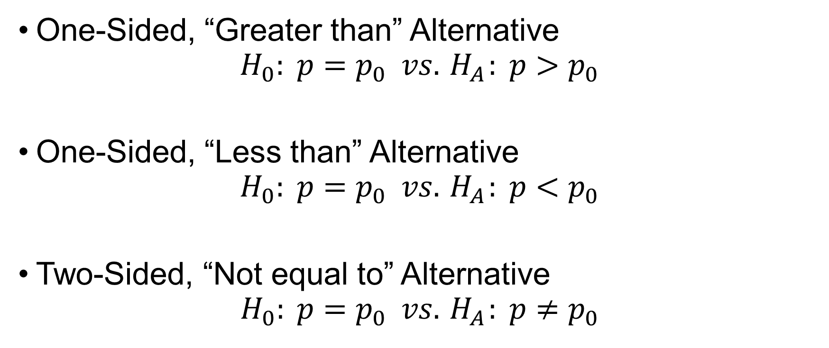
Null and Alternative Hypotheses for the Population Proportion
One-Sided, “Greater than” Alternative
$$H_{0}: p=p_{0} vs.{ H}_{A}: p>p_{0}$$
One-Sided, “Less than” Alternative
$$H_{0}: p=p_{0} vs.{ H}_{A}: p<p_{0}$$
Two-Sided, “Not equal to” Alternative
$$H_{0}: p=p_{0} vs.{ H}_{A}: p≠p_{0}$$

Slide 3
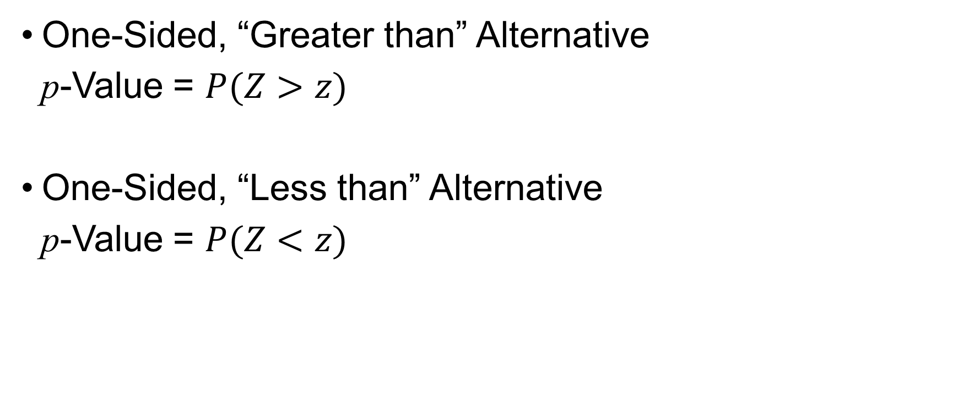
One-sided Hypothesis Test
One-Sided, “Greater than” Alternative
p-Value = $P(Z>z)$
One-Sided, “Less than” Alternative
p-Value = $P(Z<z)$

Slide 4
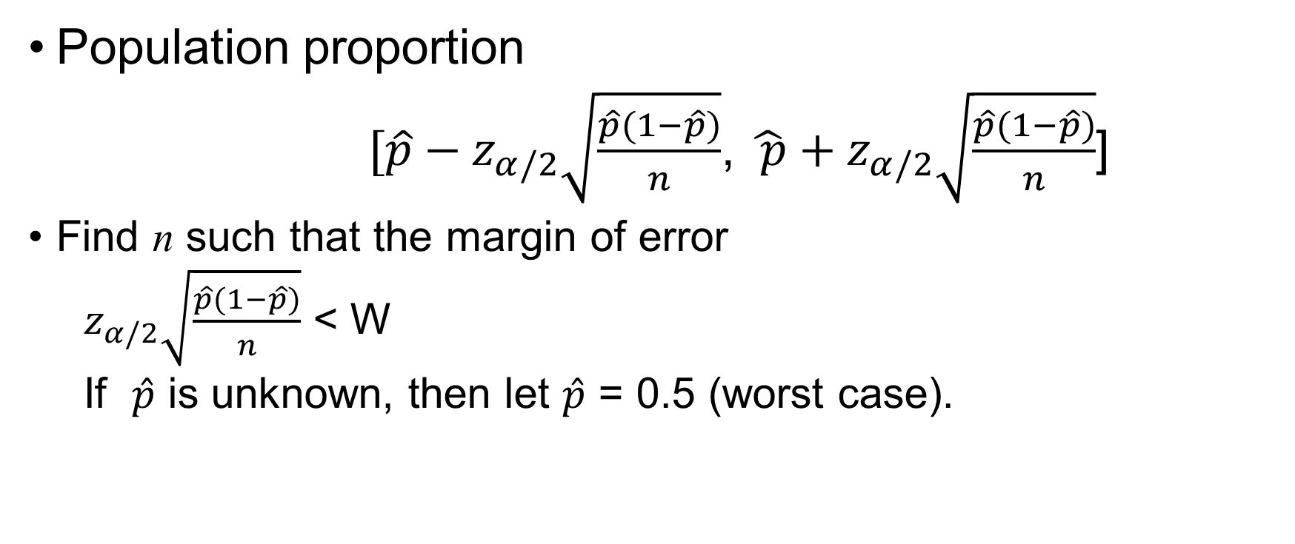
Choosing a Sample Size when Estimating a Proportion
Population proportion
$[\hat{p}−z_{α/2}\sqrt{\frac{\hat{p}(1−\hat{p})}{n}}$, $\hat{ p}+z_{α/2}\sqrt{\frac{\hat{p}(1−\hat{p})}{n}}$]
Find n such that the margin of error
$z_{α/2}\sqrt{\frac{\hat{p}(1−\hat{p})}{n}}$ < W
If $\hat{p}$ is unknown, then let $\hat{p}$ = 0.5 (worst case).

Slide 5
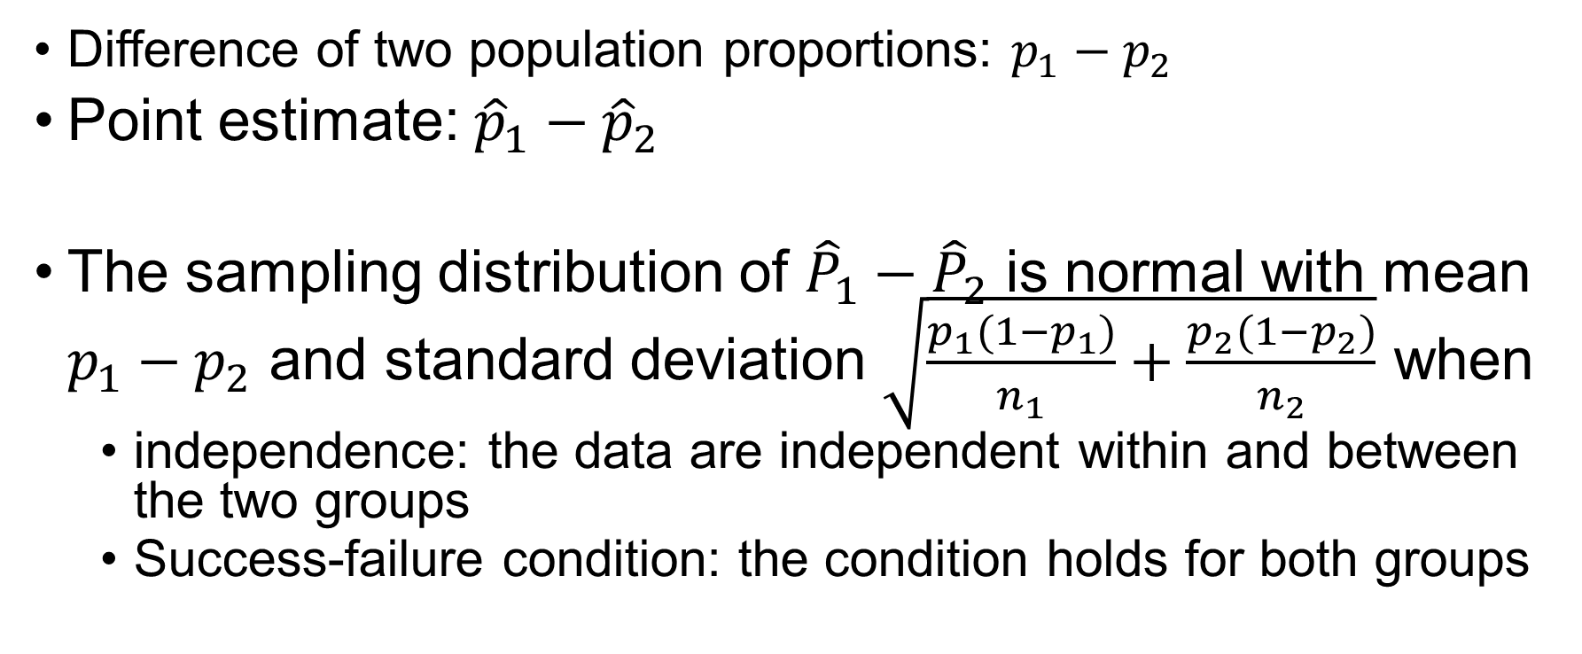
Difference of Two Proportions
Difference of two population proportions: $p_{1}−p_{2}$
Point estimate: ${\hat{p}}_{1}−{\hat{p}}_{2}$
The sampling distribution of ${\hat{P}}_{1}−{\hat{P}}_{2}$ is normal with mean $p_{1}−p_{2}$ and standard deviation $\sqrt{\frac{p_{1}(1−p_{1})}{n_{1}}+\frac{p_{2}(1−p_{2})}{n_{2}}}$ when
independence: the data are independent within and between the two groups
Success-failure condition: the condition holds for both groups

Slide 6
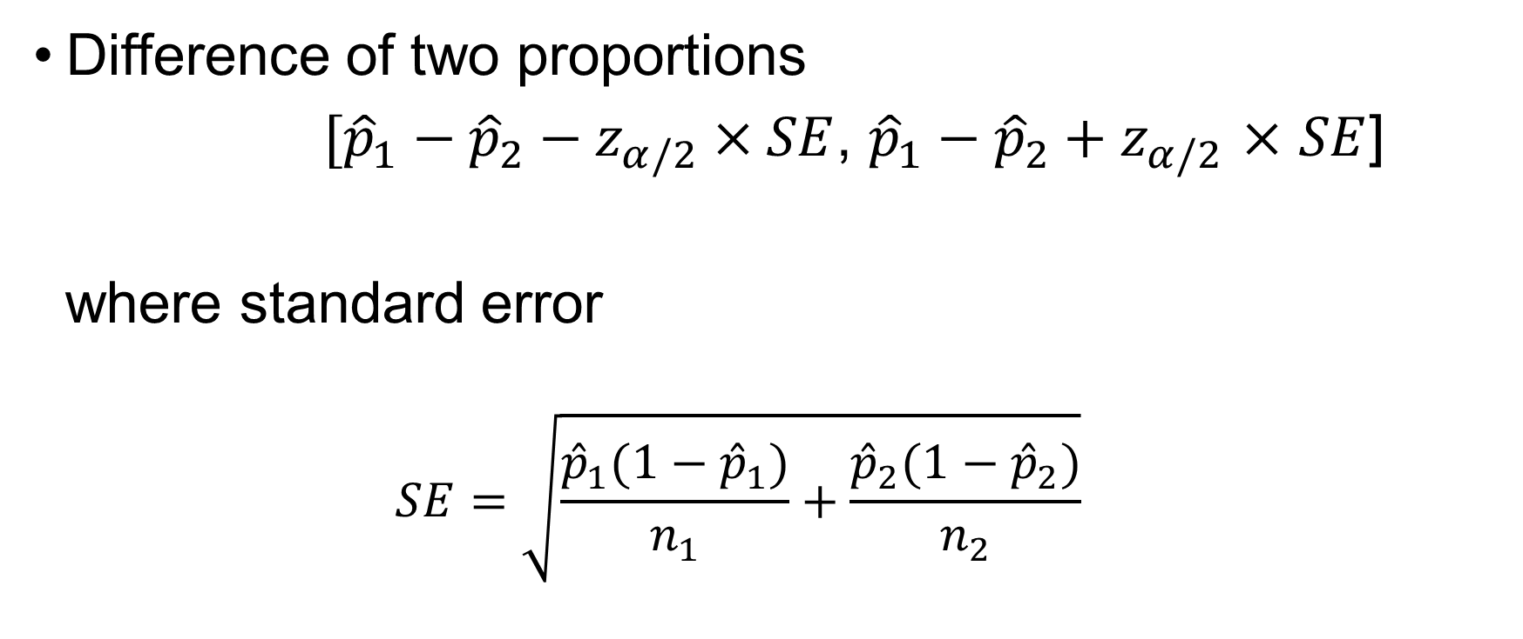
Confidence Interval
Difference of two proportions
$[{\hat{p}}_{1}−{\hat{p}}_{2}−z_{α/2}×SE$, ${\hat{p}}_{1}−{\hat{p}}_{2}+z_{α/2}$ $×$ $SE$]
where standard error
$$SE=\sqrt{\frac{{\hat{p}}_{1}(1−{\hat{p}}_{1})}{n_{1}}+\frac{{\hat{p}}_{2}(1−{\hat{p}}_{2})}{n_{2}}}$$

Slide 7

Null and Alternative Hypotheses
Two-Sided, “Not equal to” Alternative
$$H_{0}:p_{1}=p_{2} vs.{ H}_{A}:p_{1}≠p_{2}$$

Slide 8
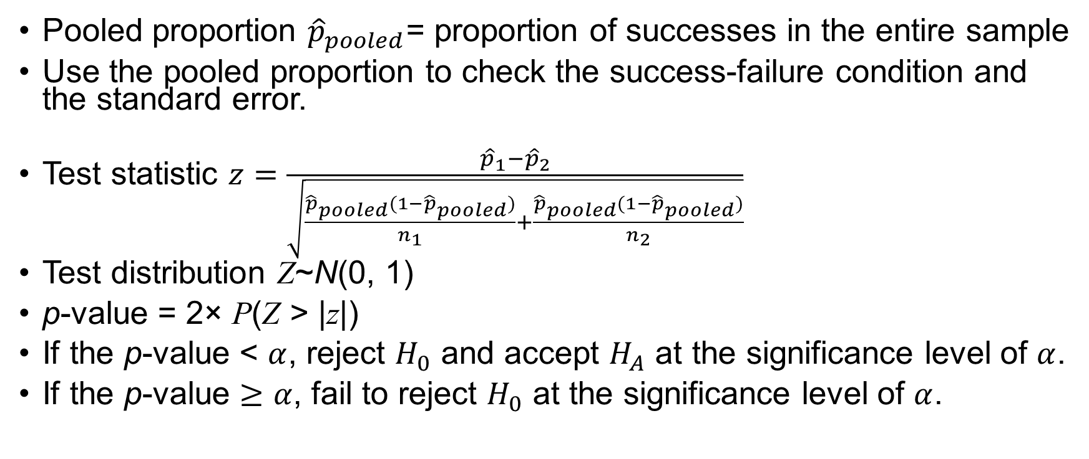
Testing Hypotheses Using the p-Values
Pooled proportion ${\hat{p}}_{pooled}$= proportion of successes in the entire sample
Use the pooled proportion to check the success-failure condition and the standard error.
Test statistic $z=\frac{{\hat{p}}_{1}−{\hat{p}}_{2}}{\sqrt{\frac{{\hat{p}}_{pooled}(1−{\hat{p}}_{pooled})}{n_{1}}+\frac{{\hat{p}}_{pooled}(1−{\hat{p}}_{pooled})}{n_{2}}}}$
Test distribution Z~N(0, 1)
p-value = 2× P(Z > |z|)
If the p-value < $α$, reject $H_{0}$ and accept $H_{A}$ at the significance level of $α$.
If the p-value $≥α$, fail to reject $H_{0}$ at the significance level of $α$.

Slide 9
Exercise
Suppose that early in an election campaign a telephone poll of 800 registered voters shows 460 in favor of a particular candidate. Just before the election day, a second poll shows only 520 of 1000 registered voters expressing the same preference. At the 5% significance level is there sufficient evidence that the candidate’s popularity has been different (or decreased)?

Slide 10
Testing for Goodness of Fit
Given a sample that can be classified into several groups, determine if the sample is representative of the general population.
A one-way table
 | G1 | G2 | G3 | G4 | Total
Observed count | 205 | 26 | 25 | 19 | 275
Expected proportion | 0.72 | 0.07 | 0.12 | 0.09 | 1

Slide 11
Testing for Goodness of Fit (cont’d)
A one-way table of observed counts and expected counts
 | G1 | G2 | G3 | G4 | Total
Observed count | 205 | 26 | 25 | 19 | 275
Expected count | 275×0.72 = 198 | 275×0.07=19.25 | 275×0.12=33 | 275×0.09=24.75 | 275×1 = 275

Slide 12
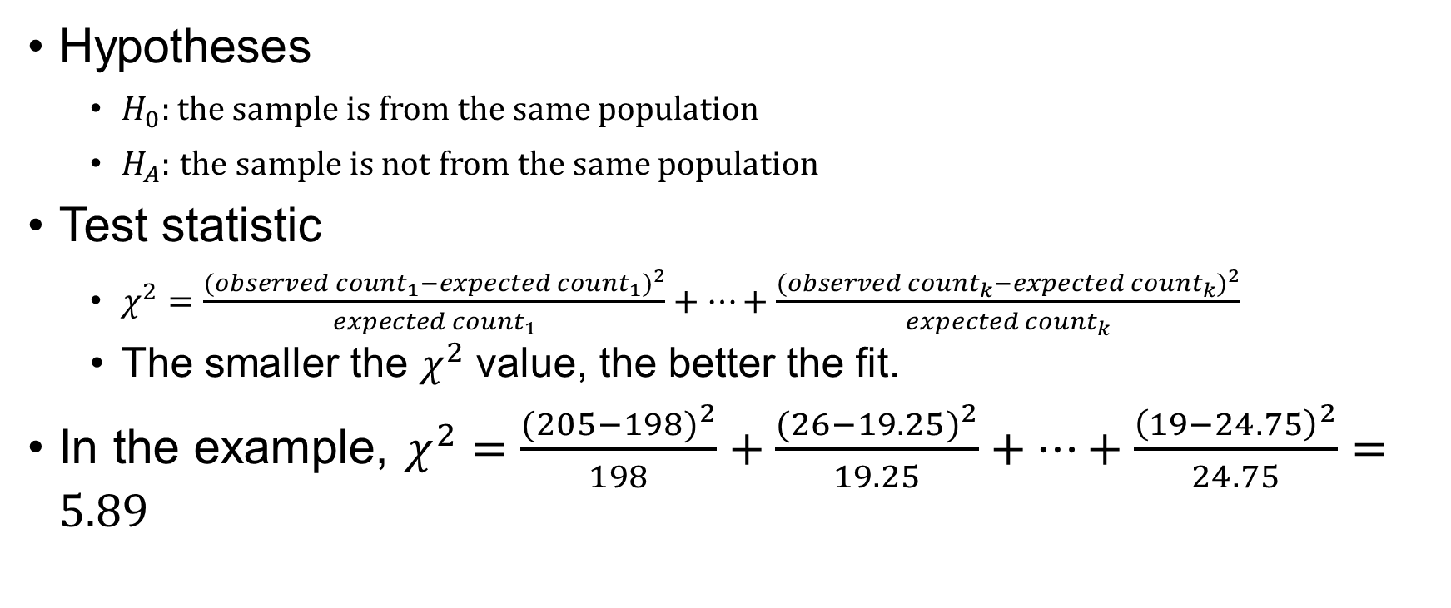
Chi-square Test
Hypotheses
$H_{0}:$the sample is from the same population
$H_{A}:$ the sample is not from the same population
Test statistic
$χ^{2}=\frac{{({observed count}_{1}−expected{ count}_{1})}^{2}}{expected{ count}_{1}}+⋯+\frac{{({observed count}_{k}−expected{ count}_{k})}^{2}}{expected{ count}_{k}}$
The smaller the $χ^{2}$ value, the better the fit.
In the example, $χ^{2}=\frac{{(205−198)}^{2}}{198}+\frac{{(26−19.25)}^{2}}{19.25}+⋯+\frac{{\left(19−24.75\right)}^{2}}{24.75}=5.89$

Slide 13
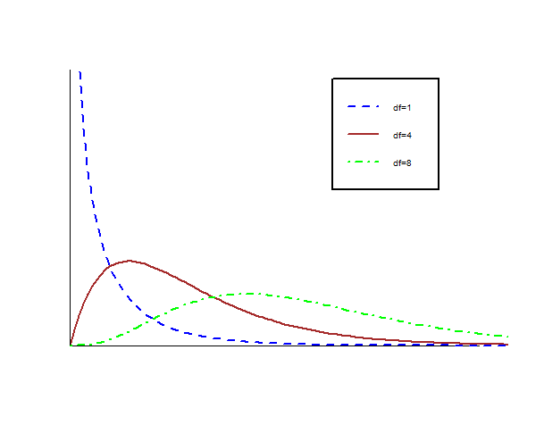
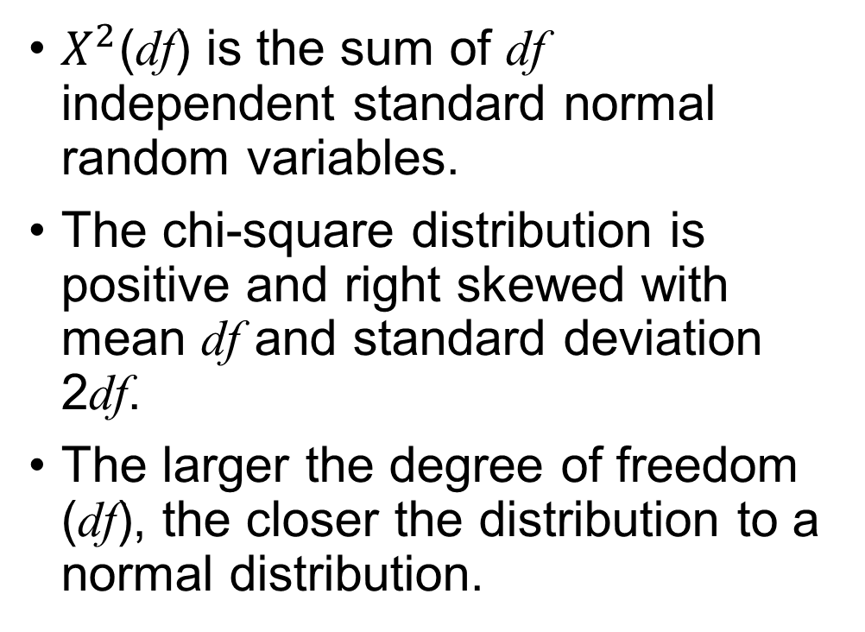
Chi-square Distribution
$X^{2}$(df) is the sum of df independent standard normal random variables.
The chi-square distribution is positive and right skewed with mean df and standard deviation 2df.
The larger the degree of freedom (df), the closer the distribution to a normal distribution.

Slide 14
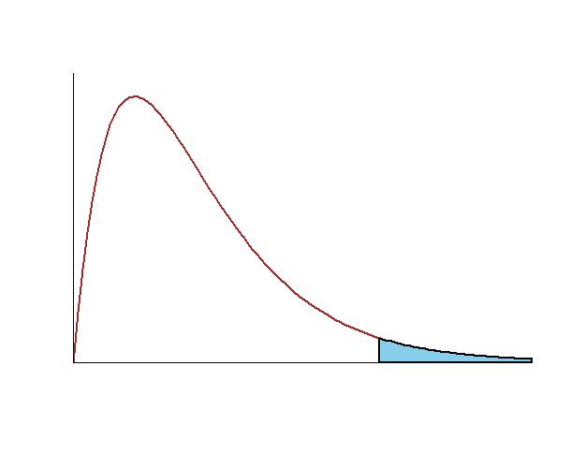
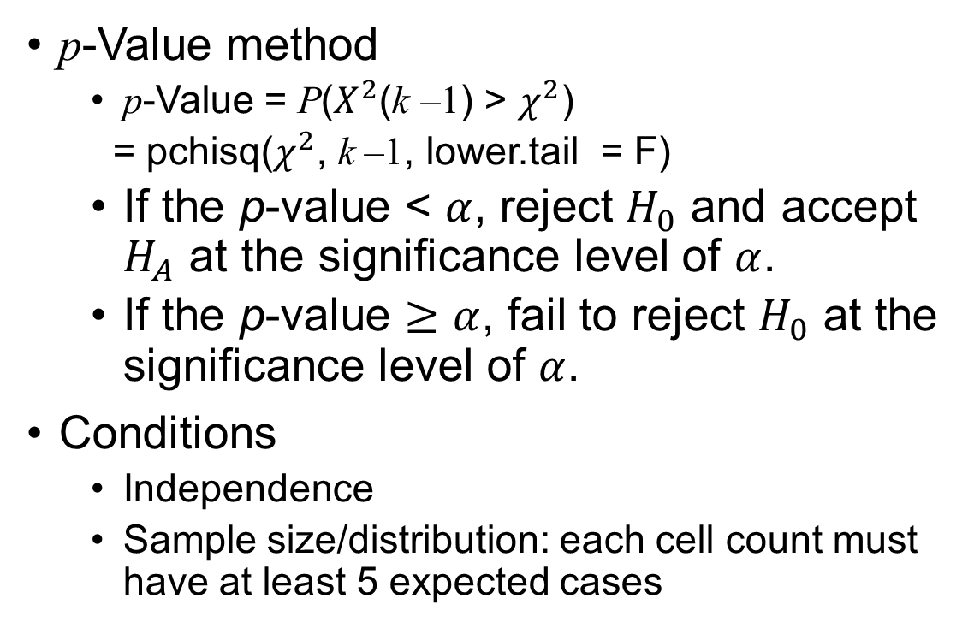
Chi-square Test (cont’d)
p-Value method
p-Value = P($X^{2}$(k –1) > $χ^{2}$)
= pchisq($χ^{2}$, k –1, lower.tail = F)
If the p-value < $α$, reject $H_{0}$ and accept $H_{A}$ at the significance level of $α$.
If the p-value $≥α$, fail to reject $H_{0}$ at the significance level of $α$.
Conditions
Independence
Sample size/distribution: each cell count must have at least 5 expected cases

Slide 15
Chi-square Test (cont’d)
In the example,
p-Value = pchisq(5.89, 4 –1, lower.tail = F) = 0.1171

Slide 16
Exercise
A grocery store manager wishes to determine whether a certain product will sell equally well in any of five locations in a store. Five displays are set up, one in each location, and the resulting numbers of the product sold are noted. Is there enough evidence that location makes a difference? Test at both the 5% and 10% significance level.
 | 1 | 2 | 3 | 4 | 5
Numbers sold | 43 | 29 | 52 | 34 | 48

Slide 17
Testing for Independence
Given two or more samples, determine if they come from some large set.
A two-way table
Are the two ways independent?
 | C1 | C2 | C3 | Total
R1 | 2 | 23 | 36 | 61
R2 | 71 | 50 | 37 | 158
Total | 73 | 73 | 73 | 219

Slide 18

Testing for Independence (cont’d)
A two-way table of observed and expected counts
Expected count_{row i, column j} = $\frac{(row i total)×(column j total) }{table total}$
 | C1 | C2 | C3 | Total
R1 | 2 (73 × 61/219 = 20.33) | 23 (73 × 61/219 = 20.33) | 36 (73 × 61/219= 20.33) | 61
R2 | 71 (73 × 158/219 = 52.67) | 50 (73 × 158/219 = 52.67) | 37 (73 × 158/219 = 52.67) | 158
Total | 73 | 73 | 73 | 219

Slide 19
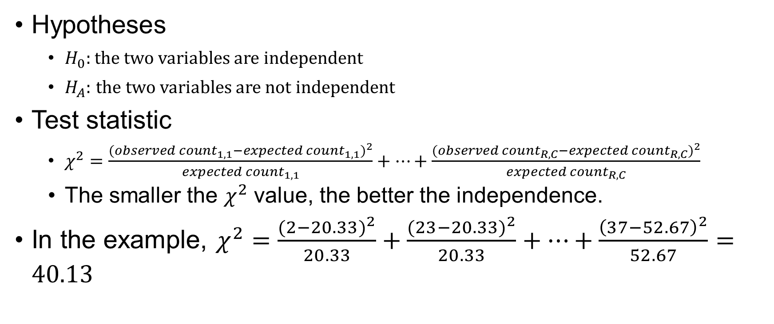
Chi-square Test
Hypotheses
$H_{0}:$the two variables are independent
$H_{A}:$ the two variables are not independent
Test statistic
$χ^{2}=\frac{{({observed count}_{1,1}−expected{ count}_{1,1})}^{2}}{expected{ count}_{1,1}}+⋯+\frac{{({observed count}_{R, C}−expected{ count}_{R, C})}^{2}}{expected{ count}_{R, C}}$
The smaller the $χ^{2}$ value, the better the independence.
In the example, $χ^{2}=\frac{{(2−20.33)}^{2}}{20.33}+\frac{{(23−20.33)}^{2}}{20.33}+⋯+\frac{{\left(37−52.67\right)}^{2}}{52.67}=40.13$

Slide 20
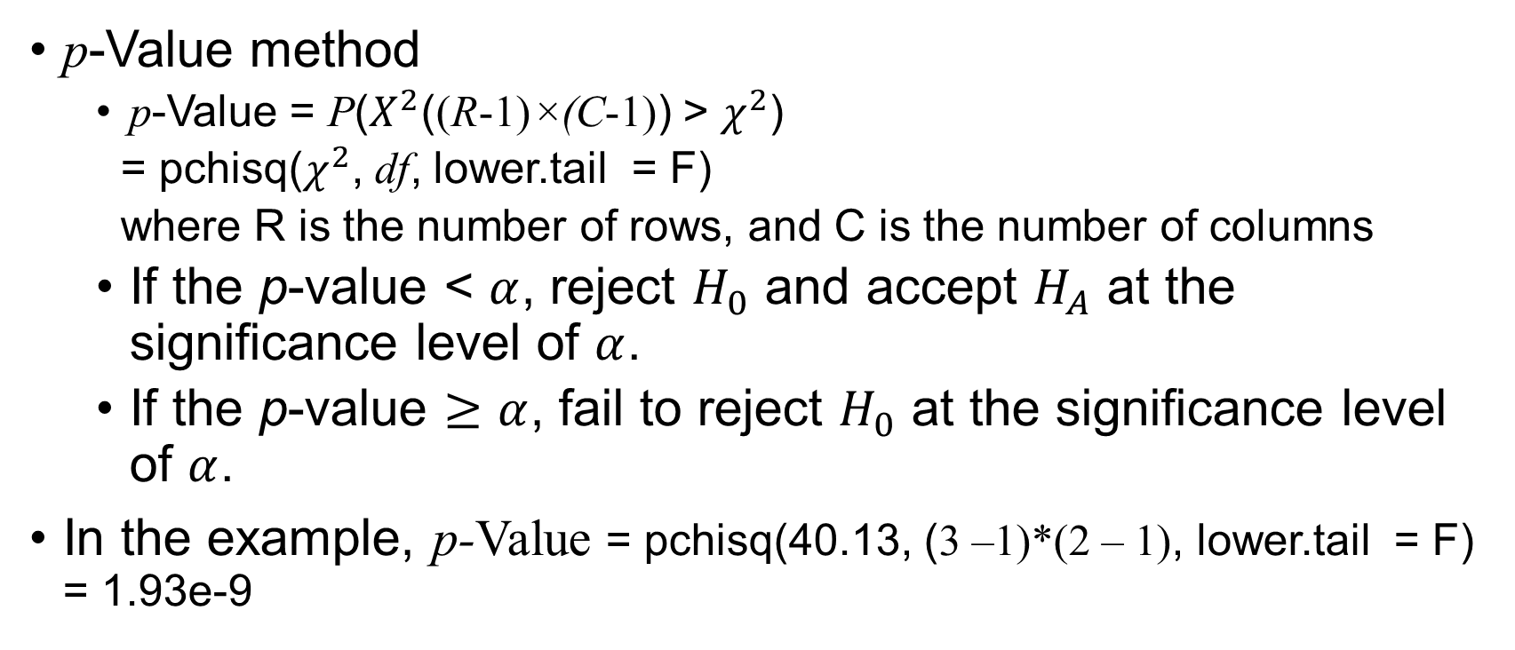
Chi-square Test (cont’d)
p-Value method
p-Value = P($X^{2}$((R-1)×(C-1)) > $χ^{2}$)
= pchisq($χ^{2}$, df, lower.tail = F)
where R is the number of rows, and C is the number of columns
If the p-value < $α$, reject $H_{0}$ and accept $H_{A}$ at the significance level of $α$.
If the p-value $≥α$, fail to reject $H_{0}$ at the significance level of $α$.
In the example, p-Value = pchisq(40.13, (3 –1)*(2 – 1), lower.tail = F) = 1.93e-9

Slide 21
Exercise
In a nationwide telephone poll of 1000 adults representing Democrats, Republicans, and Independents, respondents were asked two questions: their party affiliation and if their confidence in the U.S. banking system had been shaken by the savings and loan crisis. Is there significant evidence that shaken confidence in the banking system is independent of party affiliation? Use a 10% significance level.
 | Yes | No | No opinion
Democrats | 175 | 220 | 55
Republicans | 150 | 165 | 35
Independents | 75 | 105 | 20

