Slide 1
Chapter 7 Inference for Numerical Data

Slide 2
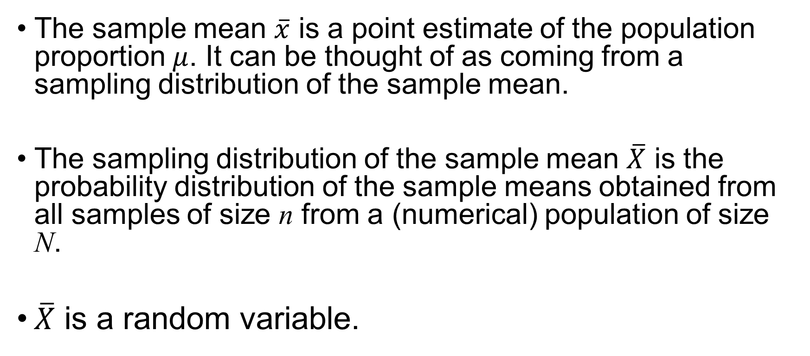
Sampling Distribution of the Sample Mean
The sample mean $\overline{x}$ is a point estimate of the population proportion $μ$. It can be thought of as coming from a sampling distribution of the sample mean.
The sampling distribution of the sample mean $\overline{X}$ is the probability distribution of the sample means obtained from all samples of size n from a (numerical) population of size N.
$\overline{X}$ is a random variable.

Slide 3
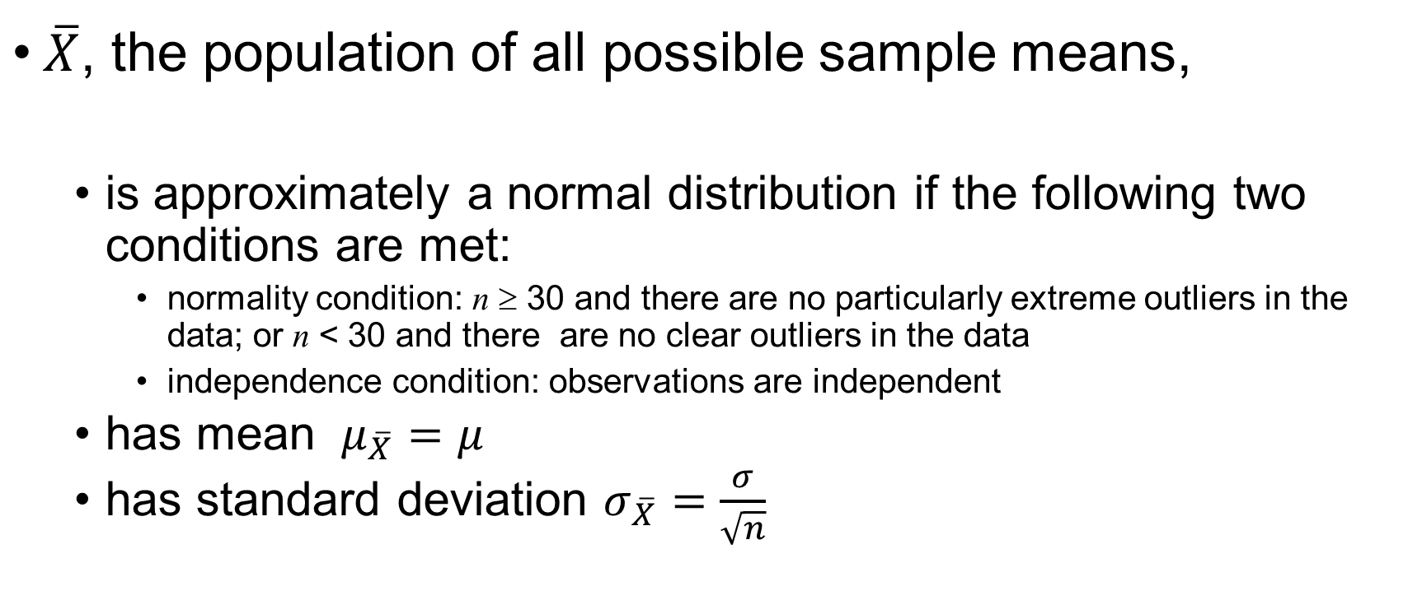
Central Limit Theorem
$\overline{X}$, the population of all possible sample means,
is approximately a normal distribution if the following two conditions are met:
normality condition: n ≥ 30 and there are no particularly extreme outliers in the data; or n < 30 and there are no clear outliers in the data
independence condition: observations are independent
has mean $μ_{\overline{X}}=μ$
has standard deviation $σ_{\overline{X}}=\frac{σ}{\sqrt{n}}$

Slide 4
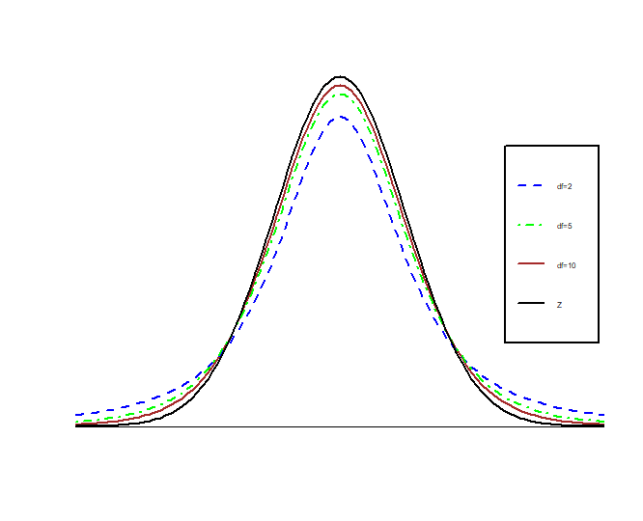
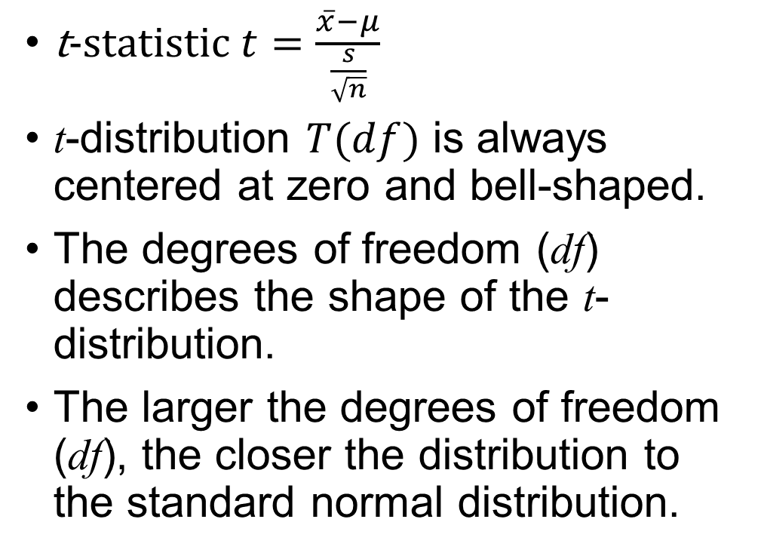
t-Distribution
t-statistic $t=\frac{\overline{x}−μ}{\frac{s}{\sqrt{n}}}$
t-distribution $T(df)$ is always centered at zero and bell-shaped.
The degrees of freedom (df) describes the shape of the t-distribution.
The larger the degrees of freedom (df), the closer the distribution to the standard normal distribution.

Slide 5
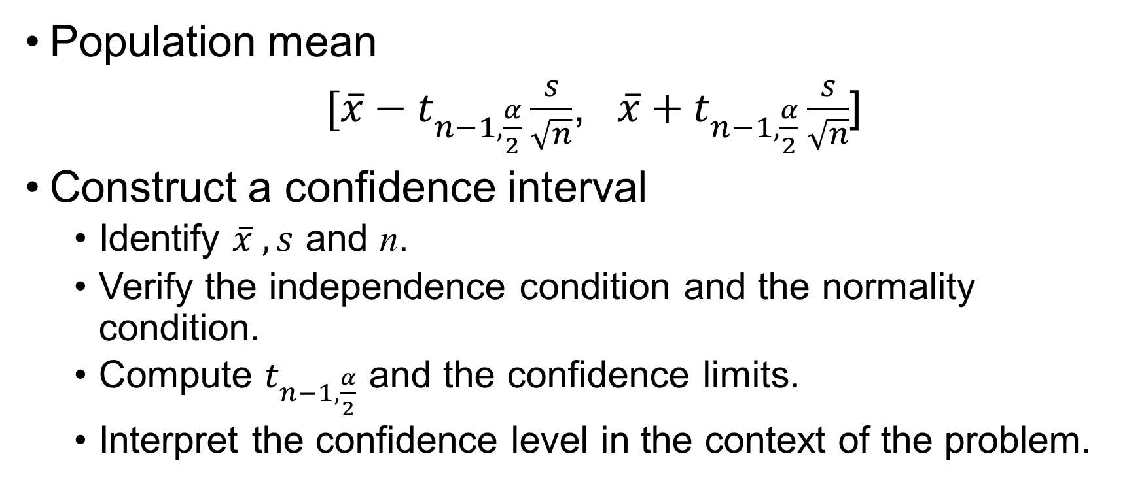
One Sample Confidence Interval
Population mean
$[\overline{x}−t_{n−1, \frac{α}{2}}\frac{s}{\sqrt{n}}$, $\overline{x}+t_{n−1, \frac{α}{2}}\frac{s}{\sqrt{n}}$]
Construct a confidence interval
Identify $\overline{x} , s$ and n.
Verify the independence condition and the normality condition.
Compute $t_{n−1, \frac{α}{2}}$ and the confidence limits.
Interpret the confidence level in the context of the problem.

Slide 6
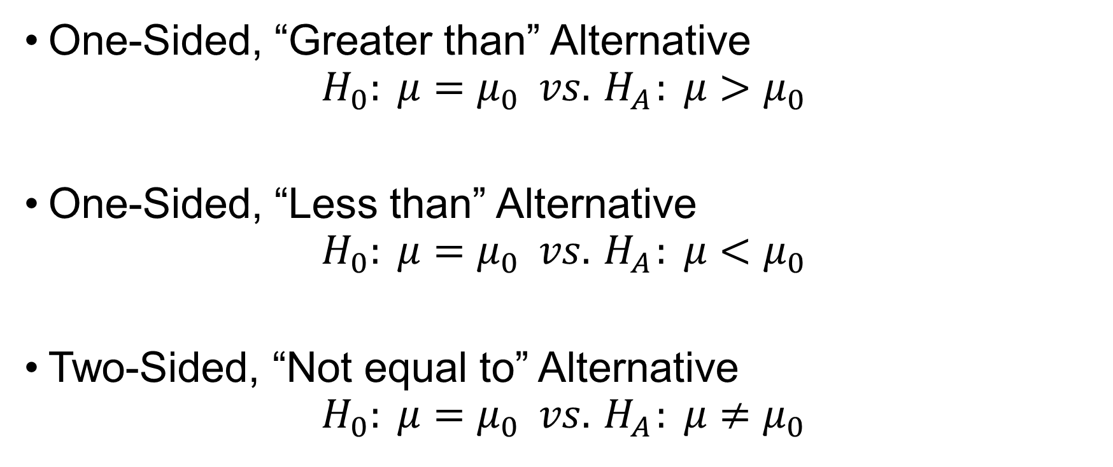
Null and Alternative Hypotheses for the Population Mean
One-Sided, “Greater than” Alternative
$$H_{0}: μ=μ_{0} vs.{ H}_{A}: μ>μ_{0}$$
One-Sided, “Less than” Alternative
$$H_{0}: μ=μ_{0} vs.{ H}_{A}: μ<μ_{0}$$
Two-Sided, “Not equal to” Alternative
$$H_{0}: μ=μ_{0} vs.{ H}_{A}: μ≠μ_{0}$$

Slide 7
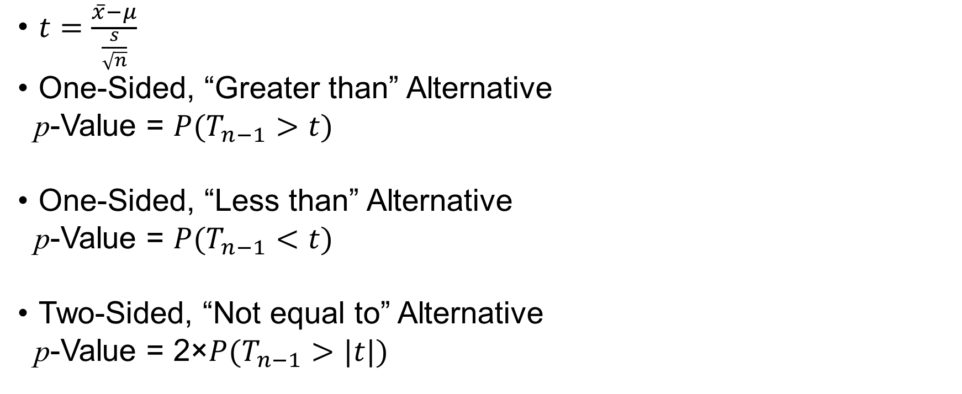
Hypothesis Testing (t-Test)
$t=\frac{\overline{x}−μ}{\frac{s}{\sqrt{n}}}$
One-Sided, “Greater than” Alternative
p-Value = $P(T_{n−1}>t)$
One-Sided, “Less than” Alternative
p-Value = $P(T_{n−1}<t)$
Two-Sided, “Not equal to” Alternative
p-Value = 2×$P(T_{n−1}>|t|)$

Slide 8
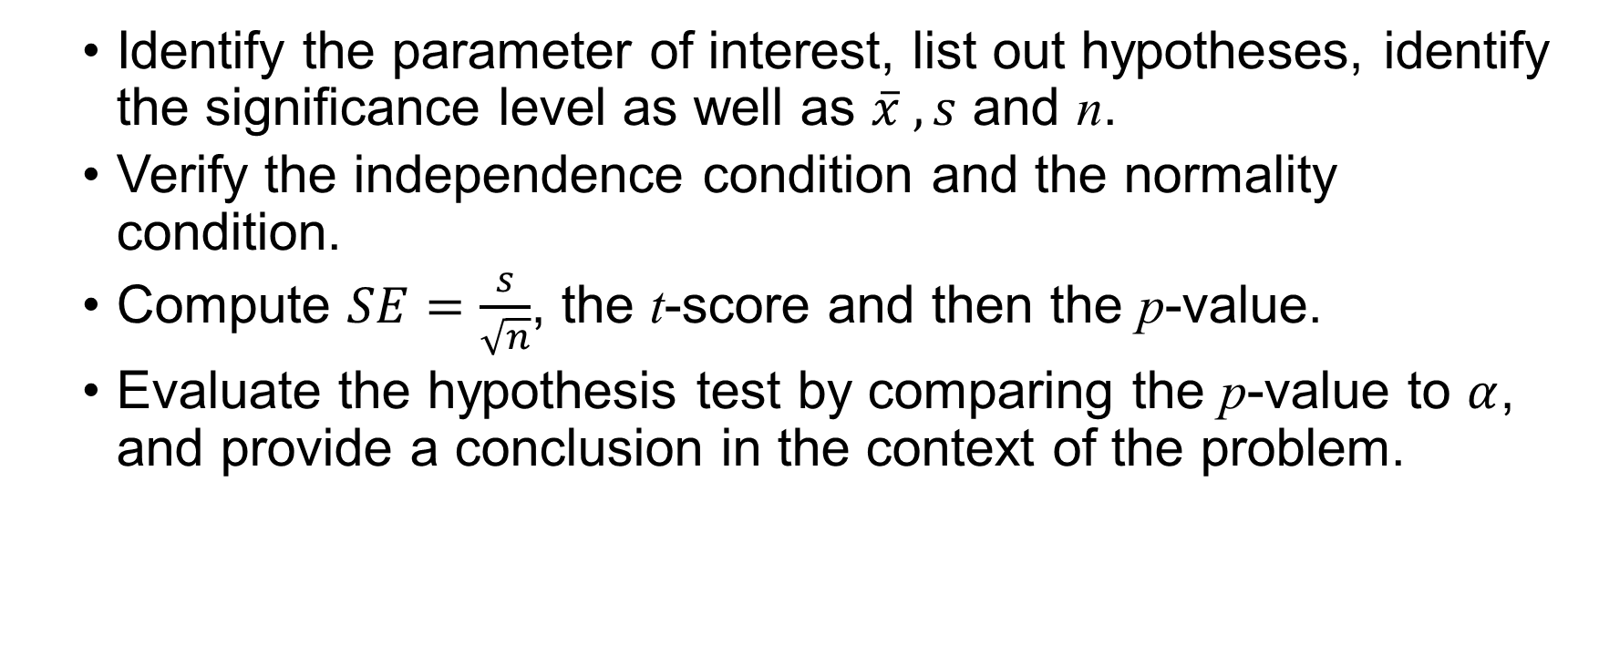
Hypothesis Testing for a Single Mean
Identify the parameter of interest, list out hypotheses, identify the significance level as well as $\overline{x} , s$ and n.
Verify the independence condition and the normality condition.
Compute $SE=\frac{s}{\sqrt{n}}$, the t-score and then the p-value.
Evaluate the hypothesis test by comparing the p-value to $α$, and provide a conclusion in the context of the problem.

Slide 9
Exercise 1
A manufacturer claims that a new brand of air-conditioning unit uses only 6.5 kilowatts of electricity per day. A consumer agency believes that the true figure is higher and runs a test on a sample of size 50. If the sample mean is 7.0 kilowatts with a standard deviation of 1.4, should the manufacturer’s claim be rejected at a significance level of 5%? Of 1%? What is the 95% confidence interval estimate for the mean electricity usage per day?

Slide 10
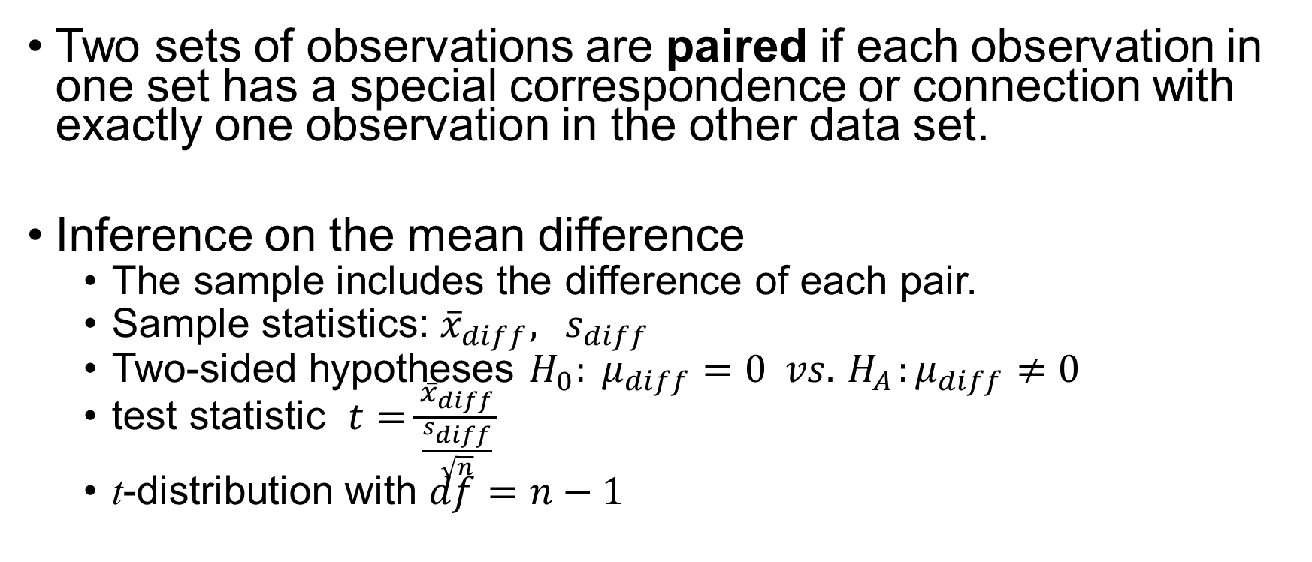
Paired Data
Two sets of observations are paired if each observation in one set has a special correspondence or connection with exactly one observation in the other data set.
Inference on the mean difference
The sample includes the difference of each pair.
Sample statistics: ${\overline{x}}_{diff},{ s}_{diff}$
Two-sided hypotheses $H_{0}: μ_{diff}=0 vs.{ H}_{A}:μ_{diff}≠0$
test statistic $t=\frac{{\overline{x}}_{diff}}{\frac{s_{diff}}{\sqrt{n}}}$
t-distribution with $df=n−1$

Slide 11
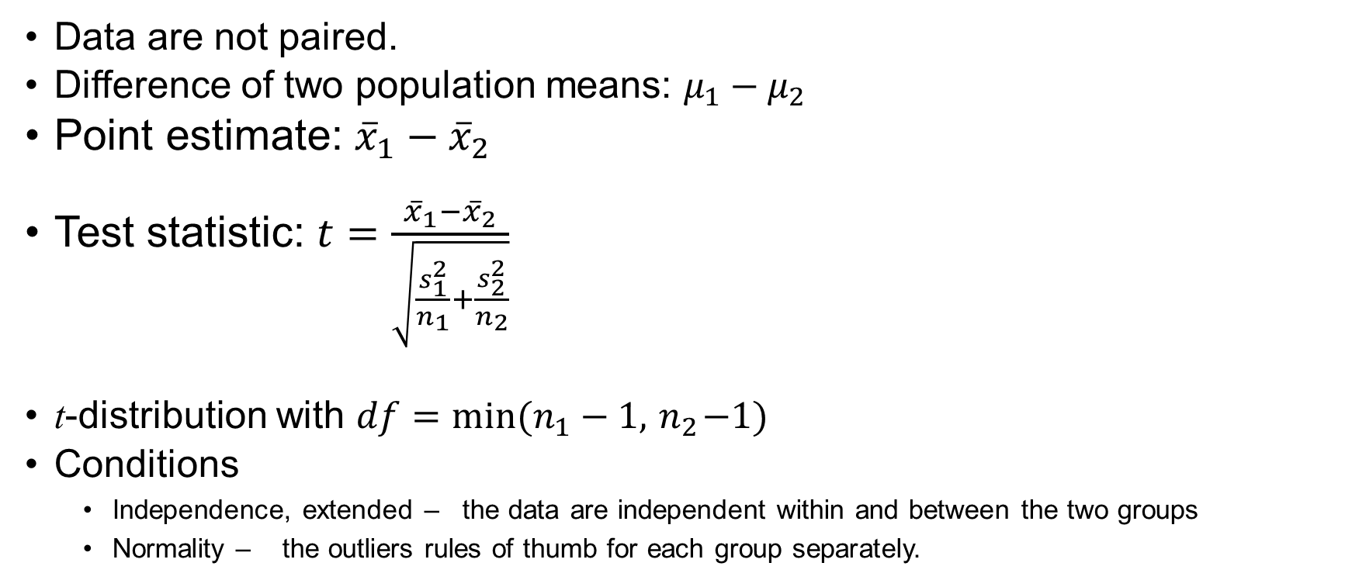
Difference of Two Means
Data are not paired.
Difference of two population means: $μ_{1}−μ_{2}$
Point estimate: ${\overline{x}}_{1}−{\overline{x}}_{2}$
Test statistic: $t=\frac{{\overline{x}}_{1}−{\overline{x}}_{2}}{\sqrt{\frac{s_{1}^{2}}{n_{1}}+\frac{s_{2}^{2}}{n_{2}}}}$
t-distribution with $df={min⁡(n}_{1}−1,{ n}_{2}−1)$
Conditions
Independence, extended – the data are independent within and between the two groups
Normality – the outliers rules of thumb for each group separately.

Slide 12
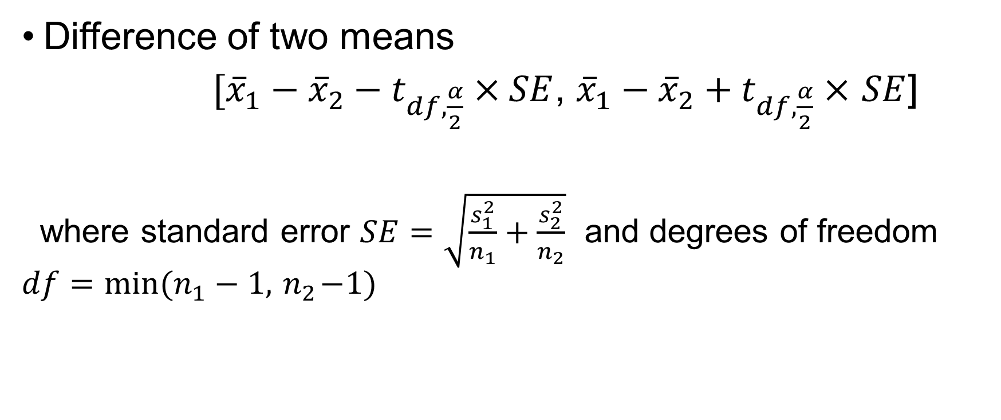
Confidence Interval
Difference of two means
$[{\overline{x}}_{1}−{\overline{x}}_{2}−t_{df, \frac{α}{2}}×SE$, ${\overline{x}}_{1}−{\overline{x}}_{2}+t_{df, \frac{α}{2}}×$ $SE$]
where standard error $SE=\sqrt{\frac{s_{1}^{2}}{n_{1}}+\frac{s_{2}^{2}}{n_{2}}}$ and degrees of freedom $df={min⁡(n}_{1}−1,{ n}_{2}−1)$

Slide 13
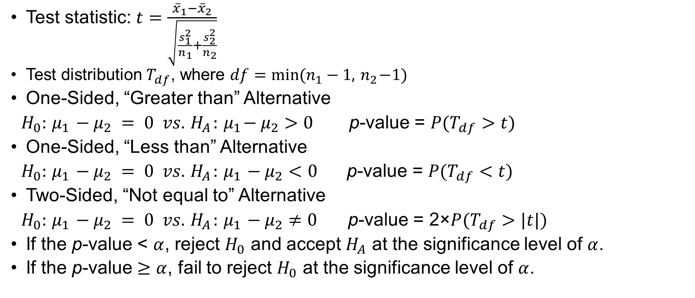
Hypothesis Testing
Test statistic: $t=\frac{{\overline{x}}_{1}−{\overline{x}}_{2}}{\sqrt{\frac{s_{1}^{2}}{n_{1}}+\frac{s_{2}^{2}}{n_{2}}}}$
Test distribution $T_{df}$, where $df={min⁡(n}_{1}−1,{ n}_{2}−1)$
One-Sided, “Greater than” Alternative
$H_{0}:{ μ}_{1} − μ_{2} = 0 vs.{ H}_{A}:{ μ}_{1}− μ_{2}>0$ p-value = $P(T_{df}>t)$
One-Sided, “Less than” Alternative
$H_{0}:{ μ}_{1} − μ_{2} = 0 vs.{ H}_{A}:{ μ}_{1} − μ_{2}<0$ p-value = $P(T_{df}<t)$
Two-Sided, “Not equal to” Alternative
$H_{0}:{ μ}_{1} − μ_{2} = 0 vs.{ H}_{A}:{ μ}_{1} − μ_{2}≠0$ p-value = 2×$P(T_{df}>|t|)$
If the p-value < $α$, reject $H_{0}$ and accept $H_{A}$ at the significance level of $α$.
If the p-value $≥α$, fail to reject $H_{0}$ at the significance level of $α$.

Slide 14
Exercise 2
A city council member claims that male and female officers wait equal times for promotion in the police department. A woman’s spokesperson, however, believes women must wait longer than men. If five men waited 8, 7, 10, 5, 7 years, respectively, for promotion while four women waited 9, 5, 12, and 8 years, respectively. What conclusion can be drawn at a significance level of 5%? What is the 95% confidence interval estimate for the difference of the average numbers of years that male and female officers wait for promotion?

Slide 15
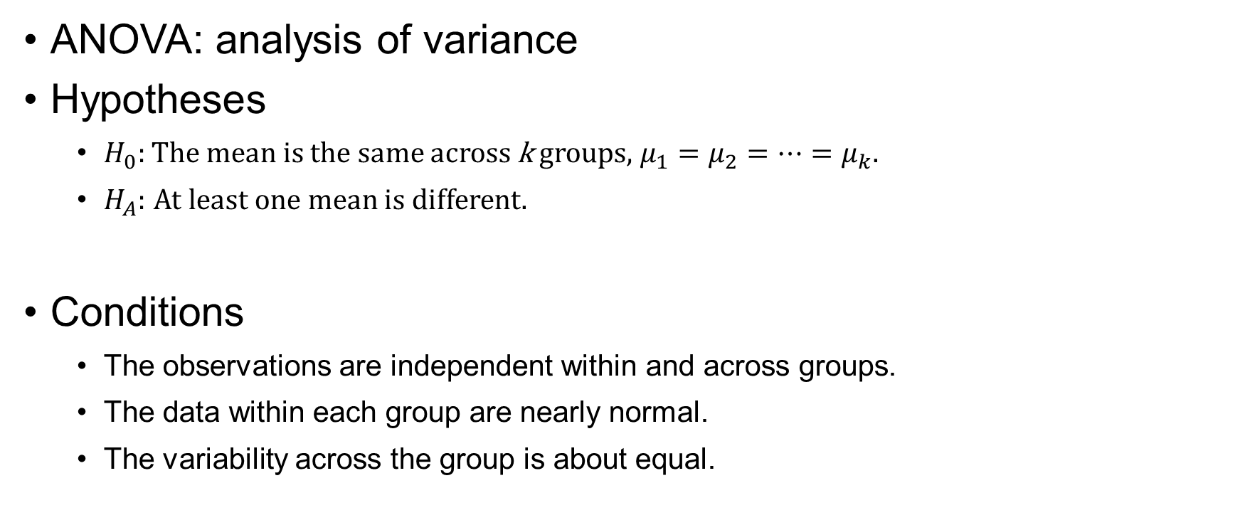
Comparing Many Means with ANOVA
ANOVA: analysis of variance
Hypotheses
$H_{0}:$The mean is the same across k groups, $μ_{1}=μ_{2}=⋯=μ_{k}$.
$H_{A}:$ At least one mean is different.
Conditions
The observations are independent within and across groups.
The data within each group are nearly normal.
The variability across the group is about equal.

Slide 16
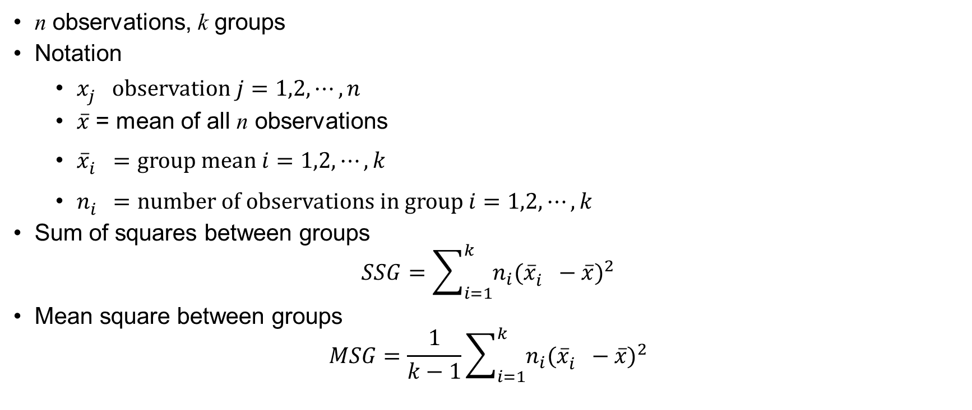
F Test
n observations, k groups
Notation
$x_{j}^{}$ observation $j=1,2,⋯,n$
$\overline{x}$ = mean of all n observations
${\overline{x}}_{i}^{}=group mean i=1,2,⋯,k$
$n_{i}^{}=number of observations in group i=1,2,⋯,k$
Sum of squares between groups
$$SSG=\sum_{i=1}^{k}{n_{i}{({\overline{x}}_{i}^{}−\overline{x})}^{2}}$$
Mean square between groups
$$MSG=\frac{1}{k−1}\sum_{i=1}^{k}{n_{i}{({\overline{x}}_{i}^{}−\overline{x})}^{2}}$$

Slide 17
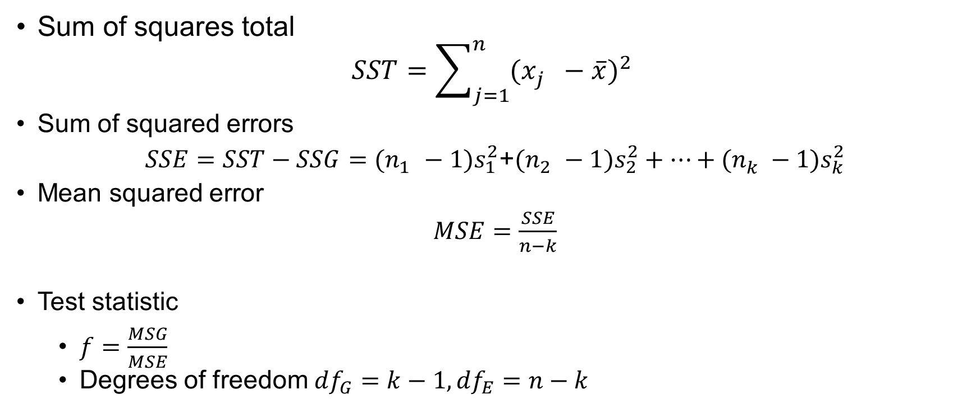
F Test (cont’d)
Sum of squares total
$$SST=\sum_{j=1}^{n}{{(x_{j}^{}−\overline{x})}^{2}}$$
Sum of squared errors
$SSE=SST−SSG=(n_{1}^{}−1)s_{1}^{2}$+$(n_{2}^{}−1)s_{2}^{2}+⋯+(n_{k}^{}−1)s_{k}^{2}$
Mean squared error
$MSE=\frac{SSE}{n−k}$
Test statistic
$f=\frac{MSG}{MSE}$
Degrees of freedom ${df}_{G}=k−1, {df}_{E}=n−k$

Slide 18
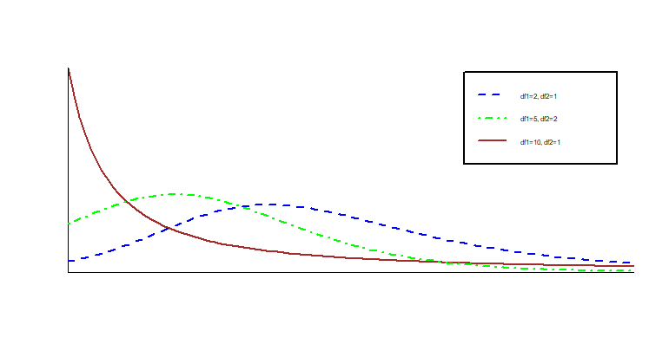
F-Distribution

Slide 19
Exercise 3
The summary statistics for three groups of observations are presented below. Is there significant evidence that the population means vary across the three groups?
 | Group 1 | Group 2 | Group 3
Sample size | 160 | 205 | 64
Sample mean | 0.32 | 0.318 | 0.302
Sample SD | 0.043 | 0.038 | 0.038

