Slide 1
Chapter 5 Foundations for Inference

Slide 2
Point Estimation
A sample statistic is a point estimate of the corresponding population parameter.
Estimation error is the difference between the sample statistic and the parameter.
The error consists of
sampling error (sampling uncertainty) – how much an estimate will tend to vary from one sample to the next
bias – a systematic tendency to over- or under-estimate the true population parameter value

Slide 3
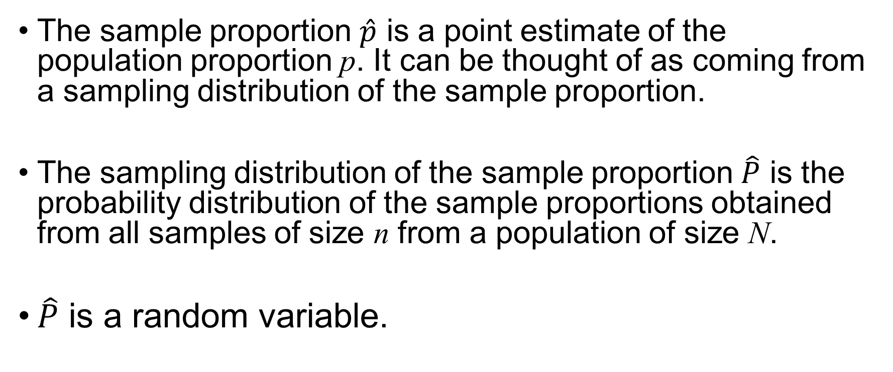
Sampling Distribution of the Sample Proportion
The sample proportion $\hat{p}$ is a point estimate of the population proportion p. It can be thought of as coming from a sampling distribution of the sample proportion.
The sampling distribution of the sample proportion $\hat{P}$ is the probability distribution of the sample proportions obtained from all samples of size n from a population of size N.
$\hat{P}$ is a random variable.

Slide 4
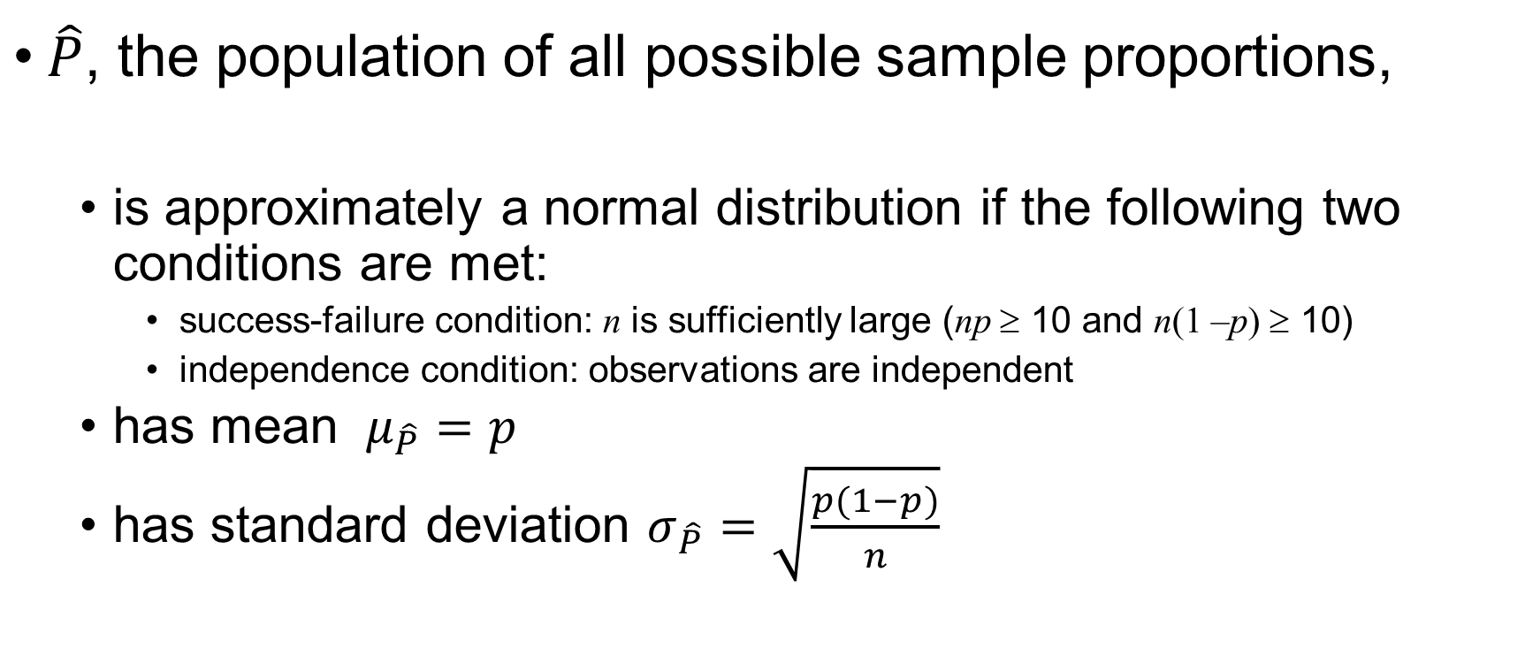
Central Limit Theorem
$\hat{P}$, the population of all possible sample proportions,
is approximately a normal distribution if the following two conditions are met:
success-failure condition: n is sufficiently large (np ≥ 10 and n(1 –p) ≥ 10)
independence condition: observations are independent
has mean $μ_{\hat{P}}=p$
has standard deviation $σ_{\hat{P}}=\sqrt{\frac{p(1−p)}{n}}$

Slide 5
Interval Estimation
A confidence interval of a population parameter is an interval constructed around the sample statistic so that we are reasonably sure, or confident, that this interval contains the population parameter.
A confidence level 1-α is a percentage that expresses how confident we are that the confidence interval contains the population parameter.
The margin of error is the maximum difference between the sample statistic and the population parameter under a given confidence level.
Margin of Error
Margin of Error
LCL
Sample Statistic
UCL

Slide 6
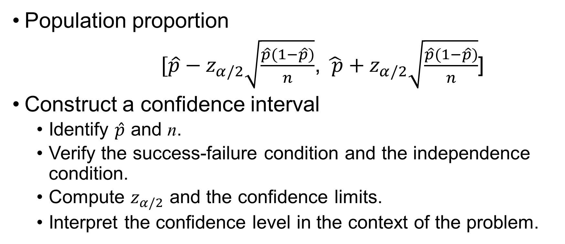
Confidence Interval
Population proportion
$[\hat{p}−z_{α/2}\sqrt{\frac{\hat{p}(1−\hat{p})}{n}}$, $\hat{ p}+z_{α/2}\sqrt{\frac{\hat{p}(1−\hat{p})}{n}}$]
Construct a confidence interval
Identify $\hat{p}$ and n.
Verify the success-failure condition and the independence condition.
Compute $z_{α/2}$ and the confidence limits.
Interpret the confidence level in the context of the problem.

Slide 7
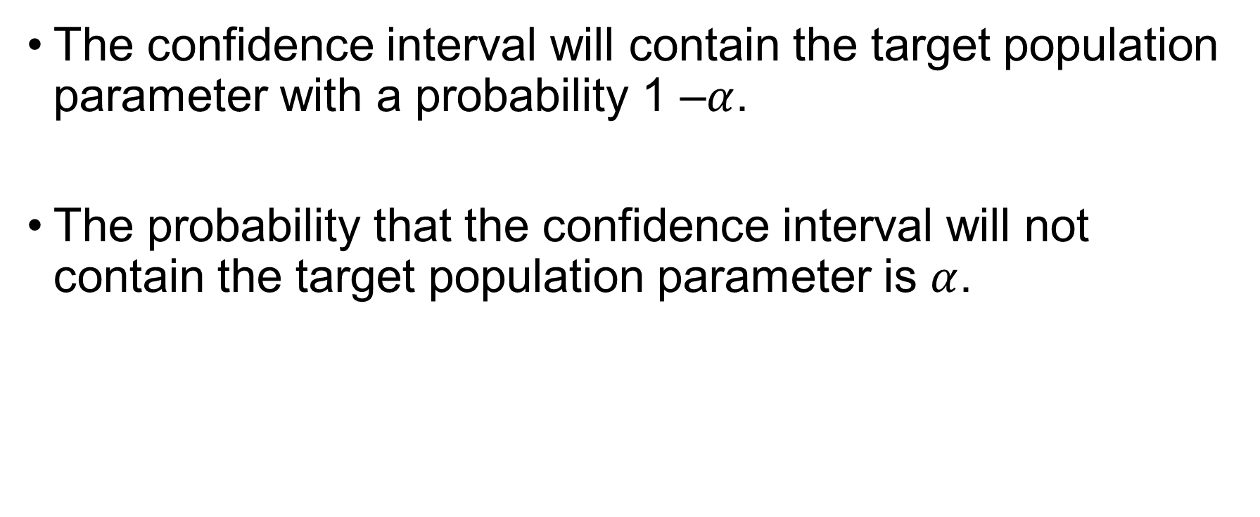
Interpreting a Confidence Interval
The confidence interval will contain the target population parameter with a probability 1 –$α$.
The probability that the confidence interval will not contain the target population parameter is $α$.

Slide 8
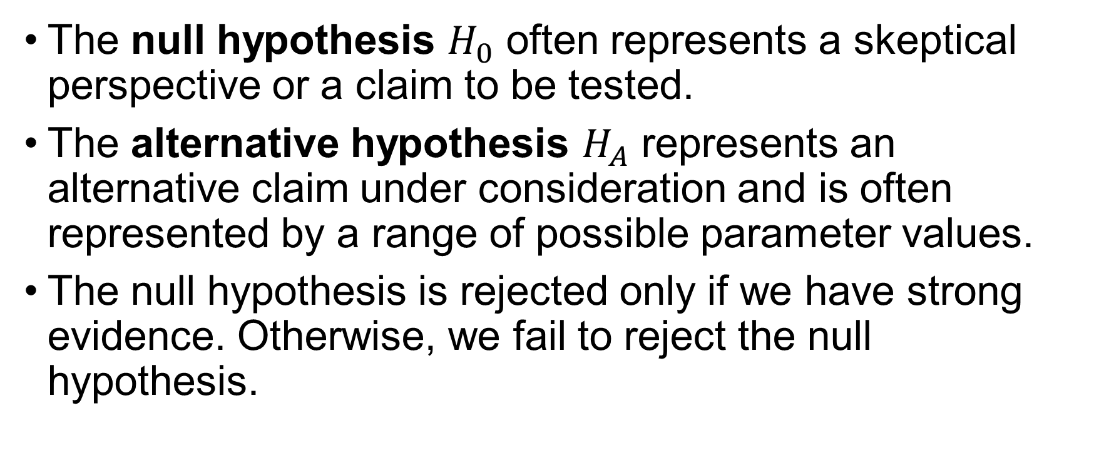
Hypotheses
The null hypothesis $H_{0}$ often represents a skeptical perspective or a claim to be tested.
The alternative hypothesis $H_{A}$ represents an alternative claim under consideration and is often represented by a range of possible parameter values.
The null hypothesis is rejected only if we have strong evidence. Otherwise, we fail to reject the null hypothesis.

Slide 9
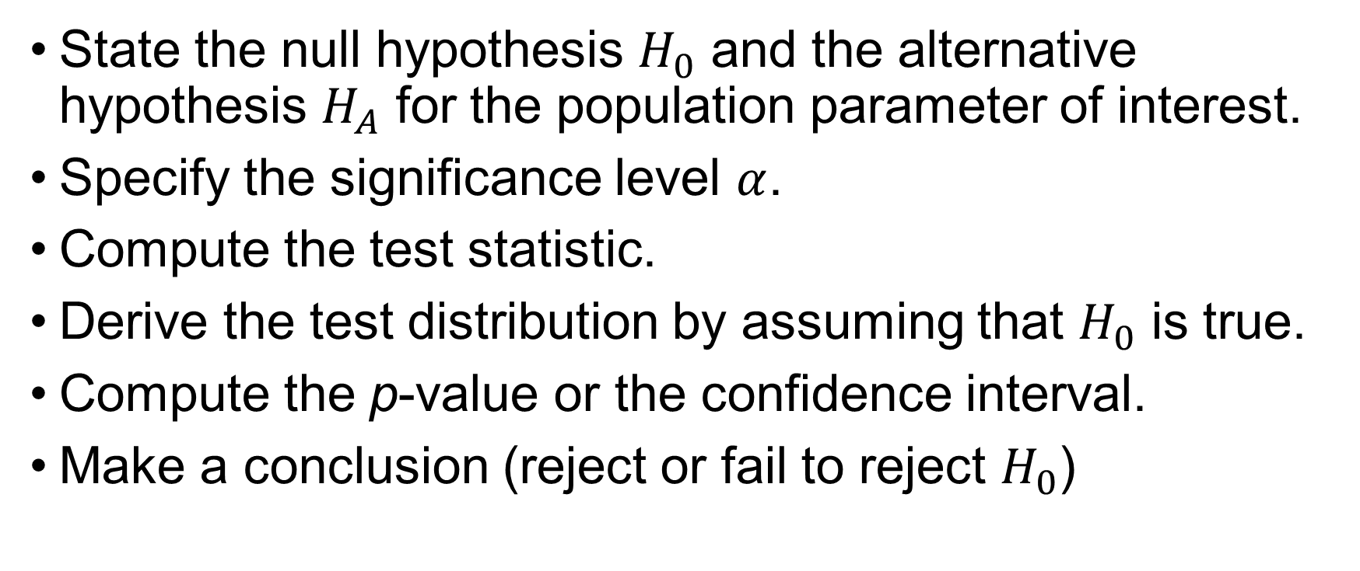
Hypothesis Testing Steps
State the null hypothesis $H_{0}$ and the alternative hypothesis $H_{A}$ for the population parameter of interest.
Specify the significance level $α$.
Compute the test statistic.
Derive the test distribution by assuming that $H_{0}$ is true.
Compute the p-value or the confidence interval.
Make a conclusion (reject or fail to reject $H_{0}$)

Slide 10
Hypothesis Testing and Proof by Contradiction
Proof by Contradiction
Hypothesis Testing
Proof by contradiction is a form of indirect proof.
It starts by assuming that the opposite proposition is true.
It then shows that such an assumption leads to a contradiction.
We want to prove that the alternative hypothesis is valid.
We assume that the null hypothesis is true.
We attempt to show that obtaining the observed sample statistic is a rare event (a contradiction).

Slide 11
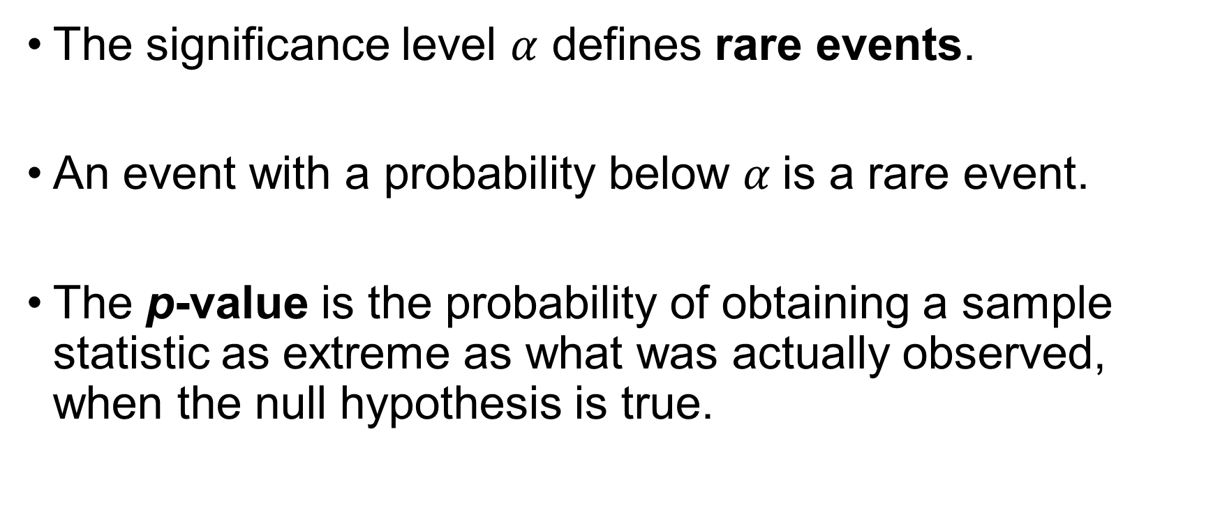
Significance Level and p-Value
The significance level $α$ defines rare events.
An event with a probability below $α$is a rare event.
The p-value is the probability of obtaining a sample statistic as extreme as what was actually observed, when the null hypothesis is true.

Slide 12

Null and Alternative Hypotheses for the Population Proportion
Two-Sided, “Not equal to” Alternative
$$H_{0}: p=p_{0} vs.{ H}_{A}: p≠p_{0}$$

Slide 13
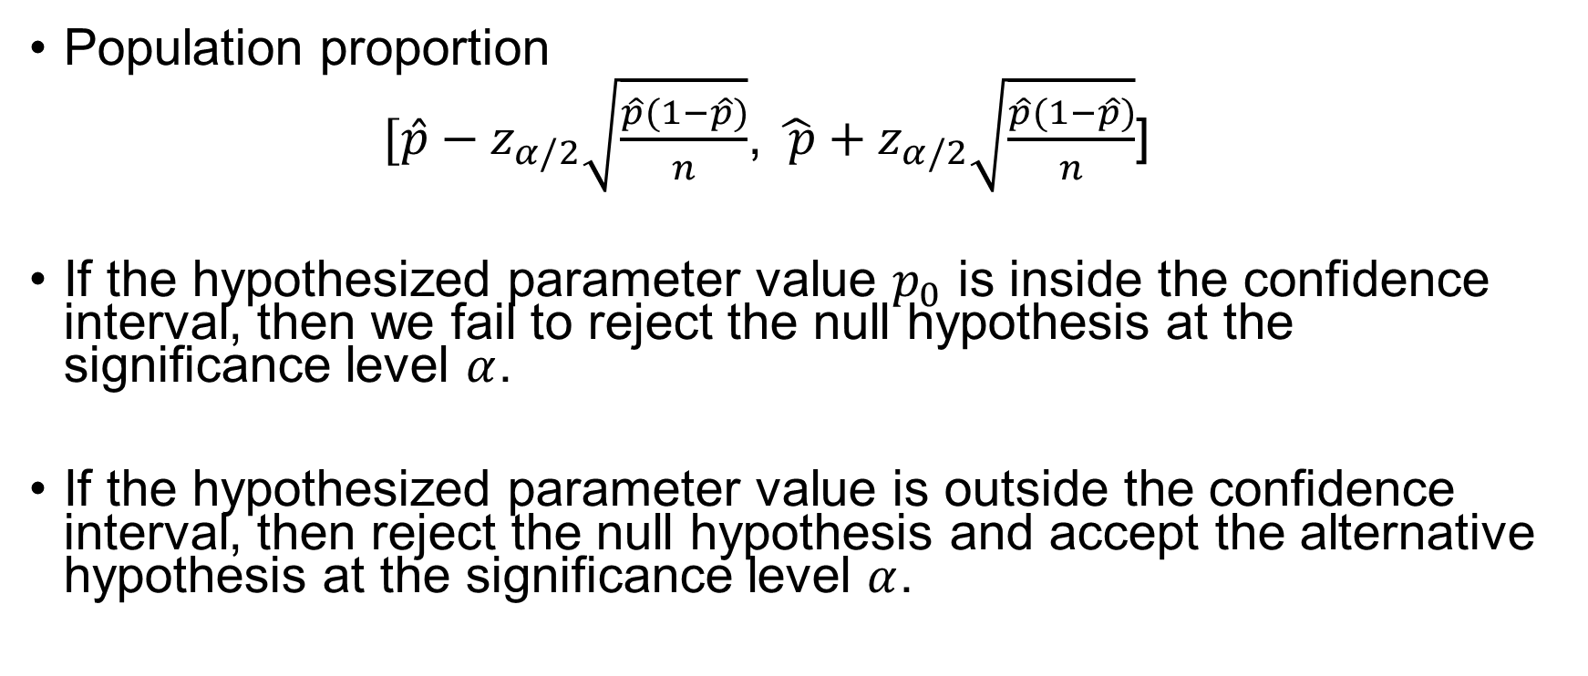
Testing Hypotheses Using Confidence Intervals
Population proportion
$[\hat{p}−z_{α/2}\sqrt{\frac{\hat{p}(1−\hat{p})}{n}}$, $\hat{ p}+z_{α/2}\sqrt{\frac{\hat{p}(1−\hat{p})}{n}}$]
If the hypothesized parameter value $p_{0}$ is inside the confidence interval, then we fail to reject the null hypothesis at the significance level $α$.
If the hypothesized parameter value is outside the confidence interval, then reject the null hypothesis and accept the alternative hypothesis at the significance level $α$.

Slide 14
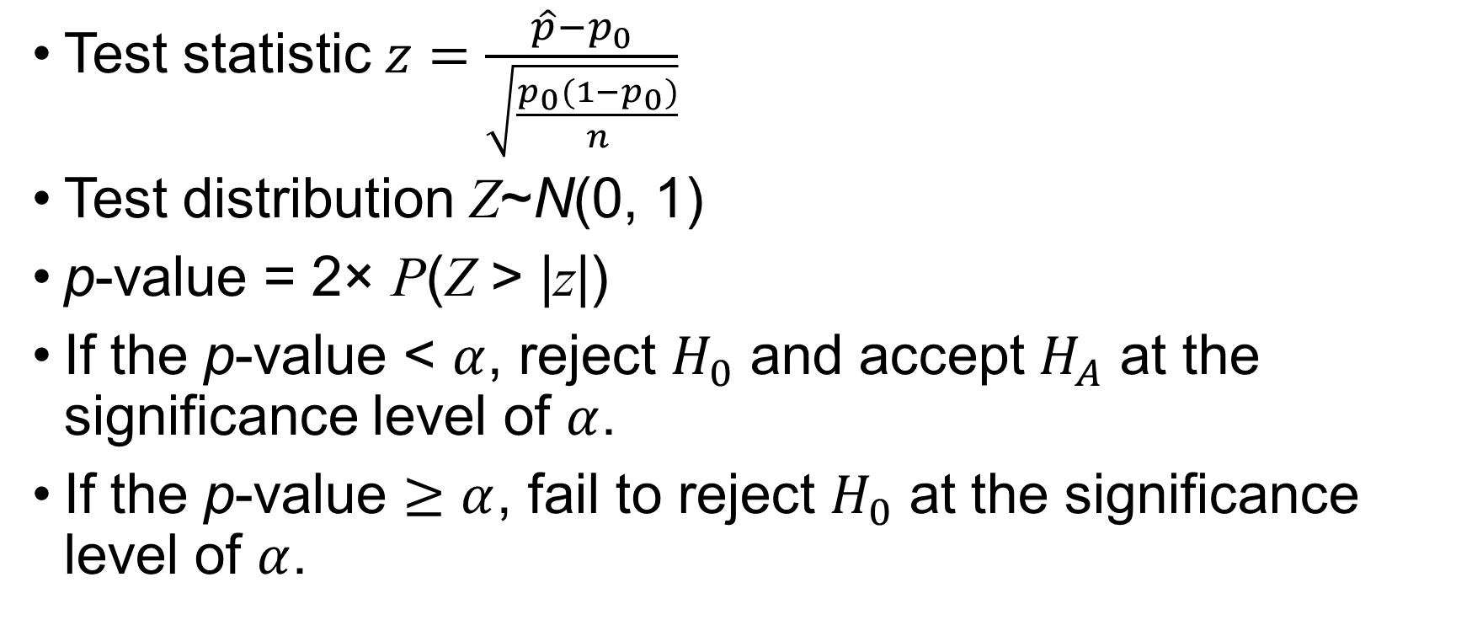
Testing Hypotheses Using the p-Values
Test statistic $z=\frac{\hat{p}−p_{0}}{\sqrt{\frac{p_{0}(1−p_{0})}{n}}}$
Test distribution Z~N(0, 1)
p-value = 2× P(Z > |z|)
If the p-value < $α$, reject $H_{0}$ and accept $H_{A}$ at the significance level of $α$.
If the p-value $≥α$, fail to reject $H_{0}$ at the significance level of $α$.

Slide 15
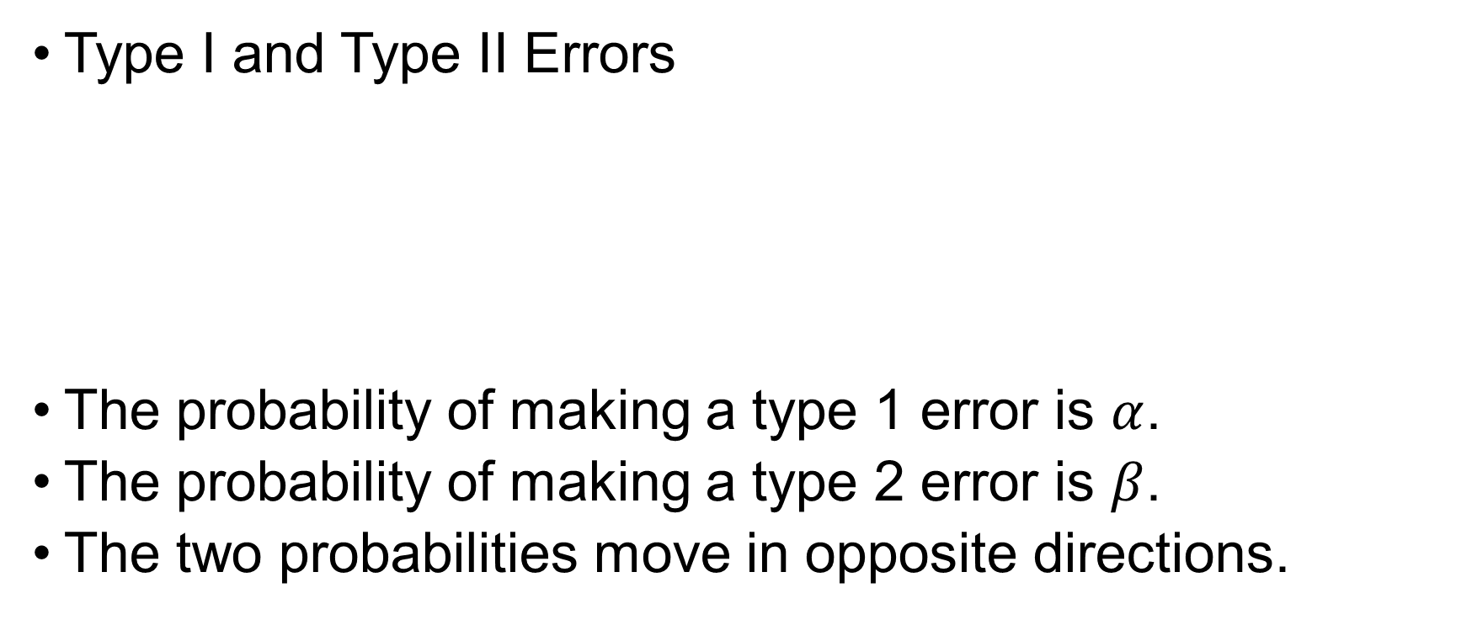
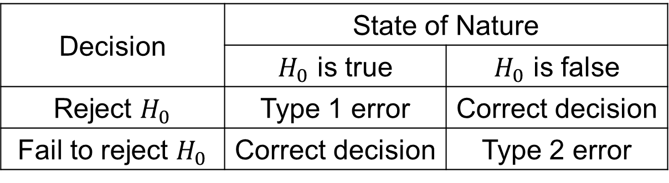
Decision Errors
Type I and Type II Errors
The probability of making a type 1 error is $α$.
The probability of making a type 2 error is $β$.
The two probabilities move in opposite directions.
Decision | State of Nature
 | $H_{0}$ is true | $H_{0}$ is false
Reject $H_{0}$ | Type 1 error | Correct decision
Fail to reject $H_{0}$ | Correct decision | Type 2 error

Slide 16
Exercise
The owner of a coin claims that the coin is fair. The coin was flipped 100 times and 45 heads were observed.
Construct a 95 percent confidence interval for the population proportion of heads.
Test the owner’ claim at the significance level of 5%.
What if 38 heads were observed?

