Slide 1
Chapter 1 Introduction

Slide 2
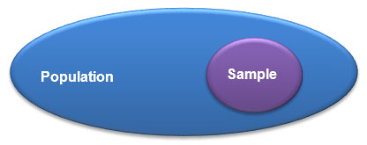
Population and Sample
A population is the set of all elements about which we wish to draw a conclusion.
A sample is a subset of the elements of a population.

Slide 3
Census vs. Sampling
Census: an examination of all elements of the population
Simple random sampling is the sampling technique such that each element of the population has an equal chance of being selected.
Sample size is the number of elements in a sample.

Slide 4
A Statistical Study
Population
Generalization
Sampling
Analysis
Sample
Notes:
Figure. Relationship between a population and a sample.

Slide 5
Exercise
Define the population and the sample in the following statistical studies
Election polls
Statistical quality control
Studies on lung cancer and smoking

Slide 6
Data
Data are facts and figures from which conclusions can be drawn.
A dataset refers to the data that are collected for a particular study
In a data set (data matrix), each row corresponds to an element, while each column corresponds to a variable.
Elements (Observations) may be people, objects, events, or other entries

Slide 7
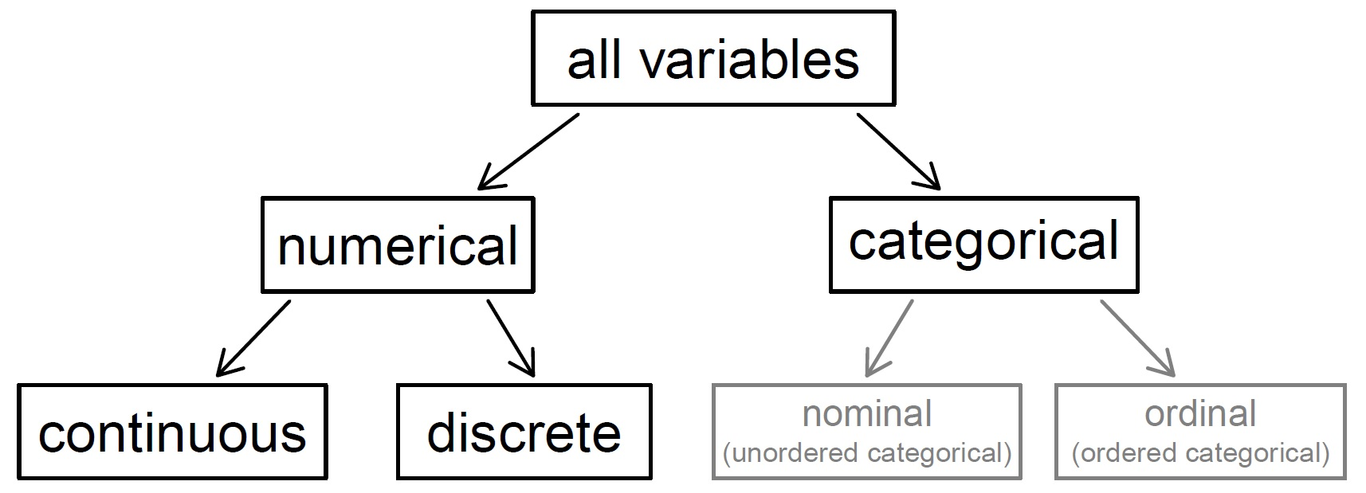
Variables
A variable is a characteristic of an element that can change or take on different values.

Slide 8
Variables (Cont’d)
Quantitative (numerical) variables: the possible measurements of the values are numbers that represent quantities.
A discrete variable takes numerical values with jumps.
A continuous variable can take any value in a range.
Qualitative (categorical) variables: the possible measurements fall into categories. Each category is called a level.
An ordinal variable is a qualitative variable with levels in order.
A nominal variable is a qualitative variable with levels not in order.

Slide 9
Exercise
Which variables are quantitative? Which variables are ordinal?
Industry
Race
Rank
Temperature
Weight
GDP
Level of agreement
ZIP code
Survey rating
Income levels

Slide 10
Relationships between Variables
A scatter plot is used to study the relationship between two quantitative variables.
Explanatory (independent) variable: placed on the x-axis
Response (dependent) variable: placed on the y-axis
A positive association is evidenced by an upward trend.
A negative association is evidenced by a downward trend.
Two variables are independent if there is no evident relationship.

Slide 11
Heights of Fathers and Their Full Grown Sons

Slide 12
Scatter Plot Showing Relationships

Slide 13
Cross-sectional and Time Series Data
Cross-sectional data are collected at the same or approximately the same point in time.
Time series data are collected over different time periods.

Slide 14
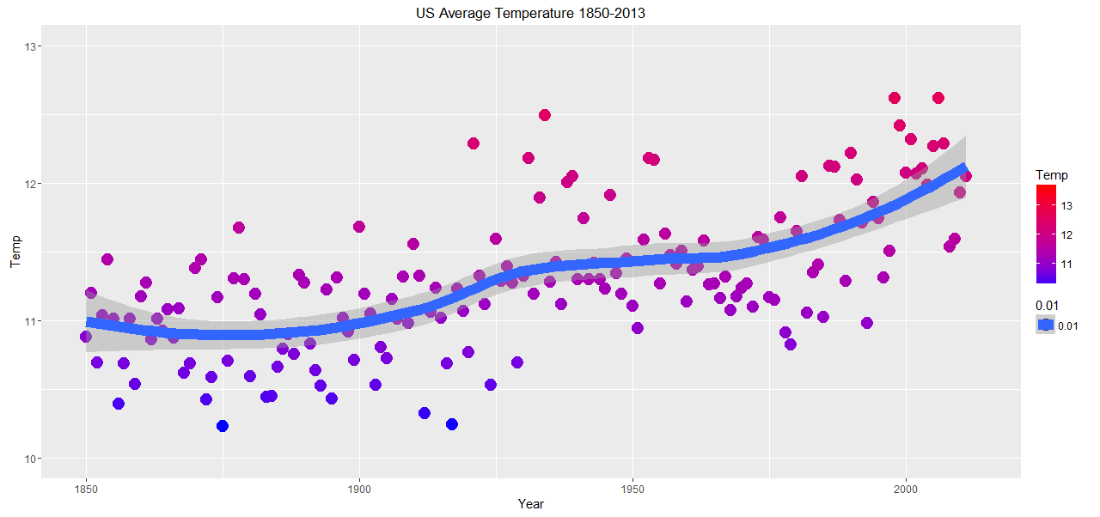
Time Series Plot (Runs Plot)
Notes:
Data source: Berkeley Earth

Slide 15
Bias
Simple random sampling helps minimize bias.
Non-response bias can skew results.
In a convenience sample, individuals who are easily accessible are more likely to be included in the sample. It is very likely to introduce bias.

Slide 16
Data Collection
In an experiment, there are a treatment group and a control group. The investigator randomly assigns subjects to either of the two groups.
In general, association does not imply causation, while a causational connection between an explanatory variable and a response variable can only be inferred from a randomized experiment.
In an observational study, the investigator does not interfere directly with how data arise.

Slide 17
Experiments and Observational Studies
A confounding variable is correlated with both the explanatory variable and the response variable in an observational study.
Experiment | Observational Study
“Treatment” randomly assigned | Observe only
Uses control group for comparison | No control group
Reports a cause and effect | Reports an association
Generalize to population | May (not) generalize to population

Slide 18
Exercise
Suppose an observational study tracked sunscreen use and skin cancer, and it was found that the more sunscreen someone used, the more likely the person was to have skin cancer.
What is the response variable? What is the explanatory variable?
Does this mean sunscreen causes skin cancer?
Which variable is likely to be confounding?

Slide 19
Exercise
A company testing the effectiveness of a new commercial for an established dog food brand recruited a large number of dog owners entering a shopping mall. They were randomly assigned to one of two small TV-viewing rooms. Both groups were shown identical videos about dog care, but one group also saw the new commercial for a particular brand of dog food. The participants were then given coupons to be redeemed in the shopping mall that day with the purchase of any brand of dog food. The managerial question is: should the new commercial be aired?
What is the population in the study? What is the sample in the study?
What is the response variable? What is the explanatory variable?
Briefly explain how the study can be used to answer the managerial questions.

Slide 20
Sampling Methods
Simple random sampling
Stratified sampling: strata + simple random sampling
Cluster sampling: clusters + sampling clusters
Multistage sampling: clusters + sampling clusters + simple random sampling in each selected cluster

Slide 21
Strata and Clusters
The strata are chosen so that similar observations are grouped together.
The variability within each cluster is expected to be high.

Slide 22
Experimental Design
Principles of randomized experiments
Controlling
Randomization
Replication
Blocking
Blocking is the strategy to group individuals into blocks before assigning them to the treatment group.
The variability within each block is lower.
A double-blind setup is employed to reduce bias.

Slide 23
Statistics
Statistics is the study of collecting, analyzing and interpreting data.
Descriptive statistics is the science of summarizing, characterizing and presenting data.
Inferential statistics is the science of making statements about the population using data collected from samples.

Slide 24
Summary Measures
Summary measures are numbers summarizing a set of observations.
A population parameter is a summary measure of the whole population.
A sample statistic is a summary measure of a sample.

Slide 25
Sampling Error
Variability – sample statistics may vary from one sample to another.
Uncertainty – sampling error is the difference between a sample statistic and the population parameter.
Statistics is the science on variability and uncertainty.

Slide 26
Exercise
A manufacturer of computer chips claims that less than 10% of his products are defective. When 1000 chips were drawn from a large production, 7.5% were found to be defective.
Describe the population and the sample in this statistical study.
Identify the variable of interest.
Describe the parameter of interest and the corresponding sample statistic.
Is the value 10% a parameter or a statistic?
Is the value 7.5% a parameter or a statistic?
Explain how the statistic can be used to make inferences on the parameter to test the claim.

Slide 27
Exercise
You are shown a coin that its owner says is fair in the sense that it will produce the same number of heads and tails when flipped a very large number of times.
Design an experiment to test the claim.
Describe the population and the sample in the study.
What is the parameter of interest?
Identify the relevant sample statistic.
Explain how statistical inference can be used to test the claim.
Do you believe that, if you flip a perfectly fair coin 100 times, you will always observe exactly 50 heads?

Slide 28
Statistical Analysis Procedure
Step 1. Problem definition
Step 2. Data preparation (collection, cleaning and transformation)
Step 3. Implementation of the analysis
Exploratory data analysis
Inferential data analysis
Step 4. Interpretation

Slide 29
Data Analysis with R
Data Visualization
Statistical Computing
Free Software Environment
Over 6,000 packages

Slide 30
Applications of Business Statistics
Market segmentation
Marketing response function estimation
Future demand prediction
Regression analysis of security price reaction to accounting disclosures
Fraudulent financial report detection
Investment strategy comparison
Quality control

