Slide 1
Chapter 2 Summarizing Data

Slide 2
Graphically Summarizing Qualitative Data
With qualitative data, names identify the different categories
Qualitative data can be summarized using a frequency distribution
Frequency distribution: A table that summarizes the number (or frequency) of items in each of the non-overlapping categories

Slide 3
Contingency Tables
A contingency table provides a tabular summary of data for two variables, one in rows and the other in columns.
A contingency table can be used to construct the frequency/relative frequency distribution of a categorical variable.
Aggregate, row and column proportions

Slide 4
Contingency Tables: “An Unusual Episode”
Survival Rate by Economic Status and Sex
Economic Status | Female | Male | Row Total
I (high) | 141/145 | 62/180 | 203/325
II | 93/106 | 25/179 | 118/285
III | 90/196 | 88/510 | 178/706
Column Total | 324/447 | 175/869 | 499/1316
Survival Rate by Economic Status and Age
Economic Status | Child | Adult | Row Total
I (high) | 6/6 | 197/319 | 203/325
II | 24/24 | 94/261 | 118/285
III | 27/79 | 151/627 | 178/706
Column Total | 57/109 | 442/1207 | 499/1316
Notes:
http://www.cs.toronto.edu/~delve/

Slide 5
Bar Plots and Pie Plots
A bar plot uses heights to compare frequencies.
Bar plots are useful in making comparisons of qualitative data.
A pie plot uses areas to compare frequencies.

Slide 6
Two-Variable Bar Plots
Stacked
Side-by-side
Standardized

Slide 7
Mosaic Plots
A mosaic plot uses box areas to represent frequencies.
One-variable
Side-by-side
Standardized

Slide 8
Graphically Summarizing Quantitative Data
A dot plot is a one-variable scatter plot. It is appropriate for small data sets.
A histogram displays the distribution of quantitative data by grouping observations into bins.
Observations are divided into non-overlapping classes (bins).

Slide 9
Shapes of Distributions
Number of prominent peaks
Unimodal
Bimodal
Multimodal
Skewness
Symmetrical
Positively skewed: a long tail extending to the right
Negatively skewed: a long tail extending to the left

Slide 10
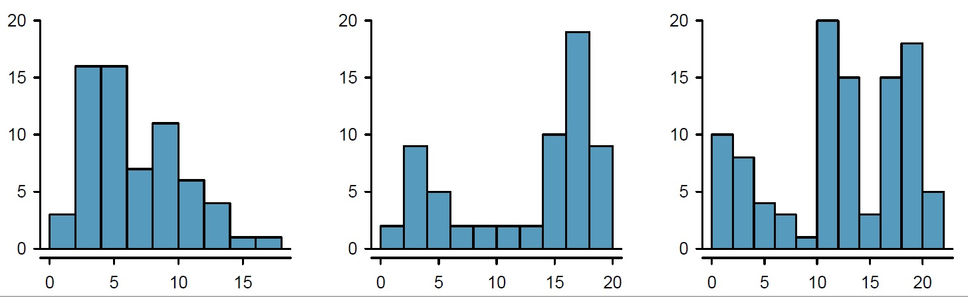
Prominent Peaks
Unimodal
Bimodal
Multimodal

Slide 11
Skewed Distributions

Slide 12
Transforming Data
If the data are strongly skewed, we sometimes transform them so they are easier to model.
A transformation is a rescaling of the data using a function. The goals include reducing skew, assisting in modeling, and linearization a relationship.
Common transformation functions
Logarithm
Square root
Inverse

Slide 13
Measures of Location
Mean
Sensitive to extreme values
Median
Insensitive to extreme values
Mode
Multimodal data – data contain at least two modes
Bimodal data – data contain exactly two modes

Slide 14
Simpson’s Paradox
A trend appears in different groups of data but disappears or reverses when these groups are combined.
Success Rates to Treat Kidney Stones
 | Treatment A | Treatment B
Small stones | 93% (81/87) | 87% (234/270)
Large stones | 73% (192/263) | 69% (55/80)
Both | 78% (273/350) | 83% (289/350)
Notes:
C. R. Charig; D. R. Webb; S. R. Payne; J. E. Wickham (29 March 1986). "Comparison of treatment of renal calculi by open surgery, percutaneous nephrolithotomy, and extracorporeal shockwave lithotripsy". Br Med J (Clin Res Ed). 292 (6524): 879–882.

Slide 15
Measures of Variability
Range
Highly influenced by extreme values
Variance
Average squared deviation from the mean
Standard deviation
Average deviation from the mean
Coefficient of variation
Standard deviation/Mean

Slide 16
Measures of Relative Standing
Percentiles
Approximately p percent of the observations have values less than the pth percentile
Quartiles
Q₁ = first quartile, or 25th percentile
Q₂ = second quartile, or 50th percentile
Q₃ = third quartile, or 75th percentile
z-score = $\frac{x_{i }− \overline{x}}{s}$

Slide 17
Empirical Rule
For data having a bell-shaped distribution,
within 1 standard deviation – 68%
within 2 standard deviations – 95%
within 3 standard deviations – almost all the data values
Outliers
Extreme values in a data set
Any data value with a z-score less than -3 or greater than +3 is an outlier.

Slide 18
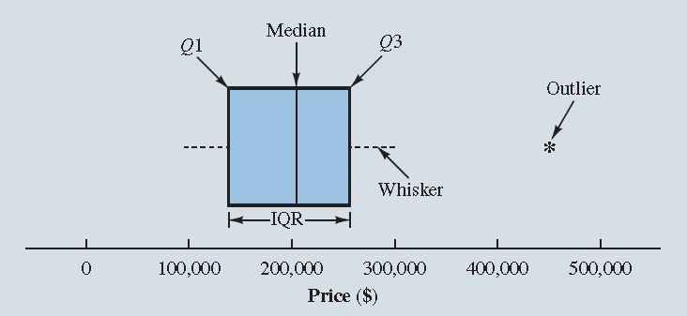
Box Plots
Graphical summary of the distribution of data

Slide 19
Comparing Numerical Data across Groups
Side-by-side box plots
Hollow histograms

