Slide 1
Chapter 3 Probability

Slide 2
Probability
A random process gives rise to an uncertain outcome.
The possible outcomes of a random process are called the sample space.
An event is a set of random outcomes.
The probability of an event is the chance that the event will occur.

Slide 3
Probability (Cont’d)
Let E be an event. P(E) denotes the probability that E will occur.
Conditions
0 ≤ P(E) ≤ 1
P(E) = 1, E is certain to occur
P(E) = 0, E can never occur
P(E)+P(E^{c}) = 1, E^{c} includes outcomes not in E and is called the complement of E.

Slide 4
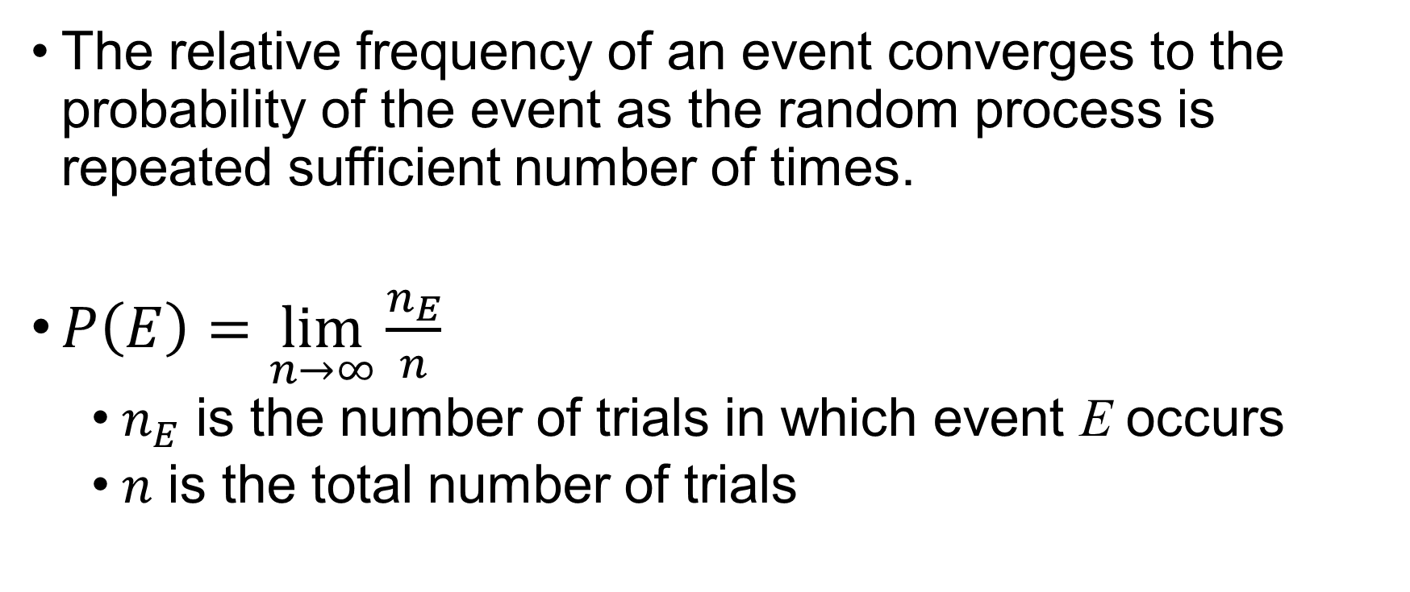
Probability and Relative Frequency
The relative frequency of an event converges to the probability of the event as the random process is repeated sufficient number of times.
$P\left(E\right)=\lim_{n→∞}{\frac{n_{E}}{n}}$
$n_{E}$ is the number of trials in which event E occurs
$n$ is the total number of trials

Slide 5
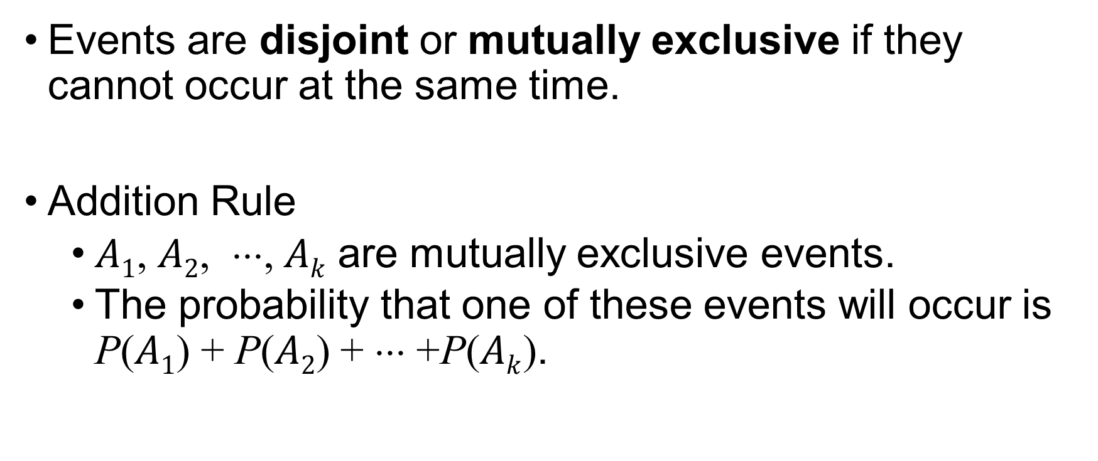
Disjoint Events
Events are disjoint or mutually exclusive if they cannot occur at the same time.
Addition Rule
$A1$, $A2$, ⋅⋅⋅, $Ak$ are mutually exclusive events.
The probability that one of these events will occur is P($A1$) + P($A2$) + ⋅⋅⋅ +P($Ak$).

Slide 6
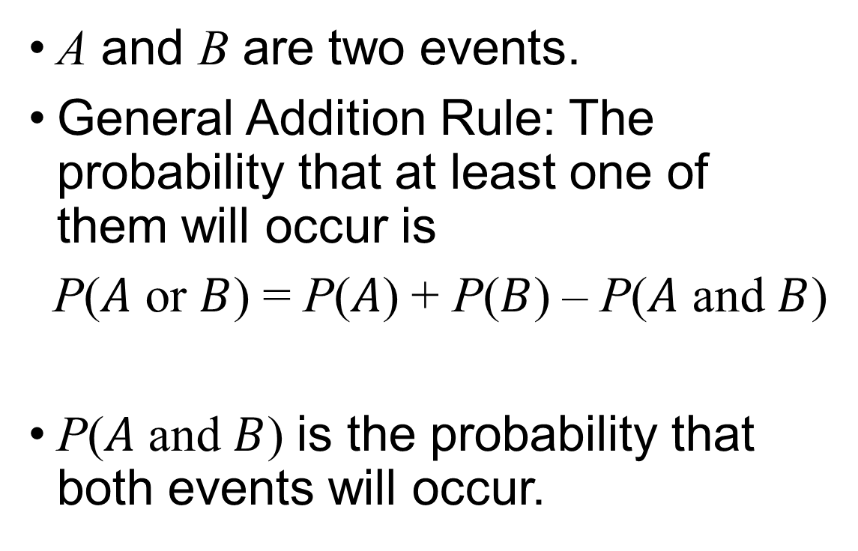
And / Or
A and B are two events.
General Addition Rule: The probability that at least one of them will occur is
P($A$ or $B$) = P($A$) + P($B$) – P($A$ and $B$)
P($A$ and $B$) is the probability that both events will occur.
A, but not B
A
A and B
B
B, but not A
Venn Diagram

Slide 7
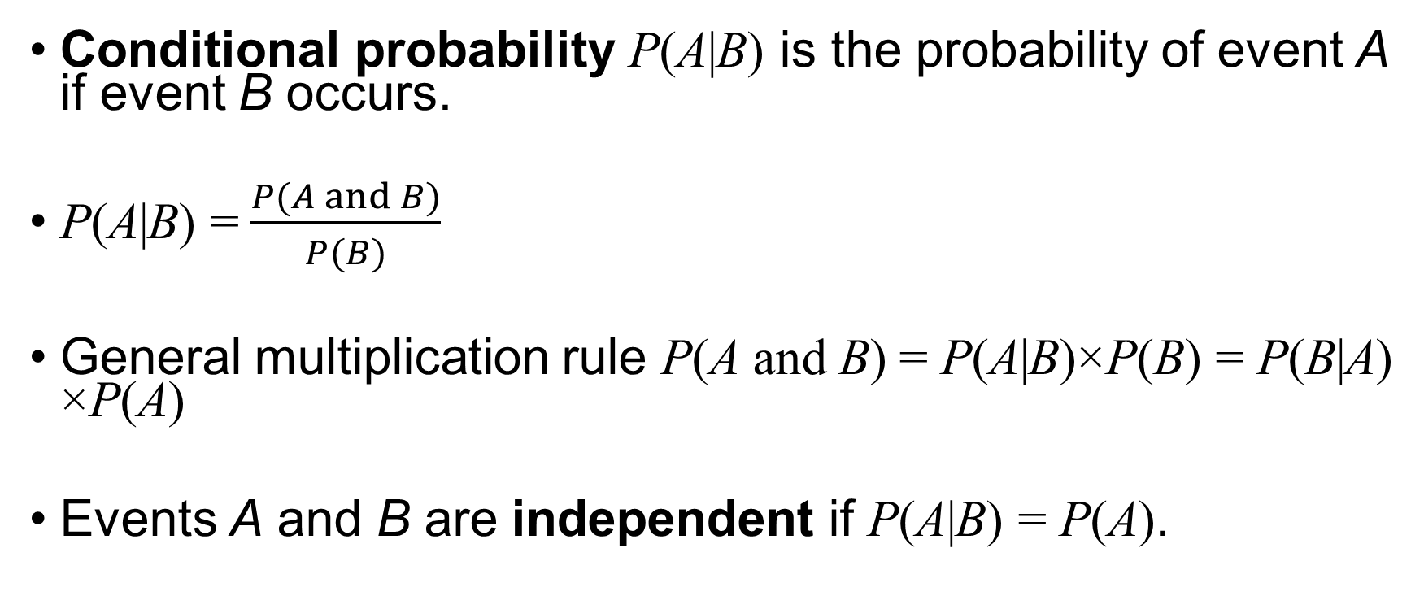
Conditional Probability
Conditional probability P(A|B) is the probability of event A if event B occurs.
P(A|B) = $\frac{P(A and B)}{P(B)}$
General multiplication rule P(A and B) = P(A|B)×P(B) = P(B|A) ×P(A)
Events A and B are independent if P(A|B) = P(A).

Slide 8
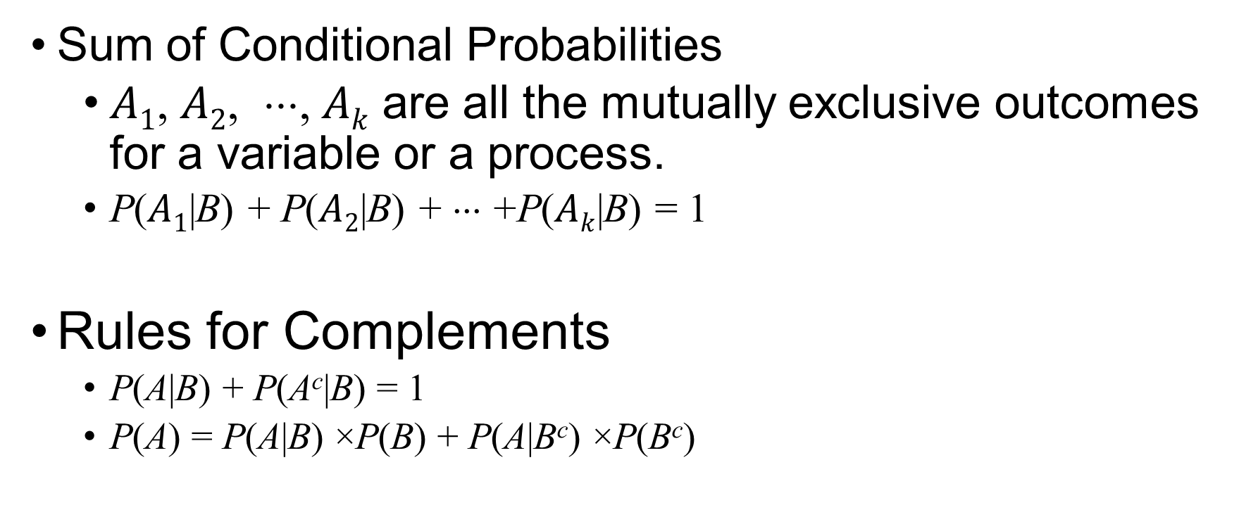
Conditional Probability (Cont’d)
Sum of Conditional Probabilities
$A1$, $A2$, ⋅⋅⋅, $Ak$ are all the mutually exclusive outcomes for a variable or a process.
P($A1$|B) + P($A2$|B) + ⋅⋅⋅ +P($Ak$|B) = 1
Rules for Complements
P(A|B) + P(A^{c}|B) = 1
P(A) = P(A|B) ×P(B) + P(A|B^{c}) ×P(B^{c})

Slide 9
Exercise
A fair die is rolled.
What is the probability of getting a “2”?
What is the probability of not getting a “2”?
What is the probability of getting an odd number?
What is the probability of getting a number greater than 2?
What is the probability of getting an odd number that is greater than 2?
What is the probability of getting an odd number or a number greater than 2?
Suppose that an odd number is observed. What is the probability of getting a number greater than 2?

Slide 10
Exercise
Two fair dice are rolled.
What is the probability that the two dice are equal?
What is the probability that the sum of the dice is 8?
What is the probability that the sum of the dice is greater than 3?
What is the probability that both of the dice are greater than 4?
What is the probability that the sum of the dice is 8, given that the sum is an even number?
What is the probability that the sum of dice is greater than 6, or an even number?

Slide 11
Exercise
A class has 18 female students and 12 male students. It is known that 6 female and 2 male students work full-time.
What is the probability that a randomly selected student is male?
What is the probability that a randomly selected student works full-time?
What is the probability that a randomly selected student is female or works full-time?
What is the probability that a randomly selected student is female and works full-time?
Suppose that a female student was randomly selected. What is the probability that this student works full-time?

Slide 12
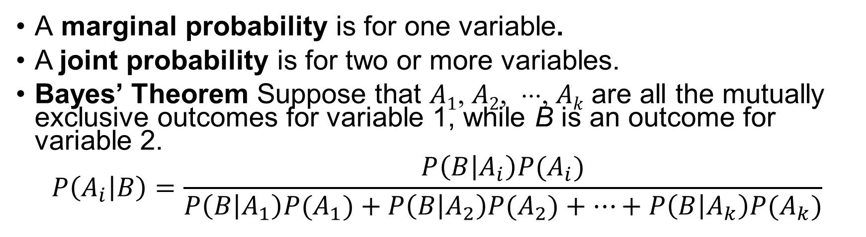
Contingency Table and Probabilities
 | Yes | No | Total
Positive | 10 | 30 | 40
Negative | 40 | 20 | 60
Total | 50 | 50 | 100
A marginal probability is for one variable.
A joint probability is for two or more variables.
Bayes’ Theorem Suppose that $A1$, $A2$, ⋅⋅⋅, $Ak$ are all the mutually exclusive outcomes for variable 1, while B is an outcome for variable 2.
$$P\left(A_{i} | B\right)=\frac{P\left(B | A_{i}\right)P(A_{i})}{P\left(B | A_{1}\right)P(A_{1})+P\left(B | A_{2}\right)P(A_{2})+⋯+P\left(B | A_{k}\right)P(A_{k})}$$

Slide 13
Tree Diagram
Yes, 0.25
0.4*0.25 = 0.1
Positive, 0.4
No, 0.75
0.4*0.75 = 0.3
Yes, 0.667
0.6*0.667 = 0.4
Negative, 0.6
No, 0.333
0.6*0.333 = 0.2
Marginal probabilities
Conditional probabilities
Joint probabilities

Slide 14
Exercise
A diagnostic test has a probability 0.95 of giving a positive result when applied to a person suffering from some disease, and a probability of 0.1 of giving a (false) positive when applied to a non-sufferer. It is estimated that 0.5% of the population are sufferers. The test is administered to a person.
What is the probability that the test will be positive?
What is the probability that, given a positive result, the person is a sufferer?
What is the probability that, given a negative result, the person is a non-suffer?
What is the probability that the person will be mismatched?

Slide 15
The Monty Hall Game Show Problem
In a TV Game show, a contestant selects one of three doors. There is a prize behind only one of the doors. After the contestant selects a door, the host opens one of the remaining doors, and reveals that there is no prize behind it. The host then asks the contestant whether she wants to SWITCH her choice to the other unopened door, or STICK to her original choice.
What is the probability of winning the prize after the contestant makes her original choice?
What is the probability of winning the prize if the contestant sticks to her original choice?
What is the probability of winning the prize if the contestant switches to the other unopened door?

Slide 16
Sampling from a Small Population
Sampling more than 10% of the population
Sampling without replacement
Events are not independent.
Sampling with replacement
Event are independent.

Slide 17
Exercise
Suppose that you have an urn containing 4 red, 3 blue and 3 green marbles.
What is the probability that the first marble you draw is red?
Suppose you draw a red marble in the first draw. If drawing with replacement, what is the probability of drawing a red marble in the second draw?
Suppose that you draw a blue marble in the first draw. If drawing with replacement, what is the probability of drawing a red marble in the second draw?
If drawing with replacement, what is the probability of drawing two blue marbles in a row?
What is your answer to each question above if drawing without replacement?

Slide 18
Random Variables
A random variable assumes numerical values determined by the outcome of a random process.
A discrete random variable assumes possible values that can be counted or listed.
The number of defective units in a batch of 20
The number of customers served every day
A continuous random variable may assume any numerical value in one or more intervals.
The waiting time for a credit card authorization
The rate of return of a stock

Slide 19
Discrete Random Variables
The probability distribution of a discrete random variable X is a table of all disjoint outcomes and their associated probabilities.
Probability distribution of the outcome to roll a fair die
Rules for Probability Distributions
The outcomes listed must be disjoint.
Each probability must be between 0 and 1.
The probabilities must total 1.
i | 1 | 2 | 3 | 4 | 5 | 6
x_{i} | 1 | 2 | 3 | 4 | 5 | 6
P(X = x_{i}) | 1/6 | 1/6 | 1/6 | 1/6 | 1/6 | 1/6

Slide 20
Discrete Random Variables (Cont’d)
Expected Value
The average of the outcomes.
μ_{X} = E(X) = x₁ P(X = x₁) + x₂ P(X = x₂) + ⋅⋅⋅ + x_{k} P(X = x_{k})
Variance
The variance and standard deviation measure the variability of a random variable.
σ_{X}² = Var(X) = (x₁ –μ)² P(X = x₁) + (x₂ –μ)² P(X = x₂) + ⋅⋅⋅ + (x_{k} –μ)² P(X = x_{k})
σ_{X} is the square root of the variance.

Slide 21
Linear Combinations of Random Variables
aX + bY is a linear combination of two random variables X and Y.
Expected value E(aX + bY) = aE(X) + bE(Y)
Variance Var(aX + bY)= a² Var(X)+ b² Var(Y) if X and Y are independent.

Slide 22
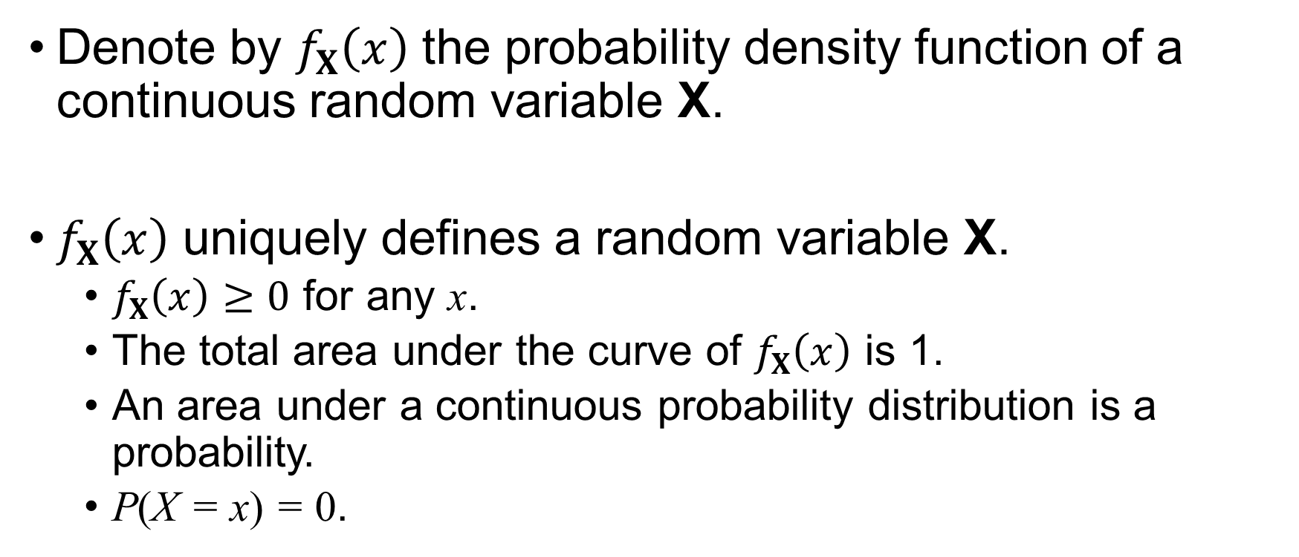
Continuous Random Variables
Denote by $f_{X}\left(x\right)$ the probability density function of a continuous random variable X.
$f_{X}\left(x\right)$ uniquely defines a random variable X.
$f_{X}\left(x\right)≥0$ for any x.
The total area under the curve of $f_{X}\left(x\right)$ is 1.
An area under a continuous probability distribution is a probability.
P(X = x) = 0.

Slide 23
Areas and Probabilities
P(x₁ < X < x₂)
P(X > x)
P(X < x)

