Slide 1
Chapter 4 Distributions of Random Variables

Slide 2
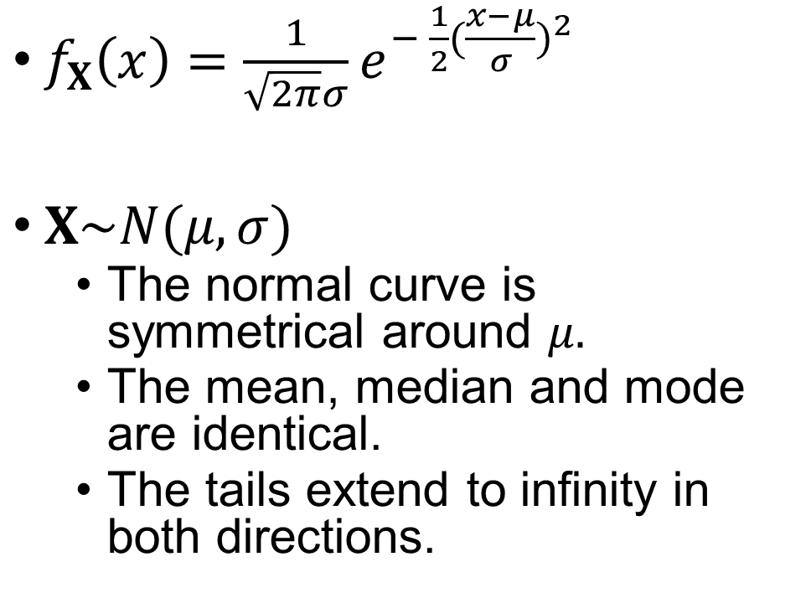
Normal Distribution
$f_{X}\left(x\right)=\frac{1}{\sqrt{2π}σ}e^{− \frac{1}{2}{(\frac{x−μ}{σ})}^{2}}$
$X\sim N(μ,σ)$
The normal curve is symmetrical around $μ.$
The mean, median and mode are identical.
The tails extend to infinity in both directions.

Slide 3


The Position and Shape of The Normal Curve
$$μ_{1}<μ_{2}$$
$$σ_{1}<σ_{2}$$
N(μ, σ₁)
N(μ₂, σ)
N(μ, σ₂)
N(μ₁, σ)

Slide 4
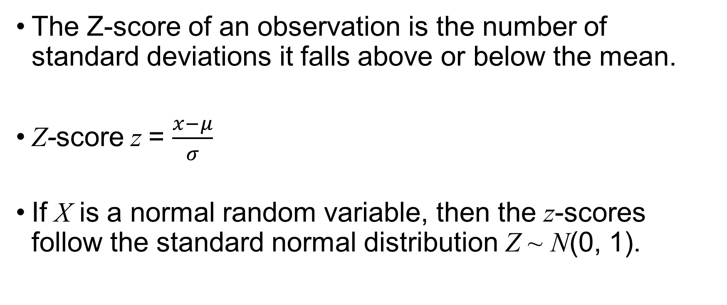
Z-Score
The Z-score of an observation is the number of standard deviations it falls above or below the mean.
Z-score z = $\frac{x−μ}{σ}$
If X is a normal random variable, then the z-scores follow the standard normal distribution Z ~ N(0, 1).

Slide 5
Three Important Percentages
N(μ, σ)

Slide 6
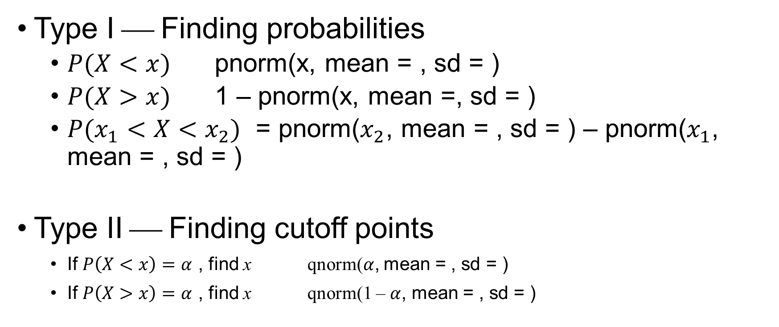
X~N(μ,σ): Two Types of Problems
Type I ⎯ Finding probabilities
$P(X<x)$ pnorm(x, mean = , sd = )
$P(X>x)$ 1 – pnorm(x, mean =, sd = )
$P(x_{1}<X<x_{2})$ = pnorm($x_{2}$, mean = , sd = ) – pnorm($x_{1}$, mean = , sd = )
Type II ⎯ Finding cutoff points
If $P\left(X<x\right)=α$ , find x qnorm($α$, mean = , sd = )
If $P\left(X>x\right)=α$ , find x qnorm(1 – $α$, mean = , sd = )

Slide 7


Critical Value $z_{α}$
Standard Normal Distribution $Z\sim N(0,1)$
Definition: $P\left(Z>z_{α}\right)=α$
z_{α} qnorm(1 – $α$)
α

Slide 8
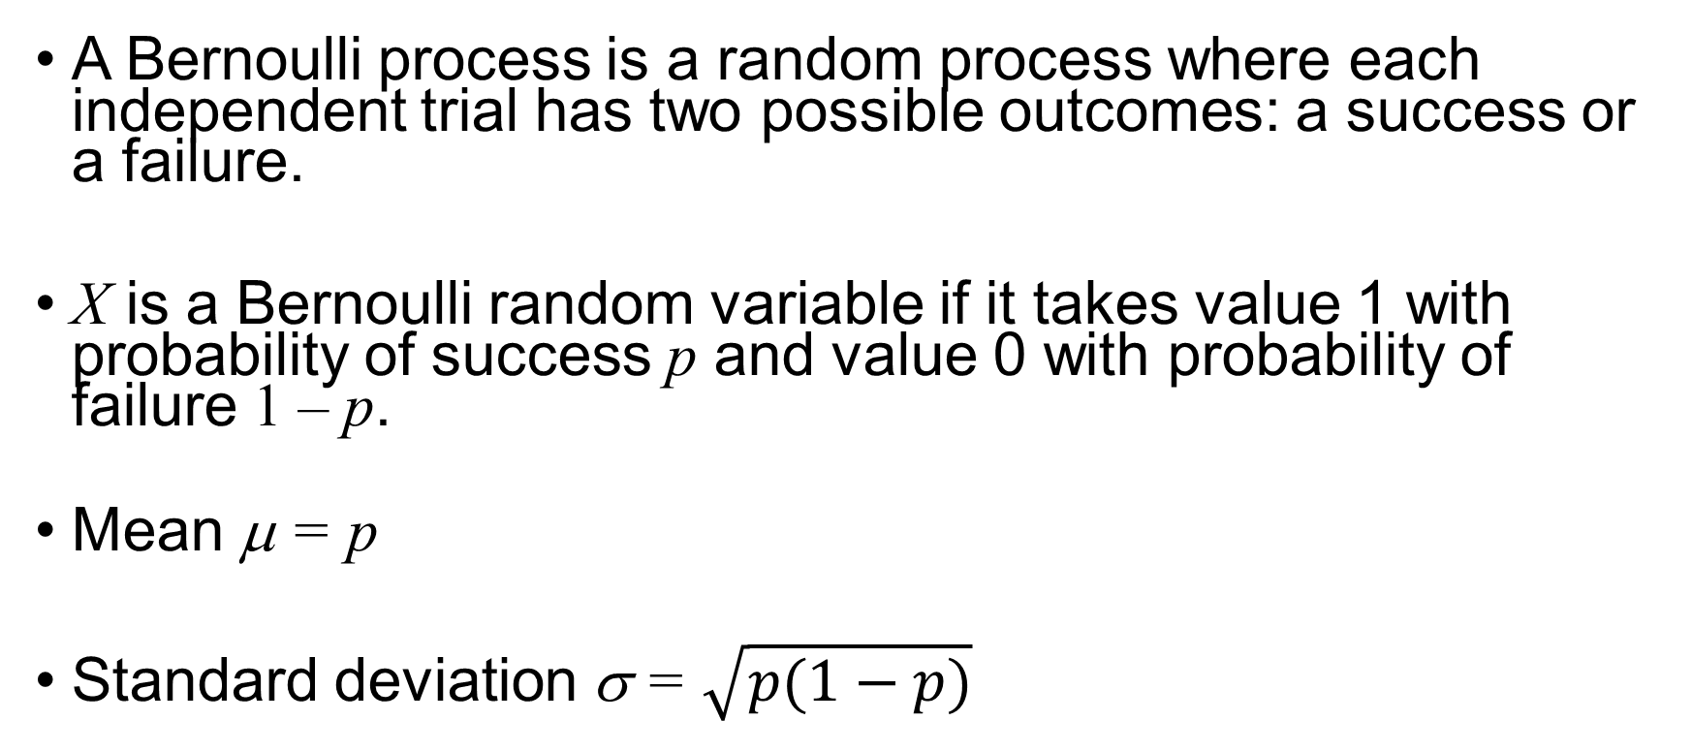
Bernoulli Distribution
A Bernoulli process is a random process where each independent trial has two possible outcomes: a success or a failure.
X is a Bernoulli random variable if it takes value 1 with probability of success p and value 0 with probability of failure 1 – p.
Mean μ = p
Standard deviation σ = $\sqrt{p(1−p)}$

Slide 9
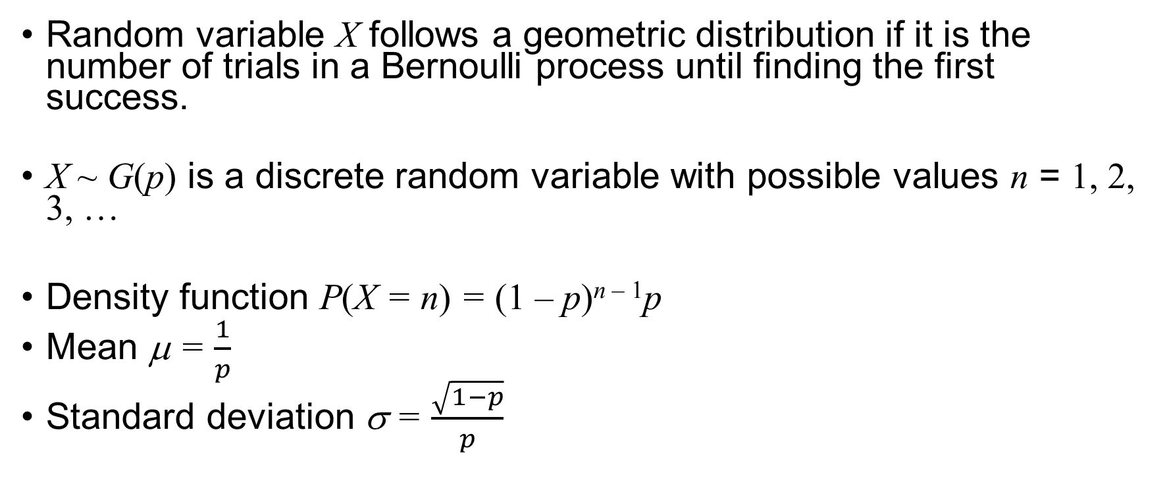
Geometric Distribution
Random variable X follows a geometric distribution if it is the number of trials in a Bernoulli process until finding the first success.
X ~ G(p) is a discrete random variable with possible values n = 1, 2, 3, …
Density function P(X = n) = (1 – p)^{n – 1}p
Mean μ = $\frac{1}{p}$
Standard deviation σ = $\frac{\sqrt{1−p}}{p}$

Slide 10
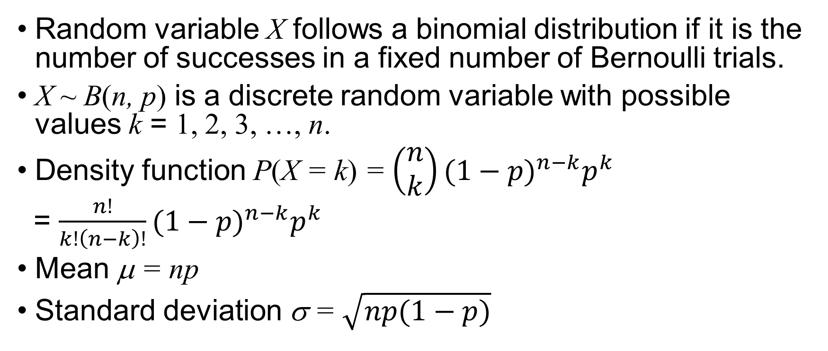
Binomial Distribution
Random variable X follows a binomial distribution if it is the number of successes in a fixed number of Bernoulli trials.
X ~ B(n, p) is a discrete random variable with possible values k = 1, 2, 3, …, n.
Density function P(X = k) = $\left(\begin{matrix}n \\ k\end{matrix}\right){(1−p)}^{n−k}p^{k}$
= $\frac{n!}{k!\left(n−k\right)!}{(1−p)}^{n−k}p^{k}$
Mean μ = np
Standard deviation σ = $\sqrt{np(1−p)}$

Slide 11
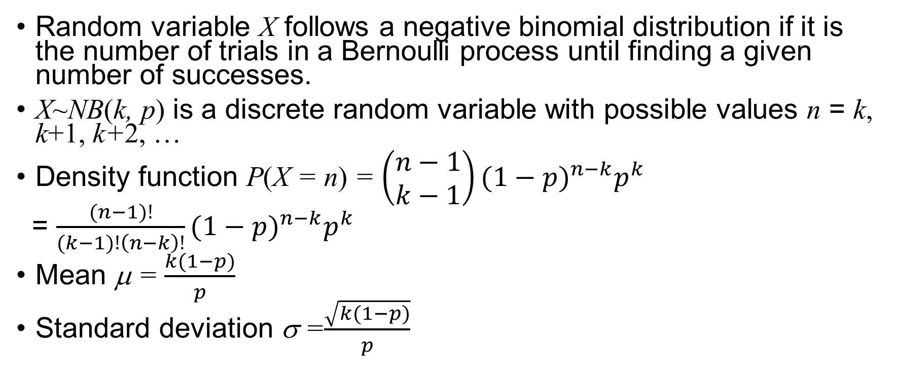
Negative Binomial Distribution
Random variable X follows a negative binomial distribution if it is the number of trials in a Bernoulli process until finding a given number of successes.
X~NB(k, p) is a discrete random variable with possible values n = k, k+1, k+2, …
Density function P(X = n) = $\left(\begin{matrix}n−1 \\ k−1\end{matrix}\right){(1−p)}^{n−k}p^{k}$
= $\frac{(n−1)!}{(k−1)!\left(n−k\right)!}{(1−p)}^{n−k}p^{k}$
Mean μ = $\frac{k(1−p)}{p}$
Standard deviation σ =$\frac{\sqrt{k(1−p)}}{p}$

Slide 12
Exercise
The defective rate of a machine is 3%. The production is considered a random process where each product is independent of the others.
What is the probability that the 10th product produced is the first with a defect?
What is the probability that in a batch of 100 products produced 4 units are defective?
What is the probability that the 100th product produced is the third with a defect?

