Slide 1
Qrisc32
5 stages RISC
1 Master Avalon Bus for instruction read
2 Masters Avalon Bus for memory read and write
32 General purpose 32-bits width registers
Has two flag in EX stage: Zero and Carry
Instruction and Data caches can be easy added(external modules)

Slide 2
Instruction set
Unconditional load to register
Unconditional store from register to memory
Unconditional jumps
Conditional relative jumps
ALU commands
Conditional load to register from register

Slide 3
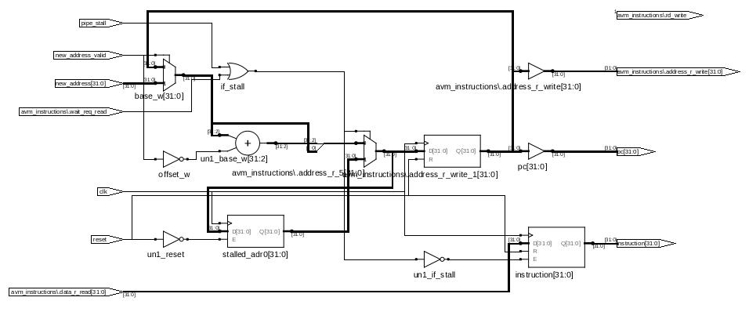
Instruction Fetch Stage
Fetching instruction from memory
Changing Program counter (PC)
Transfer PC value to next stage(for CALL, RETURN commands)

Slide 4
Instruction decode Stage
Decode instruction
Activates a lot of control signals to next stage
Read value from register
Contains WB stage(!)
WB stage writes value of registers from EX and MEM stage

Slide 5
Execution stage
Execute operates according to control signals from ID stage
Also, EX stage changes value of SRC2 register by values -4,-2,-1,0,1,2,4.
Forward result to WB stage(bypass Mem stage)

Slide 6
Mem Stage
Read and Write from-to memory
Contains internal pipeline for Avalon BUS Masters
Never stall for read and write(For read model is simplified, assumption is no cache miss or no delay from bus interconnect!)
Read operation is 2 cycles delay

Slide 7
Forwarding
EX stage forwards results to ID stages
WB stage is capable for write from 2 sources: EX(DST) and MEM(DST and SRC2) stages
ID stage can get register value from: EX or MEM or REG file.

Slide 8
Branch taken
Cycles for Branch taken is 4
Advantage is IF stage is simple
Disadvantage is big zero slot delay
For disadvantage requires effort for write efficient program

Slide 9
Instruction set
Format of Unconditional load to register
31 | 30 | 29 | 28 | 27 | 26 | 25 | 24 | 23 | 22 | 21 | 20 | 19 | 18 | 17 | 16 | 15 | 14 | 13 | 12 | 11 | 10 | 9 | 8 | 7 | 6 | 5 | 4 | 3 | 2 | 1 | 0
0 | 0 | 0 | 0 | type |  | Off | SRC2 INCR x |  |  |  | x | x | x | x | x | x | SRC2 |  |  |  |  | SRC1 |  |  |  |  | DST
Types of LDR operations: 0 - Rdst= Rsrc1, 1 - Rdst[31:16] = code[20:5] LDRH Rx,0x1234, 2 - Rdst[15:0] = code[20:5] LDRL Rx,0x5678, 3 - Rdst=[Rsrc1+offset]

Slide 10
Instruction set
Format of Unconditional store from register to memory
31 | 30 | 29 | 28 | 27 | 26 | 25 | 24 | 23 | 22 | 21 | 20 | 19 | 18 | 17 | 16 | 15 | 14 | 13 | 12 | 11 | 10 | 9 | 8 | 7 | 6 | 5 | 4 | 3 | 2 | 1 | 0
0 | 0 | 0 | 1 | xx |  | Off | SRC2 INCR x |  |  |  | x | x | x | x | x | x | SRC2 |  |  |  |  | SRC1 |  |  |  |  | DST
Types of STR operations: [Rsrc1+offset]=Rdst
STR Rdst,[Rscr1+offset],INCR2

Slide 11
Instruction set
Format of Unconditional jumps
31 | 30 | 29 | 28 | 27 | 26 | 25 | 24 | 23 | 22 | 21 | 20 | 19 | 18 | 17 | 16 | 15 | 14 | 13 | 12 | 11 | 10 | 9 | 8 | 7 | 6 | 5 | 4 | 3 | 2 | 1 | 0
0 | 0 | 1 | 0 | type |  | Off | SRC2 INCR x |  |  |  | x | x | x | x | x | x | SRC2 |  |  |  |  | SRC1 |  |  |  |  | DST
Types of Unconditional Jumps operations:
0 - jmp pc[25:0]=code[25:0]
1 - jmp pc=pc+offset(relaitive jump)
2 - call pc=pc+offset, Rdst=pc,(relative call)
3 - ret pc=Rdst

Slide 12
Instruction set
Format of Conditional relative jumps
31 | 30 | 29 | 28 | 27 | 26 | 25 | 24 | 23 | 22 | 21 | 20 | 19 | 18 | 17 | 16 | 15 | 14 | 13 | 12 | 11 | 10 | 9 | 8 | 7 | 6 | 5 | 4 | 3 | 2 | 1 | 0
0 | 0 | 1 | 1 | type |  | Off | SRC2 INCR x |  |  |  | x | x | x | x | x | x | SRC2 |  |  |  |  | SRC1 |  |  |  |  | DST
Types of Conditional Jumps operations:
0 – jmpz pc=pc+offset
1 – jmpnz pc=pc+offset
2 - jmpc pc=pc+offset
3 – jmpnc pc=pc+offset

Slide 13
Instruction set
Format of ALU operations
31 | 30 | 29 | 28 | 27 | 26 | 25 | 24 | 23 | 22 | 21 | 20 | 19 | 18 | 17 | 16 | 15 | 14 | 13 | 12 | 11 | 10 | 9 | 8 | 7 | 6 | 5 | 4 | 3 | 2 | 1 | 0
0 | 1 | 0 | 0 | type |  | Off | SRC2 INCR x |  |  |  | x | x | x | x | x | x | SRC2 |  |  |  |  | SRC1 |  |  |  |  | DST
Types of ALU operations:
0- AND, 1- OR, 2- XOR, 3- ADD, 4- MUL, 5-shift Rsrc1 left by Rscr2 ...0 MSB->C flag, 6-shift Rsrc1 right by Rscr2 ...0 LSB ->C flag, 7- compare

Slide 14
Instruction set
Format of Conditional load to register
31 | 30 | 29 | 28 | 27 | 26 | 25 | 24 | 23 | 22 | 21 | 20 | 19 | 18 | 17 | 16 | 15 | 14 | 13 | 12 | 11 | 10 | 9 | 8 | 7 | 6 | 5 | 4 | 3 | 2 | 1 | 0
0 | 1 | 0 | 1 | type |  | x | SRC2 INCR x |  |  |  | x | x | x | x | x | x | SRC2 |  |  |  |  | SRC1 |  |  |  |  | DST
Types of LDRF operations:
0-LDRZ Rdst=Rsrc1 if z=1, otherwise Rdst=Rsrc2
1-LDRNZ Rdst=Rsrc1 if z=0, otherwise Rdst=Rsrc2
2-LDRC Rdst=Rsrc1 if c=1, otherwise Rdst=Rsrc2
3-LDRNC Rdst=Rsrc1 if c=0, otherwise Rdst=Rsrc2

Slide 15
Instruction set
Common things for all instructions
31 | 30 | 29 | 28 | 27 | 26 | 25 | 24 | 23 | 22 | 21 | 20 | 19 | 18 | 17 | 16 | 15 | 14 | 13 | 12 | 11 | 10 | 9 | 8 | 7 | 6 | 5 | 4 | 3 | 2 | 1 | 0
x | x | x | x | type |  | off | SRC2 INCR x |  |  |  | x | x | x | x | x | x | SRC2 |  |  |  |  | SRC1 |  |  |  |  | DST
DST is register for write result of operation
SRC1 and SRC2 are registers to involve for obtaining result and write to DST
INCR SRC2, this field for increment of SRC2 register only by values:-4, -2, -1,0,1,2,4
Off is type of offset: 0- offset = code[24:10](signed),1 - offset = Rsrc2(signed)

Slide 16
Algorithms for the Sorting of 10 integers
Shell Sort
Modified Shell Sort
Bubble sort

Slide 17
Shell sort
ShellSort(int * a){
int inc,i,j,temp;
for(inc = 5;inc>0;inc=inc/2){
for (i = inc; i < 10; i+=1){
temp = a[i];
for (j = i; (j >= inc) && (a[j-inc] > temp); j =j-inc){
a[j] = a[j-inc];}
a[j] = temp;}
}

Slide 18
Modified Shell sort
for(inc = 20;inc>0;inc=inc/2){
  for (i = inc; i < 40; i+=4){
    temp = a[i];
    for (j = i; (j >= inc) && (a[j-inc] > temp); j =j-inc){
      a[j] = a[j-inc];}
    a[j] = temp;}
    }

Slide 19
Bubble sort
R0=mem[00],R1=mem[04],R2=mem[08],R3=mem[c],R4=mem[10]
R5=mem[14],R6=mem[18],R7=mem[1c],R8=mem[20],R9=mem[24]
R10=R0;R11=R0;//minimum
if R1<R11 then R11=R1; if R2<R11 thenR11=R2 ; if R3<R11 then R11=R3 ; if R4<R11 then R11=R4; if R5<R11 then R11=R5; if R6<R11 then R11=R6; if R7<R11 then R11=R7 ;if R8<R11 then R11=R8; if R9<R11 then R11=R9
mem[0]=R11;
for (i = 36; i > 0; i-=4){
if R0>R10 then R10=R0; if R1>R10 then R10=R1; if R2>R10 then R10=R2; if R3>R10 then R10=R3; if R4>R10 then R10=R4; if R5>R10 then R10=R5;
if R6>R10 then R10=R6; if R7>R10 then R10=R7;if R8>R10 then R10=R8; if R9>R10 then R10=R9
mem[i]=R10;
//substitute maximum by minimum
if R10=R0 then R0=R11; if R10=R1 then R1=R11 ; if R10=R2 then R2=R11; if R10=R3 then R3=R11; if R10=R4 thenR4=R11; if R10=R5 then R5=R11; if R10=R6 then R6=R11; if R10=R7 then R7=R11; if R10=R8 then R8=R11;
if R10=R9 then R9=R11;}

Slide 20
Performance of sorting algorithms
Shell – 842/612/176 cycles (543)
Modified Shell -712/669/519 cycles(633)
Bubble -455/455/455 cycles - 455!
First number for reverse order data
Second number for random order data
Third for already sorted data

