Slide 1
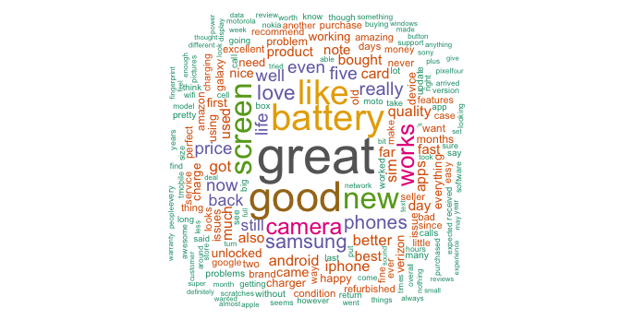

HELPFULNESS IN AMAZON REVIEWS
Nlp-1-online
Gaurav, Maria
Tamara, Dewsy
Kenny, Vu
Fast.ai Course

Slide 2
OUTLINE
What is this project about?
2. Data Preparation
3. Difficulties and Caveats
4. Experiments
5. Results and Conclusions
6. Future Scope
7. Bibliography

Slide 3
1. What is this project about?
The aim of this project is to train a LM that predicts if a given Amazon review is helpful/ not helpful.
Product categories
Each of us experimented with one of the following Amazon product categories from http://jmcauley.ucsd.edu/data/amazon/ :
Home and Kitchen
Electronics
Cell Phones and Accessories
Beauty
Grocery and Gourmet
Movies and TV

Slide 4
2. Data Preparation: The shape of our data
Amazon review schema
{"reviewerID": "A27IQHDZFQFNGG",
"asin": "616719923X",
"reviewerName": "Caitlin",
"helpful": [3, 4],
"reviewText": "Really good. Great gift for any fan of green tea! Just so expensive to purchase candy from across the sea.",
"overall": 4.0, "summary": "Yum!",
"unixReviewTime": 1381190400,
"reviewTime": "10 8, 2013"}
** We are mainly interested in the “helpful” and “reviewText” fields. The “helpful” field contains two values: the first number indicates the users that voted the review to be helpful/non-helpful, while the second number indicates the total of votes the review received.

Slide 5
3. Difficulties and Caveats
Only older data tracks helpful and non-helpful votes as a ratio; Amazon changed this functionality in recent years and now only allows for an absolute “count” of users who considered a review helpful.
Data Size: Even the “smaller” data sets took time to load, and the 8 mil reviews large “Books” data set required the use of Dask/Parquet file instead of Pandas for loading and initial processing.
What if spammers upvote their own content using their various “personas”? For illustration, the Cell Phone dataset contained a flagrant example: 8 identical reviews by 8 different users in 8 different products, each with exactly 8 “helpful” votes.
Data is unbalanced: There are more “helpful” reviews than “unhelpful” reviews in all domains we looked at.

Slide 6
4. References, Data preparation and clean-up process
We oriented ourselves on Chapter 10 (Howard, Gugger, 2020) for training NLP models
For perspective on how others had approached predicting helpfulness from Amazon reviews, we consulted Qu et al. And Alsmadi et al.
Following both (Qu et al.2016) And Alsmadi et al.(2020), we:
only kept product reviews with > 50 votes
Categorized a review as helpful when it is marked as helpful by > 75% of users
Only kept the first instance of duplicate reviews
The 50 vote barrier ensures that reviews have been rated by enough viewers to make the categorization somewhat meaningful and hopefully raises the difficulty for spammers upvoting their other personas in the event that they manage to differentiate their reviews enough to sneak through the “uniquing” process

Slide 7
4. Experiments
Balanced versus Unbalanced Data
LM Finetuning
Learning Rate Finder
Further Techniques

Slide 8
4. Experiments
Unbalanced versus Balanced
One category (“Helpful”) represents majority of the data . For example, 85% of cleaned
Electronics data consists of “helpful” reviews.
To avoid training the classifier to simply recognize the more frequently occurring category,
we trained on both “balanced” (50% helpful, 50% unhelpful) and “unbalanced” (maintaining original ratio by doing stratified splits) data for comparison.
Language Model Fine Tuning
To increase accuracy, we tried fine-tuning the LM (using the same pre-trained model as
in Chapter 10) first with smaller, then larger amounts of data.

Slide 9
4. Experiments
Learning Rate Finder
We started our experiments before the introduction of the learning rate finder
in the book – further experimentation with the learning rate finder helped avoid
overfitting.
Further Experiments
Gaurav further finetuned performance by expanding to the largest of the “small” dataset (+8 mil. Reviews) and backwards-trained the classifier.

Slide 10
5. Results – Unbalanced Data
Domain | Training Loss | Validation Loss | Accuracy | Workbook
Books – 86K LM | 0.3675 | 0.3591 | 0.8484 | Link to Notebook
Electronics – 4K LM | 0.4679 | 0.4732 | 0.7886 | https://github.com/postprandial/fastai-amazonreview/blob/main/Electronics/Electronics%20-%20Model(4).ipynb
Electronics – 19K LM | 0.5229 | 0.5242 | 0.7512 | https://github.com/postprandial/fastai-amazonreview/blob/main/Electronics/Electronics%20-%20Model-LM-v2.ipynb

Slide 11
5. Results – Balanced Data
Domain | Training Loss | Validation Loss | Accuracy | Workbook
Electronics | 0.2017 | 0.2455 | 0.9157 | Link to Notebook
Grocery&Gourmet | 0.3241 | 0.6425 | 0.8000 | https://github.com/postprandial/fastai-amazonreview/tree/main/Groceries_and_Gourmet_Food

Slide 12
6. Future Scope
Different Loss Functions
- Experiment with different loss functions, especially the ones that are known to work well with unbalanced datasets (e.g. Weighted Focal Loss)
Cross domain model applicability
- Test how the language models & the classification models work across domains, like Books & Electronics (e.g. Are they effective if we use them across domains to identify helpful reviews?)
Data Augmentation
- Use techniques such as Back Translation to study its effects on model predictability
Model Interpretability
Understand how & why the text classifier model is making the predictions that it does
Use toolkits like Language Interpretability Tool
E.g. Negative reviews appear more likely to be tagged as unhelpful

Slide 13
7. Bibliography
Abdalraheem Alsmadi, Mahmoud Al-Ayyoub, Shadi AlZu’bi, Yaser Jararweh.
Predicting Helpfulness of Online Reviews (2020). Jordan University of Science
And Technology & Al Zaytoonah University of Jordan
Jeremy Howard, Sylvain Gugger. Deep Learning for Coders with fastai &
PyTorch (2020). O’Reilly.
R. He, J. McAuley. Ups and downs: Modeling the visual evolution of fashion trends with one-class collaborative filtering (2016). WWW.
Xianshan Qu, Xiaopeng Li, Csilla Farkas, John Rose. An Attention Model
of Customer Expectation to Improve Review Helpfulness Prediction (2020).
CSE Department, University of South Carolina, Columbia

