Slide 1
British Airways – Task 1
Parth Desai

Slide 2
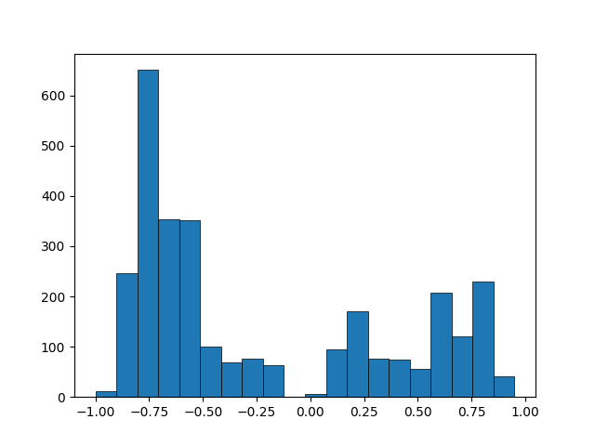

Results
Passenger Sentiment Analysis
The key topics in the flight reviews were people discussing their experiences with the service, staff, and crew.
Count
Sentiment
The histogram above indicates that most passengers (64%) wrote a negative review about their flight and the magnitude of their negative reviews were more severe

