Slide 1
Category review: Chips
June 2020
Retail Analytics
Brand note: If client logo is not required, use alternate title page layout right click slide thumbnail > Layout > Title

Slide 2
Notes:
To view Privacy video explaining how important data privacy is to Quantium, please click here: https://www.youtube.com/watch?v=Zq1QDAkoRzU
or here Q:\Company Reference\Brand & Design\Brand videos\Q Privacy.mp4
At Quantium, we believe that data is the behavioural footprint of humanity and that it has to be treated with the utmost care and responsibility.
Histories, attitudes, indeed lives are stored within it in ways that aren’t always apparent – and that’s what makes its potential so powerful.
To work with it responsibly, sensitively, we set ourselves the highest data privacy protection and governance standards.
We have spent 17 years perfecting privacy-by-design and secure-by-design principles. Central to this is not holding any personally identifiable information about people –
we neither receive it, and put the necessary protections in place to be unable to decipher it.
Every aspect of handling data is safeguarded: from its de-identification, to its encryption – data security is paramount and of the highest grade.
We pride ourselves on gaining the trust of iconic organisations around the world through years of securely working with their data,
and in turn the trust that builds with their stakeholders.

Slide 3
Executive summary
01
Chips Category Review
Chips produced by Doritos and Kettle-branded chips were the top 2 most bought chips with the highest volumes bought
02
During the trial period, 2 out of 3 trial stores experienced a statistically significant increase in total Sales and number of customers
Trial Store Analysis

Slide 4
01
Top Chips

Slide 5
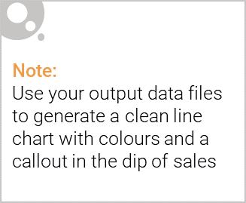
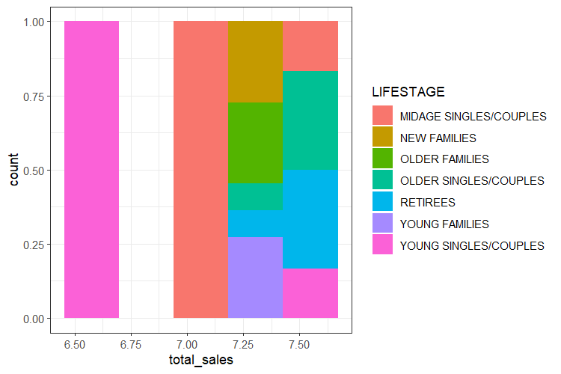
The primary observed group was Mid-Age Singles and Couples

Slide 6

Mainstream Mid-age and young singles and couples are more willing to pay more per packet of chips compared to their budget and premium counterparts.
This may be due to premium shoppers being more likely to buy healthy snacks and when they buy chips, this is mainly for entertainment purposes rather than their own consumption.
This is also supported by there being fewer premium Mid-age and young singles and couples buying chips compared to their mainstream counterparts.

Slide 7
02
Trial store performance

Slide 8
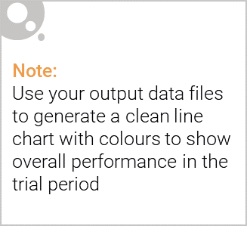
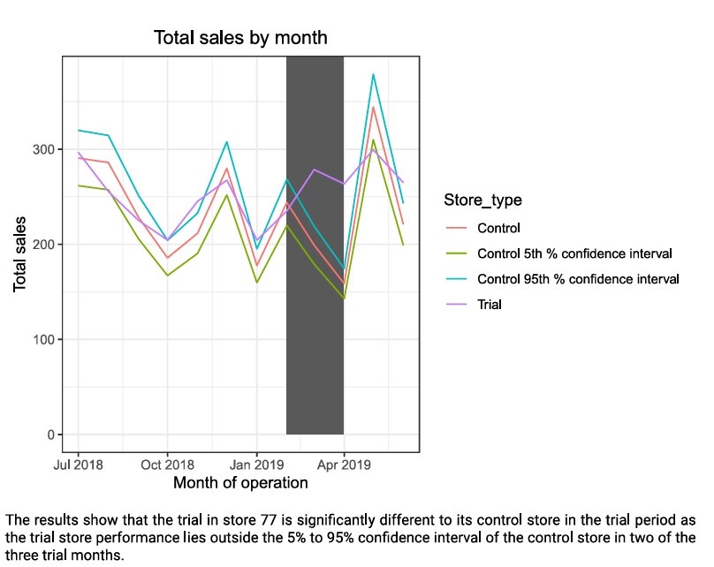
Control store vs Store 77

Slide 9
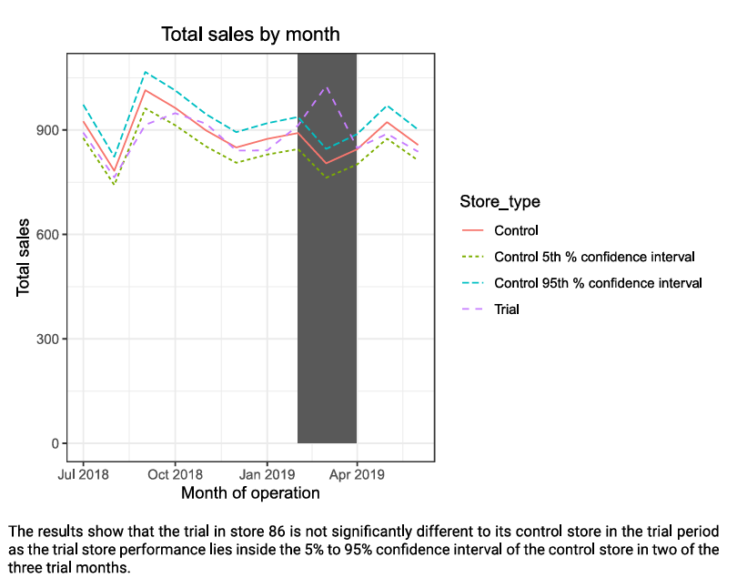
Control store vs Store 86

Slide 10
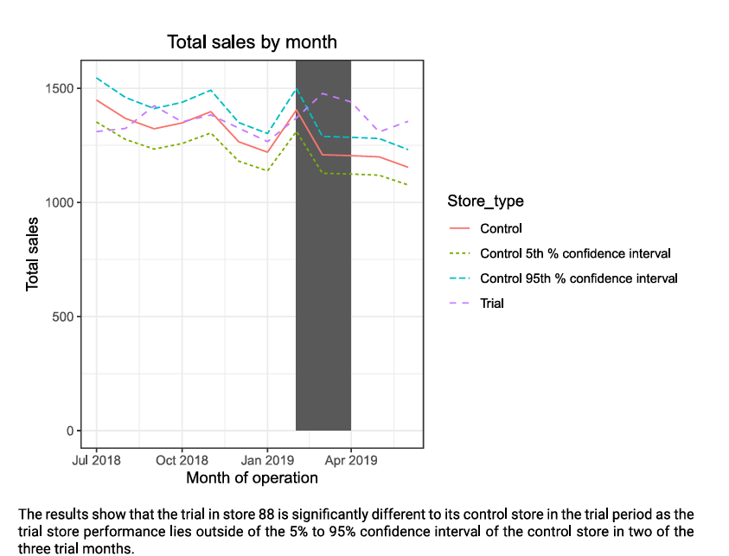
Control store vs Store 88

