Slide 1
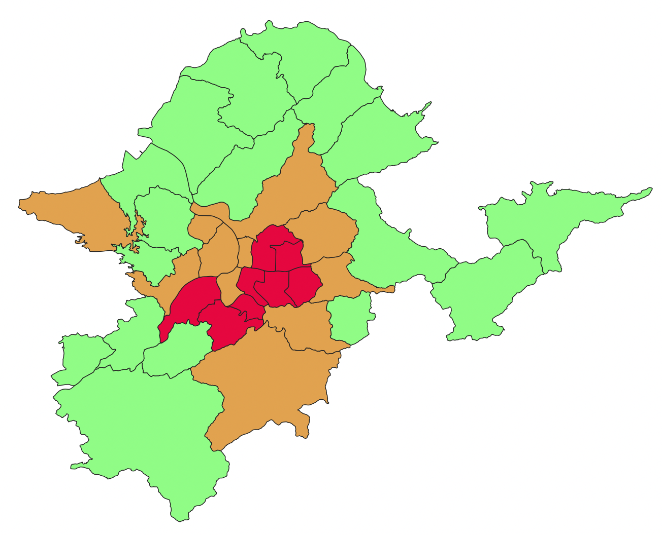
 | Downtown
 | Uptown
 | Country

