Slide 1

Response to LTI System
Chiranjeevi Yarra
06 / 04/ 2026

Slide 2
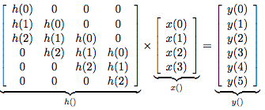
Matrix multiplication form of convolution

Slide 3
Graphical illustration of convolution

Slide 4

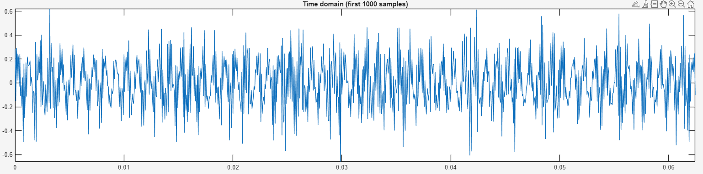
Let’s understand the signal

Slide 5
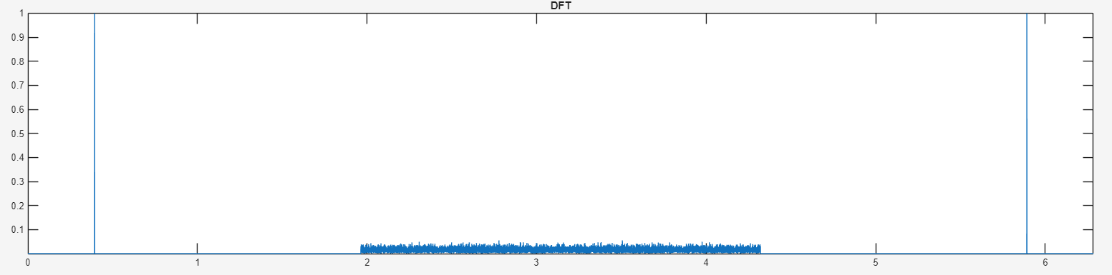
Let’s plot magnitude of DFT

Slide 6

Thank you

