Slide 1

Filters
Chiranjeevi Yarra
16 / 04/ 2026

Slide 2

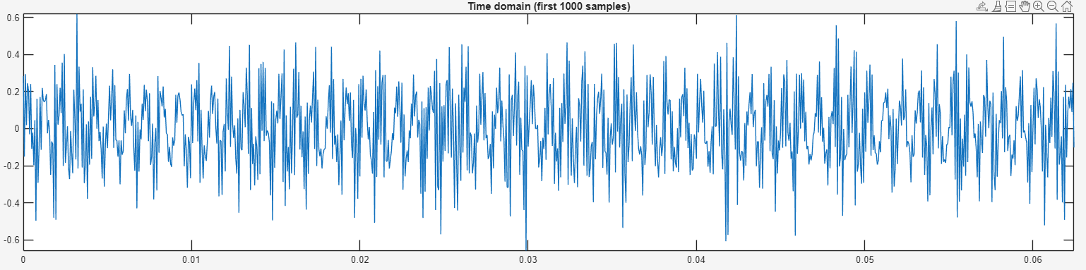
For an example signal to remove crickets sound

Slide 3
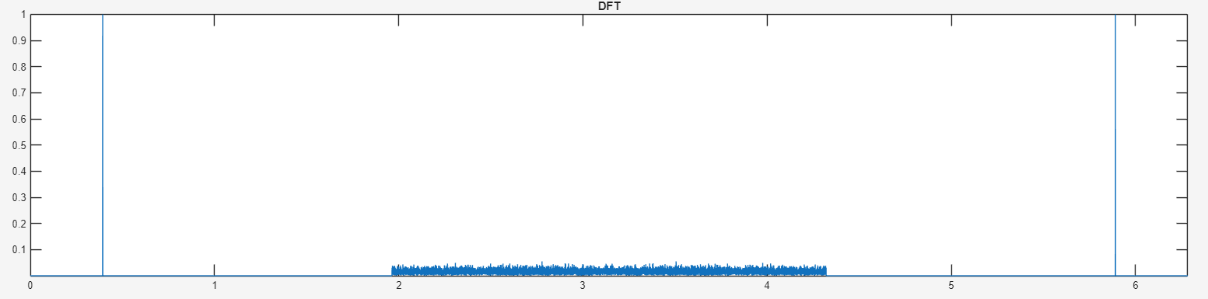
Magnitude of DFT

Slide 4
Given the signal

Slide 5
Understand using DTFT and DFT

Slide 6
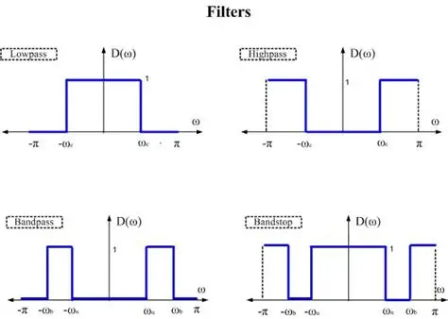
Ideal filter characteristics

Slide 7
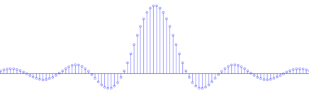
Ideal filter impulse response

Slide 8
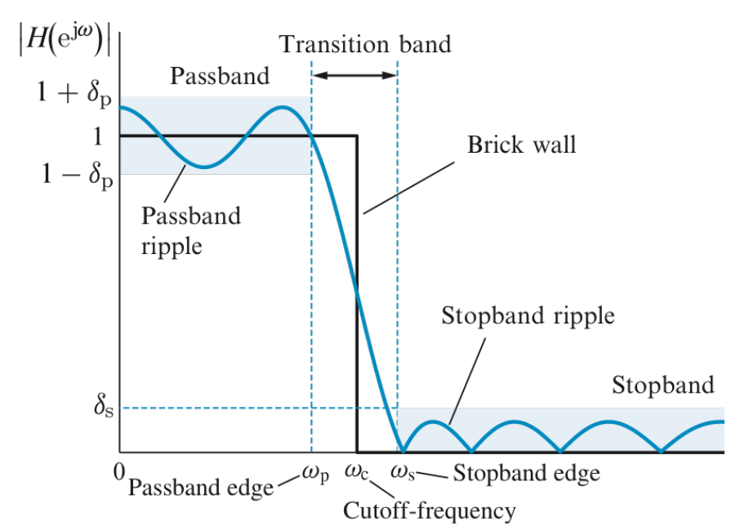
Practical filter characteristics

Slide 9

Thank you

