Slide 1

Discrete Time System?
Chiranjeevi Yarra
20 / 02/ 2026

Slide 2

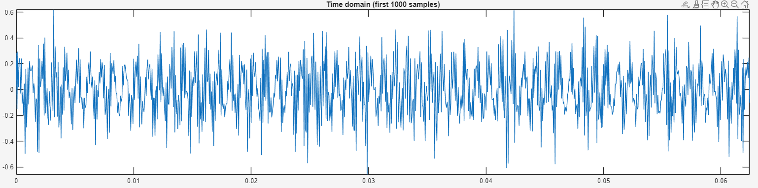
Let’s understand the signal

Slide 3
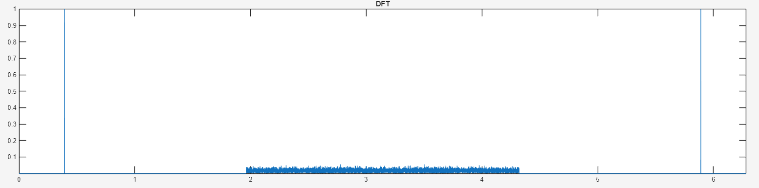
Let’s plot magnitude of DFT

Slide 4
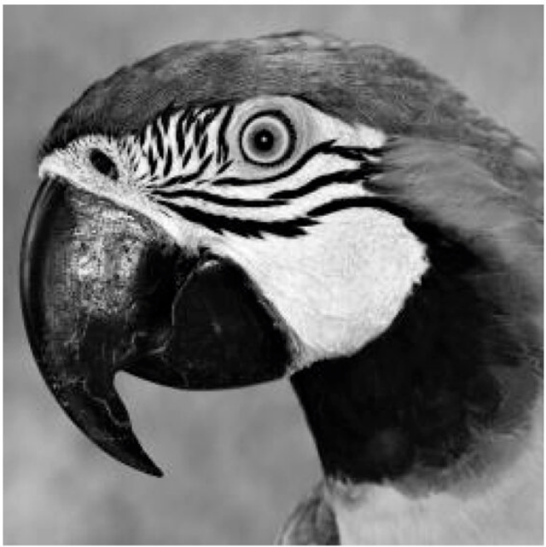
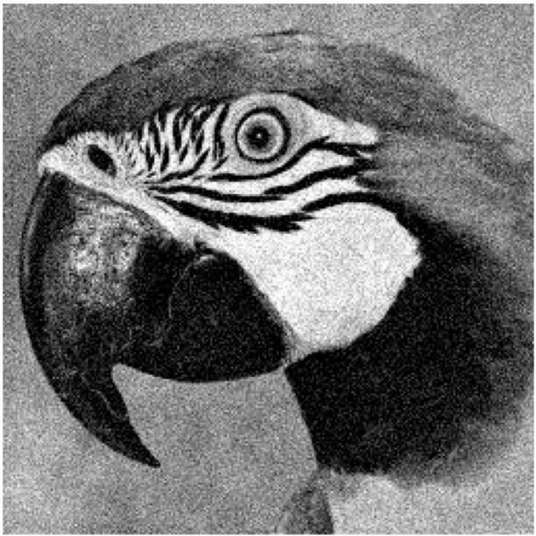
Same with images also

Slide 5

Thank you

