Slide 1
离散数学 （一）
集合论
苏宙行
华中科技大学 计算机学院 智能所 EDA团队
suzhouxing@hust.edu.cn
课程QQ群：694871331
微助教课程号：MG158
2024-02-26

Slide 2
Basic Structures: Sets, Functions, Sequences, Sums
Chapter 2

Slide 3
Chapter Summary
Sets
The Language of Sets
Set Operations
Set Identities
Functions
Types of Functions
Operations on Functions
Computability
Sequences and Summations
Types of Sequences
Summation Formulae
Set Cardinality
Countable Sets

Slide 4
Sets
Section 2.1

Slide 5
Section Summary 1
Definition of sets
Describing Sets
Roster Method
Set-Builder Notation
Some Important Sets in Mathematics
Empty Set and Universal Set
Subsets and Set Equality
Cardinality of Sets
Tuples
Cartesian Product

Slide 6
Introduction
Sets are one of the basic building blocks for the types of objects considered in discrete mathematics.
Important for counting.
Programming languages have set operations.
Set theory is an important branch of mathematics.
Many different systems of axioms have been used to develop set theory.
Here we are not concerned with a formal set of axioms for set theory. Instead, we will use what is called naïve set theory.
公理
朴素的，天真的

Slide 7
Sets
A set is an unordered collection of objects.
the students in this class
the chairs in this room
The objects in a set are called the elements, or members of the set. A set is said to contain its elements.
The notation a ∈ A denotes that a is an element of the set A.
If a is not a member of A, write a ∉ A
表示

Slide 8
Describing a Set: Roster Method
枚举法
排班，名单
S = {a,b,c,d}
Order not important
S = {a,b,c,d} = {b,c,a,d}
Each distinct object is either a member or not; listing more than once does not change the set.
S = {a,b,c,d} = {a,b,c,b,c,d}
Elipses (…) may be used to describe a set without listing all of the members when the pattern is clear.
S = {a,b,c,d, ……,z }

Slide 9
Roster Method
Set of all vowels in the English alphabet:
V = {a,e,i,o,u}
Set of all odd positive integers less than 10:
O = {1,3,5,7,9}
Set of all positive integers less than 100:
S = {1,2,3,……..,99}
Set of all integers less than 0:
S = {…., -3,-2,-1}
元音

Slide 10
Some Important Sets
N = natural numbers = {0,1,2,3….}
Z = integers = {…,-3,-2,-1,0,1,2,3,…}
Z⁺ = positive integers = {1,2,3,…..}
R = set of real numbers
R⁺ = set of positive real numbers
C = set of complex numbers.
Q = set of rational numbers

Slide 11
Set-Builder Notation
谓词表示法
Specify the property or properties that all members must satisfy:
S = {x | x is a positive integer less than 100}
O = {x | x is an odd positive integer less than 10}
O = {x ∈ Z⁺ | x is odd and x < 10}
A predicate may be used:
S = {x | P(x)}
Example: S = {x | Prime(x)}
Positive rational numbers:
Q⁺ = {x ∈ R | x = p/q, for some positive integers p,q}

Slide 12
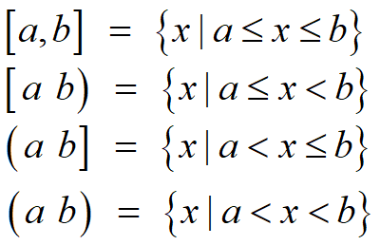
Interval Notation
区间表示法
closed interval [a,b]
open interval (a,b)

Slide 13
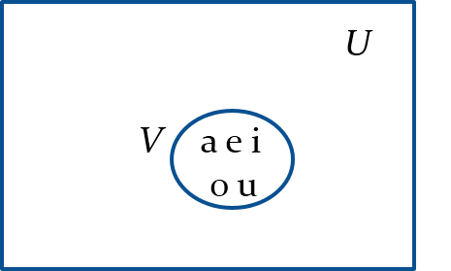
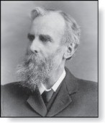
Universal Set and Empty Set
全集
The universal set U is the set containing everything currently under consideration.
Sometimes implicit
Sometimes explicitly stated.
Contents depend on the context.
The empty set is the set with no
elements. Symbolized ∅, but {} also used.
韦恩图
Venn Diagram
John Venn (1834-1923)
Cambridge, UK

Slide 14
Some things to remember
Sets can be elements of sets.
{{1,2,3},a, {b,c}}
{N,Z,Q,R}
The empty set is different from a set containing the empty set.
∅ ≠ { ∅ }

Slide 15
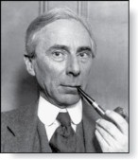
Russell’s Paradox
罗素悖论
Let S be the set of all sets which are not members of themselves. A paradox results from trying to answer the question “Is S a member of itself?”
Related Paradox:
Henry is a barber who shaves all people who do not shave themselves. A paradox results from trying to answer the question “Does Henry shave himself?”
Bertrand Russell (1872-1970)
Cambridge, UK
Nobel Prize Winner

Slide 16
Propositional Logic
命题逻辑
Constructing Propositions
Propositional Variables: p, q, r, s, …
The proposition that is always true is denoted by T and the proposition that is always false is denoted by F.
Compound Propositions; constructed from logical connectives and other propositions
Negation ¬
Conjunction ∧
Disjunction ∨
Implication →
Biconditional ↔
否，反
合取，与
析取，或
蕴含，如果……那么……
等价，当且仅当

Slide 17
Introducing Predicate Logic
谓词逻辑
Predicate logic uses the following new features:
Variables: x, y, z
Predicates: P(x), M(x)
Quantifiers (to be covered in the next slide):
Propositional functions are a generalization of propositions.
They contain variables and a predicate, e.g., P(x)
Variables can be replaced by elements from their domain.

Slide 18
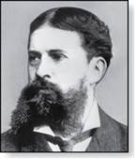
Quantifiers
Charles Peirce (1839-1914)
量词
We need quantifiers to express the meaning of English words including all and some:
“All men are Mortal.”
“Some cats do not have fur.”
The two most important quantifiers are:
Universal Quantifier, “For all,” symbol: ∀
Existential Quantifier, “There exists,” symbol: ∃
We write as in ∀x P(x) and ∃x P(x).
∀x P(x) asserts P(x) is true for every x in the domain.
∃x P(x) asserts P(x) is true for some x in the domain.
The quantifiers are said to bind the variable x in these expressions.
全称量词
存在量词

Slide 19
Russell’s Paradox
罗素悖论
Let S be the set of all sets which are not members of themselves. A paradox results from trying to answer the question “Is S a member of itself?”
Related Paradox:
Henry is a barber who shaves all people who do not shave themselves. A paradox results from trying to answer the question “Does Henry shave himself?”
Bertrand Russell (1872-1970)
Cambridge, UK
Nobel Prize Winner

Slide 20
Set Equality
Definition: Two sets are equal if and only if they have the same elements.
Therefore if A and B are sets, then A and B are equal if and only if
We write A = B if A and B are equal sets.
{1,3,5} = {3, 5, 1}
{1,5,5,5,3,3,1} = {1,3,5}

Slide 21
Subsets
Definition: The set A is a subset of B, if and only if every element of A is also an element of B.
The notation A ⊆ B is used to indicate that A is a subset of the set B.
A ⊆ B holds if and only if
is true.
Because a ∈ ∅ is always false, ∅ ⊆ S ,for every set S.
Because a ∈ S → a ∈ S, S ⊆ S, for every set S.

Slide 22
Showing a Set is or is not a Subset of Another Set
Showing that A is a Subset of B: To show that A ⊆ B, show that if x belongs to A, then x also belongs to B.
Showing that A is not a Subset of B: To show that A is not a subset of B, A ⊈ B, find an element x ∈ A with x ∉ B. (Such an x is a counterexample to the claim that x ∈ A implies x ∈ B.)
Examples:
The set of all computer science majors at your school is a subset of all students at your school.
The set of integers with squares less than 100 is not a subset of the set of nonnegative integers.
反例
表明，蕴含

Slide 23
Another look at Equality of Sets
Recall that two sets A and B are equal, denoted by A = B, iff
if and only if，当且仅当
Using logical equivalences we have that A = B iff
This is equivalent to
A ⊆ B and B ⊆ A

Slide 24
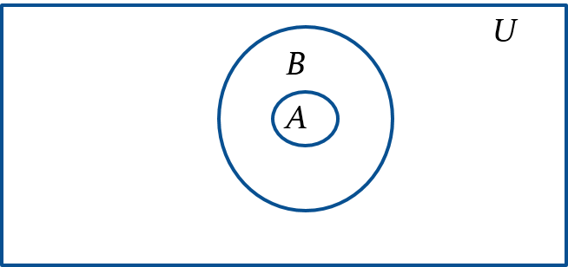
Proper Subsets
真子集
Definition: If A ⊆ B, but A ≠B, then we say A is a proper subset of B, denoted by A ⊂ B. If A ⊂ B, then
is true.
Venn Diagram

Slide 25
Set Cardinality
基数
不同的
Definition: If there are exactly n distinct elements in S where n is a nonnegative integer, we say that S is finite. Otherwise it is infinite.
Definition: The cardinality of a finite set A, denoted by |A|, is the number of (distinct) elements of A.
Examples:
|ø| = 0
Let S be the letters of the English alphabet. Then |S| = 26
|{1,2,3}| = 3
|{ø}| = 1
The set of integers is infinite.
有限的

Slide 26
离散数学 （一）
集合论
苏宙行
华中科技大学 计算机学院 智能所 EDA团队
suzhouxing@hust.edu.cn
课程QQ群：694871331
微助教课程号：MG158
2024-02-28

Slide 27
Power Sets
幂集
Definition: The set of all subsets of a set A, denoted P(A), is called the power set of A.
Example: If A = {a,b} then
P(A) = {ø, {a},{b},{a,b}}
If a set has n elements, then the cardinality of the power set is 2ⁿ. (In Chapters 5 and 6, we will discuss different ways to show this.)

Slide 28
Tuples
元组
The ordered n-tuple (a₁,a₂,…..,a_{n}) is the ordered collection that has a₁ as its first element and a₂ as its second element and so on until a_{n} as its last element.
Two n-tuples are equal if and only if their corresponding elements are equal.
2-tuples are called ordered pairs.
The ordered pairs (a,b) and (c,d) are equal if and only if a = c and b = d.
集合无序，元组有序

Slide 29
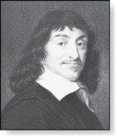
Cartesian Product 1
笛卡尔积
René Descartes (1596-1650)
Definition: The Cartesian Product of two sets A and B, denoted by A × B is the set of ordered pairs (a,b) where a ∈ A and b ∈ B .
Example:
A = {a,b} B = {1,2,3}
A × B = {(a,1),(a,2),(a,3), (b,1),(b,2),(b,3)}
Definition: A subset R of the Cartesian product A × B is called a relation from the set A to the set B. (Relations will be covered in depth in Chapter 9.)

Slide 30
Cartesian Product 2
Definition: The Cartesian products of the sets A₁,A₂,……,A_{n}, denoted by A₁ × A₂ × …… × A_{n} , is the set of ordered n-tuples (a₁,a₂,……,a_{n}) where a_{i} belongs to A_{i} for i = 1, … n.
Example: What is A × B × C where A = {0,1}, B = {1,2} and C = {0,1,2}
Solution: A × B × C = {(0,1,0), (0,1,1), (0,1,2),(0,2,0), (0,2,1), (0,2,2),(1,1,0), (1,1,1), (1,1,2), (1,2,0), (1,2,1), (1,2,2)}

Slide 31
Truth Sets of Quantifiers
量词
Given a predicate P and a domain D, we define the truth set of P to be the set of elements in D for which P(x) is true. The truth set of P(x) is denoted by
谓词
定义域
Example: The truth set of P(x) where the domain is the integers and P(x) is “|x| = 1” is the set {-1,1}
注意此处的P和幂集符号冲突了

Slide 32
Set Operations
Section 2.2

Slide 33
Section Summary 2
Set Operations
Union
Intersection
Complementation
Difference
More on Set Cardinality
Set Identities
Proving Identities
Membership Tables
并集
交集
补集
差集

Slide 34
Boolean Algebra
布尔代数
Propositional calculus and set theory are both instances of an algebraic system called a Boolean Algebra. This is discussed in Chapter 12.
The operators in set theory are analogous to the corresponding operator in propositional calculus.
As always there must be a universal set U. All sets are assumed to be subsets of U.
命题演算
相似的

Slide 35
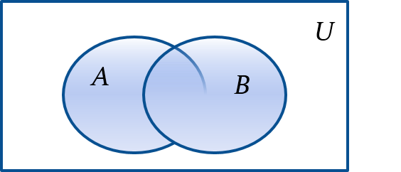
Union
Definition: Let A and B be sets. The union of the sets A and B, denoted by A ∪ B, is the set:
Example: What is {1,2,3} ∪ {3, 4, 5}?
Solution: {1,2,3,4,5}
Venn Diagram for A ∪ B

Slide 36

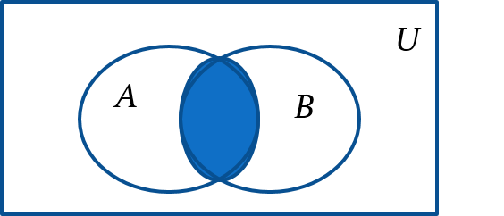
Intersection
Definition: The intersection of sets A and B, denoted by A ∩ B, is
Note if the intersection is empty, then A and B are said to be disjoint.
Example: What is? {1,2,3} ∩ {3,4,5} ?
Solution: {3}
Example:What is?
{1,2,3} ∩ {4,5,6} ?
Solution: ∅
Venn Diagram for A ∩B

Slide 37
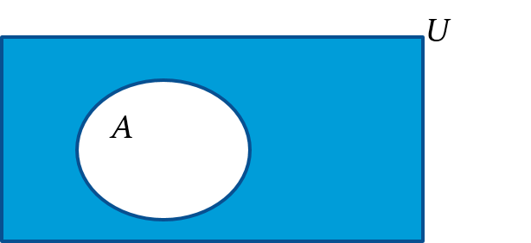
Complement
Definition: If A is a set, then the complement of the A (with respect to U), denoted by Ā is the set U - A
(The complement of A is sometimes denoted by A^{c} .)
Example: If U is the positive integers less than 100, what is the complement of
Venn Diagram for Complement

Slide 38

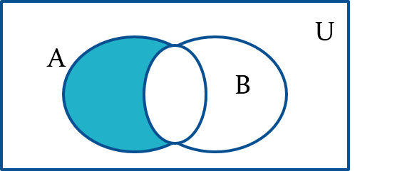
Difference
Definition: Let A and B be sets. The difference of A and B, denoted by A – B, is the set containing the elements of A that are not in B. The difference of A and B is also called the complement of B with respect to A.
Venn Diagram for A − B

Slide 39
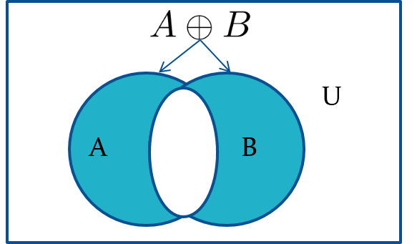
Symmetric Difference (optional)
对称差
Definition: The symmetric difference of A and B, denoted by
is the set
Example:
U = {0,1,2,3,4,5,6,7,8,9,10}
A = {1,2,3,4,5} B ={4,5,6,7,8}
What is
Solution: {1,2,3,6,7,8}
Venn Diagram

Slide 40

Review Questions
Example: U = {0,1,2,3,4,5,6,7,8,9,10} A = {1,2,3,4,5}, B ={4,5,6,7,8}
A ∪ B
Solution: {1,2,3,4,5,6,7,8}
A ∩ B
Solution: {4,5}
Ā
Solution: {0,6,7,8,9,10}
$\overline{B}$
Solution: {0,1,2,3,9,10}
A – B
Solution: {1,2,3}
B – A
Solution: {6,7,8}

Slide 41
Set Identities 1
集合算律（恒等式）
Identity laws
同一律
Domination laws
支配律
Idempotent laws
幂等律
Complementation law
双重否定

Slide 42
Set Identities 2
Commutative laws
交换律
Associative laws
结合律
Distributive laws
分配律

Slide 43
Set Identities 3
De Morgan’s laws
德摩根律
Absorption laws
吸收律
Complement laws
互补律

Slide 44
Proving Set Identities
Different ways to prove set identities:
Prove that each set (side of the identity) is a subset of the other.
Use set builder notation and propositional logic.
Substitution based on set identities to transform the two sides of the identity into the same one.
Membership Tables: Verify that elements in the same combination of sets always either belong or do not belong to the same side of the identity. Use 1 to indicate it is in the set and 0 otherwise.

Slide 45
Proof of Second De Morgan Law 1
Example: Prove that
Solution: We prove this identity by showing that:

Slide 46
Proof of Second De Morgan Law 2
These steps show that:

Slide 47
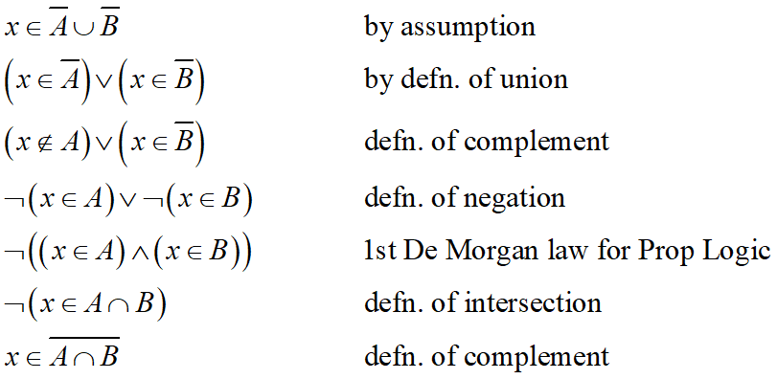
Proof of Second De Morgan Law 3
These steps show that:

Slide 48
Set-Builder Notation: Second De Morgan Law

Slide 49
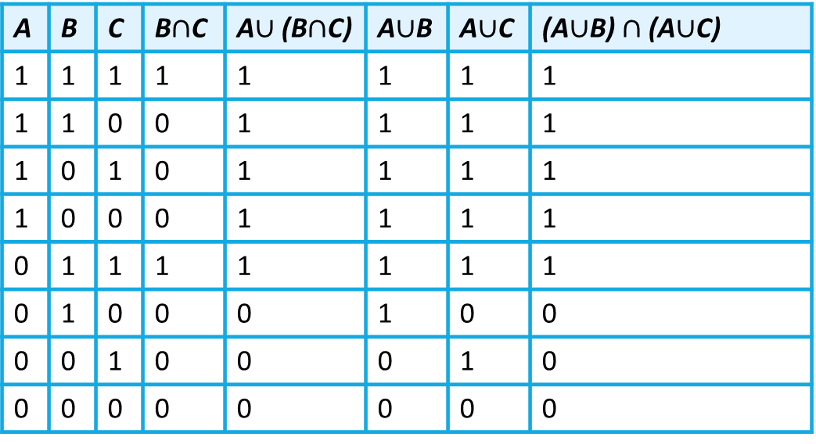
Membership Table
Example: Construct a membership table to show that the distributive law holds.
Solution:
A | B | C | B$∩$C | A$∪$ (B$∩$C) | A$∪$B | A$∪$C | (A$∪$B)$∩$ (A$∪$C)
1 | 1 | 1 | 1 | 1 | 1 | 1 | 1
1 | 1 | 0 | 0 | 1 | 1 | 1 | 1
1 | 0 | 1 | 0 | 1 | 1 | 1 | 1
1 | 0 | 0 | 0 | 1 | 1 | 1 | 1
0 | 1 | 1 | 1 | 1 | 1 | 1 | 1
0 | 1 | 0 | 0 | 0 | 1 | 0 | 0
0 | 0 | 1 | 0 | 0 | 0 | 1 | 0
0 | 0 | 0 | 0 | 0 | 0 | 0 | 0

Slide 50
Conversion Between Binary, Octal, and Hexadecimal Expansions
Let A₁, A₂ ,…, A_{n} be an indexed collection of sets.
We define:
These are well defined, since union and intersection are associative.
For i = 1,2,…, let A_{i} = {i, i + 1, i + 2, ….}. Then,

Slide 51
Functions
Section 2.3

Slide 52
Section Summary 3
Definition of a Function.
Domain, Codomain
Image, Preimage
Injection, Surjection, Bijection
Inverse Function
Function Composition
Graphing Functions
Floor, Ceiling, Factorial
Partial Functions (optional)

Slide 53
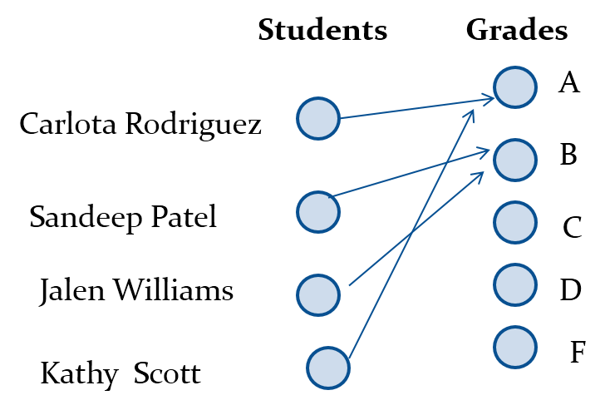
Functions 1
Definition: Let A and B be nonempty sets. A function f from A to B, denoted f: A → B is an assignment of each element of A to exactly one element of B. We write f(a) = b if b is the unique element of B assigned by the function f to the element a of A.
Functions are sometimes called mappings or transformations.
指派
唯一
映射
变换
注意如果A中的元素无法对应到B里的某个元素，则f不是A到B的函数（例：A非空但B为空集）

Slide 54
Functions 2
A function f: A → B can also be defined as a subset of A×B (a relation). This subset is restricted to be a relation where no two elements of the relation have the same first element.
Specifically, a function f from A to B contains one, and only one ordered pair (a, b) for every element a∈ A.
and

Slide 55
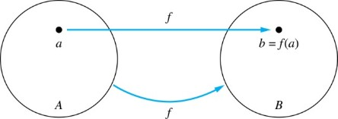
Functions 3
Given a function f: A → B:
We say f maps A to B or f is a mapping from A to B.
A is called the domain of f.
B is called the codomain of f.
If f(a) = b,
then b is called the image of a under f.
a is called the preimage of b.
The range of f is the set of all images of points in A under f. We denote it by f(A).
Two functions are equal when they have the same domain, the same codomain and map each element of the domain to the same element of the codomain.
域
陪域
像
原像
Jump to long description
注意中文教材中像和原像是集合

Slide 56
Representing Functions
Functions may be specified in different ways:
An explicit statement of the assignment. Students and grades example.
A formula.
A computer program.
A Java program that when given an integer n, produces the nth Fibonacci Number (covered in the next section and also in Chapter 5).

Slide 57
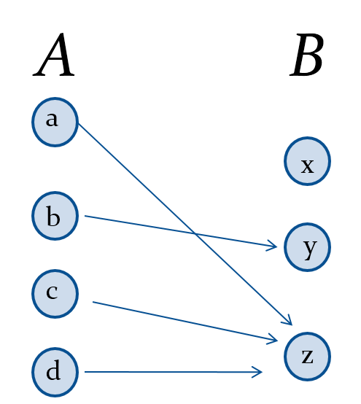
Questions
f(a) = ?
z
The image of d is ?
z
The domain of f is ?
A
The codomain of f is ?
B
The preimage of y is ?
b
f(A) = ?
{y,z}
The preimage(s) of z is (are) ?
{a,c,d}

Slide 58
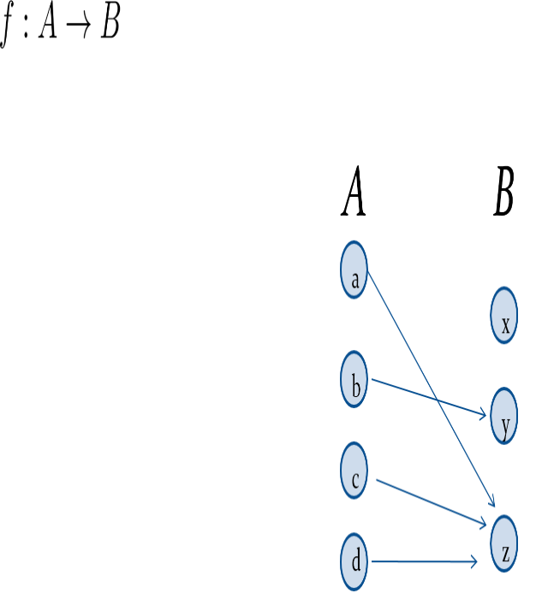
Question on Functions and Sets
If
and S is a subset of A, then
f {a,b,c,} is ?
{y,z}
f {c,d} is ?
{z}

Slide 59
函数的集合
定义：所有从A到B的函数的集合记作B^{A}：
 B^{A} = { f | f : A→B }
|A|=m, |B|=n, 且m, n>0, |B^{A}|=n^{m}
A=∅, 则B^{A}=B∅={∅}
A≠∅且B=∅, 则B^{A}=∅^{A}= ∅

Slide 60
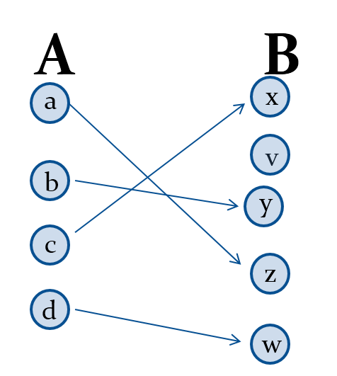

Injections
单射
Definition: A function f is said to be one-to-one, or injective, if and only if f(a) = f(b) implies that a = b for all a and b in the domain of f. A function is said to be an injection if it is one-to-one.

Slide 61
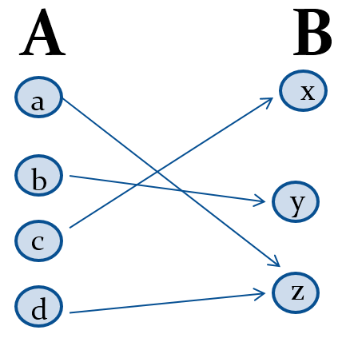
Surjections
满射
Definition: A function f from A to B is called onto or surjective, if and only if for every element
there is an element
with
A function f is called a surjection if it is onto.

Slide 62
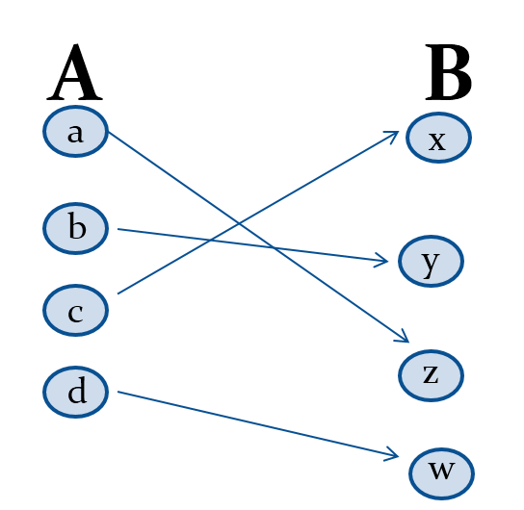
Bijections
双射
Definition: A function f is a one-to-one correspondence, or a bijection, if it is both one-to-one and onto (surjective and injective).
一一对应

Slide 63
Showing that f is one-to-one or onto 1
Suppose that f : A → B.
To show that f is injective Show that if f (x) = f (y) for arbitrary x, y ∈ A, then x = y.
To show that f is not injective Find particular elements x, y ∈ A such that x ≠ y and f (x) = f (y).
To show that f is surjective Consider an arbitrary element y ∈ B and find an element x ∈ A such that f (x) = y.
To show that f is not surjective Find a particular y ∈ B such that f (x) ≠ y for all x ∈ A.

Slide 64
Showing that f is one-to-one or onto 2
Example 1: Let f be the function from {a,b,c,d} to {1,2,3} defined by f(a) = 3, f(b) = 2, f(c) = 1, and f(d) = 3. Is f an onto function?
Solution: Yes, f is onto since all three elements of the codomain are images of elements in the domain. If the codomain were changed to {1,2,3,4}, f would not be onto.
Example 2: Is the function f(x) = x² from the set of integers to the set of integers onto?
Solution: No, f is not onto because there is no integer x with x² = −1, for example.

Slide 65
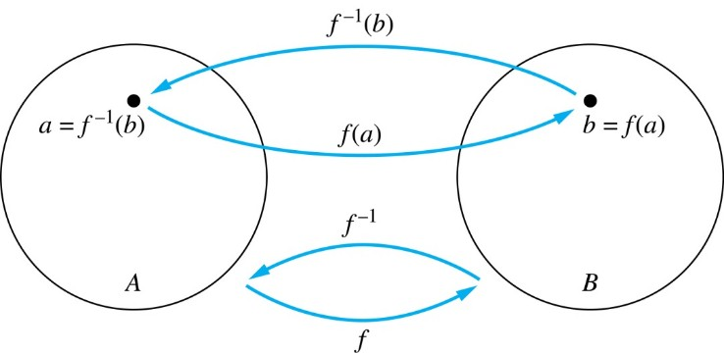
Inverse Functions 1
反函数
Definition: Let f be a bijection from A to B. Then the inverse of f, denoted
is the function from
B to A defined as
No inverse exists unless f is a bijection. Why?
Jump to long description
Notes:
如果不是单射，反函数定义域中有元素会映射到多个值；
如果不是满射，反函数定义域中有元素不能映射到陪域中；

Slide 66
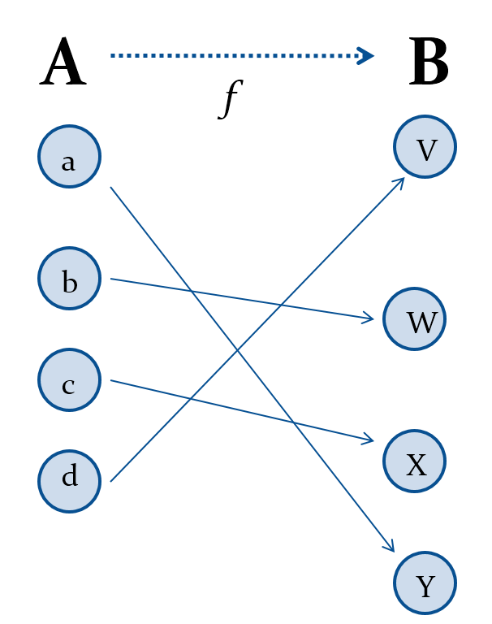
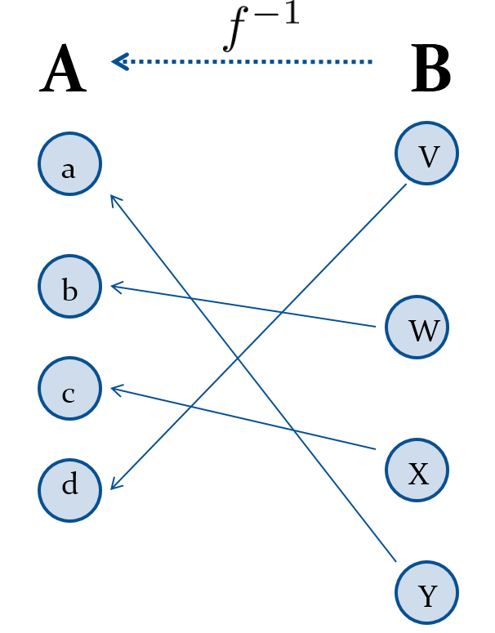
Inverse Functions 2

Slide 67
Questions 1
Example 1: Let f be the function from {a,b,c} to {1,2,3} such that f(a) = 2, f(b) = 3, and f(c) = 1. Is f invertible and if so what is its inverse?
Solution: The function f is invertible because it is a one-to-one correspondence. The inverse function f⁻¹ reverses the correspondence given by f, so f⁻¹ (1) = c, f⁻¹ (2) = a, and f⁻¹ (3) = b.

Slide 68
Questions 2
Example 2: Let f: Z → Z be such that f(x) = x + 1. Is f invertible, and if so, what is its inverse?
Solution: The function f is invertible because it is a one-to-one correspondence. The inverse function f⁻¹ reverses the correspondence so f⁻¹ (y) = y −1.

Slide 69
Questions 3
Example 3: Let f: R → R be such that
Is f invertible, and if so, what is its inverse?
Solution: The function f is not invertible because it is not one-to-one.

Slide 70


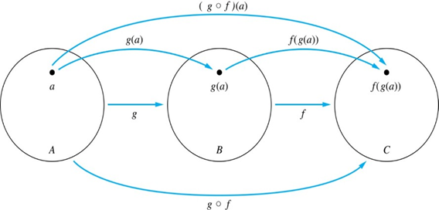
Composition 1
组合
Definition: Let f: B→C, g: A→B. The composition of g with f, denoted
is the function from A to C defined by
Jump to long description
注意有文献f和g的左右顺序相反

Slide 71
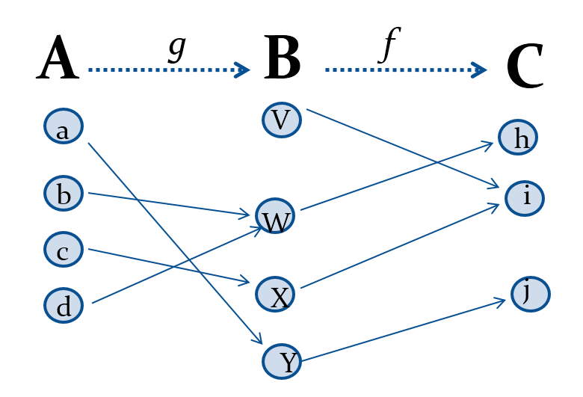
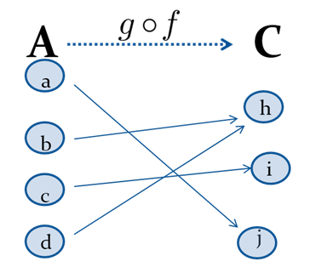
Composition 2

Slide 72
Composition 3
Example 1: If

Slide 73
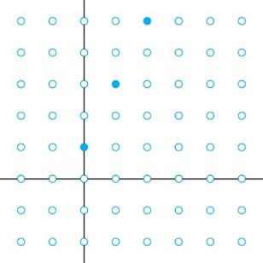
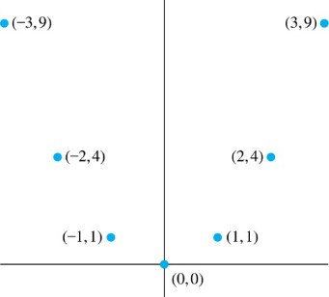
Graphs of Functions
Let f be a function from the set A to the set B. The graph of the function f is the set of ordered pairs
Graph of f(n) = 2n + 1 from Z to Z
Graph of f(x) = x² from Z to Z
Jump to long description
多元函数

Slide 74
Some Important Functions
The floor function, denoted
地板，向下取整
is the largest integer less than or equal to x.
The ceiling function, denoted
天花板，向上取整
is the smallest integer greater than or equal to x
Example:

Slide 75
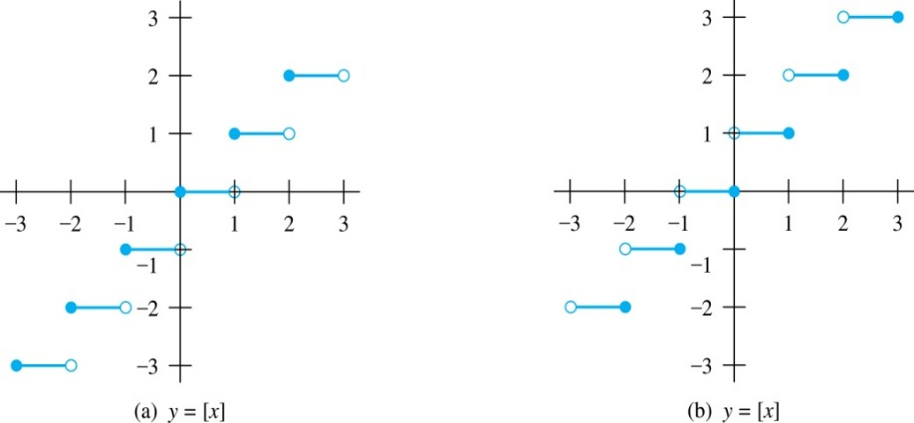
Floor and Ceiling Functions 1
Graph of (a) Floor and (b) Ceiling Functions
Jump to long description

Slide 76
Floor and Ceiling Functions 2
TABLE 1 Useful Properties of the Floor and Ceiling Functions. (n is an integer, x is a real number)

Slide 77
Proving Properties of Functions
Example: Prove that x is a real number, then ⌊2x⌋= ⌊x⌋ + ⌊x + 1/2⌋
Solution: Let x = n + ε, where n is an integer and 0 ≤ ε< 1.
Case 1: ε < ½
2x = 2n + 2ε and ⌊2x⌋ = 2n, since 0 ≤ 2ε< 1.
⌊x + 1/2⌋ = n, since x + ½ = n + (1/2 + ε ) and 0 ≤ ½ +ε < 1.
Hence, ⌊2x⌋ = 2n and ⌊x⌋ + ⌊x + 1/2⌋ = n + n = 2n.
Case 2: ε ≥ ½
2x = 2n + 2ε = (2n + 1) +(2ε − 1) and ⌊2x⌋ =2n + 1, since 0 ≤ 2 ε − 1< 1.
⌊x + 1/2⌋ = ⌊ n + (1/2 + ε)⌋ = ⌊ n + 1 + (ε – 1/2)⌋ = n + 1 since 0 ≤ ε − 1/2< 1.
Hence, ⌊2x⌋ = 2n + 1 and ⌊x⌋ + ⌊x + 1/2⌋ = n + (n + 1) = 2n + 1.
x = (int)(x + 0.5)

Slide 78





Factorial Function
阶乘
Definition: f: N → Z⁺ , denoted by f(n) = n! is the product of the first n positive integers when n is a nonnegative integer.
Stirling’s Formula:
斯特林公式
Examples:

Slide 79
Partial Functions (optional)
Definition: A partial function f from a set A to a set B is an assignment to each element a in a subset of A, called the domain of definition of f, of a unique element b in B.
The sets A and B are called the domain and codomain of f, respectively.
We say that f is undefined for elements in A that are not in the domain of definition of f.
When the domain of definition of f equals A, we say that f is a total function.
Example: f: N → R where f(n) = √n is a partial function from Z to R where the domain of definition is the set of nonnegative integers. Note that f is undefined for negative integers.

Slide 80
Sequences and Summations
Section 2.4

Slide 81
Section Summary 4
Sequences.
Examples: Geometric Progression, Arithmetic Progression
Recurrence Relations
Example: Fibonacci Sequence
Summations
Special Integer Sequences (optional)

Slide 82
Introduction 2
Sequences are ordered lists of elements.
1, 2, 3, 5, 8
1, 3, 9, 27, 81, …….
Sequences arise throughout mathematics, computer science, and in many other disciplines, ranging from botany to music.
We will introduce the terminology to represent sequences and sums of the terms in the sequences.

Slide 83
Sequences 1
序列
Definition: A sequence is a function from a subset of the integers (usually either the set {0, 1, 2, 3, 4, …..} or {1, 2, 3, 4, ….}) to a set S.
The notation a_{n} is used to denote the image of the integer n. We can think of a_{n} as the equivalent of f(n) where f is a function from {0,1,2,…..} to S. We call a_{n} a term of the sequence.

Slide 84
Sequences 2
Example: Consider the sequence {a_{n}} where

Slide 85
Geometric Progression
等比（几何）数列
Definition: A geometric progression is a sequence of the form:
where the initial term a and the common ratio r are real numbers.

Slide 86
Arithmetic Progression
等差（算数）数列
Definition: A arithmetic progression is a sequence of the form:
where the initial term a and the common difference d are real numbers.

Slide 87
Strings 1
串
Definition: A string is a finite sequence of characters from a finite set (an alphabet).
Sequences of characters or bits are important in computer science.
The empty string is represented by λ.
The string abcde has length 5.
串和序列的区别？子串和子序列的区别？

Slide 88
Recurrence Relations
递归
Definition: A recurrence relation for the sequence {a_{n}} is an equation that expresses a_{n} in terms of one or more of the previous terms of the sequence, namely, a₀, a₁, …, a_{n−1}, for all integers n with n ≥ n₀, where n₀ is a nonnegative integer.
A sequence is called a solution of a recurrence relation if its terms satisfy the recurrence relation.
The initial conditions for a sequence specify the terms that precede the first term where the recurrence relation takes effect.
句子=主语+谓语+宾语，宾语=句子|名词

Slide 89
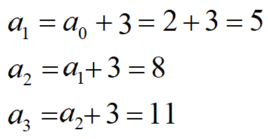
Questions about Recurrence Relations 1
Example 1: Let {a_{n}} be a sequence that satisfies the recurrence relation a_{n} = a_{n−1} + 3 for n = 1,2,3,4,…. and suppose that a₀ = 2. What are a₁ , a₂ and a₃?
[Here a₀ = 2 is the initial condition.]
Solution: We see from the recurrence relation that

Slide 90
Questions about Recurrence Relations 2
Example 2: Let {a_{n}} be a sequence that satisfies the recurrence relation a_{n} = a_{n-1} – a_{n-2} for n = 2,3,4,…. and suppose that a₀ = 3 and a₁ = 5. What are a₂ and a₃?
[Here the initial conditions are a₀ = 3 and a₁ = 5. ]
Solution: We see from the recurrence relation that

Slide 91
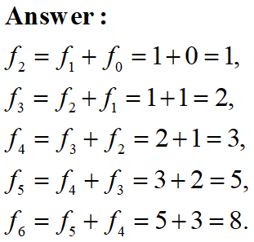
Fibonacci Sequence
Definition: Define the Fibonacci sequence, f₀ ,f₁ ,f₂,…, by:
Initial Conditions: f₀ = 0, f₁ = 1
Recurrence Relation: f_{n} = f_{n−1} + f_{n−2}
Example: Find f₂ ,f₃ ,f₄ , f₅ and f₆ .

Slide 92
Solving Recurrence Relations
Finding a formula for the nth term of the sequence generated by a recurrence relation is called solving the recurrence relation.
Such a formula is called a closed formula.
Various methods for solving recurrence relations will be covered in Chapter 8 where recurrence relations will be studied in greater depth.
Here we illustrate by example the method of iteration in which we need to guess the formula. The guess can be proved correct by the method of induction (Chapter 5).

Slide 93
Questions on Special Integer Sequences (opt) 2
TABLE 1 Some Useful Sequences.
nth Term | First 10 Terms
n² n³ n⁴ f_{n} 2^{n} 3^{n} n! | 1, 4, 9, 16, 25, 36, 49, 64, 81, 100,… 1, 8, 27, 64, 125, 216, 343, 512, 729, 1000,… 1, 16, 81, 256, 625, 1296, 2401, 4096, 6561, 10000,… 1, 1, 2, 3, 5, 8, 13, 21, 34, 55, 89,… 2, 4, 8, 16, 32, 64, 128, 256, 512, 1024,… 3, 9, 27, 81, 243, 729, 2187, 6561, 19683, 59049,… 1, 2, 6, 24, 120, 720, 5040, 40320, 362880, 3628800,…

Slide 94
Guessing Sequences (optional)
Example: Conjecture a simple formula for a_{n} if the first 10 terms of the sequence {a_{n}} are 1, 7, 25, 79, 241, 727, 2185, 6559, 19681, 59047.
Solution: Note the ratio of each term to the previous approximates 3. So now compare with the sequence 3^{n} . We notice that the nth term is 2 less than the corresponding power of 3. So a good conjecture is that a_{n} = 3^{n} − 2.
找规律填数字的本质——函数拟合——统计学习

Slide 95
Integer Sequences (optional) 1
Integer sequences appear in a wide range of contexts. Later we will see the sequence of prime numbers (Chapter 4), the number of ways to order n discrete objects (Chapter 6), the number of moves needed to solve the Tower of Hanoi puzzle with n disks (Chapter 8), and the number of rabbits on an island after n months (Chapter 8).
Integer sequences are useful in many fields such as biology, engineering, chemistry and physics.
On-Line Encyclopedia of Integer Sequences (OESIS) contains over 200,000 sequences. Began by Neil Stone in the 1960s (printed form). Now found at http://oeis.org/Spuzzle.html

Slide 96
Integer Sequences (optional) 2
Here are three interesting sequences to try from the OESIS site. To solve each puzzle, find a rule that determines the terms of the sequence.
Guess the rules for forming for the following sequences:
2, 3, 3, 5, 10, 13, 39, 43, 172, 177, ...
Hint: Think of adding and multiplying by numbers to generate this sequence.
0, 0, 0, 0, 4, 9, 5, 1, 1, 0, 55, ...
Hint: Think of the English names for the numbers representing the position in the sequence and the Roman Numerals for the same number.
2, 4, 6, 30, 32, 34, 36, 40, 42, 44, 46, ...
Hint: Think of the English names for numbers, and whether or not they have the letter ‘e.’
The answers and many more can be found at http://oeis.org/Spuzzle.html

Slide 97
Summations 1
The variable j is called the index of summation. It runs through all the integers starting with its lower limit m and ending with its upper limit n.

Slide 98
Summations 2

Slide 99
Product Notation (optional)

Slide 100
Geometric Series 1
几何级数
Sums of terms of geometric progressions
Proof: Let
To compute S_{n} , first multiply both sides of the equality by r and then manipulate the resulting sum as follows:

Slide 101
Geometric Series 2
From previous slide.
Shifting the index of summation with k = j + 1.
Removing k = n + 1 term and adding k = 0 term.
Substituting S for summation formula
if r ≠1
if r = 1

Slide 102
Some Useful Summation Formulae
TABLE 2 Some Useful Summation Formulae.
Sum | Closed From
Geometric Series: We just proved this.
Later we will prove some of these by induction.
Proof in text (requires calculus)

Slide 103
离散数学 （一）
集合论
苏宙行
华中科技大学 计算机学院 智能所 EDA团队
suzhouxing@hust.edu.cn
课程QQ群：694871331
微助教课程号：MG158
2024-03-04

Slide 104
Cardinality of Sets
Section 2.5

Slide 105
Section Summary 6
Cardinality
Countable Sets
Computability

Slide 106
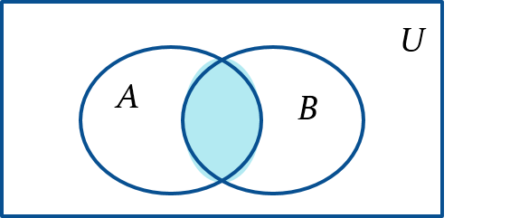
The Cardinality of the Union of Two Sets
Inclusion-Exclusion
|A ∪ B| = |A| + | B| − |A ∩ B|
Example: Let A be the math majors in your class and B be the CS majors. To count the number of students who are either math majors or CS majors, add the number of math majors and the number of CS majors, and subtract the number of joint CS/math majors.
We will return to this principle in Chapter 6 and Chapter 8 where we will derive a formula for the cardinality of the union of n sets, where n is a positive integer.
容斥原理
Venn Diagram for A, B, A ∩ B, A ∪ B

Slide 107
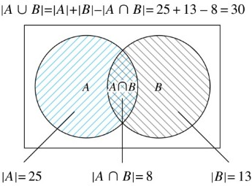
Two Finite Sets
Example: In a discrete mathematics class every student is a major in computer science or mathematics or both. The number of students having computer science as a major (possibly along with mathematics) is 25; the number of students having mathematics as a major (possibly along with computer science) is 13; and the number of students majoring in both computer science and mathematics is 8. How many students are in the class?
Solution:
Jump to long description

Slide 108
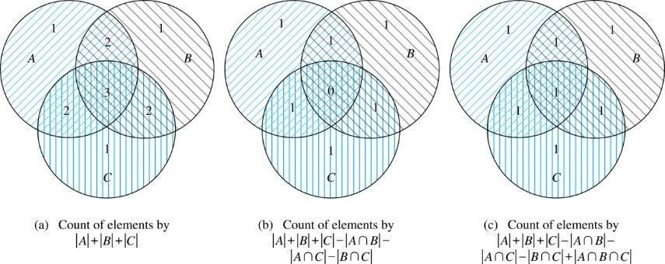
Three Finite Sets 1
Jump to long description

Slide 109
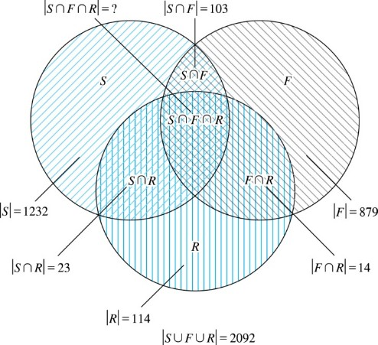
Illustration of Three Finite Set Example

Slide 110
The Principle of Inclusion-Exclusion 1
Theorem 1. The Principle of Inclusion-Exclusion: Let A₁, A₂, …, A_{n} be finite sets. Then:
Notes:
容斥原理本来要到高级计数讲

Slide 111
The Principle of Inclusion-Exclusion 2
Proof: An element in the union is counted exactly once in the right-hand side of the equation. Consider an element a that is a member of r of the sets A₁,…., A_{n} where 1≤ r ≤ n.
It is counted C(r,1) times by
It is counted C(r,2) times by
In general, it is counted C(r,m) times by the summation of m of the sets A_{i}.

Slide 112
The Principle of Inclusion-Exclusion 3
Thus the element is counted exactly
times by the right hand side of the equation.
By Corollary 2 of Section 6.4, we have
Hence,

Slide 113
Cardinality 1
Definition: The cardinality of a set A is equal to the cardinality of a set B, denoted
|A| = |B|,
if and only if there is a one-to-one correspondence (i.e., a bijection) from A to B.
If there is a one-to-one function (i.e., an injection) from A to B, the cardinality of A is less than or the same as the cardinality of B and we write |A| ≤ |B|.
When |A| ≤ |B| and A and B have different cardinality, we say that the cardinality of A is less than the cardinality of B and write |A| < |B|.

Slide 114
集合的等势——基数相等
定义：设A, B是集合，如果存在着从A到B的双射函数，就称A和B是等势的，记作A≈B。如果A不与B 等势，则记作A≉B。
集合等势的实例
例 (1) Z≈N.
则 f 是Z到N的双射函数. 从而证明了Z≈N.

Slide 115
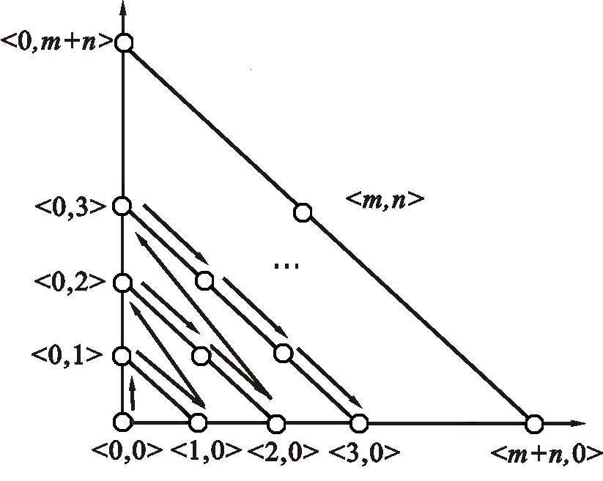
集合的等势——基数相等
集合等势的实例
例 (2) N×N≈N.
N×N中所有元素 排成有序图形
则 f 是Z到N的双射函数. 从而证明了Z≈N.

Slide 116
集合的等势——基数相等
集合等势的实例
例 (3) (0,1)≈R. 其中(0,1)={x| x∈R∧0<x<1}.
例 (4) 对任何a, b∈R, a<b, [0,1]≈[a,b].
f : [0,1]→[a,b], f(x)=(b−a)x+a

Slide 117
集合的等势——基数相等
集合等势的实例
例 (5) [0,1]≈(0,1).
推广：
任意无限集合A与有限集合B，A与A∪B等势。
（希尔伯特大饭店）

Slide 118
集合的等势——基数相等
集合等势的实例
例 (5) [0,1]≈(0,1).
f : [0,1]→(0,1),
验证：是否每个x都有y（显然）？每个y都有且仅有唯一的x？

Slide 119
集合的等势——基数相等
集合等势的实例
例 (6) {0,1}^{N}≈[0,1).

Slide 120
集合的等势——基数相等
集合等势的实例
例 (6) {0,1}^{N}≈[0,1).
证 设x∈[0,1), 0. x₁x₂… 是 x 的二进制表示. 规定表示式中不允许出现连续无数个1. 对于x，如下定义 f:[0,1)→{0,1}^{N}, f(x) = t_{x}, 且 t_{x}:N→{0,1},
t_{x}(n) = x_{n+1}, n = 0,1,2,…
例如 x = 0.1 0 1 1 0 1 0 0…, 则对应于x 的函数 t_{x}是：
n  0 1 2 3 4 5 6 7… t_{x}(n) 1 0 1 1 0 1 0 0…
t_{x}∈{0,1}^{N}, 且对于x,y∈[0,1), x≠y, 必有t_{x}≠t_{y}, 即 f(x)≠f(y).
这就证明了f:[0,1)→{0,1}^{N}是单射的.

Slide 121
集合的等势——基数相等
集合等势的实例
例 (6) {0,1}^{N}≈[0,1).
考虑 t∈{0,1}^{N}, 其中
t(0)=0, t(n)=1, n=1, 2, ….
按照 f 的定义, 只有 x = 0.011… 才能满足 f(x)=t. 但根据规定, 这个数 x 记为0.100…, 所以根本不存在 x∈[0,1), 满足 f(x)=t. 定义函数 g:{0,1}^{N}→[0,1). g的映射法则恰好与 f 相反. 即∀t∈{0,1}^{N},
t：N→{0,1}, g(t)=0. x₁x₂…, 其中x_{n+1}=t(n).
将0.x₁x₂… 看作数 x 的十进制表示. 这样就避免了形如 0.0111…和0.1000….在二进制表示中对应了同一个数的情况，从而保证了g的单射性.
根据定理有{0,1}^{N}≈[0,1). 再使用等势的传递性得{0,1}^{N}≈R.

Slide 122
集合的等势——基数相等
集合不等势的实例
例 (1)对任意集合A都有A≉P(A).
提示：证明A到P(A)不是满射

Slide 123
集合等势的性质
定理： 设A, B,C是任意集合，
(1) A≈A (2) 若A≈B，则B≈A (3) 若A≈B，B≈C，则A≈C
证明思路：利用等势的定义： (1) IA是从A到A的双射。 (2) 若 f:A→B是双射，则f ⁻¹:B→A是从B到A的双射。 (3) 若 f:A→B，g:B→C是双射，则f°g:A→C是从A到C的双射。
自反
等价关系
对称
传递

Slide 124
集合的优势——支配关系
定义： (1) 设A, B是集合, 如果存在从A到B的单射函数, 就称B优势于A, 记作A≼⋅B. 如果B不是优势于A, 则记作A⋠⋅B.
(2) 设A, B是集合, 若A≼⋅B 且 A≠B, 则称 B 真优势于A, 记作A≺⋅B. 如果 B 不是真优势于A, 则记作A⊀⋅B.
实例 N≼⋅N, N≼⋅R, A≼⋅P(A), R⋠⋅N
N≺⋅R, A≺⋅P(A), 但N⊀⋅N

Slide 125
自然数集合的定义
定义： 设a为集合, 称a∪{a}为a的后继, 记作a⁺, 即 a⁺=a∪{a}.
如下定义自然数：
0=∅
1=0⁺=∅⁺ = {∅}={0}
2=1⁺= {∅}⁺ = {∅}∪{{∅}}={∅,{∅}}={0,1}
3=2⁺={∅,{∅}}⁺= {∅,{∅},{∅,{∅}}}= {0,1,2} …
n={0, 1, …, n−1}
…

Slide 126
Cardinality 2
Definition: A set that is either finite or has the same cardinality as the set of positive integers (Z⁺) is called countable. A set that is not countable is uncountable.
When an infinite set is countable (countably infinite) its cardinality is ℵ₀ (where ℵ is aleph, the 1st letter of the Hebrew alphabet). We write |S| = ℵ₀ and say that S has cardinality “aleph null.”
The set of real numbers R is an uncountable set whose cardinality is ℵ.

Slide 127
Showing that a Set is Countable
An infinite set is countable if and only if it is possible to list the elements of the set in a sequence (indexed by the positive integers).
The reason for this is that a one-to-one correspondence f from the set of positive integers to a set S can be expressed in terms of a sequence a₁,a₂,…, a_{n} ,… where a₁ = f(1), a₂ = f(2),…, a_{n} = f(n),…

Slide 128
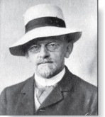
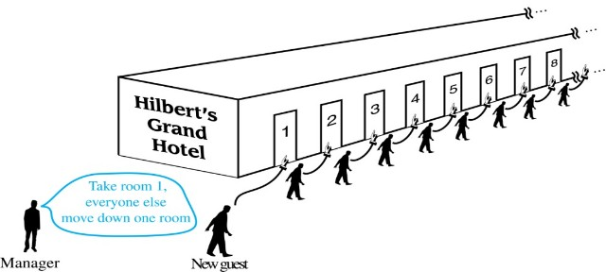
Hilbert’s Grand Hotel
The Grand Hotel (example due to David Hilbert) has countably infinite number of rooms, each occupied by a guest. We can always accommodate a new guest at this hotel. How is this possible?
Explanation: Because the rooms of Grand Hotel are countable, we can list them as Room 1, Room 2, Room 3, and so on. When a new guest arrives, we move the guest in Room 1 to Room 2, the guest in Room 2 to Room 3, and in general the guest in Room n to Room n + 1, for all positive integers n. This frees up Room 1, which we assign to the new guest, and all the current guests still have rooms.
David Hilbert
The hotel can also accommodate a countable number of new guests, all the guests on a countable number of buses where each bus contains a countable number of guests (see exercises).
可数个可数集合的并集仍然是可数集合

Slide 129
Showing that a Set is Countable 1
Example 1: Show that the set of positive even integers E is countable set.

Slide 130
Showing that a Set is Countable 1
Example 1: Show that the set of positive even integers E is countable set.
Solution: Let
Then f is a bijection from N to E since f is both one-to-one and onto. To show that it is one-to-one, suppose that f(n) = f(m). Then 2n = 2m, and so n = m. To see that it is onto, suppose that t is an even positive integer. Then t = 2k for some positive integer k and f(k) = t.

Slide 131
Showing that a Set is Countable 2
Example 2: Show that the set of integers Z is countable.

Slide 132
Showing that a Set is Countable 2
Example 2: Show that the set of integers Z is countable.
Solution: Can list in a sequence:
0, 1, −1, 2, −2, 3, −3 ,………..
Or can define a bijection from N to Z:
When n is even: f(n) = n/2
When n is odd: f(n) = −(n−1)/2

Slide 133
The Positive Rational Numbers are Countable 1
Definition: A rational number can be expressed as the ratio of two integers p and q such that q ≠ 0.
¾ is a rational number
√2 is not a rational number.
Example 3: Show that the positive rational numbers are countable.
Solution: The positive rational numbers are countable since they can be arranged in a sequence:
r₁ , r₂ , r₃ ,…
The next slide shows how this is done.

Slide 134
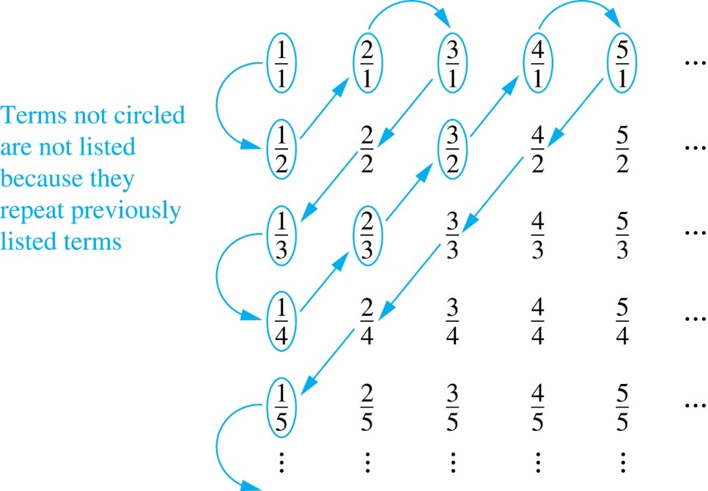
The Positive Rational Numbers are Countable 2
Constructing the List
First list p/q with p + q = 2.
Next list p/q with p + q = 3
And so on.
1, ½, 2, 3, 1/3,1/4, 2/3, ….
First row q = 1.
Second row q = 2.
etc.
可数集合的子集仍然是可数集合
Jump to long description
Notes:
素数集合的可数性、生成方法

Slide 135
Strings 2
Example 4: Show that the set of finite strings S over a finite alphabet A is countably infinite.
Assume an alphabetical ordering of symbols in A.

Slide 136
Strings 2
Example 4: Show that the set of finite strings S over a finite alphabet A is countably infinite.
Assume an alphabetical ordering of symbols in A
Solution: Show that the strings can be listed in a sequence. First list
All the strings of length 0 in alphabetical order.
Then all the strings of length 1 in lexicographic (as in a dictionary) order.
Then all the strings of length 2 in lexicographic order.
And so on.
This implies a bijection from N to S and hence it is a countably infinite set.

Slide 137
The set of all Java programs is countable.
Example 5: Show that the set of all Java programs is countable.
Solution: Let S be the set of strings constructed from the characters which can appear in a Java program. Use the ordering from the previous example. Take each string in turn:
Feed the string into a Java compiler. (A Java compiler will determine if the input program is a syntactically correct Java program.)
If the compiler says YES, this is a syntactically correct Java program, we add the program to the list.
We move on to the next string.
In this way we construct an implied bijection from N to the set of Java programs. Hence, the set of Java programs is countable.

Slide 138
可数集的性质
可数集的任何子集都是可数集
两个可数集的并是可数集
两个可数集的笛卡儿积是可数集
可数个可数集的笛卡儿积仍是可数集
无穷集A的幂集P(A)不是可数集

Slide 139
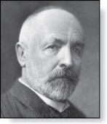

The Real Numbers are Uncountable
Georg Cantor
(1845-1918)
Example: Show that the set of real numbers is uncountable.
Solution: The method is called the Cantor diagnalization argument, and is a proof by contradiction.
Suppose R is countable. Then the real numbers between 0 and 1 are also countable (any subset of a countable set is countable - an exercise in the text).
The real numbers between 0 and 1 can be listed in order r₁ , r₂ , r₃ ,… .
Let the decimal representation of this listing be
康托尔对角线论证法
反证法
Form a new real number with the decimal expansion
r is not equal to any of the r₁ , r₂ , r₃ ,... Because it differs from r_{i} in its ith position after the decimal point. Therefore there is a real number between 0 and 1 that is not on the list since every real number has a unique decimal expansion. Hence, all the real numbers between 0 and 1 cannot be listed, so the set of real numbers between 0 and 1 is uncountable.
Since a set with an uncountable subset is uncountable (an exercise), the set of real numbers is uncountable.
线索证据：实数的不唯一性：0.9999……=1
直观理解：任意两个整数间有有限个整数，
任意两个实数间有无限个实数
Notes:
用对角线法可以证明自然数是不可数的？
问题1：实数是 0.d1 d2 d3……，如果把自然数写成 d1 d2 d3…… 的形式？
无法表示自然数1——无穷个0后一个1不是良定义——无穷没有之后。
问题2：如果把序列反过来，把自然数写成 ……d3 d2 d1？
整数一定是确定位数的，该形式下列出的可能不是整数，对角线取反得到的数也可能不是整数——类似实数中的循环小数，可能出现循环整数？取出一个12345666666……并不是整数

Slide 140
Computability (Optional)
Definition: We say that a function is computable if there is a computer program in some programming language that finds the values of this function. If a function is not computable we say it is uncomputable.
There are uncomputable functions. We have shown that the set of Java programs is countable. Exercise 38 in the text shows that there are uncountably many different functions from a particular countably infinite set (i.e., the positive integers) to itself. Therefore (Exercise 39) there must be uncomputable functions.

Slide 141
习题课
证明：A⊕B = (A−B)∪(B−A) = (A∪B)−(A∩B)
Notes:
题型无非三种：
把A变成B，或者说证明A=B
A+B=？
A+?=B

Slide 142
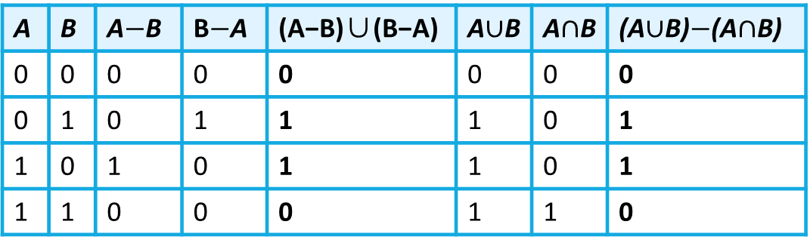
习题课
证明：A⊕B = (A−B)∪(B−A) = (A∪B)−(A∩B)
A | B | A$−$B | B$−$A | (A−B)∪(B−A) | A$∪$B | A$∩$B | (A$∪$B)$−$(A$∩$B)
0 | 0 | 0 | 0 | 0 | 0 | 0 | 0
0 | 1 | 0 | 1 | 1 | 1 | 0 | 1
1 | 0 | 1 | 0 | 1 | 1 | 0 | 1
1 | 1 | 0 | 0 | 0 | 1 | 1 | 0

Slide 143
习题课
C∈P(A) ⇔ C ? A
a∈A ⇔ {a} ? A ⇔ {a} ? P(A)

Slide 144
习题课
C∈P(A) ⇔ C ⊆ A
a∈A ⇔ {a} ⊆ A ⇔ {a}∈P(A)

Slide 145
习题课
给出(A−B)∪(A−C) = A成立的充要条件

Slide 146
习题课
给出(A−B)∪(A−C) = A成立的充要条件
可考虑韦恩图（容易疏忽写出非必要条件）、成员表、恒等变换证明
（为方便书写，用~A表示A的补集）
(A−B)∪(A−C) = (A∩~B)∪(A∩~C) = A∩(~B∪~C) = A∩~(B∩C)
故B∩C ⊆ ~A时命题成立。

Slide 147
习题课
给出(A−B) ⊕ (A−C) = Ø成立的充要条件

Slide 148
习题课
给出(A−B) ⊕ (A−C) = Ø成立的充要条件
加粗的两行对应的情况不存在时结果为空集，即，不存在元素a，a∈A且 a∈~B且a∈C；同时，不存在元素b，b∈A且 b∈B且b∈~C。
(A∩~B∩C)∪(A∩B∩~C) = Ø A∩((~B∩C)∪(B∩~C)) = Ø A∩(B⊕C) = Ø
A | B | C | A−B | A−C | (A−B) ⊕ (A−C)
0 | 0 | 0 | 0 | 0 | 0
0 | 0 | 1 | 0 | 0 | 0
0 | 1 | 0 | 0 | 0 | 0
0 | 1 | 1 | 0 | 0 | 0
1 | 0 | 0 | 1 | 1 | 0
1 | 0 | 1 | 1 | 0 | 1
1 | 1 | 0 | 0 | 1 | 1
1 | 1 | 1 | 0 | 0 | 0
逻辑表达式化简的通用方法：见附加内容

Slide 149
习题课
判断A×(B∩C) = (A×B)∩(A×C)是否成立，如果成立给出证明，不成立则给出反例

Slide 150
习题课
判断A×(B∩C) = (A×B)∩(A×C)是否成立，如果成立给出证明，不成立则给出反例
成立。
分别证明 A×(B∪C) ⊆ (A×B)∪(A×C)和(A×B)∪(A×C) ⊆ A×(B∪C)：
①任取(x, y)∈A×(B∪C)， 则(x∈A)∧(y∈(B∪C))（笛卡尔积运算的定义）， 即(x∈A)∧((y∈B)∨(y∈C))（集合并运算的定义）。 故有((x∈A)∧(y∈B))∨((x∈A)∧(y∈C))， 得到(x, y)∈A×B或(x, y)∈A×C（笛卡尔积运算的定义）， 故有(x, y)∈(A×B)∪(A×C)（集合并运算的定义）， 所以A×(B∪C)⊆(A×B)∪(A×C)。

Slide 151
习题课
判断A×(B∩C) = (A×B)∩(A×C)是否成立，如果成立给出证明，不成立则给出反例
成立。
分别证明 A×(B∪C) ⊆ (A×B)∪(A×C)和(A×B)∪(A×C) ⊆ A×(B∪C)：
②任取(x, y)∈(A×B)∪(A×C)， 则有((x, y)∈A×B)∨((x, y)∈A×C)（集合并运算的定义）， 即(x∈A)∧(y∈B)∨(x∈A)∧(y∈C)（笛卡尔积运算的定义）， 得到(x∈A)∧((y∈B)∨(y∈C))， 从而由(x∈A)∧(y∈(B∪C))（集合并运算的定义）， 可得(x, y)∈A×(B∪C)（笛卡尔积运算的定义）。 所以(A×B)∪(A×C)⊆A×(B∪C)。
由以上①和②得知，A×(B∪C)=(A×B)∪(A×C)。

Slide 152
课外延伸
皮亚诺公理
Zermelo-Fraenkel集合论
Bernstein-Schroeder定理
康托尔定理：幂级的基数大于集合的基数
康托尔连续统假设
康托尔悖论：S为所有集合的集合，康托尔定理成立？

Slide 153
Appendix of Image Long Descriptions

Slide 154
Functions 3 – Appendix
The circle representing set A has element A inside. The circle representing set B has element B equals F left parenthesis A right parenthesis. Also, there are two arrows labeled F. From circle A to circle B, and from element A to B.
Jump to the image

Slide 155
Inverse Functions 1 – Appendix
There are two circles representing sets A and B. Circle A has element A equal to F power minus one left parenthesis B right parenthesis. Circle B has element B equal to F left parenthesis A right parenthesis. Also, there are 4 arrows: an arrow from element A to element B labeled F left parenthesis A right parenthesis, an arrow from element B to element A labeled F power minus one left parenthesis B right parenthesis, an arrow from circle A to circle B labeled F. And arrow from circle B to circle A labeled F power minus one.
Jump to the image

Slide 156
Composition 1 – Appendix
There are three circles, representing sets A, B, and C. Circle A has element A. Circle B has element G left parenthesis A right parenthesis. Circle C has element F left parenthesis G left parenthesis A two right parentheses. Also, there are 6 arrows. From circle A to circle B labeled G. From circle B to circle C labeled F. From circle A to circle C labeled F circle G. From element A to element G left parenthesis A right parenthesis labeled G left parenthesis A right parenthesis. From element G left parenthesis A right parenthesis to element F left parenthesis G left parenthesis A 2 right parentheses labeled F left parenthesis G left parenthesis A 2 right parentheses. From element A to element F left parenthesis G left parenthesis A 2 right parentheses labeled left parenthesis F circle G right parenthesis left parenthesis A right parenthesis.
Jump to the image

Slide 157
Graphs of Functions – Appendix
There are eight rows by eight columns of plotted points. There is a line passing through the points in the third column and a line passing through the points in the sixth row. The point in the first row fifth column, the point in the third row fourth column, and the point in the fifth row third column are shaded.
Jump to the image

Slide 158
Floor and Ceiling Functions – Appendix
The X and Y axes range from -3 to 3, in increments of 1. There are horizontal segments of unit length. In the floor graph, each segment has a shaded point on its left end and a blank point on its right end. The segments are: from x = −3 to −2 and y = −3, from x = −2 to −1 and y = −2, from x = −1 to 0 and y = −1, from x = 0 to 1 and y = 0, from x = 1 to 2 and y = 1, from x = 2 to 3 and y = 2. In the ceiling graph, each segment has a blank point on its left end and a shaded point on its right end. The segments are: from x = −3 to −2 and y = −2, from x = −2 to −1 and y = −1, from x = −1 to 0 and y = 0, from x = 0 to 1 and y = 1, from x = 1 to 2 and y = 2, from x = 2 to 3 and y = 3.
Jump to the image

Slide 159
The Positive Rational Numbers are Countable – Appendix
There are some rows and columns of elements. Each element is a fraction, where the numerator is a number of the row and the denominator is a number of the column. The elements are connected by arrows starting from the top left one. The path is as follows. One first circled, one half circled, two firsts circled. Three firsts circled, two halves not circled, one third circled. One fourth circled, two thirds circled, three halves circled. Four firsts circled, five firsts circled, four halves not circled. Three thirds not circled, two fourths not circled, one fifth circled, etc.
Jump to the image

