Slide 1
The Heart
Lecture Notes based on the
textbook “Bioelectromagnetism”
authored by
Malmivuo & Plonsey, 1995
Nevzat G. Gençer, Fall 2004

Slide 2
Location of the Heart
The heart is located between the lungs behind the sternum and above the diaphragm.
It is surrounded by the pericardium.
Its size is about that of a fist, and its weight is about 250-300 g.
Its center is located about 1.5 cm to the left of the midsagittal plane.

Slide 3
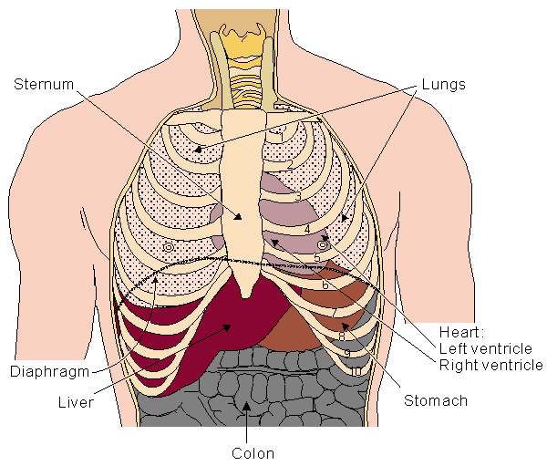
Location of the heart in the thorax

Slide 4
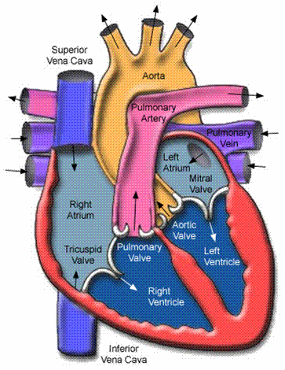
Anatomy of the heart
The walls of the heart are composed of cardiac muscle, called myocardium.
It consists of four compartments:
  the right and left atria and ventricles

Slide 5
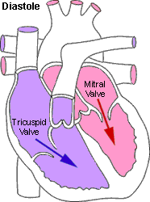
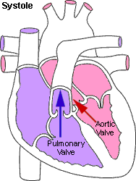
The Heart Valves
The tricuspid valve regulates blood flow between the right atrium and right ventricle.
The pulmonary valve controls blood flow from the right ventricle into the pulmonary arteries
The mitral valve lets oxygen-rich blood from your lungs pass from the left atrium into the left ventricle.
The aortic valve lets oxygen-rich blood pass from the left ventricle into the aorta, then to the body
Notes:
Four types of valves regulate blood flow through your heart:
The tricuspid valve regulates blood flow between the right atrium and right ventricle.
The pulmonary valve controls blood flow from the right ventricle into the pulmonary arteries, which carry blood to your lungs to pick up oxygen.
The mitral valve lets oxygen-rich blood from your lungs pass from the left atrium into the left ventricle.
The aortic valve opens the way for oxygen-rich blood to pass from the left ventricle into the aorta, your body's largest artery, where it is delivered to the rest of your body.

Slide 6
Blood circulation via heart
The blood returns from the systemic circulation to
the right atrium and from there goes through the
tricuspid valve to the right ventricle.
It is ejected from the right ventricle through the
pulmonary valve to the lungs.
Oxygenated blood returns from the lungs to the
left atrium, and from there through the mitral valve
to the left ventricle.
Finally blood is pumped through the aortic valve to the
aorta and the systemic circulation..

Slide 7
The Heartbeat
http://www.pbs.org/wgbh/nova/heart/heartmap.html
Notes:
A heartbeat is a two-part pumping action that takes about a second. As blood collects in the upper chambers (the right and left atria), the heart's natural pacemaker (the SA node) sends out an electrical signal that causes the atria to contract. This contraction pushes blood through the tricuspid and mitral valves into the resting lower chambers (the right and left ventricles). This part of the two-part pumping phase (the longer of the two) is called the diastole.
The second part of the pumping phase begins when the ventricles are full of blood. The electrical signals from the SA node travel along a pathway of cells to the ventricles, causing them to contract. This is called systole. As the tricuspid and mitral valves shut tight to prevent a back flow of blood, the pulmonary and aortic valves are pushed open. While blood is pushed from the right ventricle into the lungs to pick up oxygen, oxygen-rich blood flows from the left ventricle to the heart and other parts of the body.
After blood moves into the pulmonary artery and the aorta, the ventricles relax, and the pulmonary and aortic valves close. The lower pressure in the ventricles causes the tricuspid and mitral valves to open, and the cycle begins again. This series of contractions is repeated over and over again, increasing during times of exertion and decreasing while you are at rest.
Your heart does not work alone, though. Your brain tracks the conditions around you—climate, stress, and your level of physical activity—and adjusts your cardiovascular system to meet those needs.
The human heart is a muscle designed to remain strong and reliable for a hundred years or longer. By reducing your risk factors for cardiovascular disease, you may help your heart stay healthy longer.

Slide 8
Electrical activation of the heart
In the heart muscle cell, or myocyte, electric activation takes place by means of the same mechanism as in the nerve cell, i.e., from the inflow of Na ions across the cell membrane.
The amplitude of the action potential is also similar, being 100 mV for both nerve and muscle.

Slide 9
The duration of the cardiac impulse is, however, two orders of magnitude longer than in either nerve cell or sceletal muscle cell.
As in the nerve cell, repolarization is a consequence of the outflow of K ions.
The duration of the action impulse is about 300 ms.

Slide 10
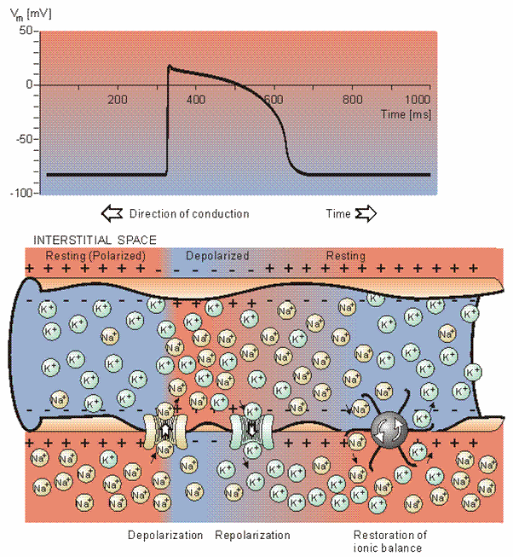
Electrophysiology of the cardiac muscle cell

Slide 11
Mechanical contraction of Cardiac Muscle
Associated with the electric activation of cardiac
muscle cell is its mechanical contraction,
which occurs a little later.
An important distinction between cardiac muscle
tissue and skeletal muscle is that in cardiac muscle,
activation can propagate from one cell to another
in any direction.

Slide 12
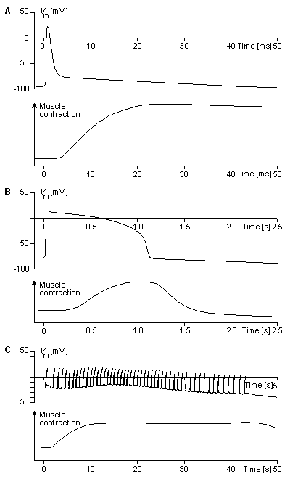
Electric and mechanical activity in
(A) frog sartorius muscle cell,
(B) frog cardiac muscle cell,
(C) rat uterus wall smooth muscle cell.

Slide 13
The Conduction System
Electrical signal begins in the sinoatrial (SA) node: "natural pacemaker."
  causes the atria to contract.
The signal then passes through the atrioventricular (AV) node.
  sends the signal to the ventricles via the “bundle of His”
  causes the ventricles to contract.

Slide 14
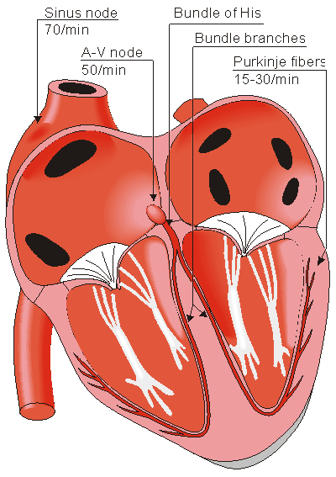
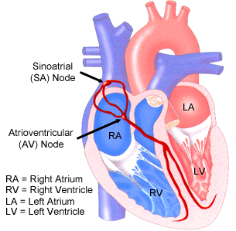
The Conduction System
Notes:
Electrical impulses from your heart muscle (the myocardium) cause your heart to beat (contract). This electrical signal begins in the sinoatrial (SA) node, located at the top of the right atrium. The SA node is sometimes called the heart's "natural pacemaker." When an electrical impulse is released from this natural pacemaker, it causes the atria to contract. The signal then passes through the atrioventricular (AV) node. The AV node checks the signal and sends it through the muscle fibers of the ventricles, causing them to contract. The SA node sends electrical impulses at a certain rate, but your heart rate may still change depending on physical demands, stress, or hormonal factors.

Slide 15
Conduction on the Heart
The sinoatrial node in humans is in the shape of a crescent and is about
15 mm long and 5 mm wide.
The SA nodal cells are self-excitatory, pacemaker cells.
They generate an action potential at the rate of about 70 per minute.
From the sinus node, activation propagates throughout the atria, but
cannot propagate directly across the boundary between atria and
ventricles.
The atrioventricular node (AV node) is located at the boundary between
the atria and ventricles; it has an intrinsic frequency of about
50 pulses/min.
If the AV node is triggered with a higher pulse frequency, it follows this
higher frequency. In a normal heart, the AV node provides the only
conducting path from the atria to the ventricles.

Slide 16
Propagation from the AV node to the ventricles is provided by a
specialized conduction system.
Proximally, this system is composed of a common bundle, called the
bundle of His (after German physician Wilhelm His, Jr., 1863-1934).
More distally, it separates into two bundle branches propagating
along each side of the septum, constituting the right and left bundle
branches. (The left bundle subsequently divides into an anterior and
posterior branch.)
Even more distally the bundles ramify into Purkinje fibers (named after Jan Evangelista Purkinje (Czech; 1787-1869)) that diverge to the inner sides of the ventricular walls.
Propagation along the conduction system takes place at a relatively high speed once it is within the ventricular region, but prior to this (through the AV node) the velocity is extremely slow.

Slide 17
Propagation on ventricular wall
From the inner side of the ventricular wall, the many
activation sites cause the formation of a wavefront
which propagates through the ventricular mass toward
the outer wall.
This process results from cell-to-cell activation.
After each ventricular muscle region has depolarized,
repolarization occurs.

Slide 18
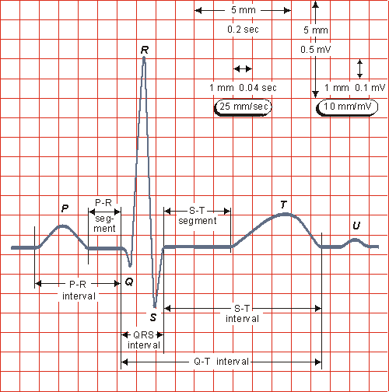
The normal electrocardiogram

Slide 19
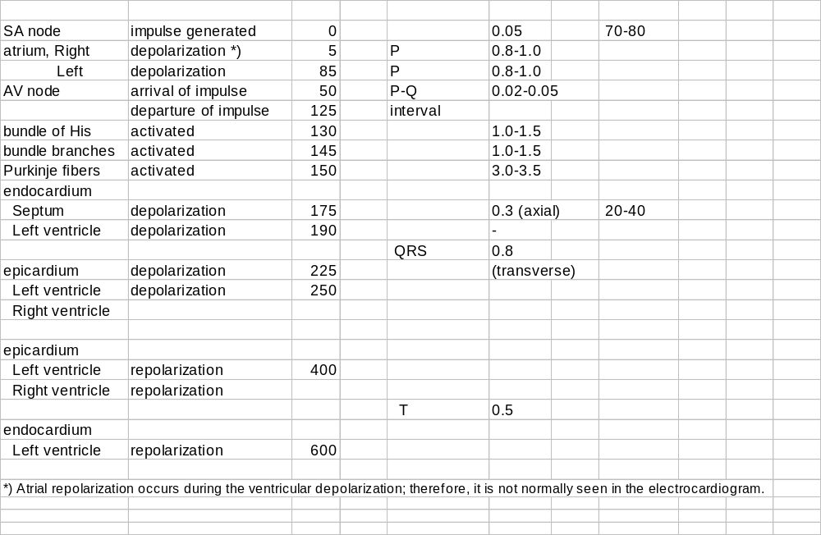
Electrical events in the heart

Slide 20
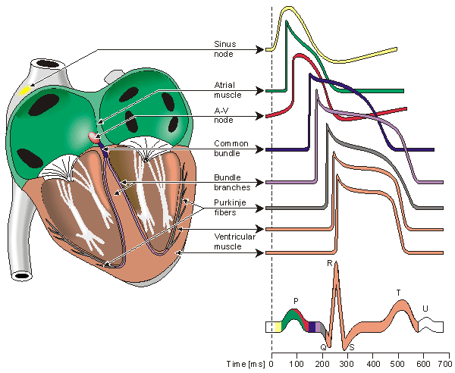
Electrophysiology of the heart
Different waveforms for each of the specialized cells

Slide 21
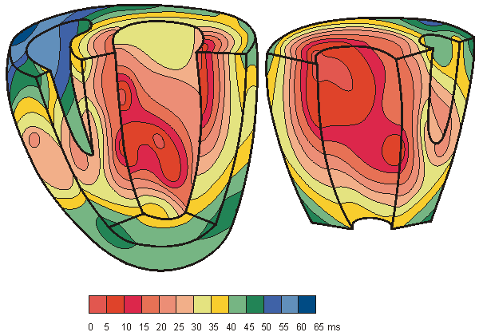
Isochronic surfaces of the ventricular activation
(From Durrer et al., 1970.)

Slide 22
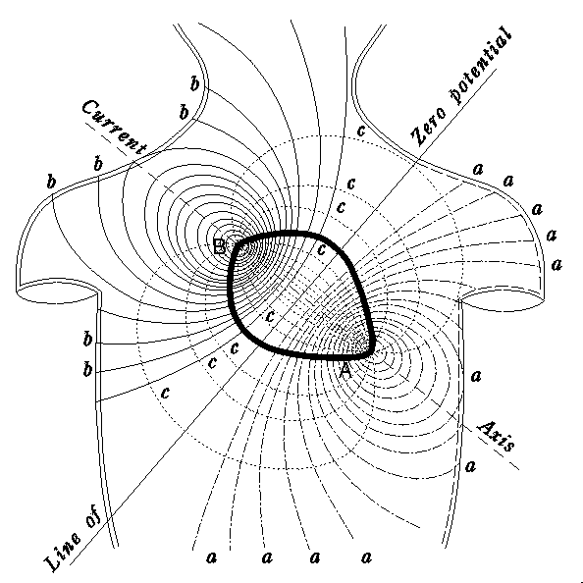
Electric field of the heart on the surface of the thorax, recorded by Augustus Waller (1887).
The curves (a) and (b) represent
the recorded positive and negative isopotential lines, respectively.
These indicate that the heart is a dipolar source having the positive and negative poles at (A) and (B), respectively.
The curves (c) represent the
assumed current flow lines..

Slide 23
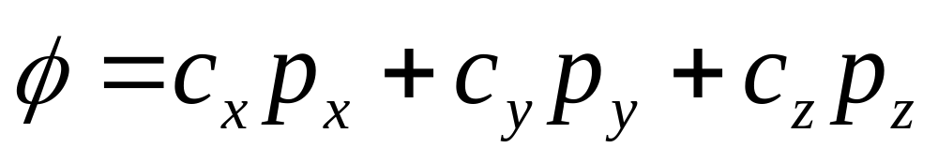
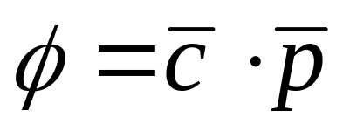
Lead Vector
The potential Φ at point P due to any dipole p can be written as
The vector c is the lead vector. Note that the value of the lead vector is a property of the lead and volume conductor and does not depend on the magnitude and direction of the dipole p.

Slide 24
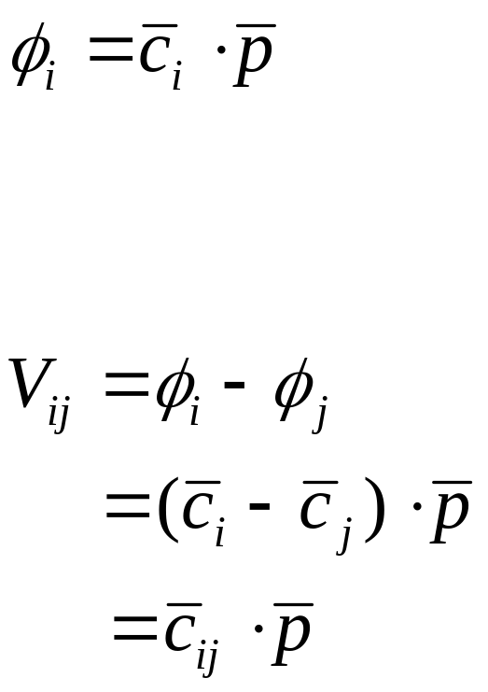
Extending the concept of lead vector
Unipolar lead: measuring the voltage relative to a remote reference.
Bipolar lead: formed by a lead pair and is the voltage between any two points:

Slide 25
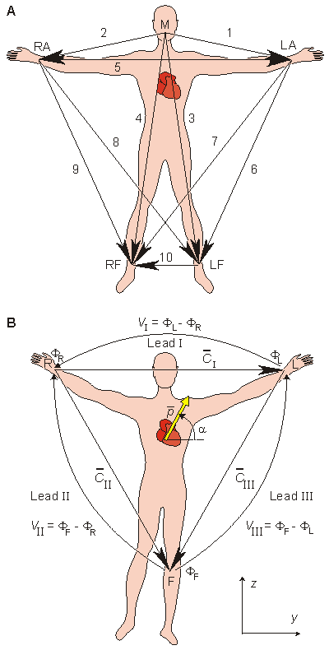
The 10 ECG leads of Waller.
Einthoven limb leads (standard leads) and Einthoven triangle.
The Einthoven triangle is an approximate description of the lead vectors associated with the limb leads.

Slide 26
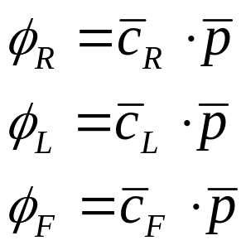
Limb leads
The Einthoven limb leads (standard leads) are defined in the following way:
Lead I: V_{I} = Φ_{L} - Φ_{R}
Lead II: V_{II} = Φ_{F} – Φ_{R}
Lead III: V_{III} = Φ_{F} - Φ_{L}
where V_{I} = the voltage of Lead I
V_{II} = the voltage of Lead II
V_{III} = the voltage of Lead III
Φ_{L} = potential at the left arm
Φ_{R} = potential at the right arm
Φ_{F} = potential at the left foot
According to Kirchhoff's law these lead voltages have the following relationship:
V_{I} + V_{III} = V_{II}
hence only two of these three leads are independent.

Slide 27
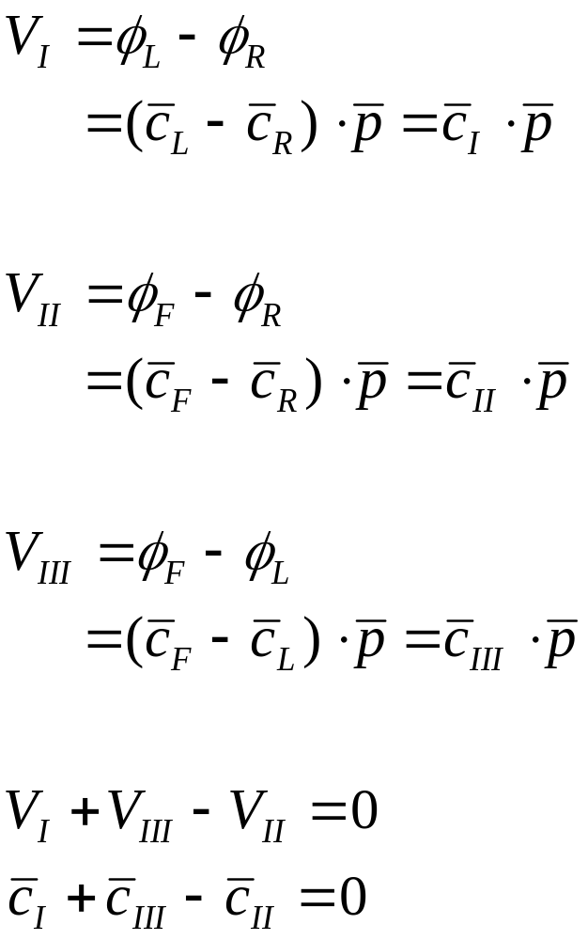
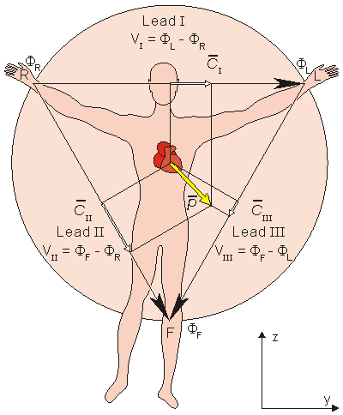
Standard lead vectors form an equilateral triangle

Slide 28
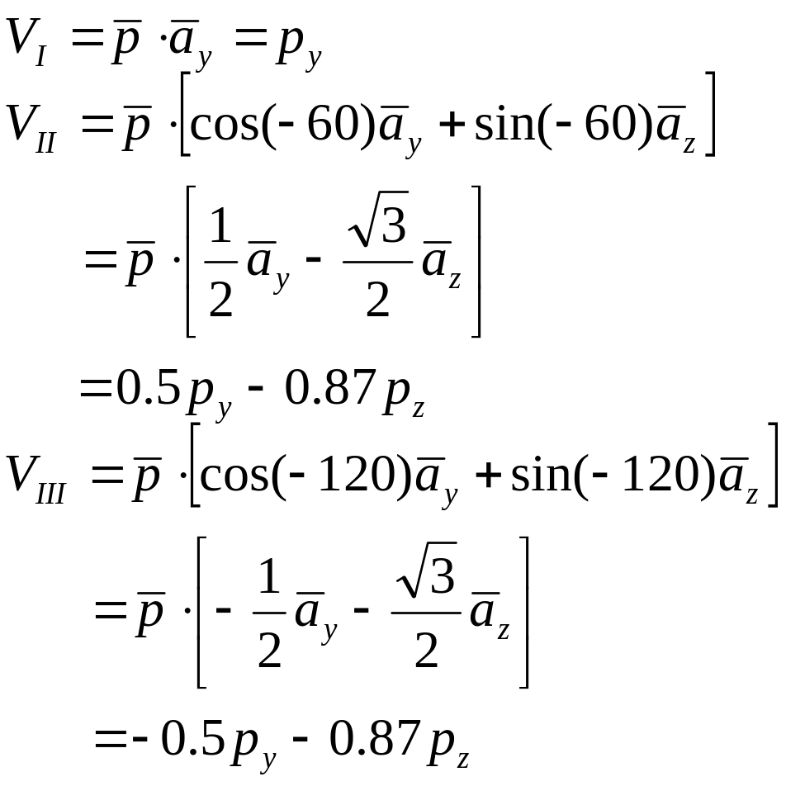
Lead voltages from lead vectors

Slide 29
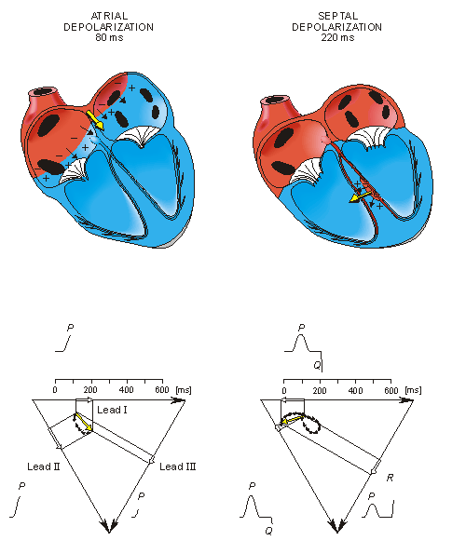
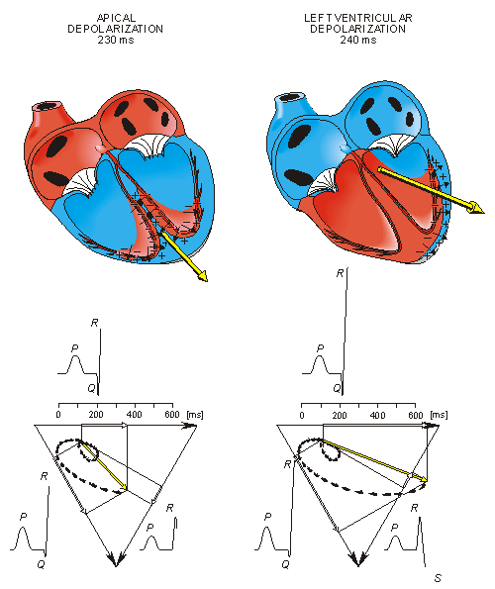
The generation of the ECG signal in the Einthoven limb leads - I

Slide 30
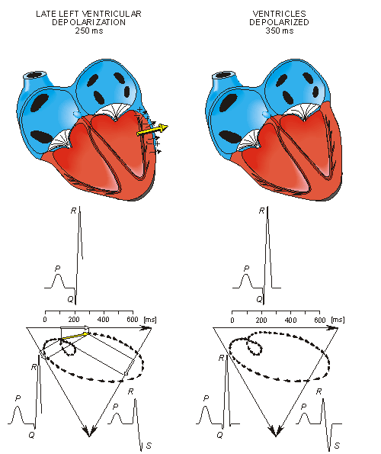
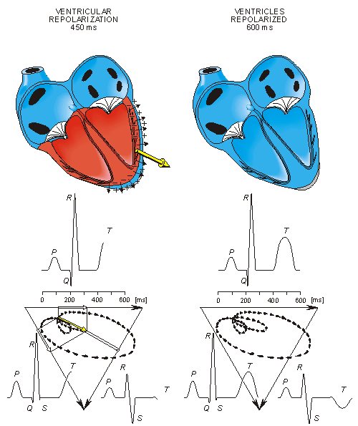
The generation of the ECG signal in the Einthoven limb leads - II

Slide 31
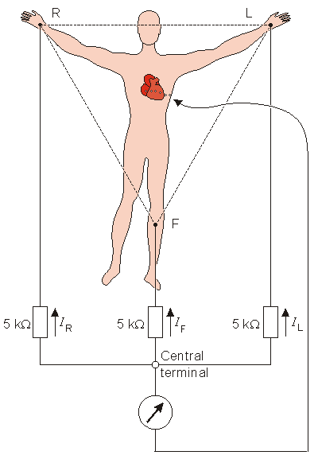
The Wilson central terminal (CT) is formed by connecting a 5 k resistance to each limb electrode and interconnecting the free wires; the CT is the common point.
The Wilson central terminal represents the average of the limb potentials. Because no current flows through a high-impedance voltmeter, Kirchhoff's law requires that
I_{R} + I_{L} + I_{F} = 0.

Slide 32
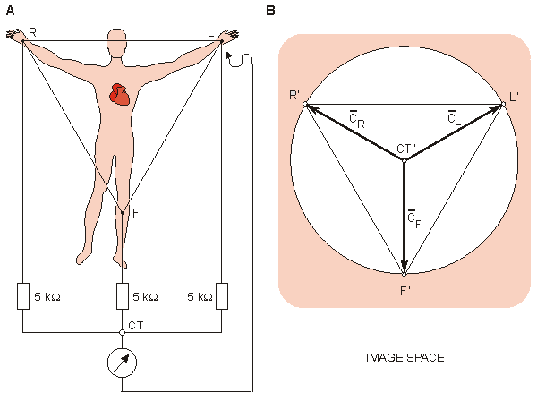
(A) The circuit of the Wilson central terminal (CT).
(B) The location of the Wilson central terminal in the image space (CT'). It is located in the center of the Einthoven triangle.

Slide 33
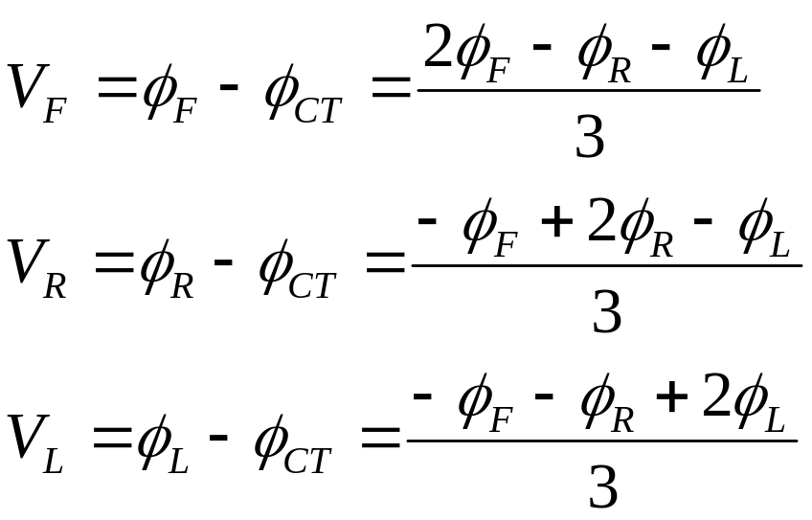
Additional limb leads
Three additional limb leads V_{R}, V_{L}, and V_{F} are obtained by measuring the potential between each limb electrode and the Wilson central terminal.

Slide 34
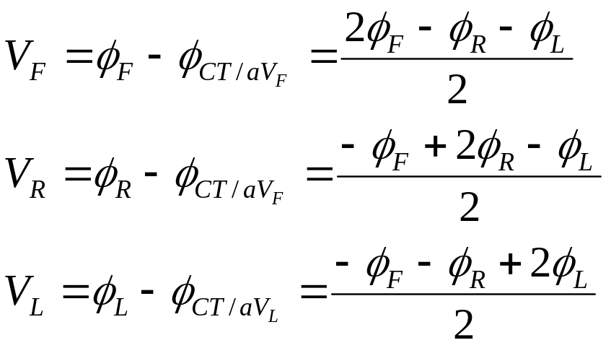
Goldberger Augmented leads
Goldberger observed that the signals from the additional limb leads can be augmented by omitting that resistance from the Wilson central terminal which is connected to the measurement electrode.
The aforementioned three leads may be replaced with a new set of lead that are called augmented leads because of augmentation of the signal.
The augmented signal is 50% larger than the signal with the Wilson ventral terminal chosen as reference.

Slide 35
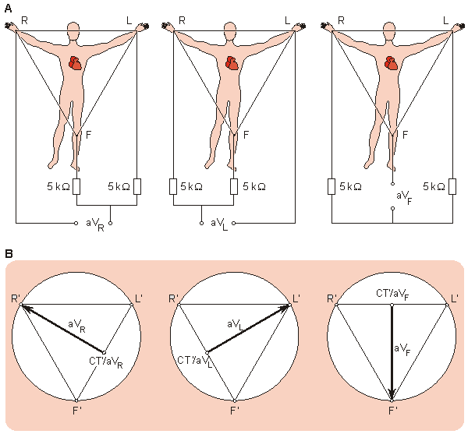
(A) The circuit of the Goldberger augmented leads.
(B) The location of the Goldberger augmented lead vectors in the image space.

Slide 36
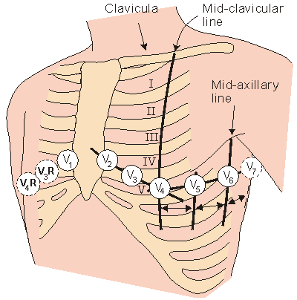
Precordial Leads
For measuring the potentials close to the heart, Wilson introduced the precordial leads (chest leads) in 1944. These leads, V₁-V₆ are located over the left chest as described in the figure.

Slide 37
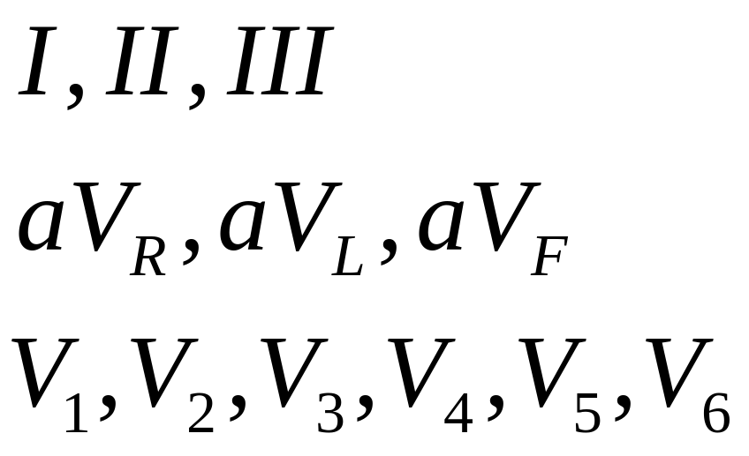
The 12-Lead System
The most commonly used clinical ECG-system, the 12-lead ECg system, consists of the following 12 leads, which are:

Slide 38
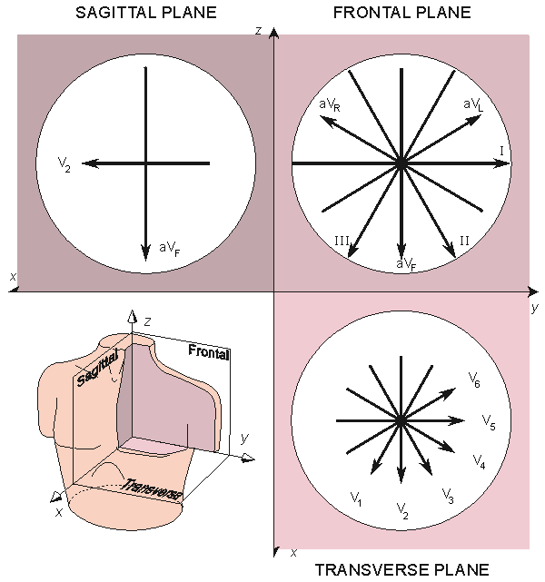
The projections of the lead vectors of the 12-lead ECG system in three orthogonal planes
(when one assumes the volume conductor to be spherical homogeneous and the cardiac source centrally located).

