Slide 1
Salary Predication Using Different Algorithm
By : Mrunali Potdar

Slide 2
Introduction
About Dataset
The dataset contains information about the annual incomes of people from 42 different countries, but the majority (90%) is dominated by the United States. The runner-up in this category is Mexico at 2%, leaving only 8% for the other 40 countries.
Object
To predict if a said person, given his attributes, earns more than $50k per annum or not.

Slide 3
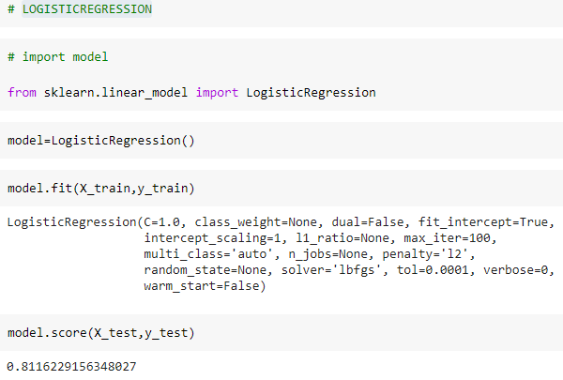
Algorithms
Logistic Algorithm
Logistic regression is a statistical model that in its basic form uses a logistic function to model a binary dependent variable, although many more complex extensions exist.

Slide 4
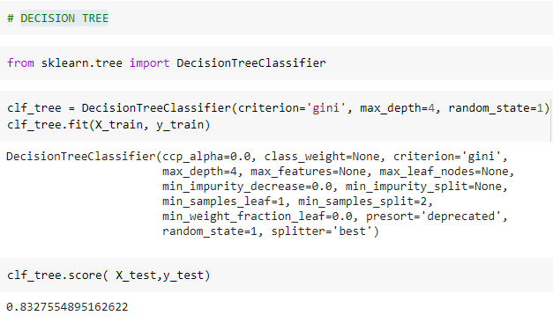
Continue…
Decision Tree
Decision tree analysis involves making a tree-shaped diagram to chart out a course of action or a statistical probability analysis

Slide 5
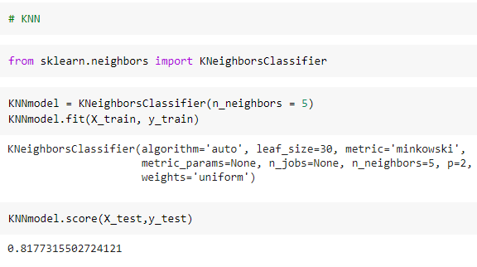
Continue..
KNN
A k-nearest-neighbor is a data classification algorithm that attempts to determine what group a data point is in by looking at the data points around it.

Slide 6
Summary
Decision Tree gives maximum accuracy i.e 82%.
Logistic gives accuracy 81%
KNN gives accuracy 81%

Slide 7
THANK YOU

