Slide 1
Fission Open Source Serverless Functions For Kubernetes
Soam Vasani
Software Engineer, Platform9

Slide 2
Agenda
Functions as a Service: Motivation and background
Fission: What it is and how it works
Demos
Questions

Slide 3
Containers
Brought uniformity to a complex space
Somewhat heavyweight:
Image management, versioning etc.
Registry management

Slide 4
Resource Allocation
We’re moving to a world with a lot of small services
Rarely-used services still need minimum resource allocation
Cluster capacity as a function of deployment size vs. actual use

Slide 5
What if?
What if we had the power of containers but very light dev workflows?
What if we could have cluster capacity as a proportion of actual service usage?

Slide 6
Functions as a Service
Short-lived stateless “functions”
Source / function / module level
Associated with an Event / HTTP / other trigger; activated on request only
Fast on-demand start (“cold start”)
Notes:
To have low resource usage, we must start functions on-demand. -> needs to be fast enough, otherwise you’d want them to be running at all times.

Slide 7
Fission
Open source FaaS framework for Kubernetes
By Platform9 Systems + many open source contributors

Slide 8
Fission: FaaS on Kubernetes
Functions
Environments: “Generic” containers
Triggers
Notes:
3 core concepts:
Functions ;
Environments - language-specific customizable containers; the only lang specific thing
Triggers

Slide 9
Fission: how it works
Pool of “generic” containers for each environment
Functions loaded on demand

Slide 10
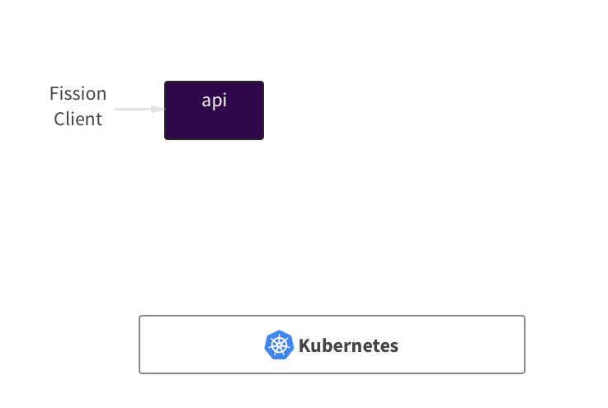

Slide 11
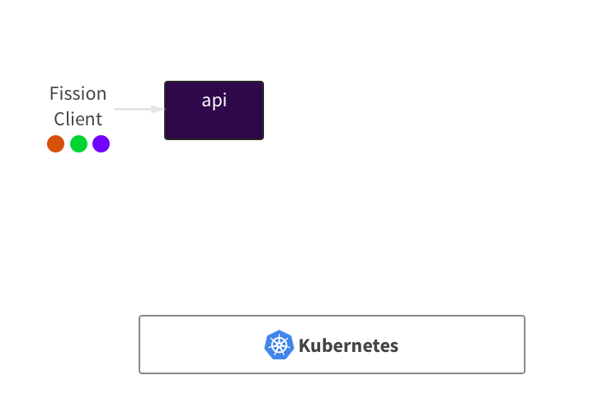

Slide 12
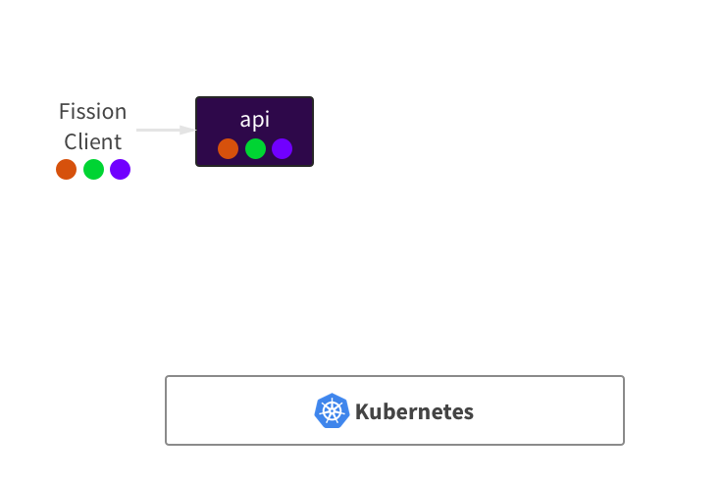

Slide 13
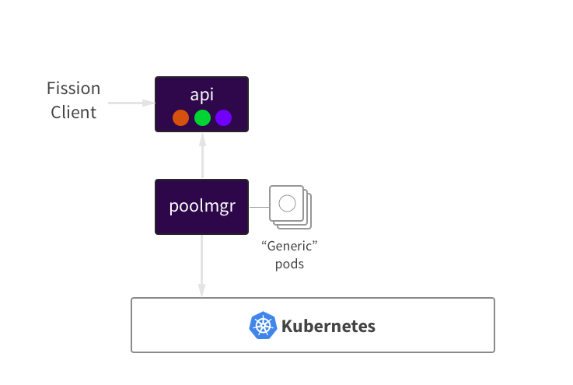

Slide 14
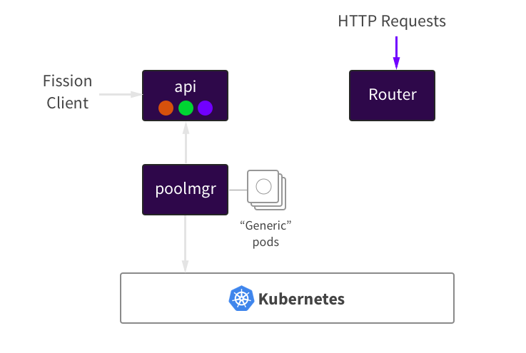

Slide 15


Slide 16
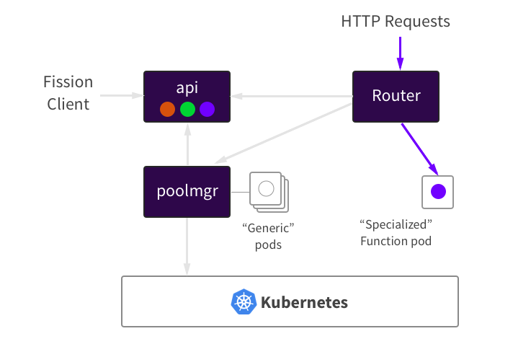

Slide 17


Slide 18


Slide 19


Slide 20
Use Cases
~Small REST APIs
Webhook implementations
Kubernetes watch event handlers

Slide 21
Demos

Slide 22
Project Status
Open sourced Nov 2016
Currently alpha; beta in Nov 2017
Healthy community!
1900 Github stars, 33 contributors, 165 on the Slack

Slide 23
Near-Future Roadmap
More powerful environments (packages, compile step)
Composing functions together into Workflows
Deployment and testing: incremental updates, unit testing
Event queues (NATS.io; cloud-specific queues)
Monitoring: Prometheus, OpenTracing/Zipkin
Better K8s integration (ThirdPartyResources, Ingress, etc)
Autoscaling for functions
Fission UI improvements

Slide 24
Recap
Fission is a lightweight, open source FaaS framework
Runs everywhere that Kubernetes runs:
Public cloud, your own infrastructure,
Or your laptop
Head to http://fission.io for setup instructions

Slide 25
Links
Github: https://github.com/fission/fission
Web: http://fission.io
Slack: http://slack.fission.io
Twitter:
@fissionio
@soamv

