Slide 1
Project: Jenkins CI/CD Deployment Hub
Presented By : Pothanapalli sakshi
Registration no: 12219299
Section: K0o22
Roll no: 33

Slide 2
Jenkins CI/cd Deployment Hub Consists of Three Parts:
1. Creation of Personal Access Token
2.The integration of Jenkins and GitHub
3. CI/CD Pipeline

Slide 3
1.Personal Access Token:
What is a PAT?
A secure key that acts like a password
Allows Jenkins to interact with your GitHub repositories
More secure than using your actual GitHub password

Slide 4
→ Creation of Personal Access Token

Slide 5
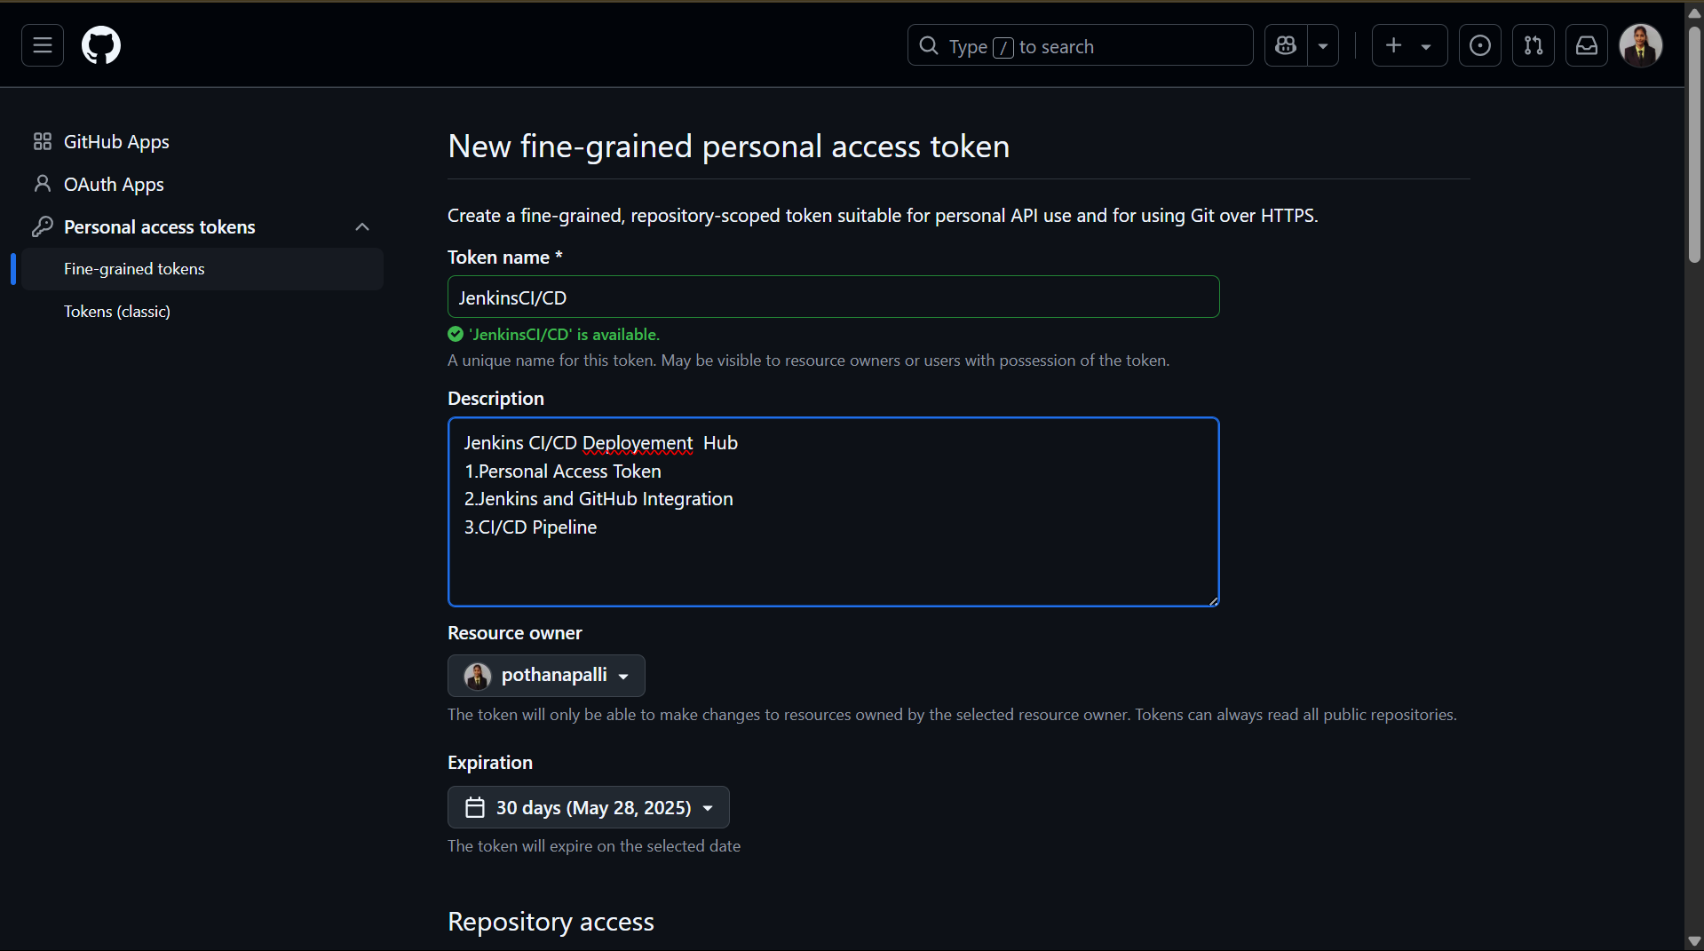

Slide 6
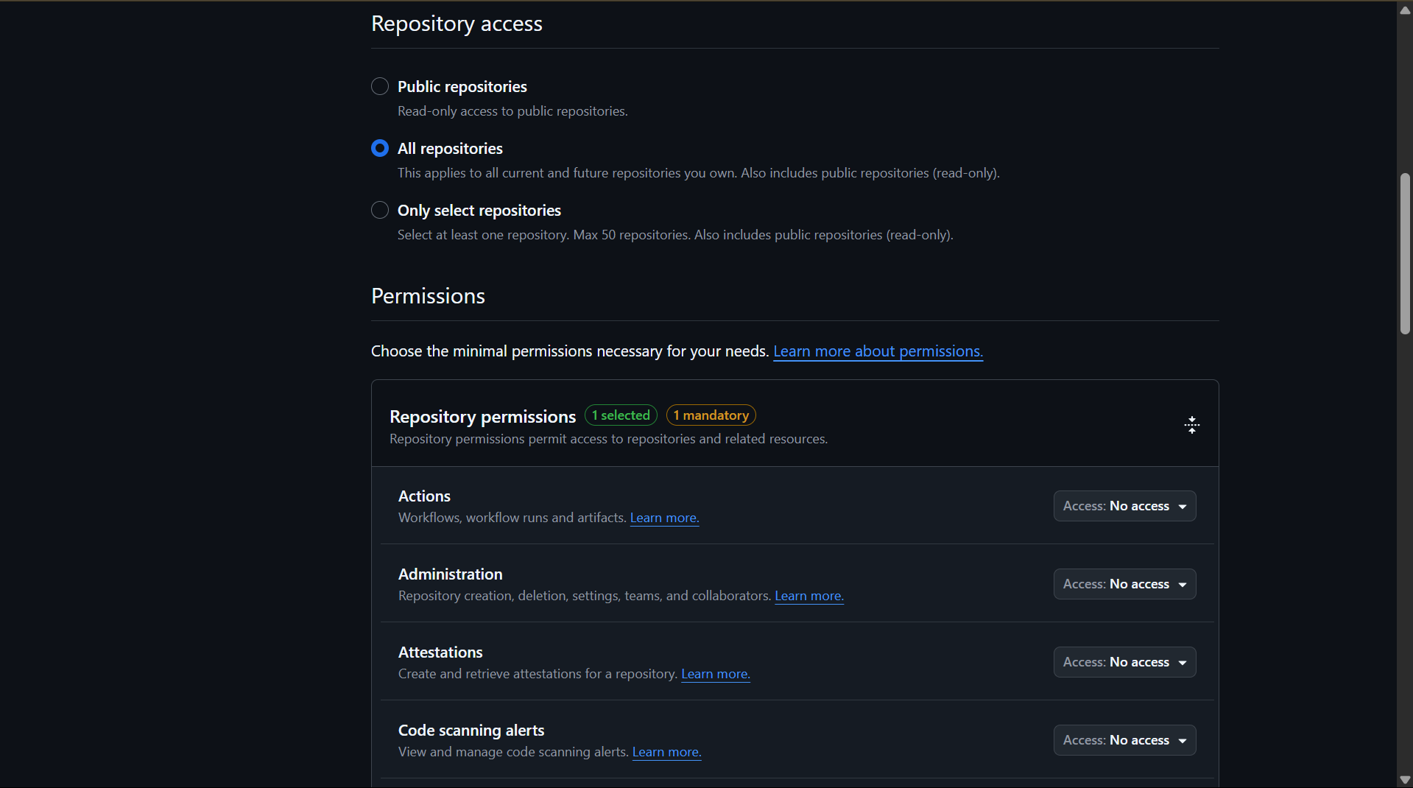

Slide 7
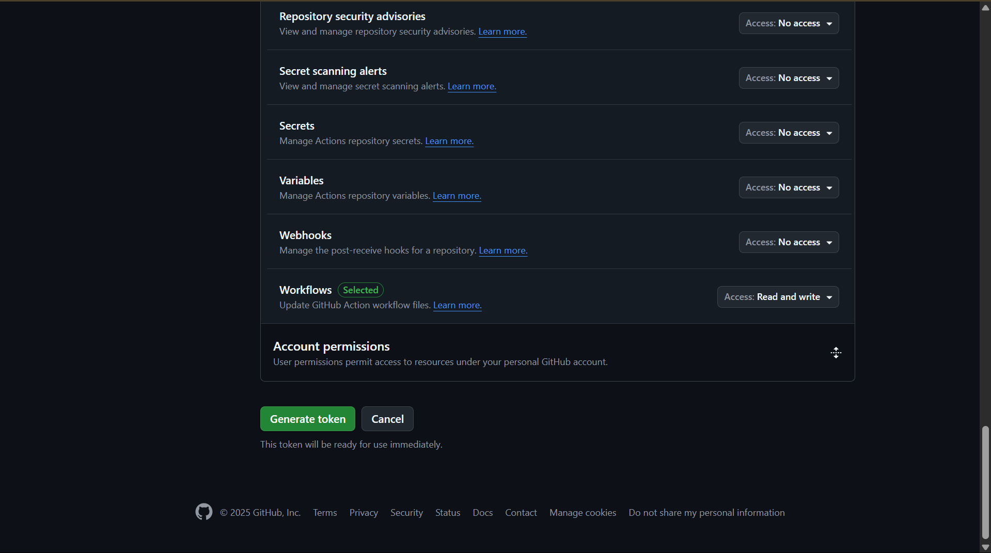

Slide 8
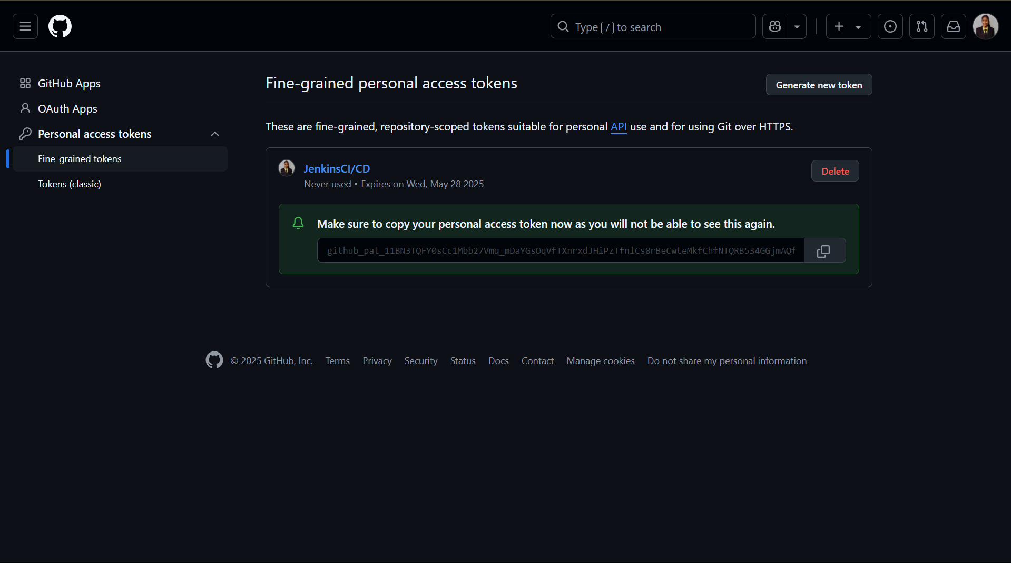

Slide 9
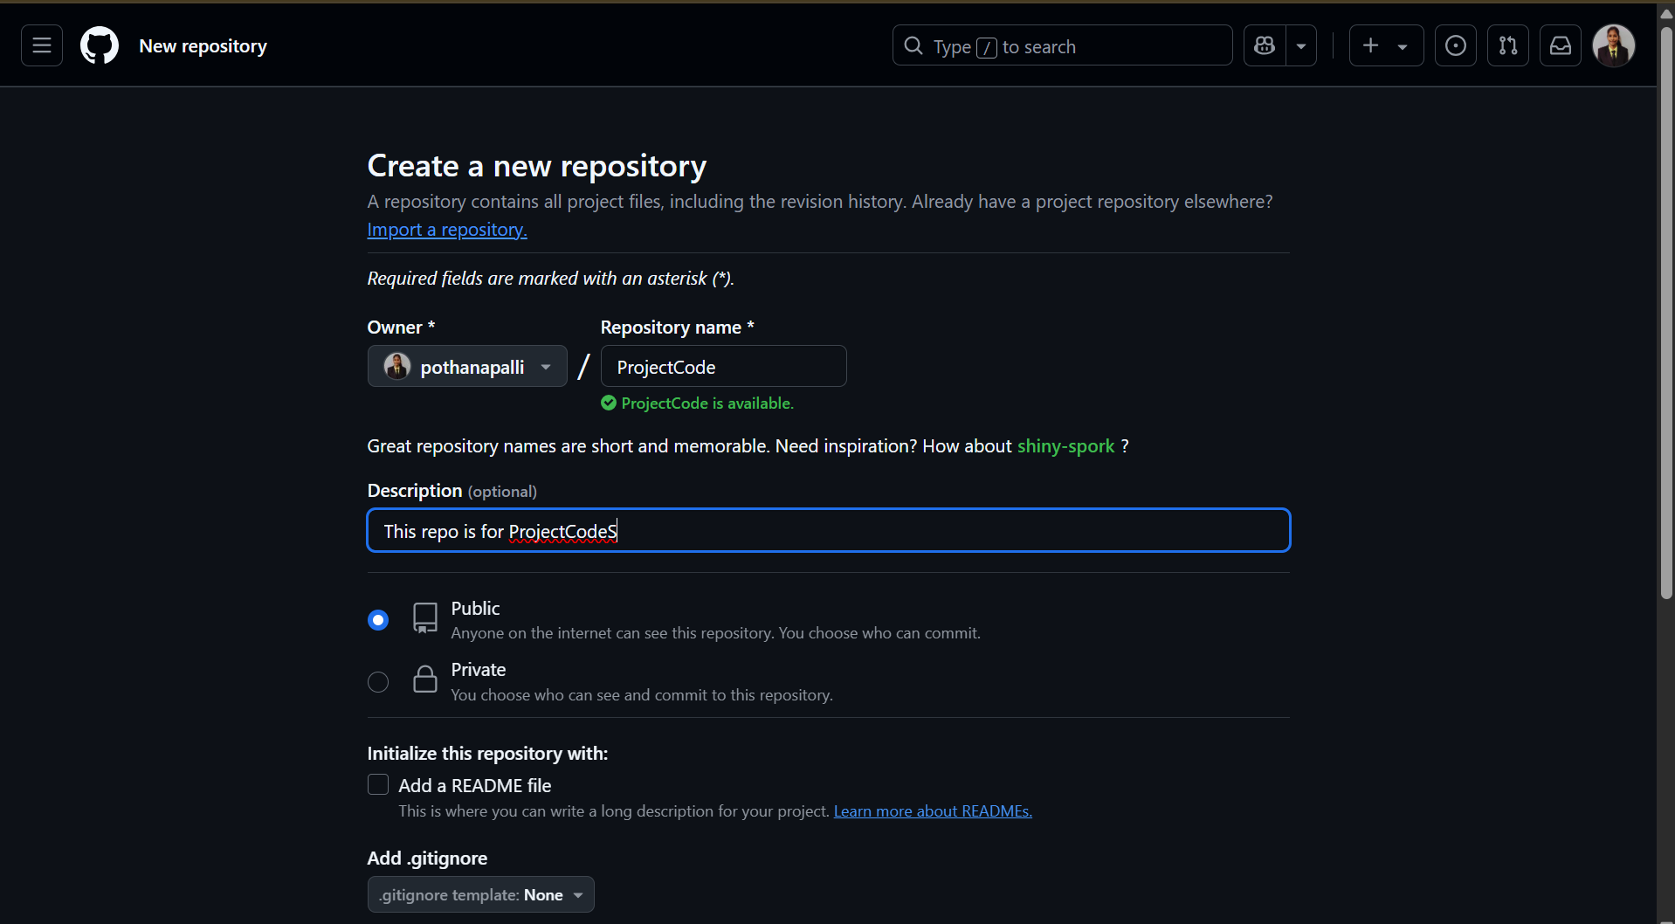

Slide 10
→ Jenkins and GitHub Integration

Slide 11
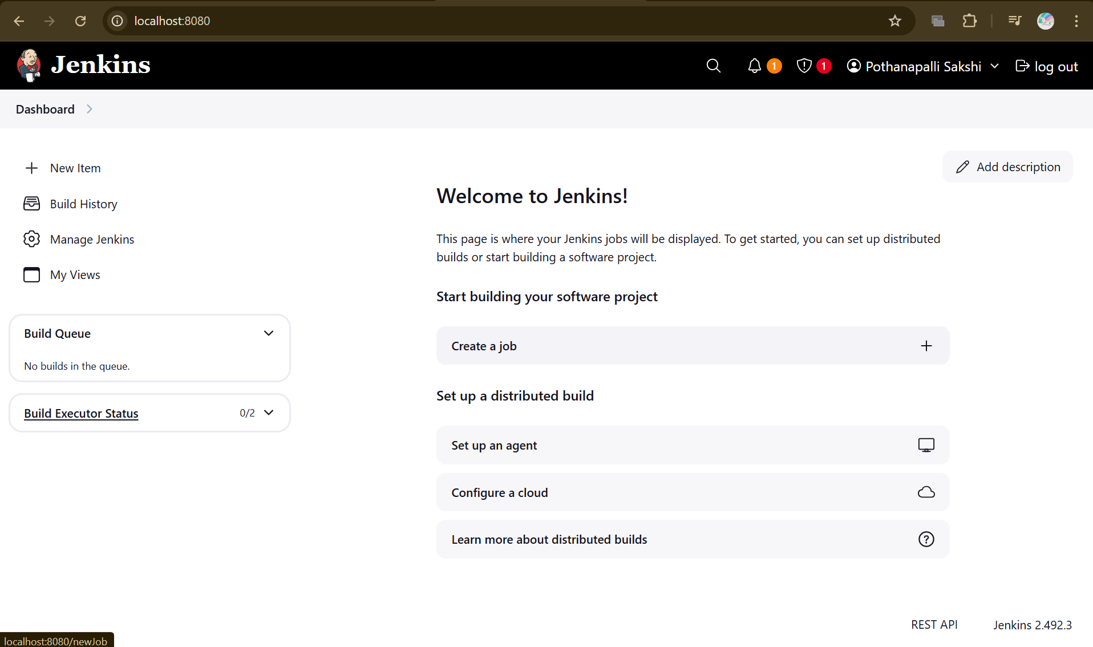

Slide 12
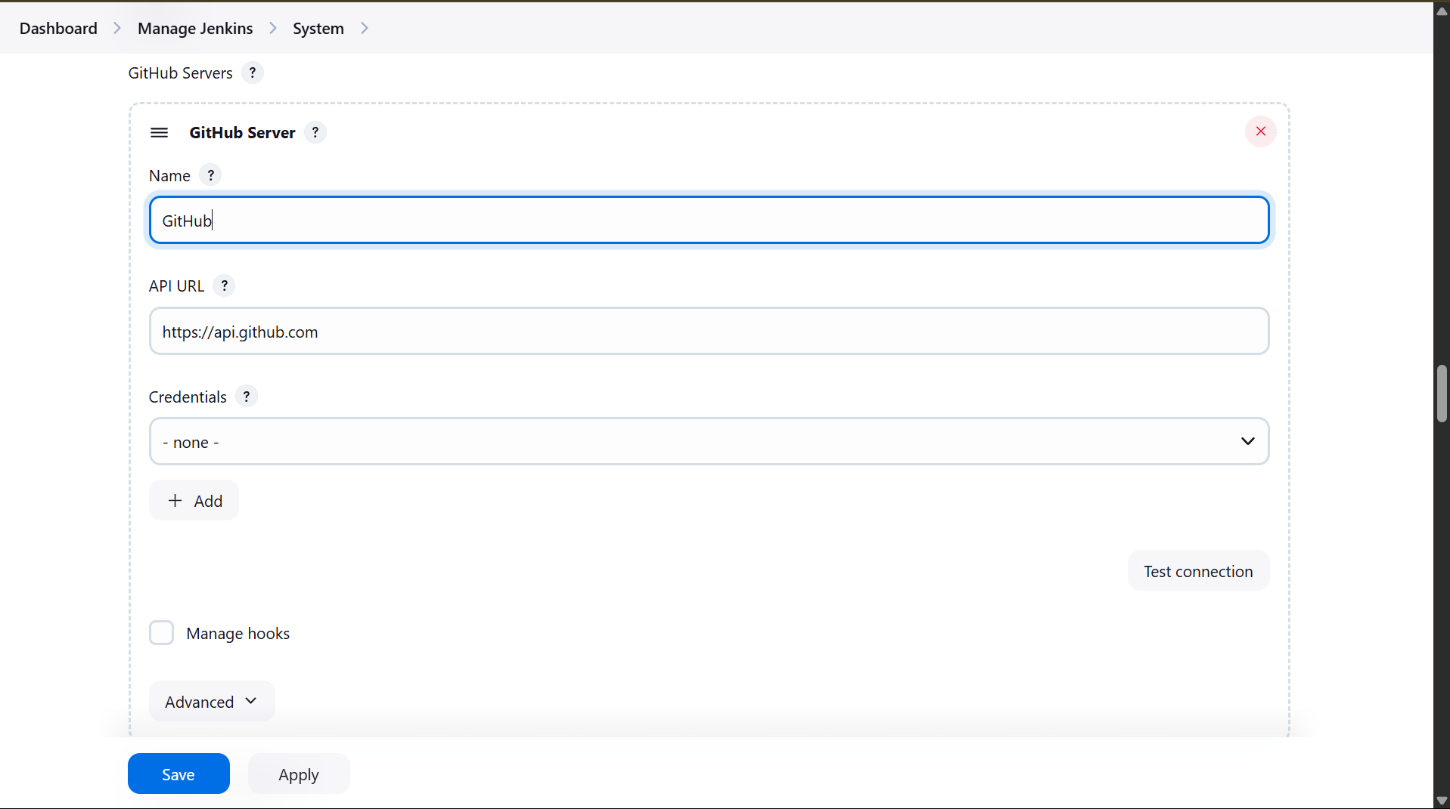

Slide 13
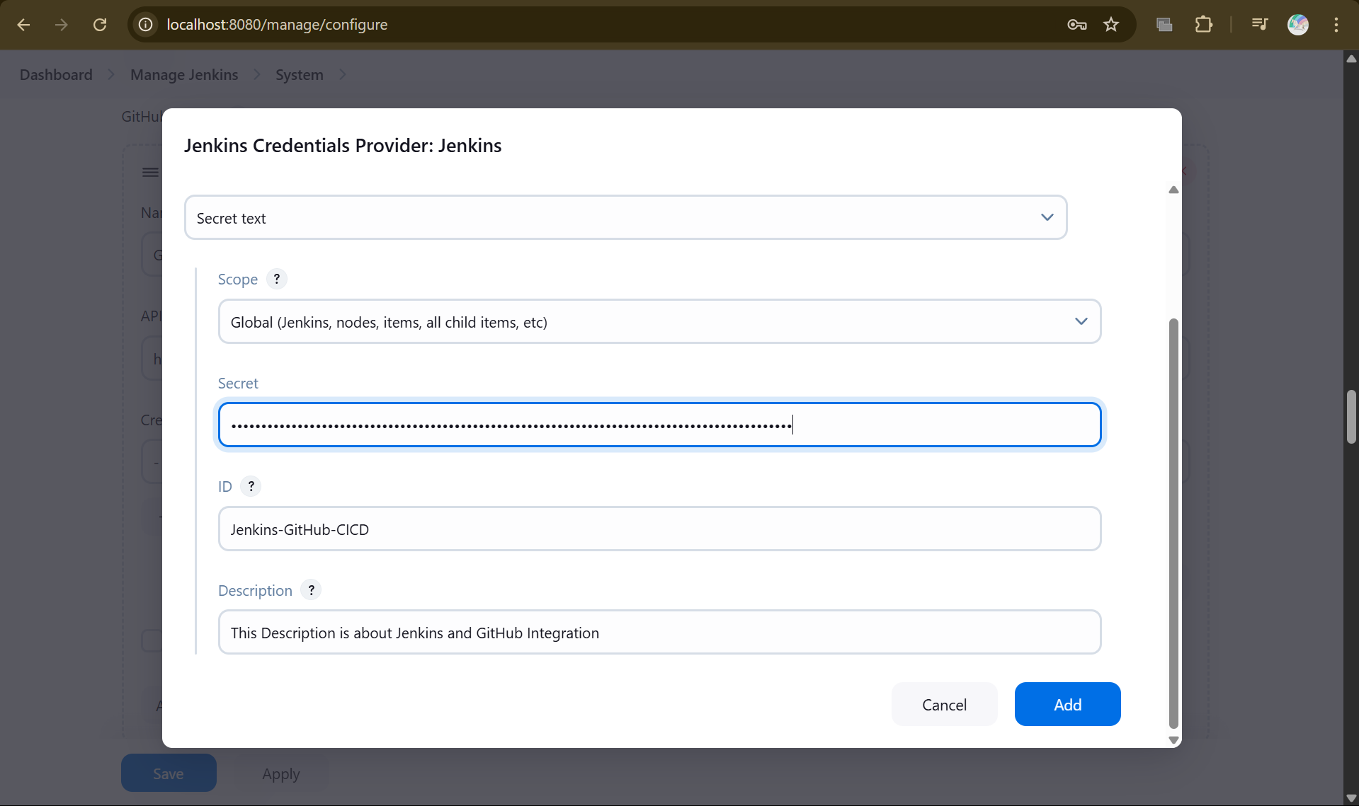

Slide 14
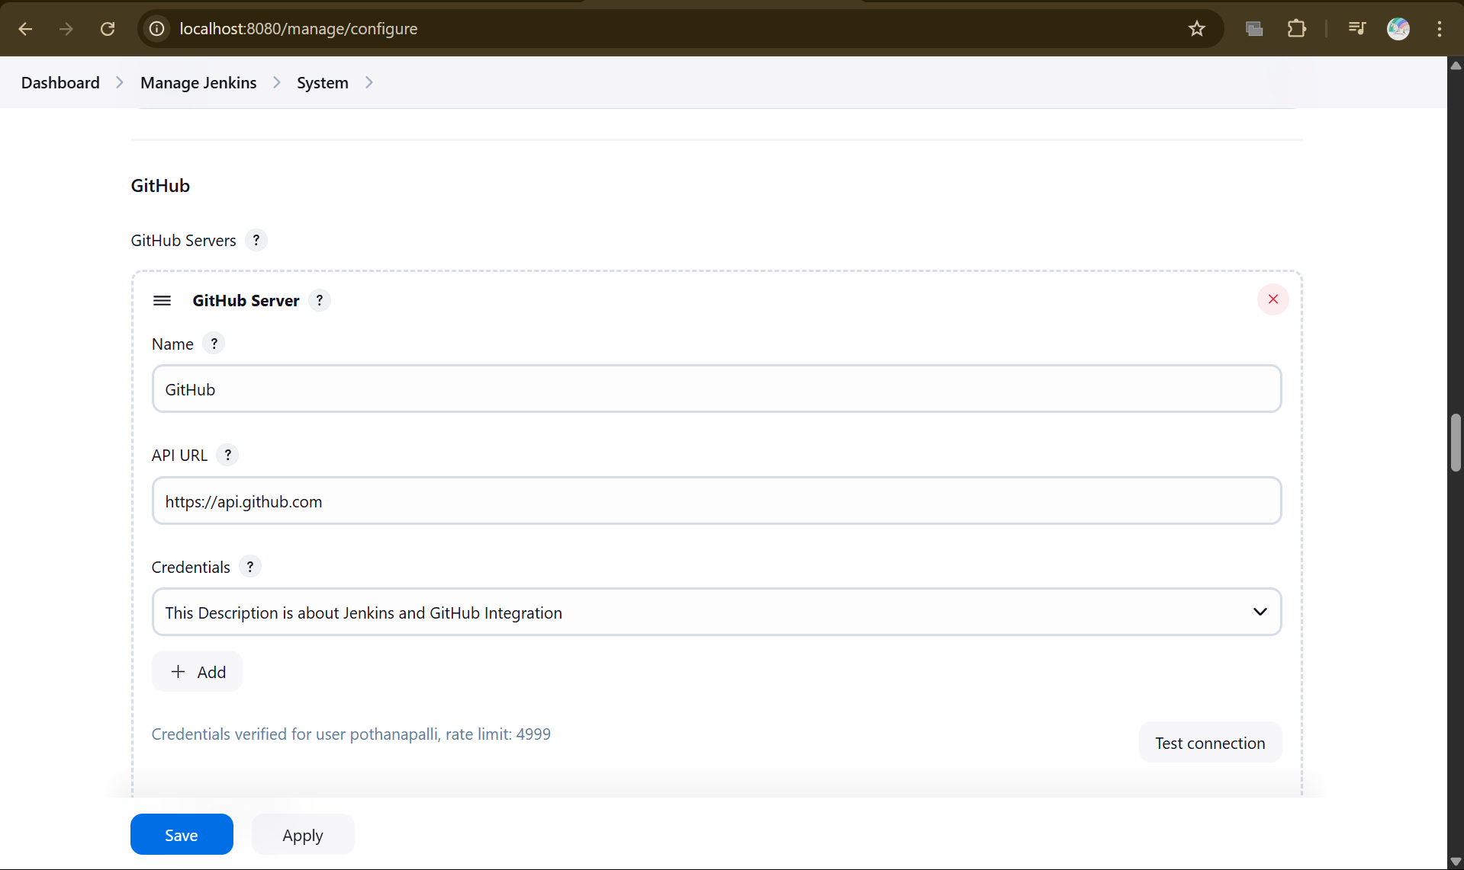

Slide 15
→ CI/CD Pipeline

Slide 17
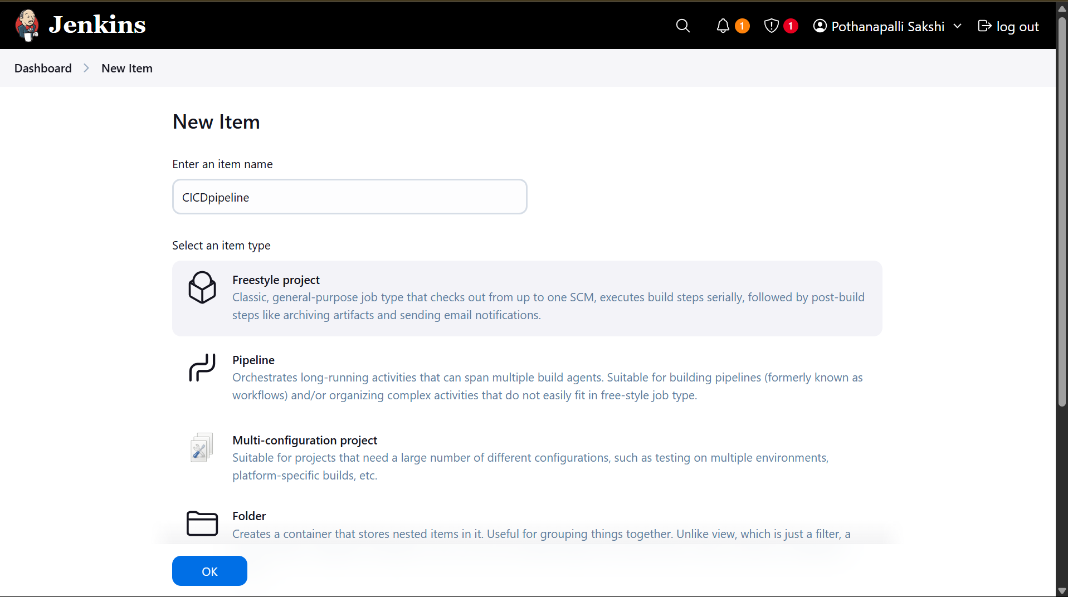

Slide 18
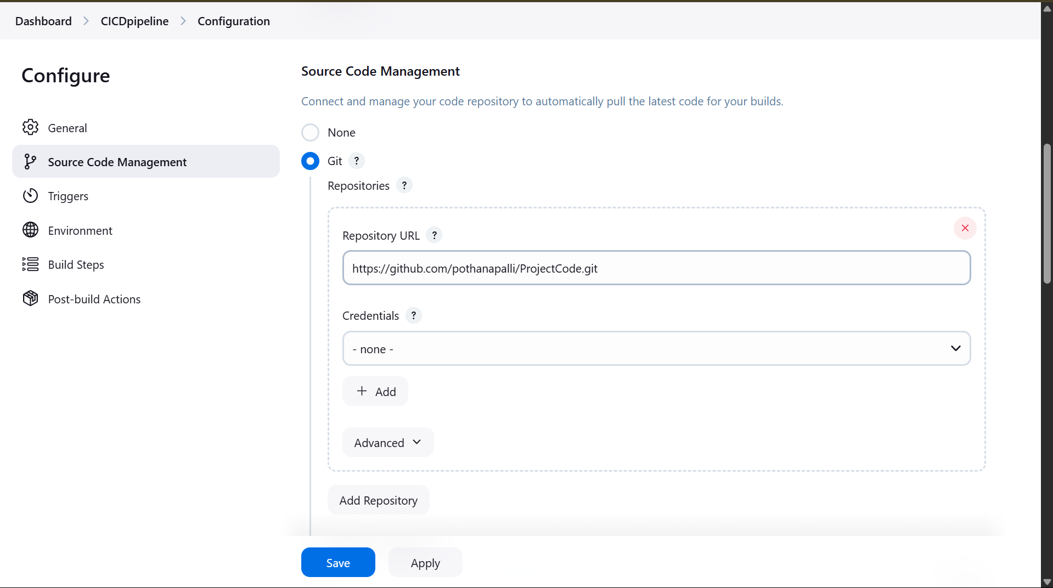

Slide 19
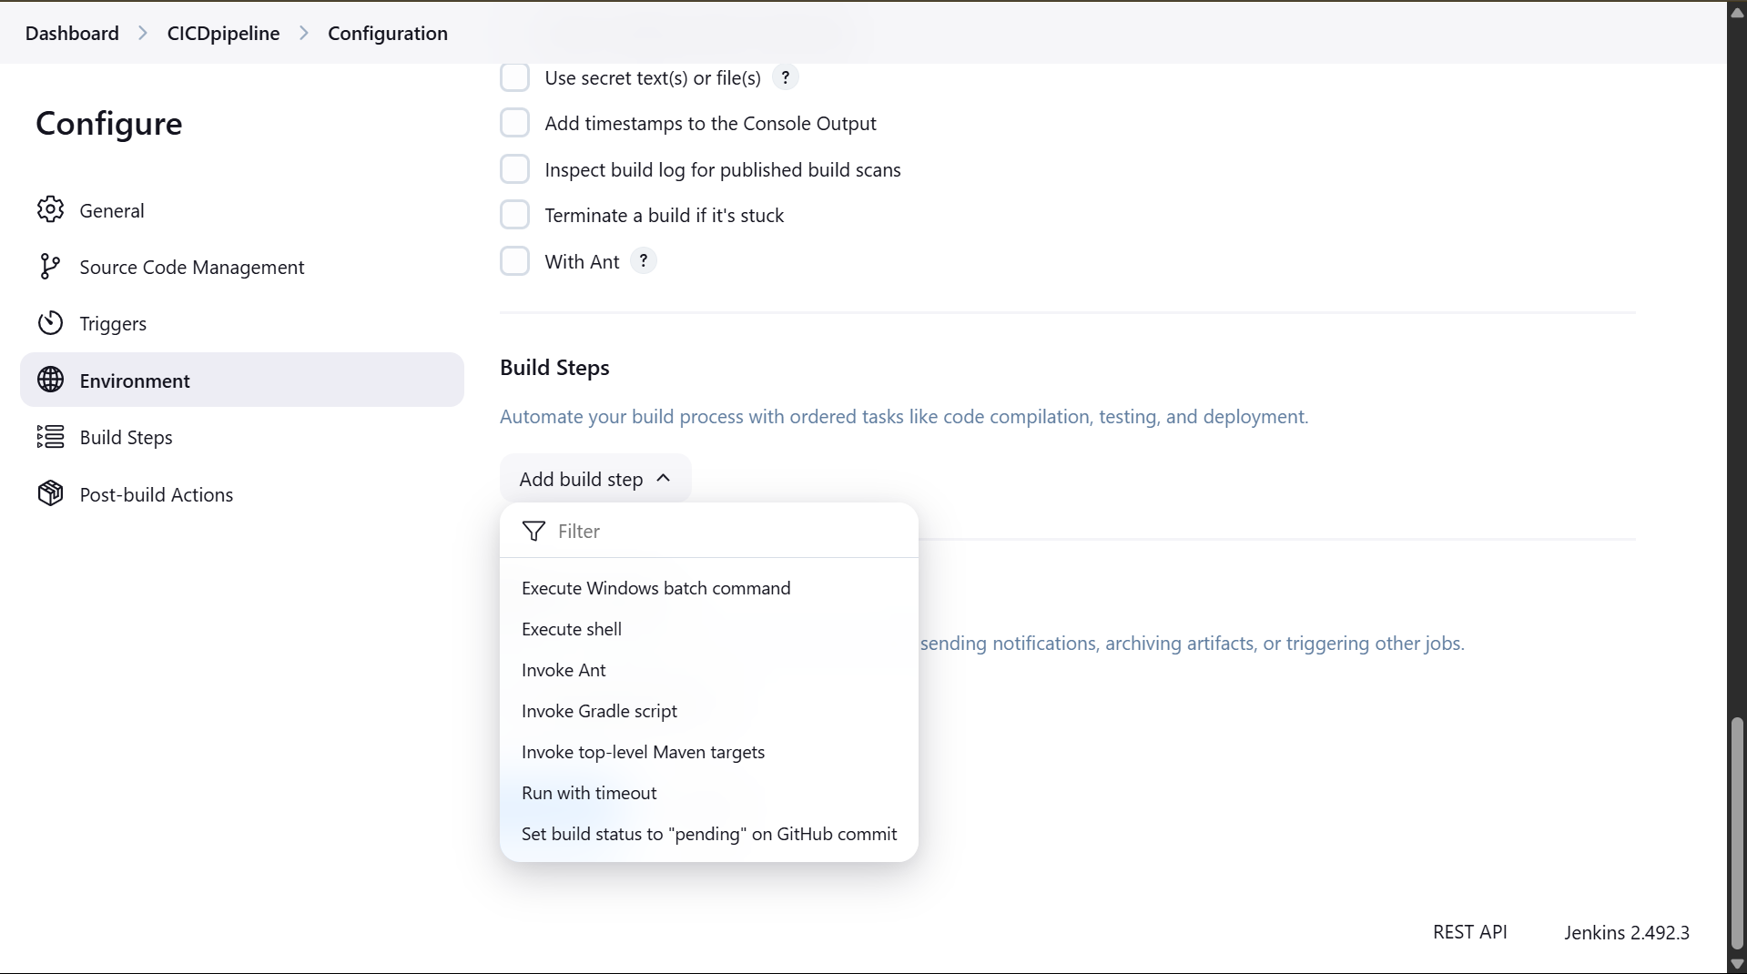

Slide 20
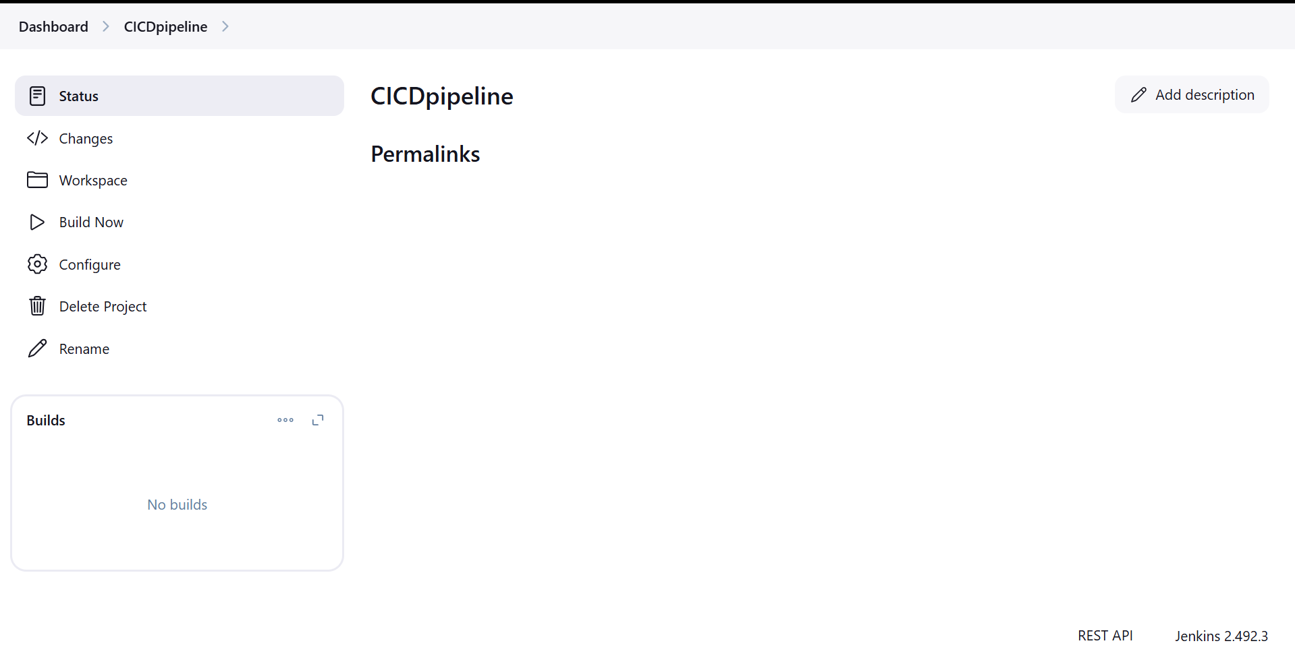

Slide 21
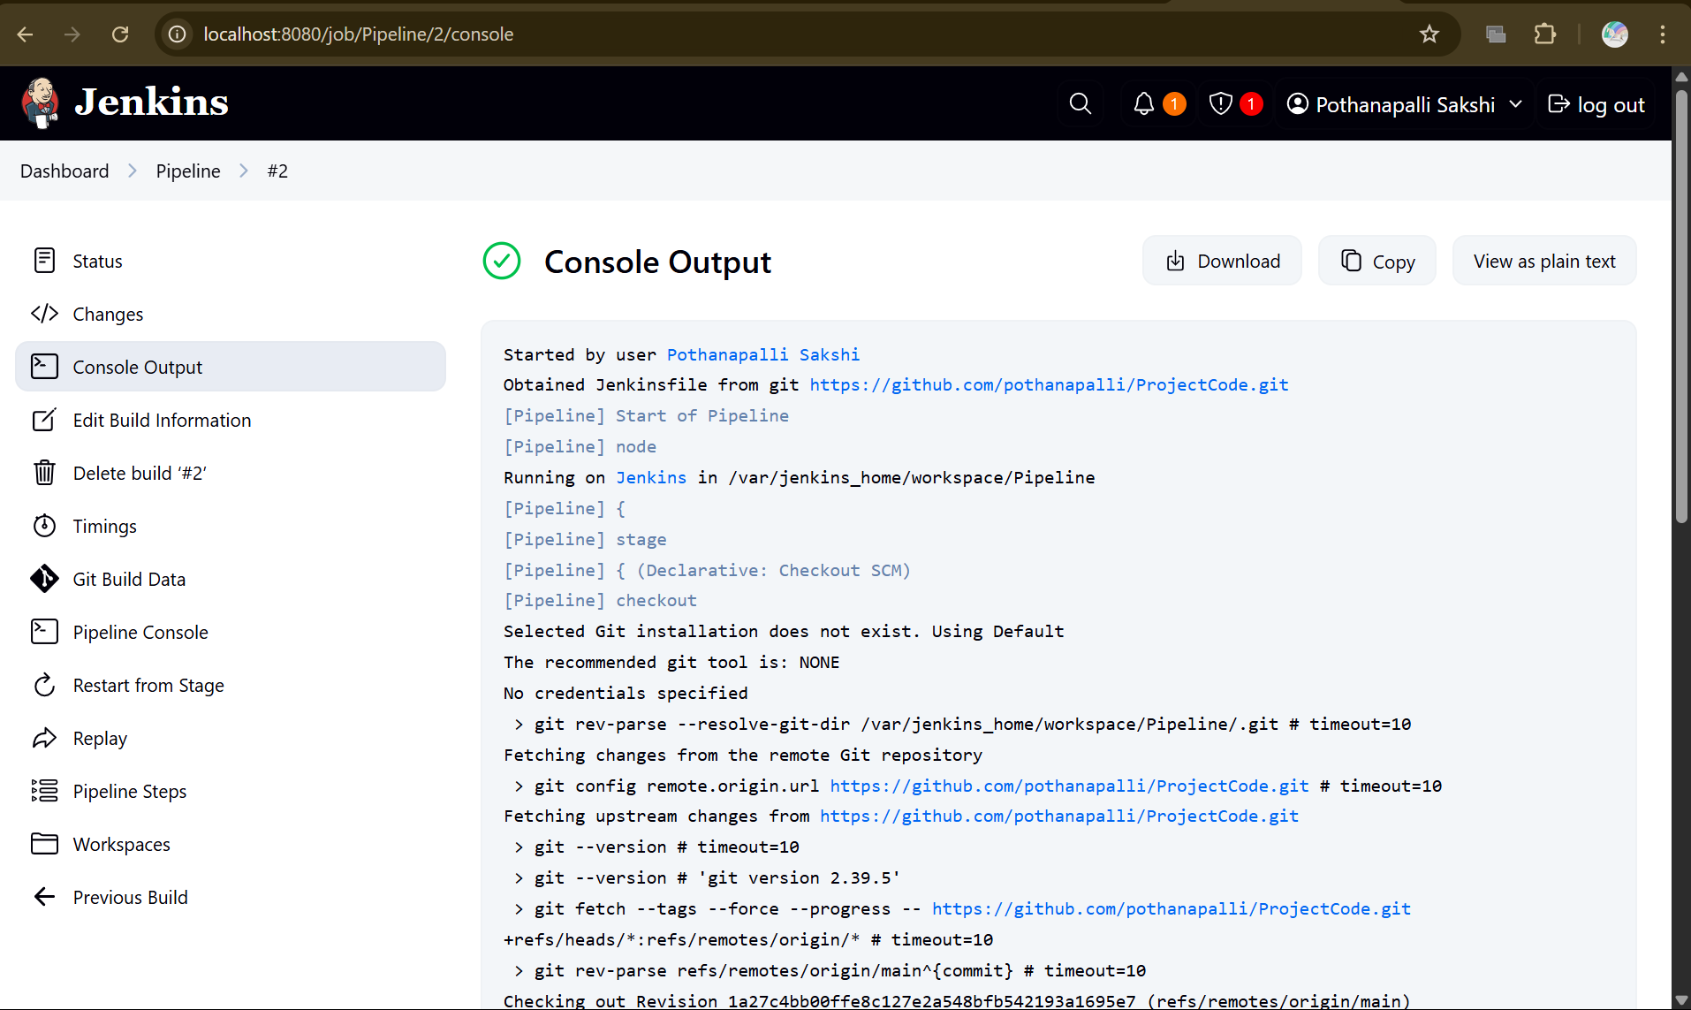

Slide 22
Final Summary: Jenkins CI/CD Deployment Hub
"To automate your software workflow with Jenkins, first create a Personal Access Token (PAT) in GitHub to securely connect Jenkins. Next, integrate Jenkins with GitHub by adding the PAT in Jenkins' settings. Finally, create a CI/CD pipeline that defines steps to checkout, build, test, and deploy your code—making the entire process fast, reliable, and hands-free. This setup saves time, reduces errors, and lets you focus on writing great code!"

Slide 23
Tools Used:
GitHuB
Jenkins
Docker

Slide 24
END

