Slide 1

React Native UI Kits
Group Member:
Pothea Chorn
Sereyratha Chann
Sokny Norn
Sreynieth Leourn
Da Duon
Group 5

Slide 2
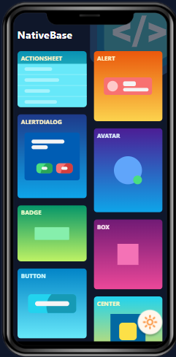
Native Base
Package:
npm i native-base
const Example = () => {
return <Box alignItems="center">
<Button onPress={() => alert("hello world")}>Click Me</Button>
</Box>;
};
Reference :
https://docs.nativebase.io/button#h3-basic
or
https://www.npmjs.com/package/native-base
Note: add - -legacy-peer-deps parameter if there is unresolved dependencies tree error when you install.

Slide 3
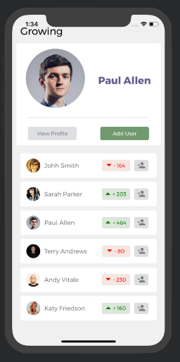
React Native Elements
npm install @rneui/themed @rneui/base
<Stack row align="center" spacing={4}>
<Button title="Solid" />
<Button title="Outline" type="outline" />
<Button title="Clear" type="clear" />
</Stack>
Reference :
https://reactnativeelements.com
Note: add - -legacy-peer-deps parameter if there is unresolved dependencies tree error when you install.

Slide 4
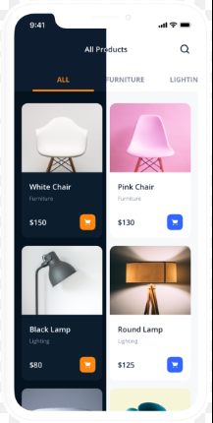
UI Kitten
npm i react-native-ui-kitten @eva-design/eva
<Layout style={styles.container} level='1'>
<Button style={styles.button} appearance='filled'>
FILLED
</Button>
</Layout>
Reference :
https://akveo.github.io/react-native-ui-kitten/#kitten-tricks
Note: add - -legacy-peer-deps parameter if there is unresolved dependencies tree error when you install.

Slide 5
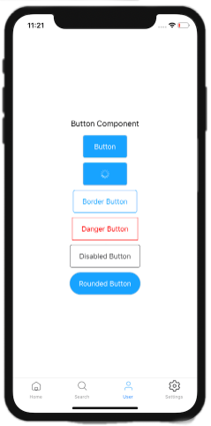
React Native Starter Kit
npm i react-native-app-starter
import { Button } from '../components'<Button style={styles.demoButton}
primary disabled
caption="Button"
onPress={() => {}}/>
Reference :
https://docs.reactnativestarter.com/
Note: add - -legacy-peer-deps parameter if there is unresolved dependencies tree error when you install.

Slide 6
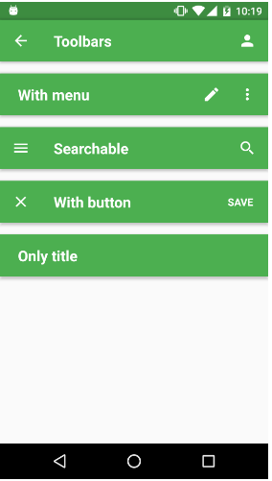
React Native Material UI
npm i react-native-material-ui
import { Button } from 'react-native-material-ui';
render() {
<View>
<Button primary text="Primary" />
</View>
}
Reference :
https://github.com/xotahal/react-native-material-ui
Note: add - -legacy-peer-deps parameter if there is unresolved dependencies tree error when you install.

