Slide 1
ACE
Engineering College
An AUTONOMOUS Institution
Department Of Computer Science and Engineering
I Year B .Tech Semester – II Section - A
PYTHON PROGRAMMING LAB
REAL TIME PROJECT
On
“WEBSITE BLOCKER ”
By
*co Ordinator :
BN REDDY SIR
CSE DEPARTMENT
24AG1A0502-AMITH
24AG1A0546-BHAVYA SRI.P
24AG1A0553-R.DHARANI REDDY

Slide 2

Website blocker
. A website blocker is a tool that prevents users from accessing specified websites by modifying the system’s host file.
This project implements a simple GUI-based website blocker using Python and Tkinter.

Slide 3
TECHNOLOGIES USED
Technologies Used:
Language: Python
GUI: Tkinter
File Operations: Python built-in file handling
OS Interaction: Host file manipulation

Slide 4
ALGORITHM FOR WEBSITE BLOCKER
✅ Simple Algorithm: Website Blocker
Start
Set the websites to block (like facebook.com, youtube.com)
Set working hours (e.g., from 9 AM to 5 PM)
Repeat Forever
Get the current time
If current time is within working hours:
Open the hosts file
Add blocked websites if not already present
Else (outside working hours):
Open the hosts file
Remove the blocked websites if present
Wait for 5 minutes
Go back to step 4

Slide 5
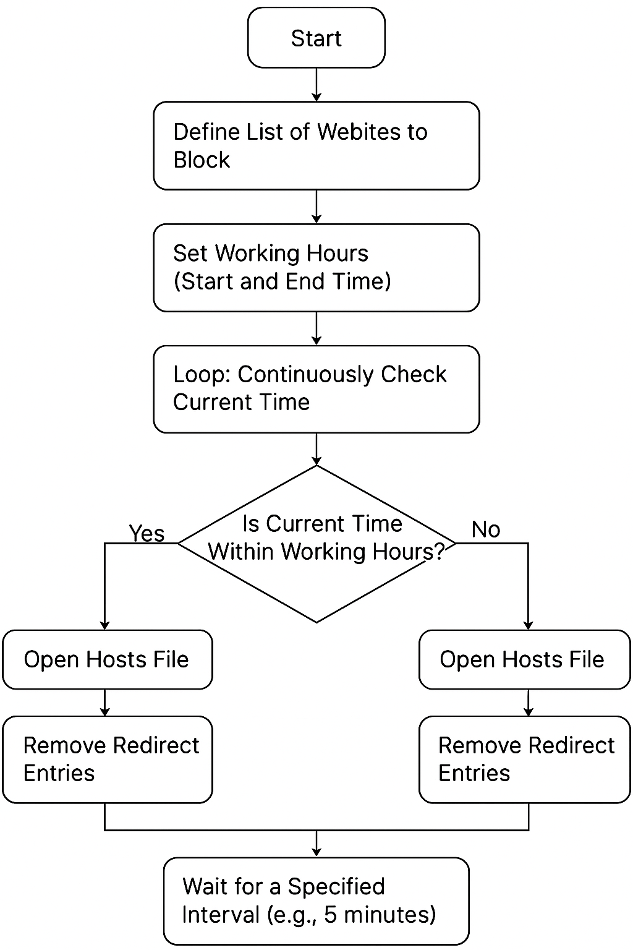
F
L
O
W
C
H
A
R
T

Slide 6
LIBRARIES AND IMPORT STATEMENT REQUIREMENTS
import os # Used to detect the OS (Windows/Linux).
import tkinter as tkz #GUI library to build the interface.
from tkinter import END, Label, messagebox
# Set path and IP for blocking
host_path = r'C:\Windows\System32\drivers\etc\hosts' if os.name == 'nt' else '/etc/hosts'
ip_address = '127.0.0.1'

Slide 7
FUNCTION TO BLOCK WEBSITES
def block():
ws_list = en1.get("1.0", END) ## Get text from input box
ws = [w.strip() for w in ws_list.split(",") if w.strip()] ## Clean and split
try:
with open(host_path, 'r+') as host_file:
file = host_file.read() ## Read entire file contents
for w in ws:
if w in file or f"www.{w}" in file:
msg = "Already Blocked!"
else:
host_file.write(ip_address + " " + w + '\n')
host_file.write(ip_address + " www." + w + '\n')
msg = "Website(s) Blocked!"
Label(root, text=msg, font=('Arial', 12, 'bold'), bg='#515151',fg='white').place(x=90, y=160)
except PermissionError:
messagebox.showerror("Permission Denied", "Run this program as Administrator.")

Slide 8
FUNCTION TO UNBLOCK WEBSITES
def unblock():
ws_list = en1.get("1.0", END)
ws = [w.strip() for w in ws_list.split(",") if w.strip()]
try:
with open(host_path, 'r+') as host_file:
lines = host_file.readlines()
host_file.seek(0)
for line in lines:
if not any(w in line for w in ws):
host_file.write(line)
host_file.truncate()
Label(root, text="Website(s) Unblocked!", font=('Arial', 12, 'bold'), bg='#515151', fg='white').place(x=90, y=160)
except PermissionError:
messagebox.showerror("Permission Denied", "Run this program as Administrator.")

Slide 9
CREATING GUI WINDOW USING TINKER LIBRARY
root = tk.Tk()
root.title("Website Blocker")
root.geometry("400x260")
root.config(bg="#515151")
root.resizable(False, False)
Label(root, text="Website Blocker", font=('Arial', 16, 'bold'), bg='#515151', fg='white').pack(pady=10)
Label(root, text="Enter websites (comma-separated):", font=('Arial', 10), bg='#515151', fg='white').place(x=20, y=60)
en1 = tk.Text(root, height=2, width=40, font=('Arial', 10))
en1.place(x=20, y=85)
tk.Button(root, text="Block", font=('Arial', 10, 'bold'), bg="red", fg="white", width=10, command=block).place(x=80, y=200)
tk.Button(root, text="Unblock", font=('Arial', 10, 'bold'), bg="green", fg="white", width=10, command=unblock).place(x=220, y=200)
root.mainloop()

Slide 10
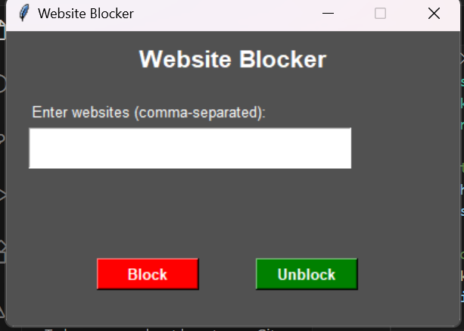
GUI WINDOW FOR OUTPUT

Slide 11
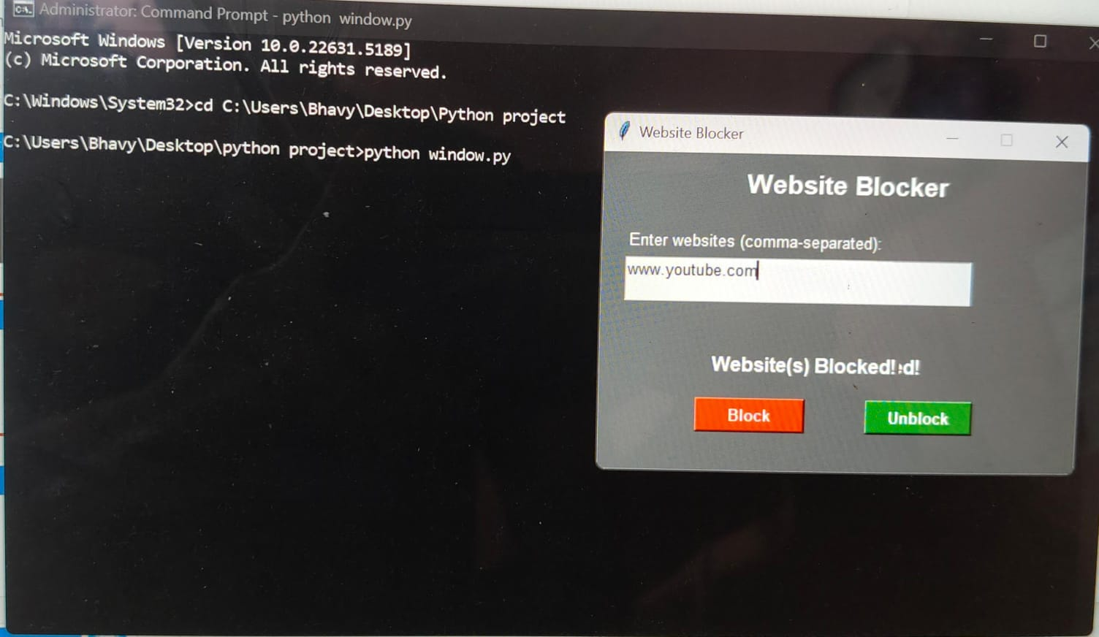

Slide 12


Websites before and after unblocking

Slide 13
CONCLUSION
This project successfully demonstrates how Python can be used to develop a practical utility to block distracting websites.
It simplifies a system-level operation through a user-friendly interface, making it accessible even to non-technical users.

Slide 14
REFERENCES
Medium: https://medium.com/dataflair/python-website-blocker-control-your-web-access-39ebc82e948d
Python Documentation: https://docs.python.org
Tkinter Docs: https://docs.python.org/3/library/tkinter.html

