Slide 1
Cluster-Based Retrieval Using Language Models Xiaoyong Liu and W. Bruce Croft Proceedings of the 27th Annual International ACM SIGIR Conference on Research and Development in Information Retrieval. ACM, 2004. A Cluster-Based Resampling Method for Pseudo-Relevance Feedback Kyung Soon Lee, W. Bruce Croft, and James Allan Proceedings of the 31st Annual International ACM SIGIR Conference on Research and Development in Information Retrieval. ACM, 2008.
Presented by Polykarpos Thomadakis
CS 834 - Introduction to Information Retrieval
Fall 2017
Old Dominion University

Slide 2
Cluster Based Retrieval
Based on the hypothesis that similar documents will match the same information needs
Groups documents into clusters and returns a list of documents based on the clusters they come from
Two approaches:
Clustering the entire collection and then perform document based retrieval (Static clustering)
Query-specific clustering. Cluster only the documents retrieved from document based retrieval

Slide 3
Clustering Methods
Static Clustering
Two ways to do use it
Use clusters as a way to identify the subset of documents that are more likely to be relevant, so that only those documents will be matched to the query
Match the query to all clusters in the collection and rank clusters based on their similarity to the query. Documents in clusters with higher rank are considered more relevant
Query-specific Clustering
Perform the clustering to the set of documents returned from document based retrieval. This will smooth out the differences between representations of individual documents
If an optimal cluster exists and IR retrieves it then it will always perform better than a document-based retrieval
Clusters put in use “manually” based on already known relevance judgements

Slide 4
Cluster-based Language Models
Language Model (LM): Probability distribution over all terms in a language vocabulary
Organize documents around topics
Each cluster represents a topic containing only relevant documents
Language models are estimated per cluster
Language models are used as a representation of each topic and to select the right topics for a given story

Slide 5
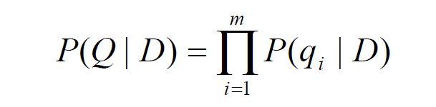
Cluster-based Retrieval using LM (Standard model)
The basic approach for using language models for IR is to model the query generation process
Rank the documents according to how likely the query Q could have been generated from the document models (referred as query-likelihood)
Where $q_{i}$is the $i_{th}$ term in the query and $P\left(q_{i} | D\right)$ is specified by

Slide 6
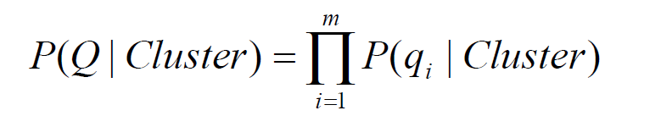
Cluster-based Retrieval using LM (CQL model)
Rank the clusters (instead of individual documents) according to how likely the query Q could have been generated from their models
Automates relevance extraction
Where $P(q_{i}|Cluster)$ is specified by the cluster language model CQL

Slide 7
Cluster-based Retrieval using LM (CBDM model)
Smooth documents language models using models of the clusters that they come from
The cluster model is first smoothed with the collection model, and the document model is then smoothed using the smoothed cluster model
Where P(W|Cluster) is given from the CQL model

Slide 8
Clustering Algorithms
First define similarity measures:
Cosine measure
Dice coefficient
Jaccard coefficient
Overlap coefficient
Kullback-Liebler divergence
For static clustering:
3-pass K-means algorithm
For query-specific clustering:
Single linkage
Complete linkage
Group average
Centroid
Ward’s method

Slide 9
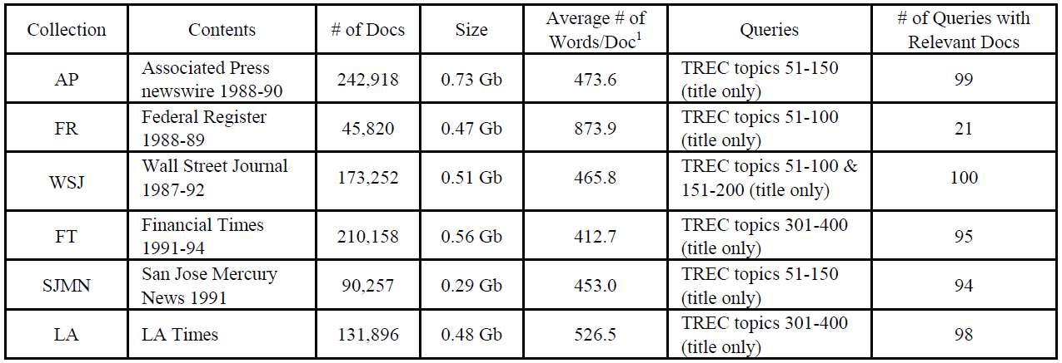
Experiment Setup
Parameter tuning was executed on AP before the actual tests took place. All sets but FR are homogenous, for this reason FR is the most difficult case and extra tuning was
performed specifically for it

Slide 10
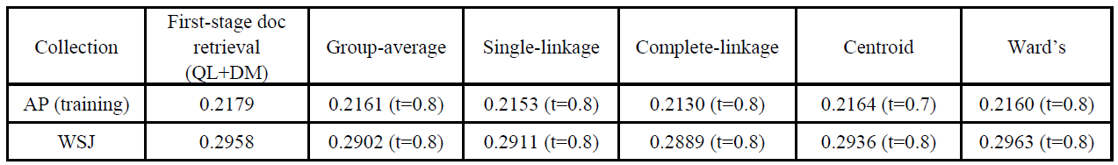
Experimental Design (CQL)
Investigate whether CQL can perform good quality cluster ranking
Five different clustering algorithms
Various similarity thresholds
Two smoothing techniques
Results compared to the standard document based query-likelihood
First perform document based retrieval using standard model, then use CQL to cluster the top 1000 documents retrieved

Slide 11
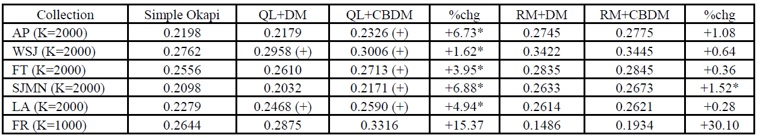
Experimental Design (CBDM)
Examine the effectiveness of cluster-based retrieval CBDM
Query likelihood (QL) retrieval context
Relevance model (RM) context
For static clustering and query-specific clustering
Compared with that used in the original document model

Slide 12
Cluster-Based Retrieval Using Language Models Xiaoyong Liu and W. Bruce Croft Proceedings of the 27th Annual International ACM SIGIR Conference on Research and Development in Information Retrieval. ACM, 2004. A Cluster-Based Resampling Method for Pseudo-Relevance Feedback Kyung Soon Lee, W. Bruce Croft, and James Allan Proceedings of the 31st Annual International ACM SIGIR Conference on Research and Development in Information Retrieval. ACM, 2008.

Slide 13
Relevance Feedback
Take the results that are initially returned from a given query
Gather user feedback
Use the feedback to find out whether those results are relevant
Perform a new query based on this information to have better results

Slide 14
Pseudo-Relevance Feedback
Same as before but..
Use top-retrieved documents as feedback instead of user’s response
Assuming that top-retrieved documents are relevant
However, top retrieved documents may contain non-relevant documents (“noise”)
Resulting in drifting the query representation away from the original query
Selecting the appropriate documents is crucial for effective pseudo-relevance feedback

Slide 15
Cluster-based IR and Pseudo-Relevance Feedback
Selective Resampling Approach
Select randomly from the original sample
Selective sampling
Boosting: Adaptively change the distribution of training examples focusing on weak learners
Skipping some top retrieved documents
Using a query-regularized estimation method
Leaving a single term of the query out as a noisy term
Cluster-based Approaches
Re-ranking using clusters
Cluster-based resampling

Slide 16
Cluster-Based Selective Resampling
Based on the language and relevance model frameworks
A dominant document for a query is one with good representation of the topics of a query
For example, one with several nearest neighbors with high similarity
In overlapped clusters, will appear in multiple highly-ranked clusters
From such a dominant document, expansion terms that retrieve related documents can be selected

Slide 17
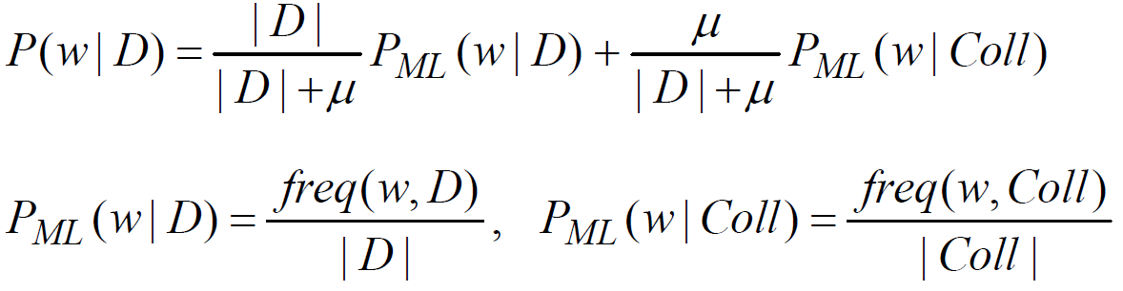
Resampling Process
Documents are retrieved for a given query by the query likelihood language model
Clusters are generated by k-nearest neighbors clustering method for the top-retrieved N documents
The clusters are ranked by a cluster-based query-likelihood language model (CQL) and the dominant documents are retrieved
The dominant documents are repeatedly being fed for the resampling process

Slide 18
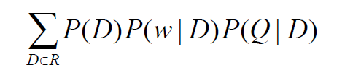
Resampling Process (cont.)
Expansion terms are selected using the relevance model for each dominant document in the top-ranked clusters.
The probability of a word in the distribution is estimated by
Finally, the most likely terms are chosen and combined with the original query
R: set of pseudo-relevant documents

Slide 19
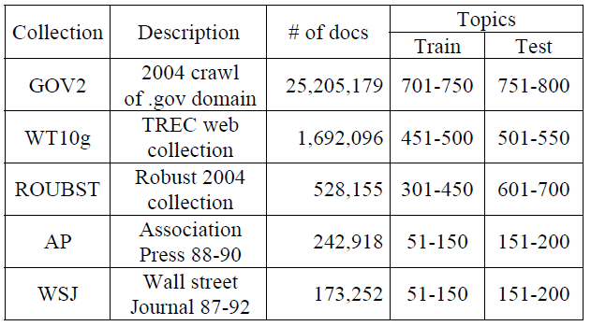
Experimental Setup
Each test collection, topics divided into training and test topics
Training topics are used for parameter estimation and the test topics are used for evaluation

Slide 20
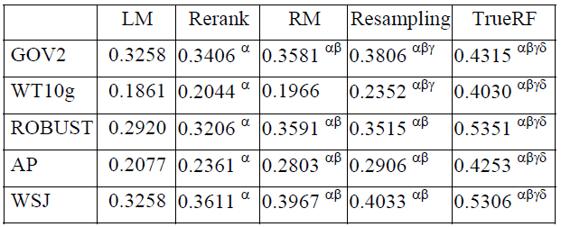
Test Collection Results
LM: Language Model RM: Relevance Model Rerank: Reranking using clusters TrueRF: True Relevance Feedback

Slide 21

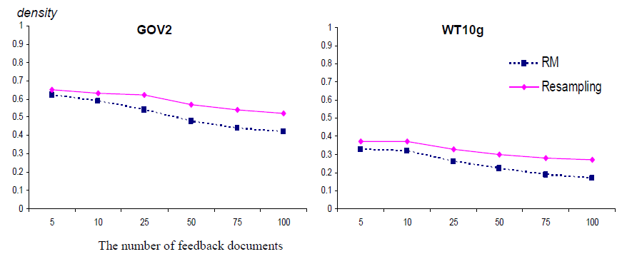
Justification by Relevance Density
Relevance density is measured to justify the assumption that dominant documents are relevant to the query

