Slide 1
Hybrid Index Structures for Location-Based Web Search Y. Zhou, X. Xie, C. Wang, Y. Gong, and W. Ma. In Proceedings of the 14th ACM international conference on Information and knowledge management Processing Spatial-Keyword Queries in Geographic Information Retrieval Systems R. Hariharan, B. Hore, C. Li and S. Mehrotra. 19th International Conference on Scientific and Statistical Database Management (SSDBM 2007)
Presented by: Thomadakis Polykarpos
CS 834 – Introduction to Information Retrieval
Fall 2017
Old Dominion University

Slide 2
Location-based web search
Location-specific information common on Web
Nearly one fifth of web search related to place/region
Mostly useful for mobile users
Efficiently indexing and searching location-specific information is a key problem
Naïve approach: treat location information as common keywords
Neglects spatial relationships

Slide 3
Solution
Design an indexing structure that considers both spatial and textual features
Three approaches tested
Inverted file and R*-tree double index
First index file then R*-tree
First R*-tree then inverted file

Slide 4
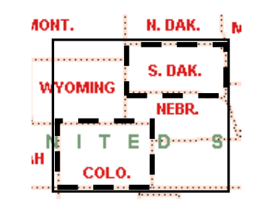
Preliminaries: MBR
Minimum Bounding Rectangles (MBRs) can be used for a simple approximation to region’s shape
Only two diagonal points needed to represent location
Memory efficient and simple for computations
Multiple MBRs per web page can be used

Slide 5
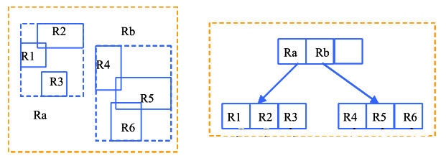
Preliminaries: R*-tree
MBR structure where the parent node contains all sub-MBR regions.
Useful to represent part-of relationships
Used to extract the geographical scope of web pages

Slide 6
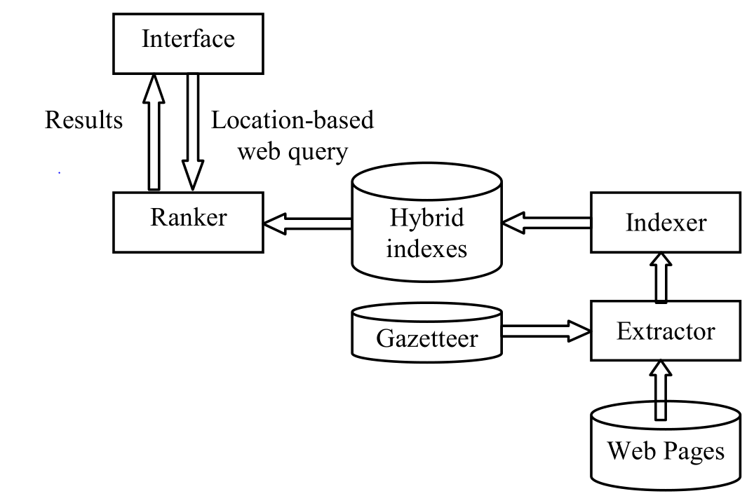
Framework
Accepts input in map region or text
Builds hybrid index structures
Combines textual and spatial relevant pages and ranks them
Extracts geographical information
Translates geographical information to MBRs

Slide 7
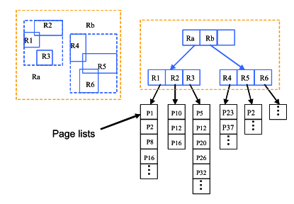
Approach 1: Inverted file and R*-tree double index
Web pages indexed separately twice
By R*-tree for MBRs
By inverted file for keywords
R*-tree leaves contain points to a page list
Query answering:
Retrieve page lists with the keywords from inv. Index
Retrieve MBRs for R*-tree and the corresponding page lists
Merge the two lists

Slide 8
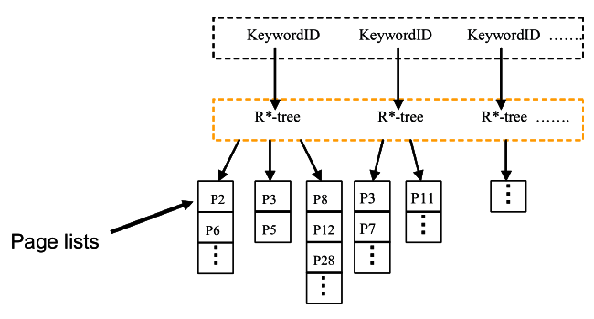
Approach 2: First Inverted File Then R*-tree
Each keyword points to an R*-tree
Built on the different MBRs of the pages of the in its page list according to their geographic scope
Answering queries:
Retrieve the keywords
Search in the corresponding R*-trees and get their page lists
Merge the page lists returned by the R*-trees

Slide 9
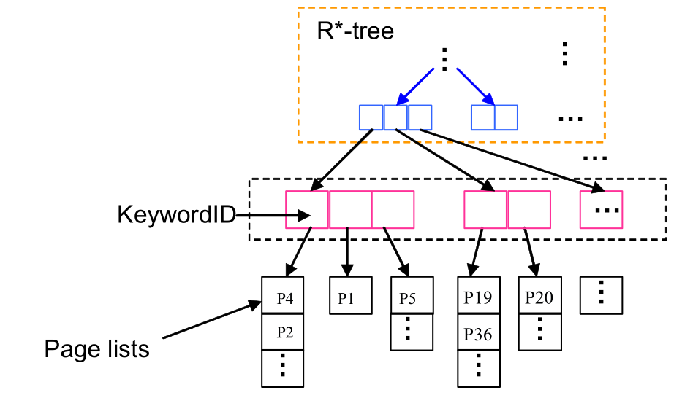
Approach 3: First R*-tree Then Inverted File
R*-tree is built on all MBRs included in scopes of all web pages
Web pages assigned to MBRs according to their scopes
All pages of each MBR are textually indexed by keywords
Answering queries
Get the MRBs from the R*-tree
For each MRB, retrieve the keywords’ page lists
Merge the page lists

Slide 10
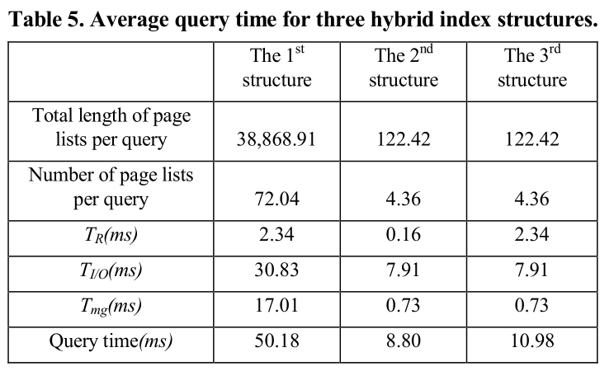
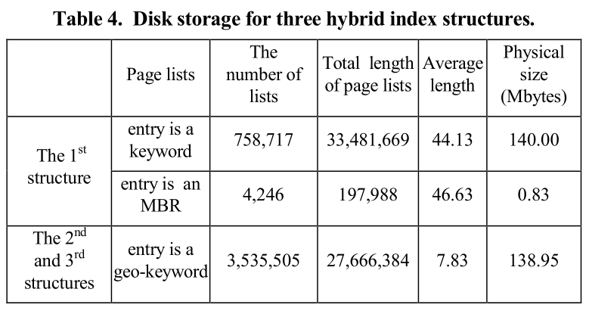
Results

Slide 11
Why Processing Queries in GIS?
GIS databases contain vital location-based information for applications such as:
disaster management
national infrastructure protection
crime analysis
Crucial to be able to answer geographic based queries e.g:
Find shelters with emergency medical facilities in OrangeCounty.
Find earthquake-prone zones in Southern California.

Slide 12
GIS databases
Comprise of two components:
Spatial information
Textual information
Queries also contain spatial and textual components referred as spatio-keyword queries (SK)
Defined as {spatial part as MBR, set of keywords}
Answer is a set of objects which MBRs has a non-empty intersection with the query and contains ALL keywords in the query
Retrieval of such information referred as Geographic Information Retrieval (GIR)

Slide 13
Framework for GIR Systems
GIR Database
Can come from structured or unstructured data sources
Indexer
Indexes both textual and spatial information
Ranker
Ranks GIS objects based on their relevance to the SK query
Interface
Input using map and a text interface

Slide 14
Indexing Mechanisms
Separate index for spatial and textual attributes
Index of spatial data: Grid, Quadtree, R*-tree, etc.
Index of textual data: Inverted index
Pros
Ease of maintaining two separate indices
Cons
Too much traffic on the disk

Slide 15
Indexing Mechanisms (cont.)
Hybrid index combining spatial and text attributes
Inverted File – R*-tree
R*-tree – Inverted File
Cons
1st case: Does not take advantage of the association of keywords in space. Paying extra costs to access closely related SKs from different R*-tress
2nd case: Leverages the above disadvantage but spatial filtering generates many candidate objects

Slide 16
Proposed method: KR*-Tree
Prune text and space simultaneously, merging the two steps into one
Instead of pruning them separately or one after the other
Capture the joint distribution of keywords
Instead of maintaining them separately
Thus objects containing the query words are directly obtained without merging any lists
Similar to R*-tree – Inverted File but
Internal and leaf nodes augmented with a set of keywords appearing in the space covered by them

Slide 17
Answering SK Queries
First the children node ids of the current node that contain all the keywords in the query are obtained
Next, each of these children that has a non-empty intersection with the Q’s MBR is chosen for further traversal
Leaf children are added to the results, otherwise they are traversed recursively.
Finally, the set of objects that satisfy the query is returned

Slide 18
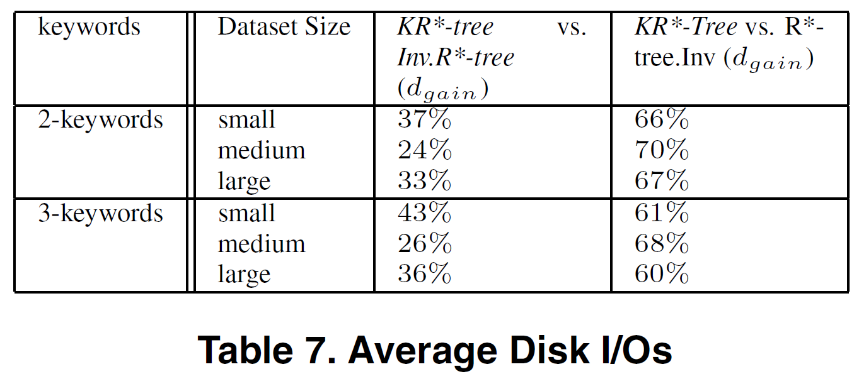
Results

