Slide 1
Fast On-line Index Construction By Geometric Partitioning Nicholas Lester, Alistair Moffat, And Justin Zobel Proceedings Of The 14th ACM International Conference On Information And Knowledge Management.
Efficient On-line Index Maintenance For Dynamic Text Collections By Using Dynamic Balancing Tree Ruijie Guo, Xueqi Cheng, Hongbo Xu, Bin Wang Proceedings Of The 16th ACM International Conference On Information And Knowledge Management.
Presented By : Polykarpos Thomadakis CS 834 – Introduction to Information Retrieval Fall 2017 Old Dominion University

Slide 2
Inverted Index
Consists of two main parts:
Vocabulary
Set of inverted lists of document pointers (postings)
May include within document frequencies and an extra list of positions
Sorted in document, frequency or impact order
Compressed to benefit space and query evaluation time
Stored on disk in single contiguous extent (partition)
1 disk seek + 1 disk read per query term

Slide 3
The Challenge
Adding new documents (postings) to the index is not trivial
Two approaches:
Off-line
Introduces lag to the availability of a new document for queries
Easier to implement
On-line
Data must be continuously queryable
More complex

Slide 4
Merge-based Index Update
Inverted index stored in two components
In-memory for recently included documents
On-disk for existing index
Periodically combined in a merging event and written back to disk
Effective because
Typical series of documents has many common terms => sequential access for merging
Random access operations take place in memory
Documents searchable immediately
However, querying more complex; must use both components

Slide 5
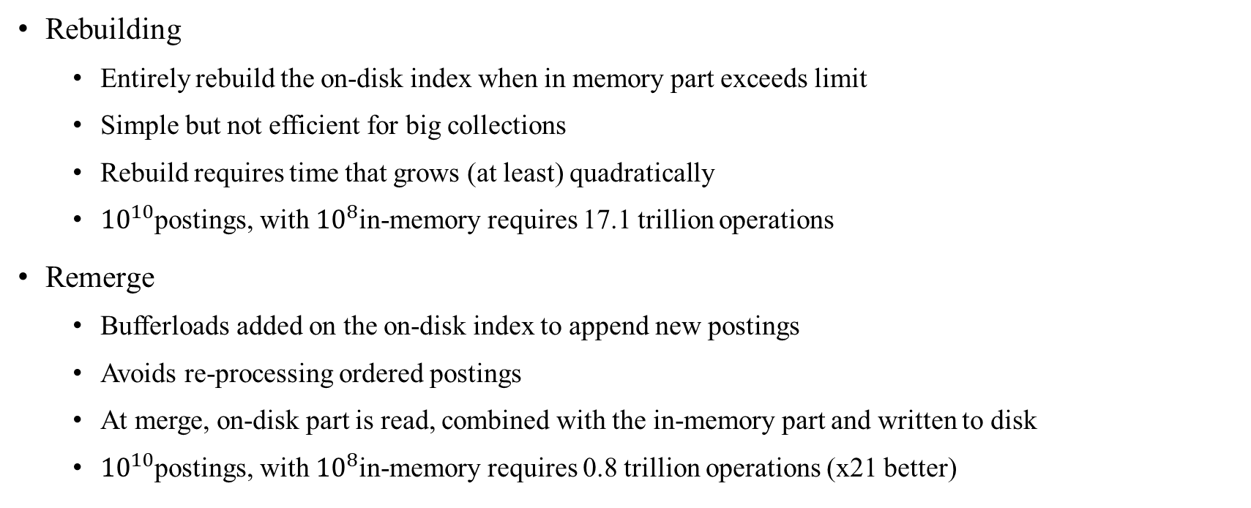
Index Maintenance Algorithms
Rebuilding
Entirely rebuild the on-disk index when in memory part exceeds limit
Simple but not efficient for big collections
Rebuild requires time that grows (at least) quadratically
${10}^{10}$postings, with ${10}^{8}$in-memory requires 17.1 trillion operations
Remerge
Bufferloads added on the on-disk index to append new postings
Avoids re-processing ordered postings
At merge, on-disk part is read, combined with the in-memory part and written to disk
${10}^{10}$postings, with ${10}^{8}$in-memory requires 0.8 trillion operations (x21 better)

Slide 6
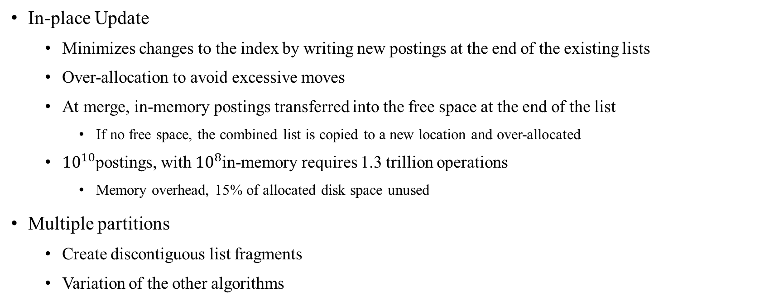
Index Maintenance Algorithms (cont.)
In-place Update
Minimizes changes to the index by writing new postings at the end of the existing lists
Over-allocation to avoid excessive moves
At merge, in-memory postings transferred into the free space at the end of the list
If no free space, the combined list is copied to a new location and over-allocated
${10}^{10}$postings, with ${10}^{8}$in-memory requires 1.3 trillion operations
Memory overhead, 15% of allocated disk space unused
Multiple partitions
Create discontiguous list fragments
Variation of the other algorithms

Slide 7
Geometric Partitioning
Break index into tightly controlled number of partitions
Partitions ordered on partition sizes
Smallest partition contains the most recent documents
Biggest partition contains the oldest ones
Blends the remerge and too-many fragments methods
Vocabulary entry records multiple disk addresses, one for each partition
Allows better merging than remerge
By giving more options to achieve the best merge with a bufferload
Faster querying than too-many fragments
By controlling the number of partitions

Slide 8
Hierarchical Merging
The key issue is to manage the sequence of mergings to minimize the total merging cost
The two lists should not differ significantly in size
Two approaches
Fix the number of postings per partition; parameter r
The limit to the number of pointers in one partition is r times the limit of the previous
Fix the number of partitions; parameter p

Slide 9

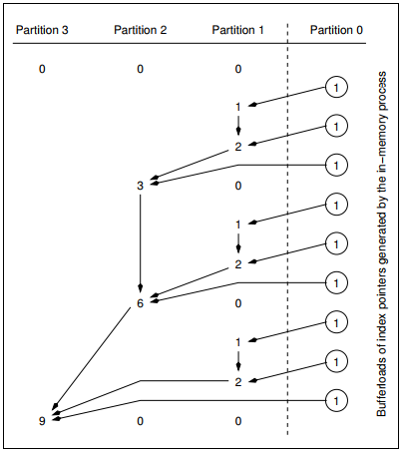
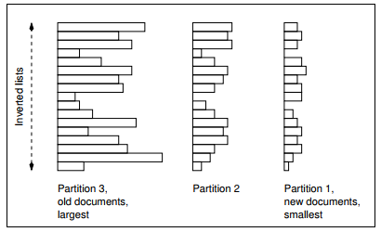
Hierarchical Merging (example)
r=3
18
6
2
limit:
ok
ok
ok
notok
Set first partition limit = (r-1)b
3
bufferloads

Slide 10
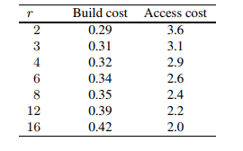
Varying The Radix
The best choice of r depends on the balance of operations
An overly small value of r is likely to harm query costs
However, for insertions a smaller number for r should be preferred

Slide 11
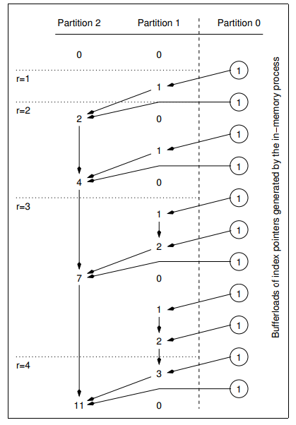
Fixing The Number Of Partitions
Instead of creating a new partition when the limit is reached, increase r by 1
Makes the seeks-per-term part querying cost independent of the number of indexes
Slowly increases per-insertion times

Slide 12
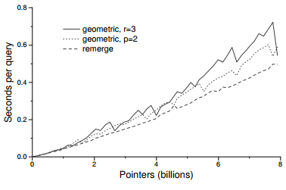
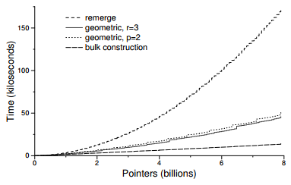
Experiments
Query times
Index creation times

Slide 13
Conclusions
Construction costs significantly reduced versus standard contiguous inverted indexes
Index reconstruction for a 10 GB collection reduced by 4 compared to remerge
Modest degradation in query times, about 20%
Takeaway: on-line methods offer an attractive compromise between construction costs, querying costs, and access immediacy

Slide 14
Fast On-line Index Construction By Geometric Partitioning Nicholas Lester, Alistair Moffat, And Justin Zobel Proceedings Of The 14th ACM International Conference On Information And Knowledge Management.
Efficient On-line Index Maintenance For Dynamic Text Collections By Using Dynamic Balancing Tree Ruijie Guo, Xueqi Cheng, Hongbo Xu, Bin Wang Proceedings Of The 16th ACM International Conference On Information And Knowledge Management.
Presented By : Polykarpos Thomadakis CS 834 – Introduction to Information Retrieval Fall 2017 Old Dominion University

Slide 15
Index Maintenance
On-line index construction includes query processing and index update operations
Document insertions
Document deletions
Insertion or deletion of document => update for thousands of terms
Update operation costly in disk accesses and complex in space management
Three methods for index maintenance
In-place
Merge based
Hybrid
Short posting lists updated using a merge strategy
Long posting lists are updated in-place

Slide 16
Insertions vs Deletions
These index update strategies are designed for documents insertions
Without considering document deletions
For insertions, new postings can “simply” be appended to an existing posting list
No need to decompress the lists
Efficient
For deletions, can potentially affect the posting lists of many indexes
Decompression is required to delete the appropriate postings
Usually performed when a merge event is triggered
Very expensive

Slide 17

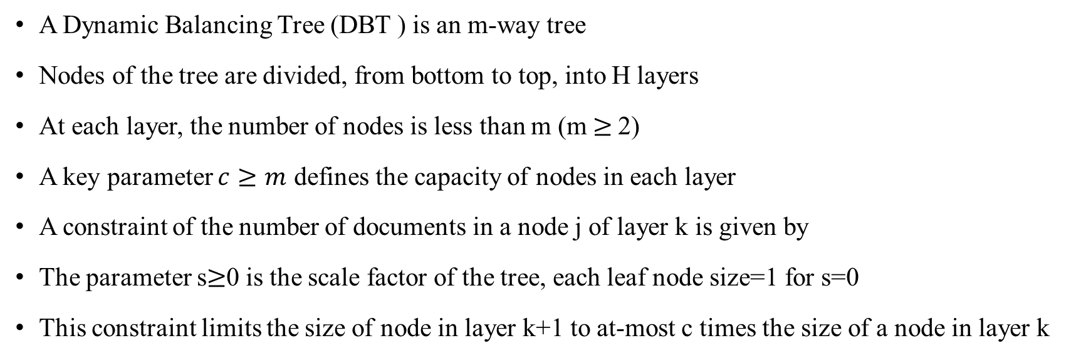
Dynamic Balancing Tree
A Dynamic Balancing Tree (DBT ) is an m-way tree
Nodes of the tree are divided, from bottom to top, into H layers
At each layer, the number of nodes is less than m (m$≥$ 2)
A key parameter $c≥m$ defines the capacity of nodes in each layer
A constraint of the number of documents in a node j of layer k is given by
The parameter s$≥$0 is the scale factor of the tree, each leaf node size=1 for s=0
This constraint limits the size of node in layer k+1 to at-most c times the size of a node in layer k

Slide 18
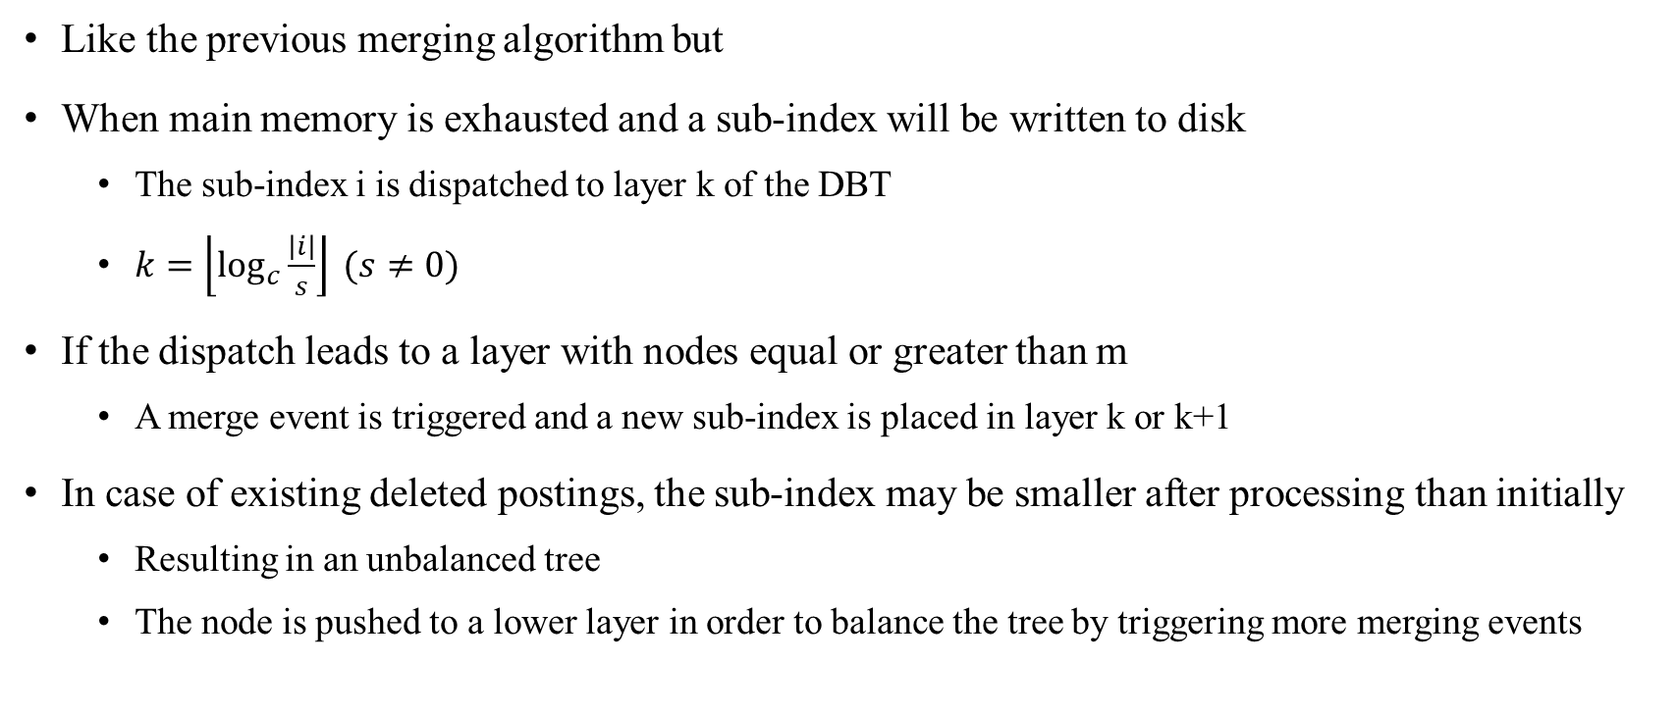
Dynamic Balancing Tree Merge
Like the previous merging algorithm but
When main memory is exhausted and a sub-index will be written to disk
The sub-index i is dispatched to layer k of the DBT
$k=\left\lfloor \log_{c}{\frac{\left|i\right|}{s}}\right\rfloor (s≠0)$
If the dispatch leads to a layer with nodes equal or greater than m
A merge event is triggered and a new sub-index is placed in layer k or k+1
In case of existing deleted postings, the sub-index may be smaller after processing than initially
Resulting in an unbalanced tree
The node is pushed to a lower layer in order to balance the tree by triggering more merging events

Slide 19
Garbage Collection in DBT
Two different methods to handle deletions
Keep deleted documents in the posting lists
Need to keep track of the deleted documents in a bitmap
Do not keep them
Filter deleted documents, recompress and write remaining documents
Expensive to run on each merge event
DBT: Keep track of the deleted posting lists, perform garbage collection when
Relative number of deleted documents of a sub-index > threshold ρ
Relative number of deleted documents of a sub-index included in a merge event > threshold ρ
Reduces the amount of postings decompressed

Slide 20
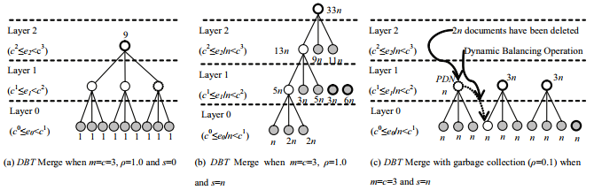
Dynamic Balancing Trees (example)

Slide 21
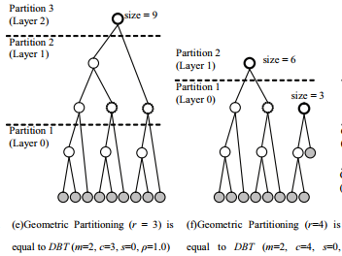
Geometric Partitioning As DBT Without Balancing

Slide 22
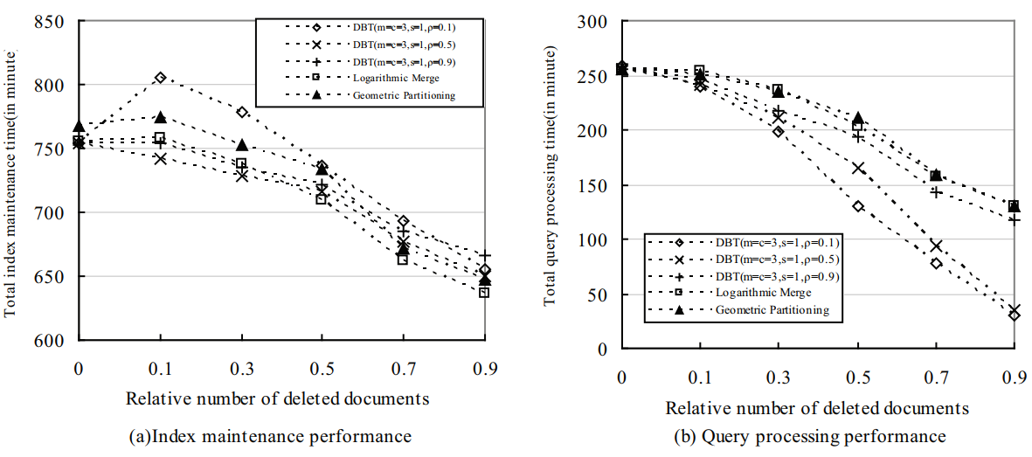
Experimental Results

Slide 23
Conclusions
DBT provides an efficient garbage collection mechanism that offers better query processing performance than other methods
While maintaining equivalent level of index maintenance
Can process queries 30% faster by a cost of 2% in index maintenance performance
Cost of document deletions still very expensive

