Slide 1
Bigtable: A Distributed Storage System For Structured Data Fay Chang, Jeffrey Dean, et al. OSDI'06: Seventh Symposium on Operating System Design And Implementation Cassandra - A Decentralized Structured Storage System Avinash Lakshman , Prashant Malik ACM SIGOPS Operating Systems Review 2010
Presented By :Polykarpos Thomadakis
CS 834 – Introduction to Information Retrieval
Fall 2017 Old Dominion University

Slide 2
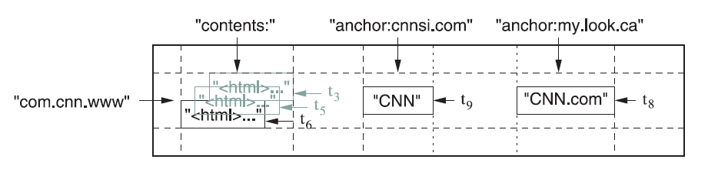
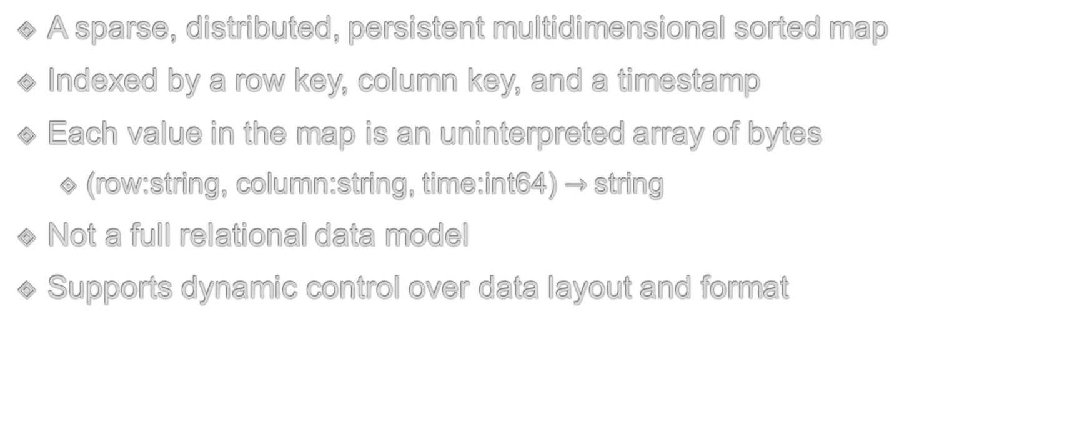
Big Table
A sparse, distributed, persistent multidimensional sorted map
Indexed by a row key, column key, and a timestamp
Each value in the map is an uninterpreted array of bytes
(row:string, column:string, time:int64) $→$string
Not a full relational data model
Supports dynamic control over data layout and format

Slide 3
Rows
Row
Row key
Row keys are arbitrary strings
Reads/Writes under a single row key are atomic
Makes it easier to reason about concurrent updates on the row
Data maintained in lexicographic order by row key
Rows with consecutive keys consist a tablet
Unit of distribution and load balancing
As a result, reads of short row ranges require communication with only a small number of machines
Select good keys to get good locality for data accesses
Column 1 | Column 2
… | …
… | …
… | …
… | …
… | …
… | …
… | …
… | …
Tablet 1
Tablet 2

Slide 4
Columns
Column keys
Column Family
Columns
Column keys are grouped into sets called column families
Basic unit of access control
Columns in a family are usually of the same type (compressed together)
A column key must belong to a family to store data in it
Accessed using the syntax : family:quantifier
Column families should be small in number ( hundreds at most) and change rarely
In contrast, number of columns is not bounded

Slide 5
Timestamps
Timestamps
Each cell can contain multiple versions of the same data
Indexed by timestamps
Timestamps can be assigned by
Bigtable, real time representation in microseconds
Client application
Different versions stored in decreasing timestamp order
Most recent version is read first
Automatic garbage collection
Keep n last versions of the data
Keep all versions not older than a time period

Slide 6
Building Blocks
GFS
Stores log and data files
Uses SSTables
Cluster management system
Scheduling jobs
Managing resources
Dealing with machine failures
Monitoring machine status
Chubby
Highly-available and persistent distributed file and lock service

Slide 7
SSTables
An ordered immutable map from keys to values
Keys and values arbitrary byte strings
Contains a sequence of data blocks plus an index
Index is loaded into memory when SSTable is opened
A lookup can be performed with a single disk seek
Find block from in memory index
Read the block from disk
Can optionally be mapped into memory
Without touching the disk
64K block
64K block
64K block
SSTable
Index

Slide 8
Implementation
Three major components
Master server
Table server
A library linked into every client
One master server
Many tablet servers
Assigns tablets to tablet servers
Detects addition and expiration of tablet servers
Performs load balancing
Garbage collection
Schema changes (e.g table and family column creations)
Manages a set of tablets
Handles read/write requests to its tablets
Splits tables that have grown too large

Slide 9

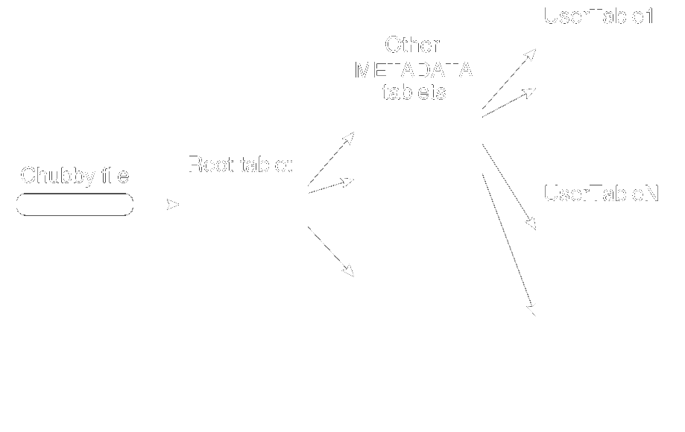
Tablet Location
Three-level hierarchy
File stored in Chubby, contains the location of the root tablet
Root tablet contains the location of all tablets in special METADATA table
User tablets
Client libraries cache tablet locations
If tablet location unknown for a client
Recursively move up the tablet location hierarch

Slide 10
Tablet Assignment
Each tablet is assigned to one tablet server at a time
Master keeps track of live tablet servers, assignment of tablets to servers and unassigned tablets
Chubby is used to keep track of tablet servers
Tablet server starts -> creates and acquires lock on a uniquely name file in a Chubby directory.
This directory is used by master to discover servers
A tablet server stops serving its tablets if it loses its lock (due to some failure)
Will attempt to reacquire lock if file still exists
Kills itself if it fails

Slide 11
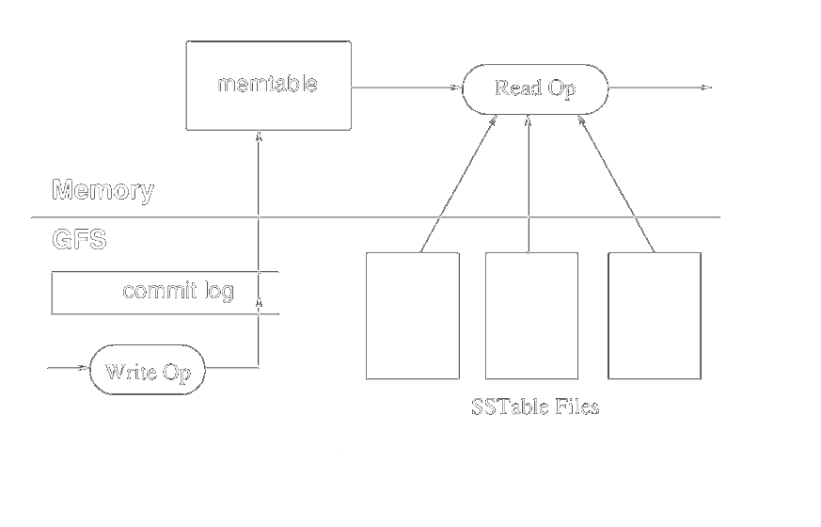
Tablet Serving
The persistent state of a tablet is stored in GFS
Updates are committed to a commit log
Recently commited ones stored sorted in a buffer called memtable
Older ones in a sequence of SSTable files
To recover a tablet, a server
Reads metadata from the METADATA table containing
A list of SSTables
A set of redo points

Slide 12
Tablet Serving Operations
Write Operations
Read Operations
Server checks if operation is valid
A valid mutation is written to the commit log
After commitment, the contents of the write are inserted into the memtable
Server checks if operation is valid
A valid operation is executed on a merged view of the sequence of SSTables and the memtable
Efficient since both are stored lexicographically sorted

Slide 13
Compactions
Threshold reached
Minor compaction
memtable
Memory
GFS
Commit Log
SSTable
SSTable
SSTable
SSTable
SSTable
Write Op

Slide 14
Compactions
new memtable
Minor compaction
Shrinks the memory usage of the tablet server
Reduces data that have to be read from the commit log during recovery
memtable
Memory
GFS
Commit Log
SSTable
SSTable
SSTable
SSTable
SSTable
Write Op

Slide 15
Compactions
Merging Compaction
Number of SSTables increases arbitrary
Bound their number by merging a set of SSTables and the memtable into a new SSTable
The SSTables and memtable can be discarded after compaction
Can contain special deletion entries
Major Compaction
Rewrites all SSTables into one SSTable
Contains no deleted information or data
Allows to reclaim resources
Ensures deletion of data in a timely fashion, important for sensitive data

Slide 16
Cassandra
A distributed storage system
Managing very large amounts of structured data
Spread out across many commodity servers
Highly available service
No single point of failure
Aimed to run on top of hundreds of nodes

Slide 17
Data Model
Similar to Bigtable
A distributed multi dimensional map indexed by a key
Row key in a table is a string with no size restrictions
Operations atomic per row
Columns grouped into families
Supports two kinds of families
Simple
Super
Can be visualized as a column family within a column family
Sorting by Time or Name
Access -> family : super_family : column

Slide 18
Architecture
h(key1)
Partioning
Order preserving hash function
Output range is in a ring
Nodes assigned a key representing their position in the ring
Data items given a key in the ring
Assigned to the next node moving clockwise (coordinator)
Departure/Arrival of a node affects only its neighbors
A
F
B
E
C
D
h(key2)

Slide 19
Architecture
Membership
Use gossip to find other nodes in the system
Periodic, Pairwise, inter-node communication
Low frequency communication ensures low cost.
Random selection of peers.
Round by round doubling the peers makes protocol very robust.

Slide 20
Architecture
Replication
Data items replicated at N hosts
Coordinator responsible
Three policies:
Rack Unaware
Rack Aware
Datacenter Aware
Failure Detection
Accrual Failure Detector
Assign a sliding window of inter-arrival times of gossip messages per node
Assume node as down when threshold is reached

Slide 21
Architecture
Bootstrapping
Two ways to add new node
New node gets assigned a random token which gives its position in the ring. It gossips its location to rest of the ring
New node reads its config file to contact its initial contact points.
Scaling
New nodes assigned appropriately to alleviate a heavily loaded node
Splits the range of data the other node was responsible for

Slide 22
Architecture
Local Persistence
Writes are commited into a log file
After commiting the update is performed in memory
Much like Bigtable ( including compactions)
Requests
Writes: System routes requests to replicas and waits for a quorum of replicas to acknowledge completion
Reads: System routes requests to the closest replica or to all replicas waiting for a quorum of responses

