Slide 1
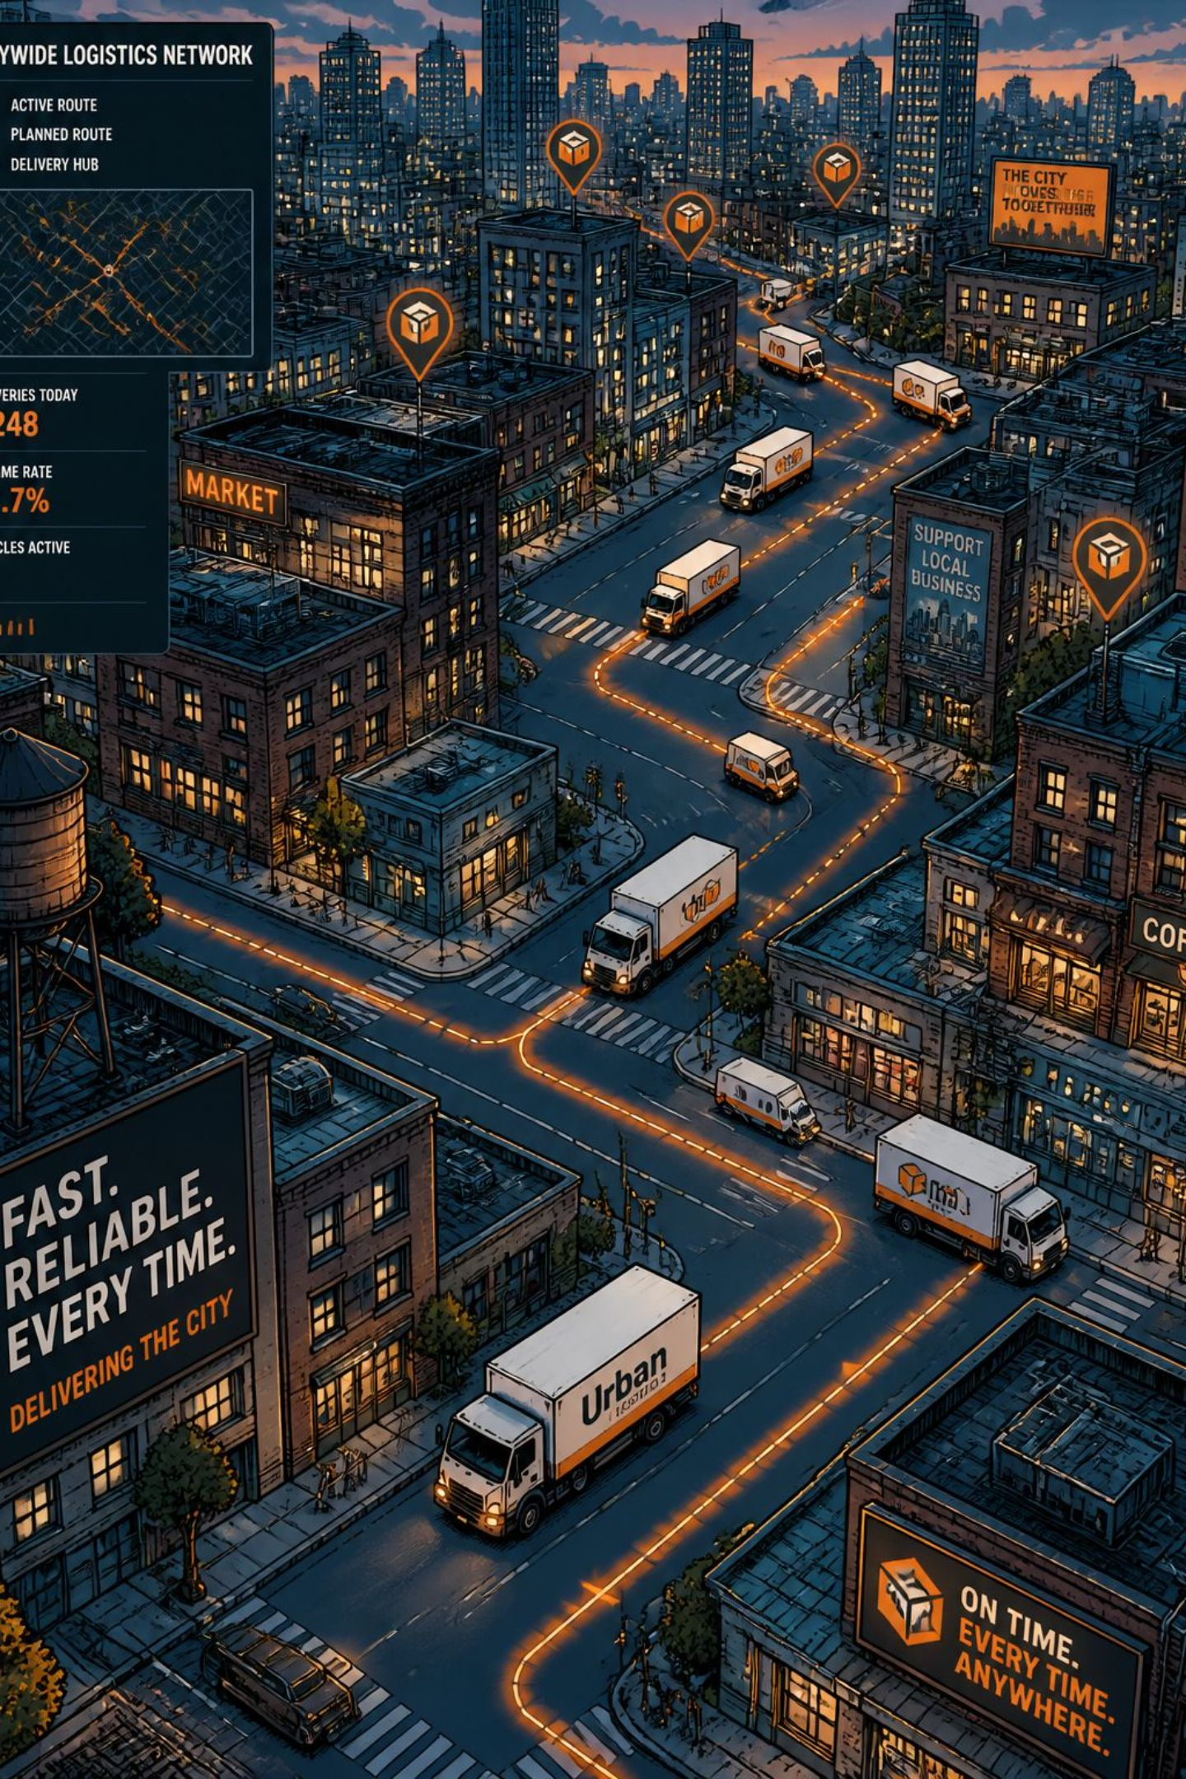
Online Order Delivery Time Prediction System
Using Machine Learning, Logistics Analytics, and Traffic Data Analysis to deliver accurate, real-time estimated arrival times across e-commerce, logistics, and last-mile delivery operations.

Slide 2

Why Traditional Estimation Falls Short
Fixed rules and historical averages ignore the dynamic realities of modern delivery operations.
Static Rules
No Context Awareness
Flat-rate estimates ignore real-time traffic, weather, and order volume.
Delivery partner availability, road conditions, and peak hours are never factored in.
High Error Rates
Inaccurate ETAs erode customer trust and inflate operational costs.

Slide 3
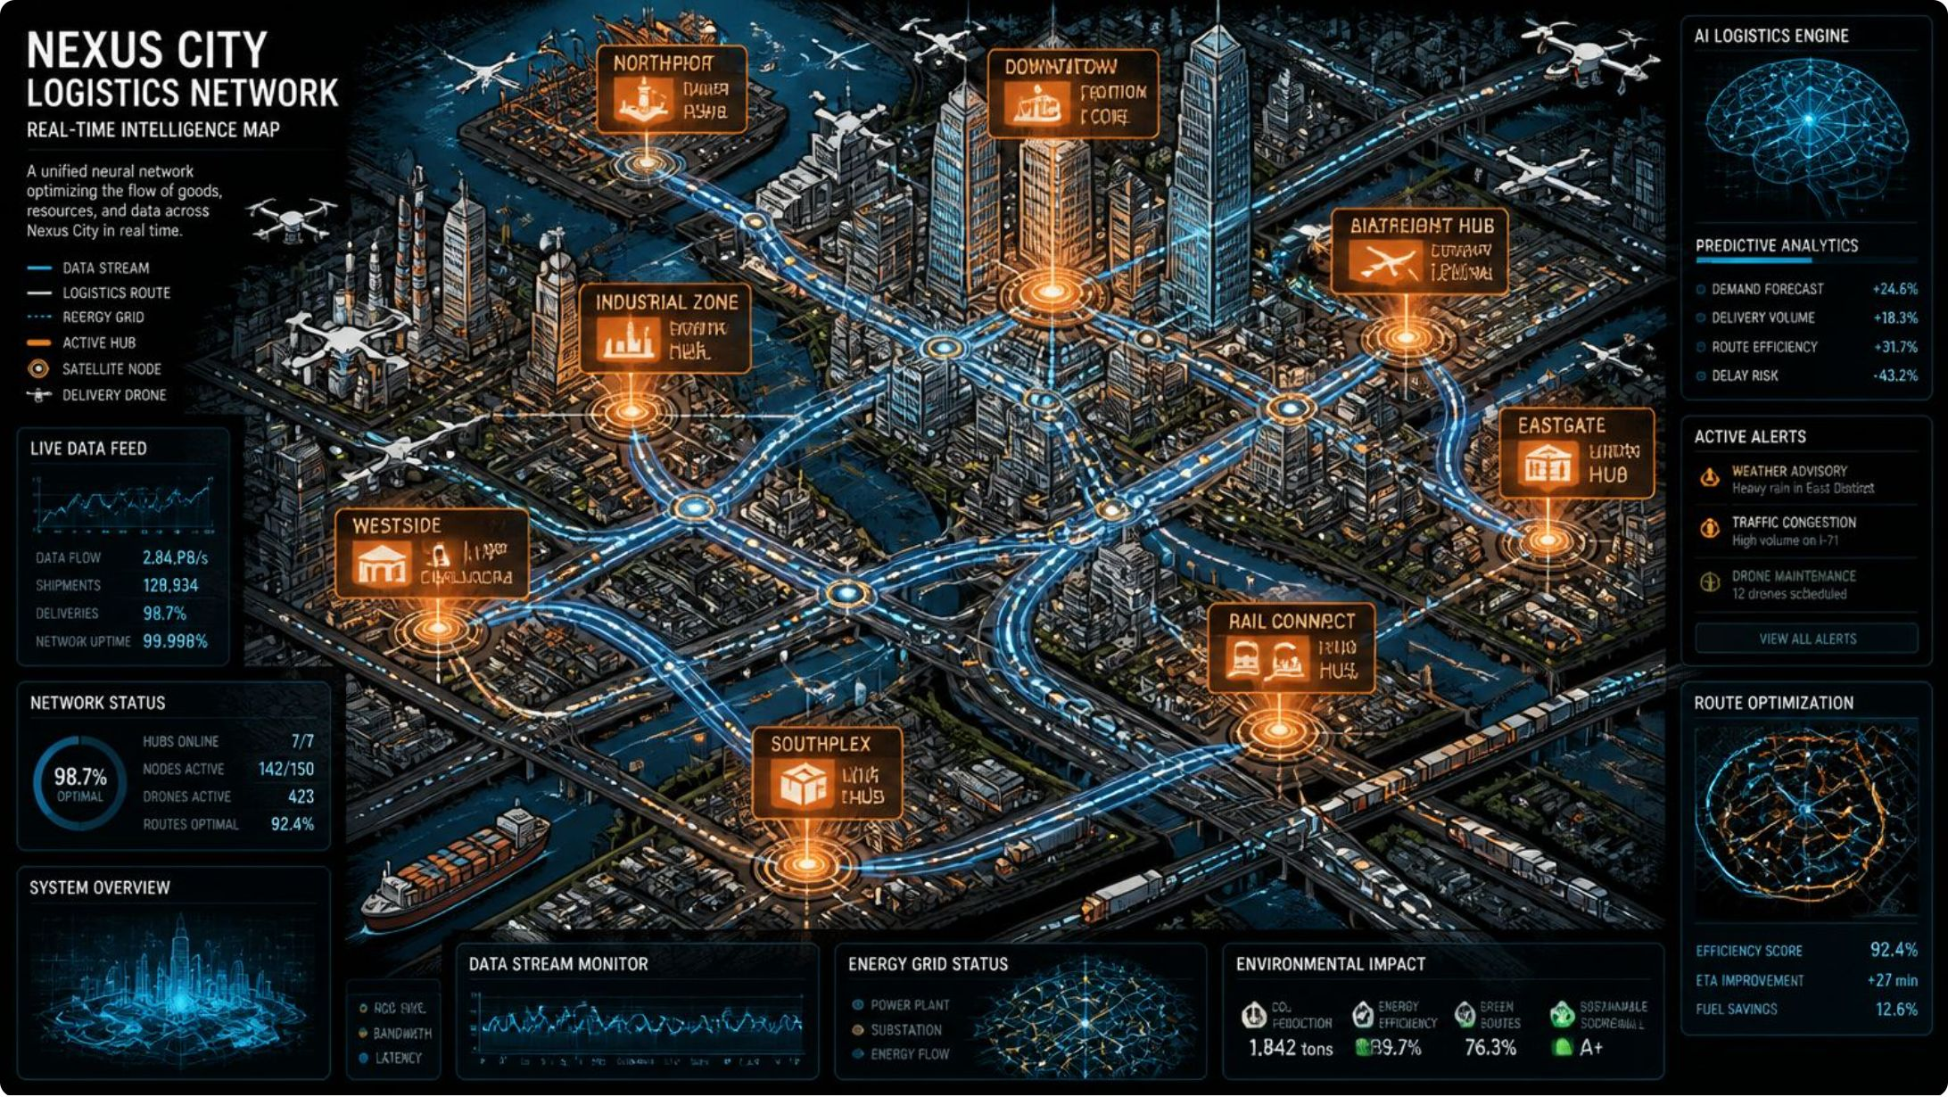

The Intelligent Prediction Solution
Our system combines Machine Learning, Logistics Analytics, and Traffic Data Analysis to generate precise, context-aware delivery time predictions — dynamically adapting to live conditions for every order.
Multi-Factor Modeling
Continuous Learning
Real-Time Inference
Incorporates distance, traffic, weather, partner availability, and order priority.
Models retrain on new delivery data, improving accuracy over time.
Predictions generated in milliseconds at order placement and throughout transit.

Slide 4
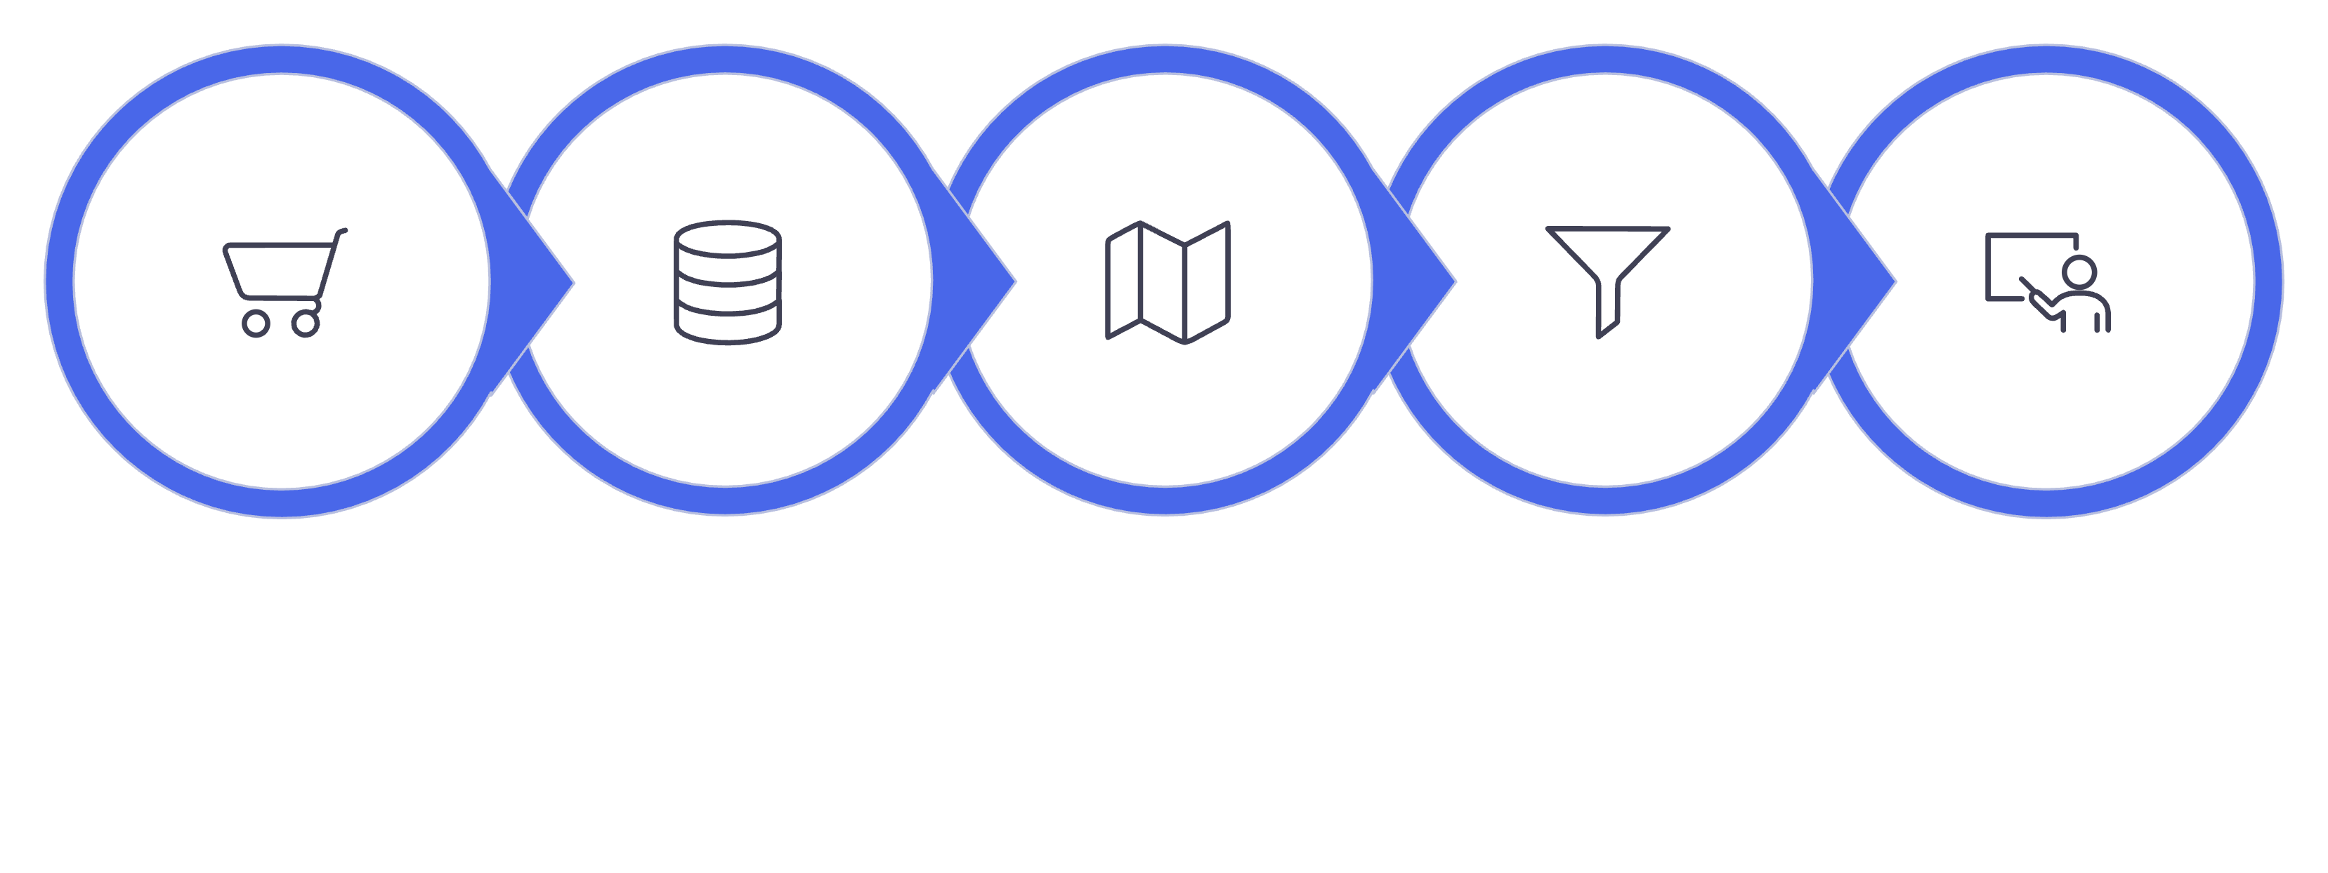
SYSTEM WORKFLOW
End-to-End Prediction Pipeline
Order Placement
Data Collection
Route & Traffic
Preprocessing
Model Training
Each stage is automated and interconnected — from the moment a customer places an order to the final delivery confirmation, the system continuously ingests, processes, and learns from operational data.

Slide 5
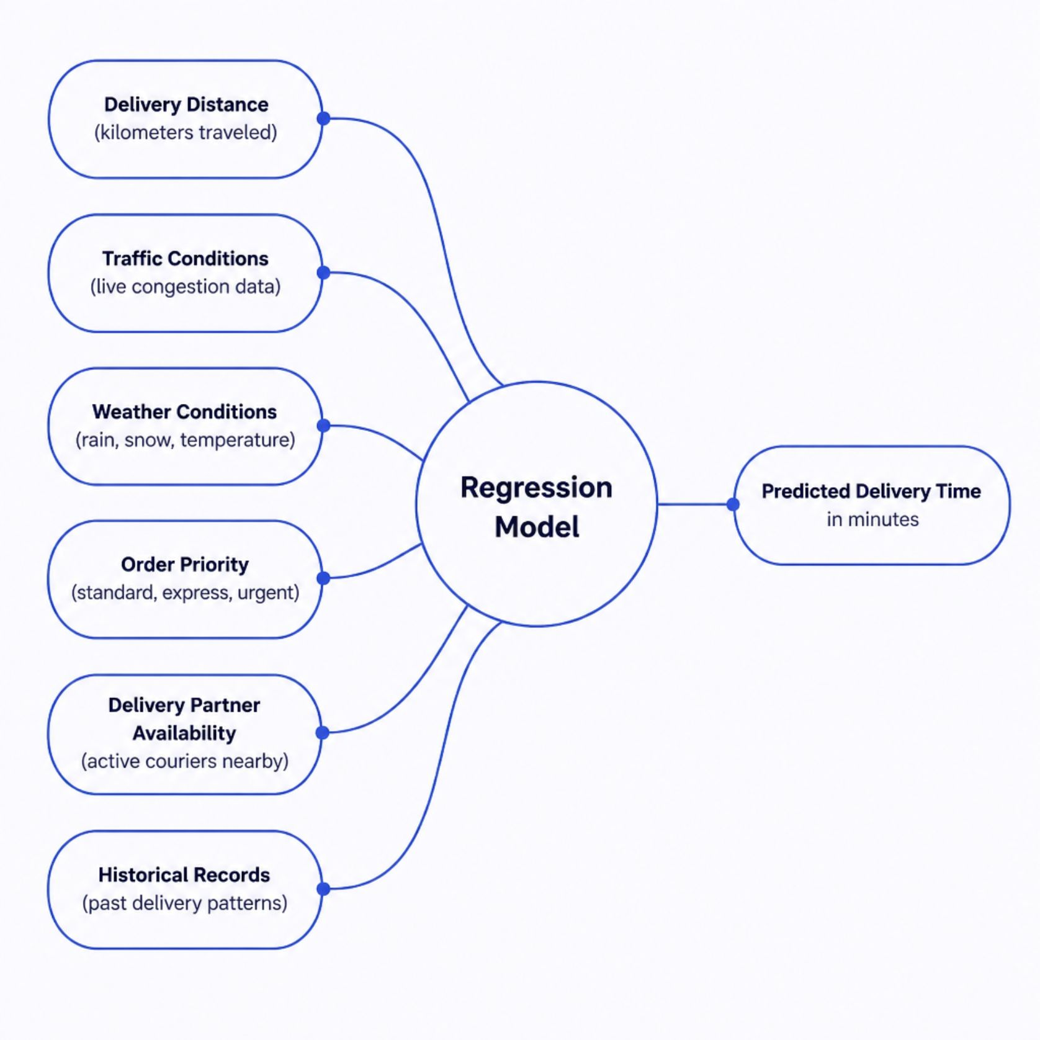
Machine Learning Prediction Engine
Regression Algorithms in Action
The prediction engine uses supervised regression models trained on labeled historical delivery data. Algorithms such as Random Forest, Gradient Boosting, and XGBoost map input features to a continuous delivery time estimate.
Feature selection via correlation analysis and SHAP values
Cross-validation to prevent overfitting
Ensemble methods for robust, low-variance predictions

Slide 6
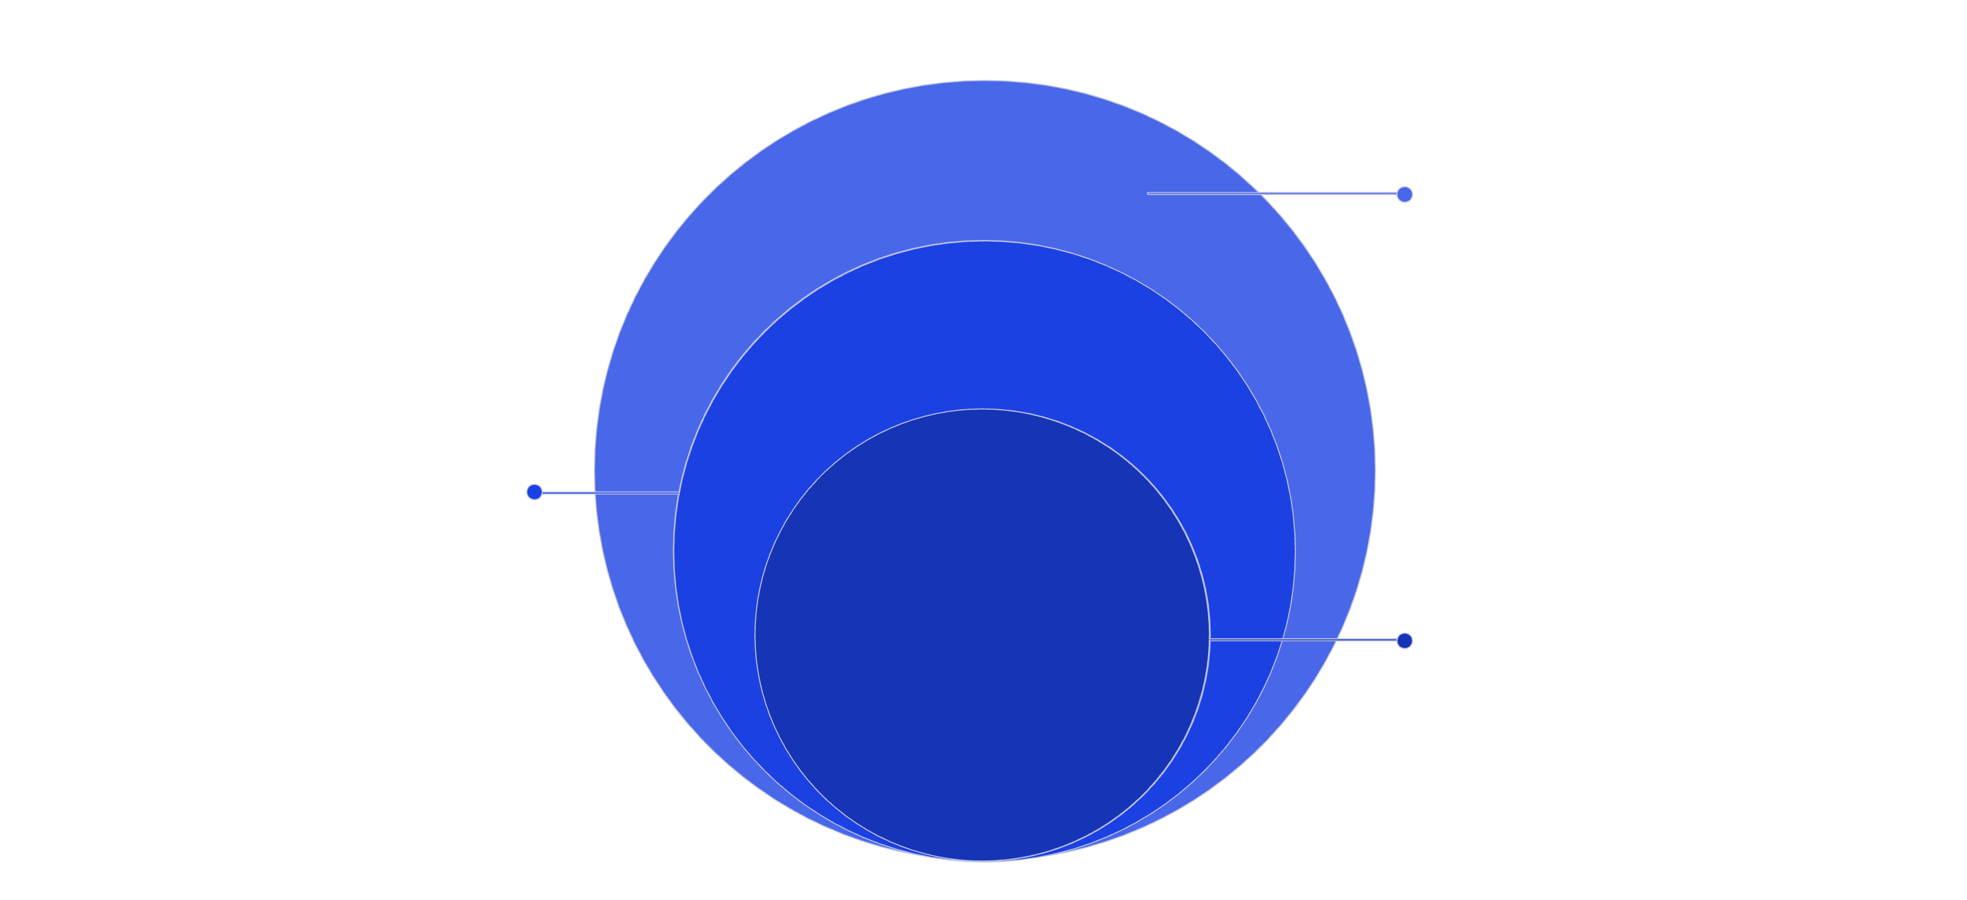
ARCHITECTURE
System Architecture & Technology Stack
Outer Application
REST API, Dashboard, Alert System
Processing Layer
Python, Pandas, Spark for ETL
Core ML Engine
Scikit-learn, XGBoost, TensorFlow
The architecture separates concerns across four layers — enabling independent scaling, fault isolation, and seamless integration with third-party data sources.
Backend
ML Frameworks
Python · Flask/FastAPI · PostgreSQL · Redis
Scikit-learn · XGBoost · TensorFlow · Keras
APIs & Data
Frontend
Google Maps · OpenWeatherMap · HERE Traffic
React · D3.js · Plotly · Grafana

Slide 7
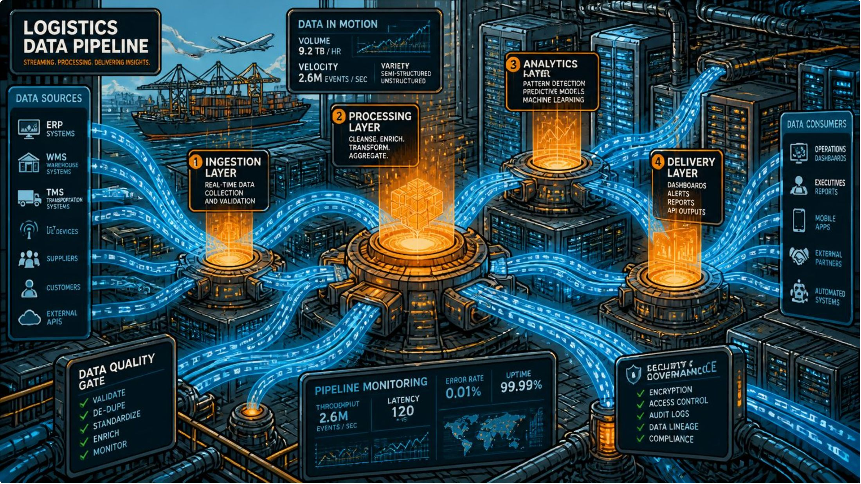
Data Pipeline: Collection to Deployment
A Rigorous Data Lifecycle
Quality predictions require quality data. The pipeline ensures every record is clean, relevant, and model-ready.
01
02
Collection
Preprocessing
Ingest from traffic APIs, weather feeds, GPS trackers, and order databases.
Handle missing values, outliers, normalization, and categorical encoding.
03
04
Feature Engineering
Train / Test / Deploy
Derive time-of-day, day-of-week, distance zones, and traffic density indices.
Split data, validate models, then deploy via containerized microservices (Docker/Kubernetes).

Slide 8
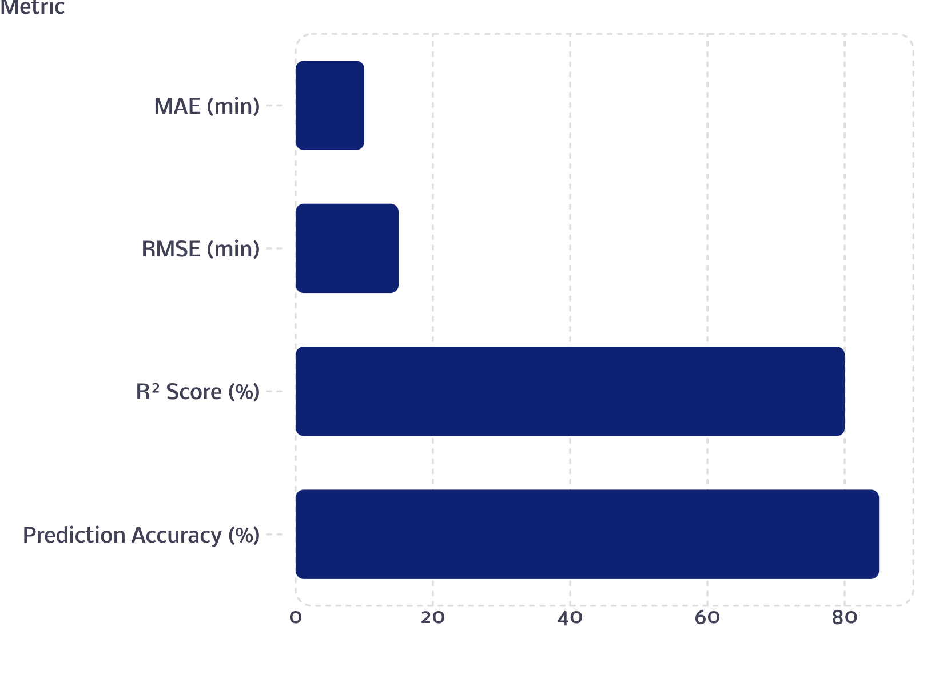

Model Performance & Evaluation Metrics
What the Metrics Mean
MAE — Average absolute error in minutes; lower is better.
RMSE — Penalizes larger errors more heavily; reflects prediction stability.
R² Score — Proportion of variance explained; 91% indicates strong fit.
Prediction Accuracy — Percentage of estimates within acceptable tolerance.
The model exceeds all target thresholds, demonstrating production-ready accuracy for real-world deployment.

Slide 9






Key Features & Real-World Applications
Real-Time Prediction
Traffic-Aware Routing
Live ETA updates at order placement and throughout transit.
Integrates live congestion data to adjust routes and ETAs dynamically.
Weather-Aware Estimation
E-Commerce & Retail
Factors in rain, snow, and temperature impacts on travel speed.
Accurate ETAs at checkout reduce cart abandonment and boost satisfaction.
Food & Courier Services
Supply Chain & Logistics
Optimizes last-mile delivery for perishables and time-sensitive parcels.
Enables fleet managers to plan capacity, reduce delays, and cut costs.

Slide 10
Scalability, Future Roadmap & Impact
What's Next
The Bottom Line
Phase 1 — Live Integration
1
This system transforms delivery estimation from a guess into a precise, data-driven operation — delivering measurable business value.
Connect live traffic APIs, GPS tracking, and IoT sensors for real-time data ingestion.
2
Phase 2 — AI Route Optimization
Integrate reinforcement learning for dynamic, multi-stop route planning.
Phase 3 — Cloud-Native Scale
3
Deploy on AWS/GCP with auto-scaling, multi-region redundancy, and enterprise security.
↑ Customer Satisfaction
↓ Operational Costs
↑ Supply Chain Efficiency
Accurate ETAs build trust and reduce support tickets.
Optimized routing reduces fuel, time, and labor waste.
Predictable delivery windows improve inventory and capacity planning.

