Slide 1
Anomaly detection and outlier analysis
“The most exciting phrase to hear ... the one that heralds the most discoveries-
is not ""Eureka"" but " That’s funny …”.
-- Isaac Asimov

Slide 2
Outline
Introduction
Motivation, definition, challenges
Outlier detection methods
Distance based methods,
Challenges in high dimension
Application to real data sets
Discussions and comments
Conclusion

Slide 3
Introduction
motivation
Identifying misinformation and misbehavior on the web;
Anomaly detection from system logs in complex computer systems;
Finding irregularities in electrical consumption on smart grids;
Modeling antisocial behavior in online discussion communities;
Characterizing a malignant tumor in medical images for diagnosis ;
Predicting illegal insider trading in stock market data;
Evaluating the potential of insider threats in organizations;
Detecting traffic anomalies in urban interstate systems;
Illegal reseller identification by Internet marketplaces like Amazon.
Notes:
Cisco visual networking Index for charts: https://www.cisco.com/c/en/us/solutions/collateral/service-provider/visual-networking-index-vni/white-paper-c11-738429.html

Slide 4
Introduction
What is an outlier?
An observation which deviates so much from the other observations as to arouse suspicions that it was generated by a different mechanism
What is an anomaly?
An observation that has resulted from a distinct generative process that may or may not appear in the data as outliers.
Note: the two terms “anomaly” and “outlier” are often times used interchangeably in the statistics literature.
They are also referred to as abnormalities, discordants, deviants, or anomalies.

Slide 5
Introduction
Application areas
Credit card fraud detection
Unauthorized (abnormal) use may show different buying patterns.
Such as a buying spree from geographically obscure locations may lead to a stolen card
Medecine
Unusual patterns in data collected from MRI scans, PET scans or ECG time-series may reflect disease conditions.
Intrusion Detection Systems
Malicious activities generated by an unusual behavior of some generating mechanism

Slide 6
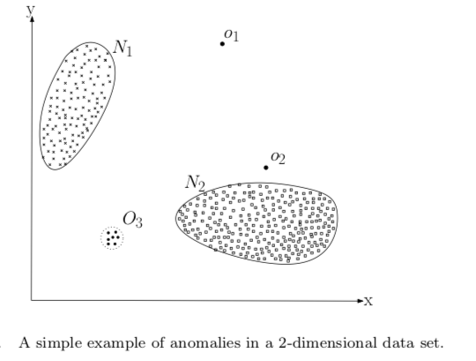
Introduction
Different type of outliers
Global outlier — The object deviates significantly from the rest of the data set ( e.g. o1).
Context outlier — The object deviates significantly depending on the selected context. For example, 28 ° C is impossible in winter in Ottawa while 28 ° C is ok in summer ( e.g. o2).
Collective Outlier — A subset of data objects collectively departs significantly from the dataset, even though individual data objects may not be outliers. For example, a large number of transactions of the same stock between a small portion over a short period can be considered as evidence of market manipulation (e.g. O3)

Slide 7
Cause of outliers
Poor data quality / contamination
Low quality measurements, malfunctioning equipment, manual error
Correct but exceptional data

Slide 8
Study in high dimensions: case n<<p
Challenges
The observations are comprised of prohibitively large number of features (biological data and market-basket data
In such spaces observations are often \textbf{isolated} and scattered (or sparse) and the notion of proximity fails to maintain its relevance.
In high-dimensional, it is difficult to distinguish between its nearest and farthest neighbors due to the curse of dimensionality
The problem is like finding a needle in a haystack, even when we know the relevant dimensions of interest.

Slide 9
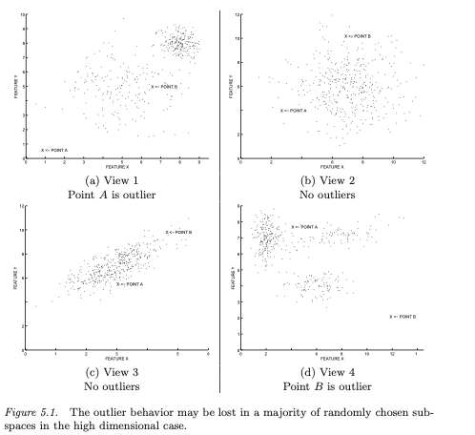
Possible solutions in high dimension
Outlier detection point of view, it is experimentally found that one can develop optimal algorithms by looking for outliers in subspaces of the data.
So dimensionality reduction is essential before anything (features selection)
Low dimensional representation is expected to produce superior outlier detection performance over full dimension .
Filters out the additive noise effects of the large number of dimensions, and results in more robust outliers.
Methods are: Rarity-based, Aggregation-based
. B
. B
. A
. A
. B
. A
. A
. B

Slide 10
Outlier methods
Outlier detection techniques can be broadly divided into parametric and non-parametric, as shown below. The statistics-based: use a pre-defined statistical distribution, and data objects are determined to be outliers depending on how they appear in relation to the postulated model.
Non-parametric methods rely on a well-defined notion of distance to measure the separation between a pair of data objects. The non-parametric method includes:
Parametric
Statistical methods
Outlier detection
Distance based methods
Density based methods
Clustering based methods
Non-Parametric

Slide 11
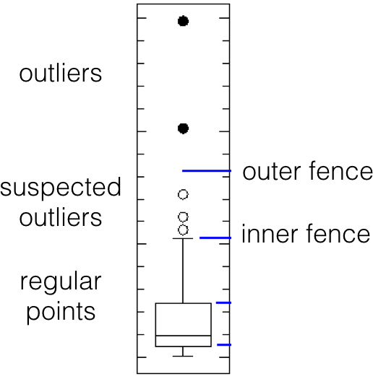
Statistical based outlier detection (parametric)
Tukey's boxplot test
A pre-defined statistical distribution is assumed (distribution, mean,...)
Perhaps the most commonly-used test, normally distributed data , regular, observations lie between the inner fences Q_1-1.5(Q_3-Q_1) and Q_3+1.5(Q_3-Q_1).
Suspected outliers lie between the inner fences and their respective outer fences Q_1-3(Q_3-Q_1) and Q_3+3(Q_3-Q_1).
Points beyond the outer fences are identified as outliers, Q_1 and Q_3 represent the data's 1st and 3rd quartile, respectively;
Other tests include: Grubbs test, depth-based, ...

Slide 12
Limitations of this methods
The choice of the data model is crucial, incorrect choice lead to poor results;
Best choice of a model is often data set specific;
Highly depends upon the analyst’s understanding of the natural data patterns in that particular domain;
Almost all of the statistical models are univariate and those that are multivariate only efficiently handle less than 4 dimensions.

Slide 13
Non-parametric based methods (proximity based)
To counter the limitations associated with the statistical methods, non- parametric methods such as distance-based ones are introduced;
Uses a proximity (distance) between pairs to classify them into groups;
Avoid the expensive task of fitting a model for the data in this regard;
Distance-based includes: K-Nearest-Neighbors (KNN);
Density based includes: Local Outlier Factor (LOF);
Cluster-Based includes: Cluster-Local Outlier Factor (CBLOF).

Slide 14
Non-parametric based methods (proximity based)
All these methods classify data points as outliers based on a degree of outlines (scores), a spectrum from normal data to noise and finally to anomalies (or outliers). Anomalies have higher score than noise.
Some authors use the terms weak outliers and strong outliers to differentiate noise and anomalies .
While noise may not be interesting in its own right, its removal and identification continues to be an important problem for mining purposes.

Slide 15
Applications
Data sets used
Two data sets are used:
Dataset 1: Transactions data
Dataset 2: Airlines data
Algorithms used:
Local Outlier Factor (LOF)
Isolation Forest
K- Nearest Neighbours
Principal Comp. Analysis (PCA).

Slide 16
Timeline
Data set 1: Transactions data
Data set 3: ….
1
3
2
Data set 2: Airlines data

Slide 17
Applications
Data set 1: transactions
Contains sales from a certain company. Records are labeled as "ok" or "fraud".
It consists of 387010 transactions, with 5 features (variables).
After pre-treatment (standardization, so that those with a large scale do not dominate the others, NA’s and qualitative variables removed ...), 15546 observations are retained with 1199 fraudulent transactions (7 %).
This is a supervised learning problem.
Data is available in the "DMwR" package in R.
Notes:
Les vendeurs fixent leurs propres prix de vente et rapportent les ventes à l’entreprise à la fin de chaque mois

Slide 18
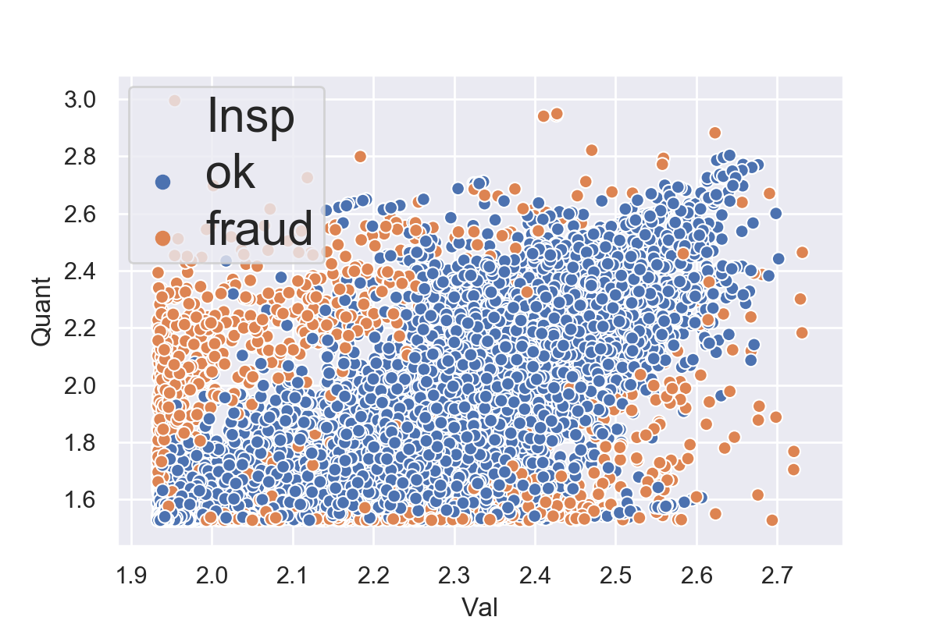
Scatter plot of the transaction data set
Orange points are fraudulent transactions labeled as fraud
Blue points are good transactions labeled as OK
Goal: train the model to correctly identify fraudulent and non-fraudulent transactions and predict the result for new transactions
Scatterplot of sales

Slide 19
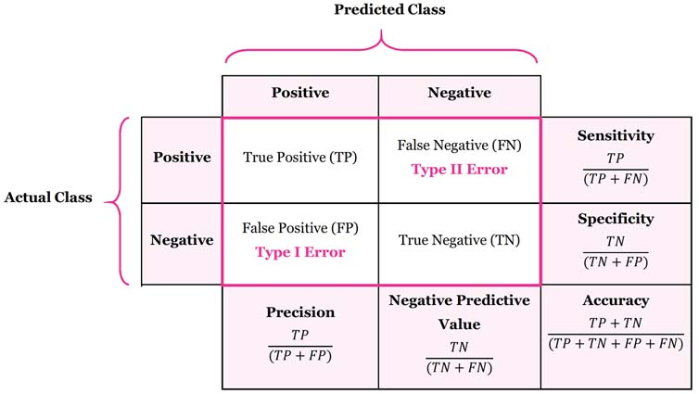
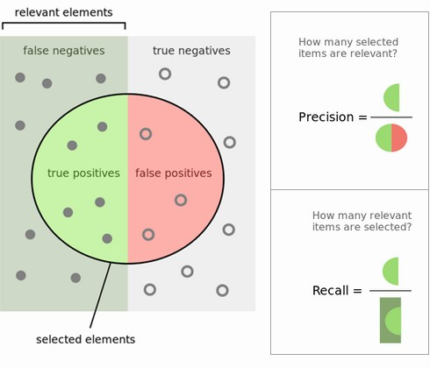
Applications
Dataset 1: transactions
Assessment of model performance, are considered:
Recall, Specificity, Precision, Accuracy, …
Precision: number of correct positive predictions made out of all positive predictions that could have been made.
Recall: number of correct positive predictions made out of all actual positive values .
Confusion matrix
Source: google image
Notes:
Les vendeurs fixent leurs propres prix de vente et rapportent les ventes à l’entreprise à la fin de chaque mois

Slide 20
Applications
Dataset 1: transactions
 | KNN | PCA | IsolForest | LOF
Rappel | 4% | 7% | 95% | 93%
Specificity | 67% | 86% | 43% | 18%
Precision | 58% | 86% | 95% | 93%
VPN | 6% | 7% | 44% | 18%
FP | 34% | 14% | 57% | 82%
FN | 96% | 93% | 5% | 7%
FD | 42% | 14% | 5% | 7%
Accuracy | 9% | 13% | 91% | 87%
The Isolation Forest (accuracy 91 %) and LOF (accuracy 87 %) perform quite good here.
KNN (accuracy 9 %) and PCA (accuracy 13 %) perform badly on this data.

Slide 21
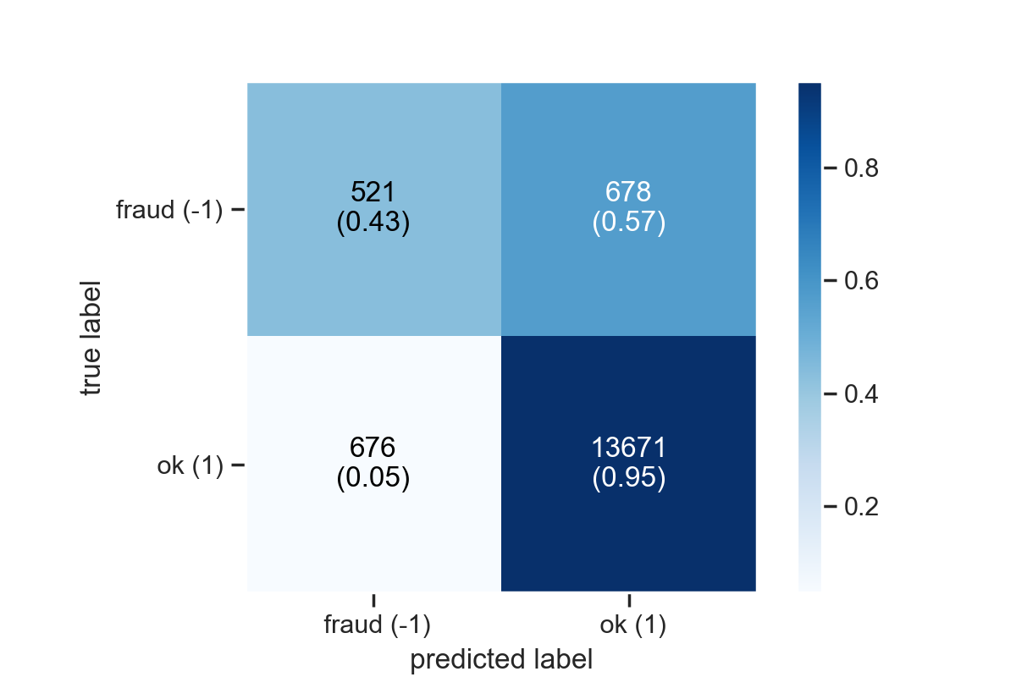
Confusion matrix of Isolation Forest
Rows true labels, Columns predictions
Out of 1199 frauds, it has predicted
521 as fraud (i.e. TN 43% )
678 as ok (i.e. FP 57%)
Similar remarks for OK.
Overall, Isolation Forest scores 14192 correctly i.e. 91%.
Confusion matrix

Slide 22
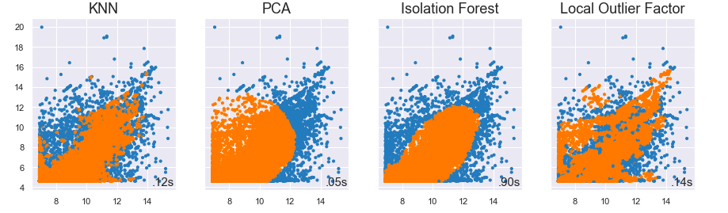
Comparison between actual and predicted data
Actual data points
blue points predicted as ok
orange points predicted as fraud
Predictions

Slide 23
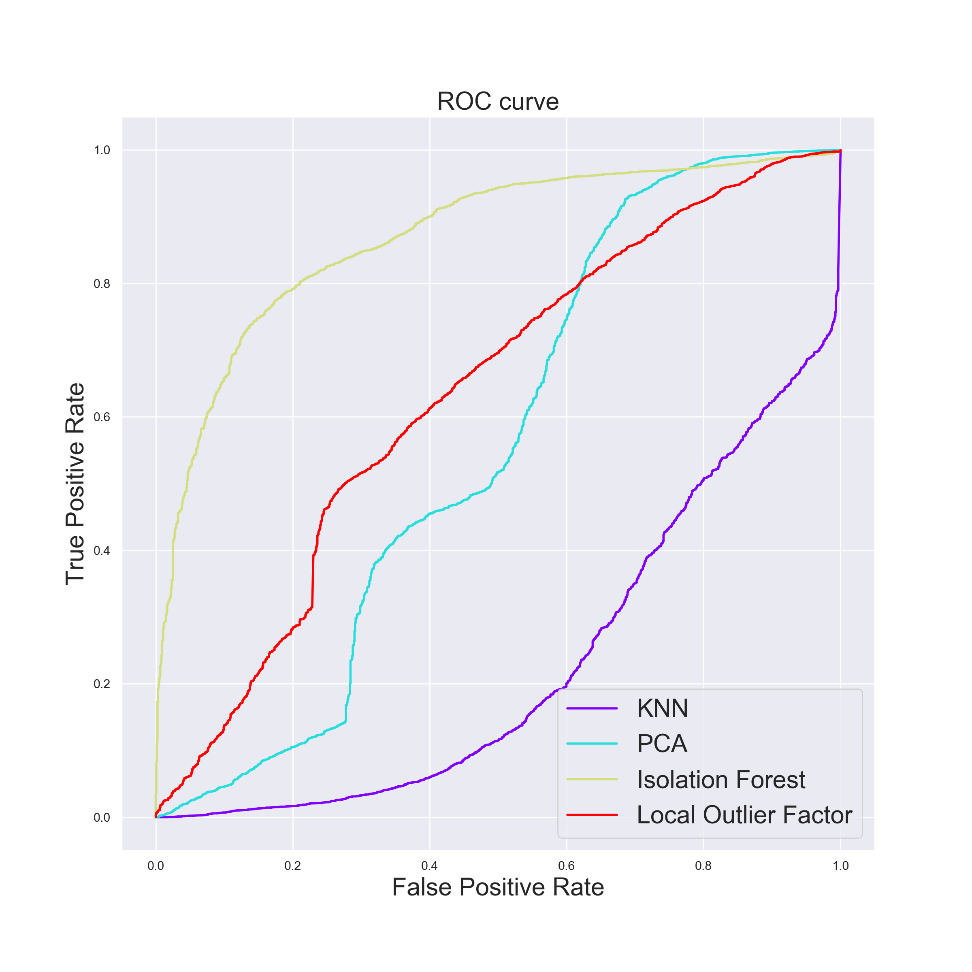
ROC and AUC
The ROC and AUC are tools to select optimal models and to discard suboptimal ones .
A perfect model corresponds to an area of 1
A bad one correspond to an area = 0.5
One can conclude that
Isolation Forest is a good model for this dataset with AUC of 0.870
LOF with an AUC of 0.632, hence performs relatively less than Isolation Forest.
PCA (AUC =0.56) and KNN (AUC=0.23) perform poorly.
ROC Curve Plot for PCA, KNN, Isolation Forest, LOF
ROC : Receiver Operating Characteristic curve and AUC: Area under the ROC curve.

Slide 24
Timeline
Data set 1: Transactions data
Data set 3:.....
1
3
2
Data set 2:
Airlines data

Slide 25
Applications
Data set 1: flights from Chicago Airport
Contains flights informations in USA in 2019: departure time, arrival time, origin airport, destination airport, etc.
A flight is considered to be "on time" if arrives less than 15 mins later than the indicated time (in CRS).
After pre-treatment (standardization, NA’s and qualitative variables removed ...), 10000 flights departing from Chicago O'Hare Airport (ORD) are extracted.
The carrier's computer reservation systems (CRS)

Slide 26
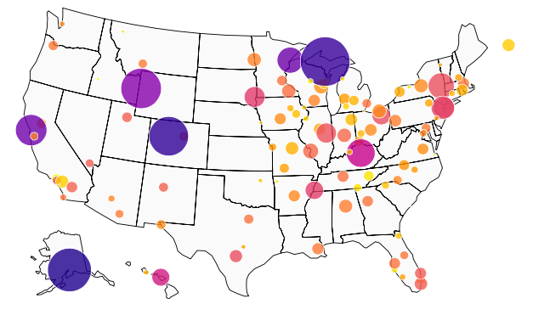
Scatter plot of flights data set
Anomalies are flights with chronic delays (more than 15 minutes), difference in minutes between scheduled and actual arrival time.
The average arrival times are calculated for all flights in relation to airport arrival times.
The anomalies are therefore the airports that show unusual average delays .
Goal: to analyse delays in arrival times for each flights .
Marquette, MI
Jackson,WY
San Francisco,CA
Eagle, CO
Anchorage,AK
Scatter plot of the airports with the size of the balls corresponding to average arrival times

Slide 27
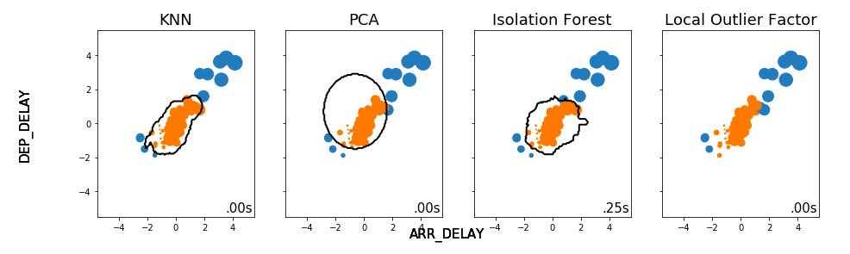
Airports detected as outliers by KNN, LOF, PCA and
Isolation Forest
Blue circles represent airports with normal arrival times, while the orange circles are abnormal behavior .

Slide 28
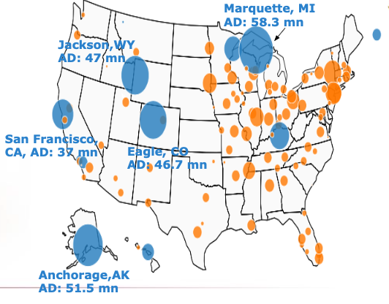
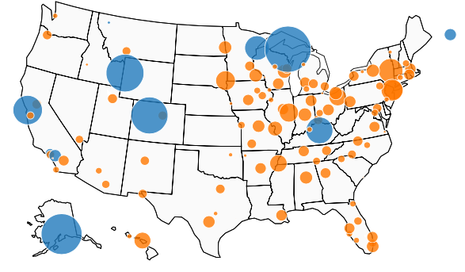
Output of Iso. Forest
Output of KNN
vs
Marquette, MI AD: 58.3 mn
1
1
Jackson,WY AD: 47 mn
2
2
San Francisco,
CA, AD: 37 mn
Eagle, CO AD: 46.7 mn
Anchorage,AKAD: 51.5 mn
Ontario, CA, -15 mns
Burbank, CA, -12 mns
1: Kalispell, MT, -4 mns
2: Oakland, CA, -15 mns

Slide 29
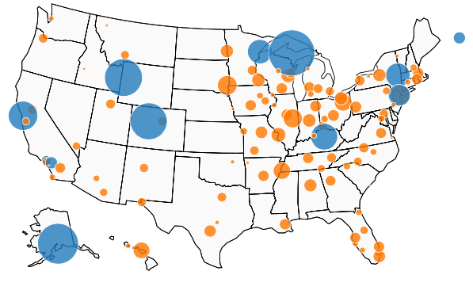
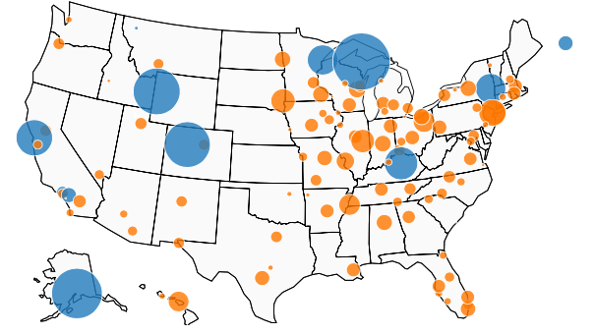
Output of LOF
Output of PCA
vs
Marquette, MI AD: 58.3 mn
Marquette, MI AD: 58.3 mn
1
Jackson,WY AD: 47 mn
Jackson,WY AD: 47 mn
2
2
San Francisco,
CA, AD: 37 mn
San Francisco,
CA, AD: 37 mn
Eagle, CO AD: 46.7 mn
Eagle, CO AD: 46.7 mn
Anchorage,AKAD: 51.5 mn
Anchorage,AKAD: 51.5 mn
Ontario, CA, -15 mns
Burbank, CA, -12 mns
1: Kalispell, MT, -4 mns
2: Oakland, CA, -15 mns

Slide 30
Comments
Anomalies are flights with average arrival times > 15 mns .
The size of the balls indicates the arrival delays i.e. difference in minutes between scheduled and actual arrival time.
Some airports are identified as outliers by all methods: Eagle, San Francisco, Marquette, Anchorage, amongst others.
Chronic delays occurred in Marquette (with 58 mns delay on average), anchorage (with 51 mns), Jackson and Eagle ( ~ 47 mns).
This delay can be explained by a long process and/or poor infrastructure conditions at the airport or delays caused by bad weather ...., deserves further investigation.

Slide 31
Comments (cntd)
Negative numbers indicate that the flight arrived earlier than the scheduled time, hence it’s not a late arrival.
Kalispell (-4), Oakland (-15), Ontario (-15) and Burbank (-12), arrived on average 4, 15 , 15, 12 mns earlier than the scheduled time but they are falsely classified as outliers by almost all the methods.
Kalispell is not classified as such by LOF.

Slide 32
Timeline
Data set 1: Transactions data
Data set 3: ...
1
3
2
Data set 2: Airlines data

Slide 33
Discussions and Remarks
Anomaly detection and outlier analysis is a vast and interesting field.
The curse of dimensionality is major challenge .
Extensive application of different methods has allowed us to understand the strengths and limitations of each of them.
Important to realize that there is NO perfect (“magic” ) methods for all the data.
They are rather data depend as well as the field of application.
"All the models are wrong but some are useful”.Question to ask : “ How bad do they have to be before they're useless? ”
-- George Box.

Slide 34

Q & A

Slide 35
References
[1] Aggarwal, C.C. [2017], Outlier Analysis} (2nd ed.), Springer.
[2] Aggarwal, C. C. et YU, P. S. (2001). Outlier detection for high dimensional data. In ACM Sigmod Record, pages 37–46. ACM.
[3] Maimon, O., Rokach, L. [2010], Data Mining and Knowledge Discovery Handbook, Springer.
[4] Prasanta, G., et al. [2011], A Survey of Outlier Detection Methods in Network Anomaly Identification. Oxford University Press, 54 (4), 570--588
[5] Ranga, S.N.N.R., [2019], Outlier Detection: Techniques and Applications: A Data Mining Perspective. Springer Nature Switzerland AG; 1st ed
[6] Kandanaarachchi, S., Hyndman, R.J. [2019], Dimension reduction for outlier detection using DOBIN, Monash Business School.
[7] Priyanga, D.T., et al., [2019], Anomaly detection in high-dimensional data.
[8] Aggarwal, C.C., Sathe, S. [2017], Outlier Ensembles, an Introduction, Springer.
[9] Jian T., Zhixiang C., Ada W. F., David, W C., Capabilities of outlier detection schemes inlarge datasets, framework and methodologies, Springer-Verlag London Limited 2006
[10] Ranga, S.N.N.R., [2019], Outlier Detection: Techniques and Applications: A Data Mining Perspective. Springer Nature Switzerland AG; 1st ed
[11] Eric Poulin, Colin Yu: Outlier Detection & Analysis.

