Slide 1
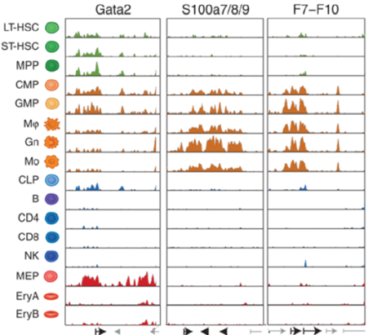
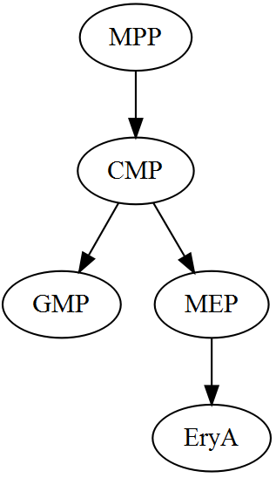
A Novel Algorithm to Infer Cell Lineage Tree from Enhancer Profiles
Shang-Yang Chen
DGP Biomedical Informatics Track

Slide 2
Outline
A Primer on Chromatin Biology
Enhancer Profiles and Cellular Differentiation
The Algorithm

Slide 3
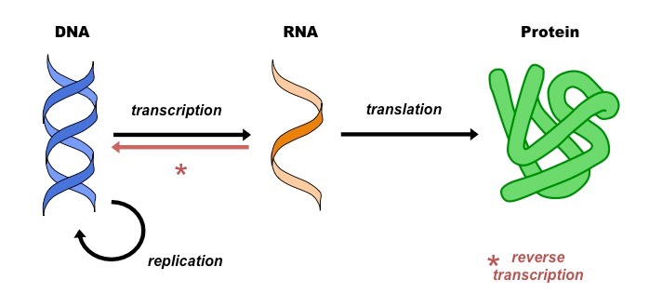
The Central Dogma
Protein coding genes only made up 1-2% of the human genome.
How are gene expressions regulated so precisely and how do the rest of the genome contribute => chromatin

Slide 4
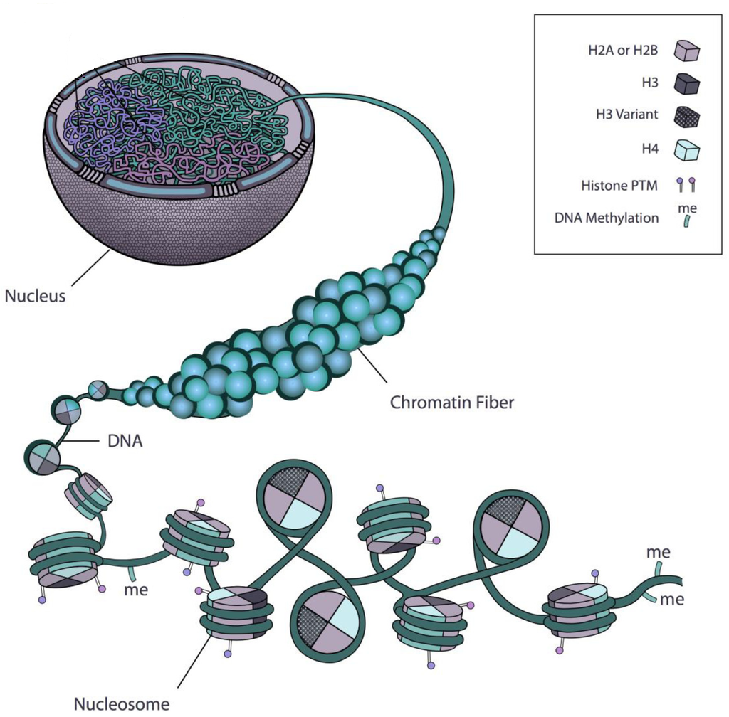
The Basic Repeat Element of Chromatin is the Nucleosome
Nucleosome
Rosa S, Shaw P. Insights into Chromatin Structure and Dynamics in Plants. Biology. 2013; 2(4):1378-1410.

Slide 5
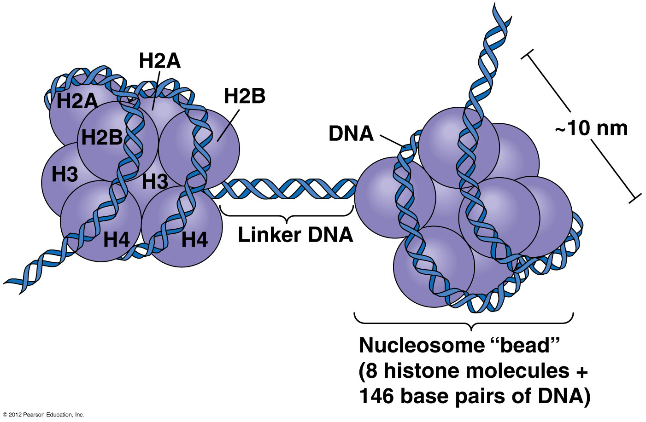
The Structure of Nucleosome
Around 146 basepairs (bp) of superhelical DNA wrapped around a histone octomer, which contains two copies each of the histone core proteins (H2A, H2B, H3 and H4).

Slide 6
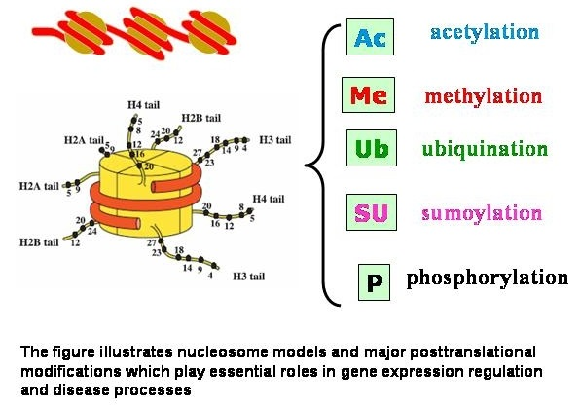
Histones undergo posttranslational modifications that alter their interaction with DNA and nuclear proteins

Slide 7
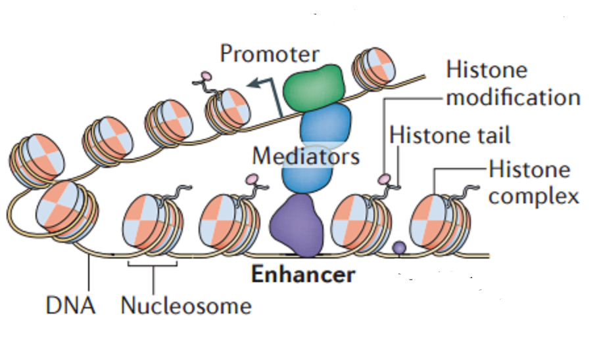
Enhancers are Cis-acting Distal Regulatory Elements
RNA polymerase
Transcription Factor

Slide 8
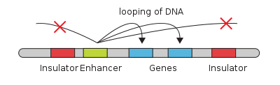
Enhancer Regulates Gene Expression by Recruiting TFs to the Transcription Complex
Distal regulatory elements that may function in combination with promotors or other enhancers to influence the transcription of one or more genes through the binding of transcription factors.
Small discrete DNA elements (50-1500 bp) characterized by densely clustered TF-binding motifs.

Slide 9
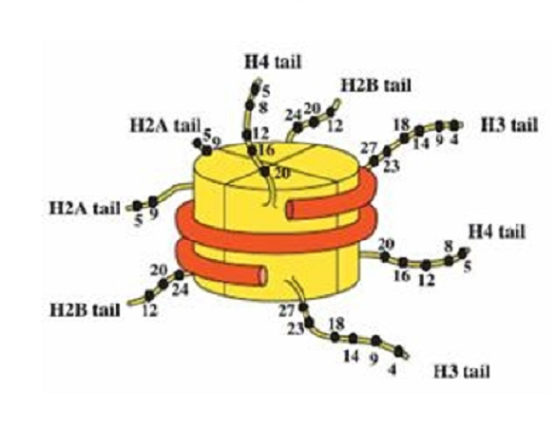
Promoters and Enhancers are Associated with Specific Histone Modifications
Promoter <- high H3K4me3
Poised Enhancer <- high H3K4me1/2 & low H3K4me3
Active Enhancer <- high H3K27ac & high RNA expression levels of the nearest gene
The sites of cis-acting regulatory elements can be identified through whole genome profiling of histone modifications
Chromatin Profiling

Slide 10
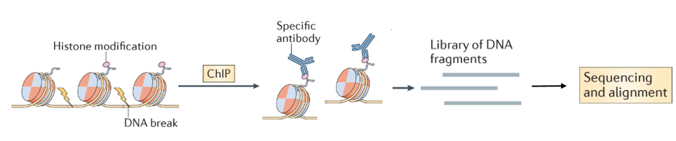
Chromatin Profiling: ChIP-seq
ChIP-seq combines chromatin immunoprecipitation (ChIP) with massively parallel DNA sequencing to identify the binding sites of DNA-associated proteins => histone modifications.
Align to the reference genome using open source algorithms (e.g. bowtie2)

Slide 11
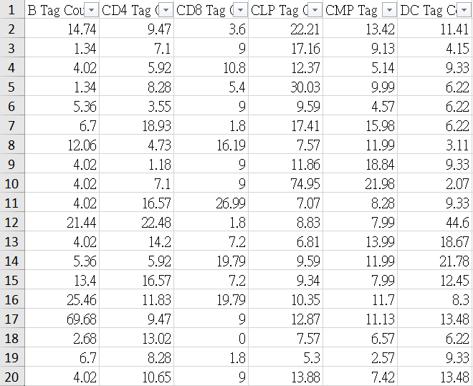
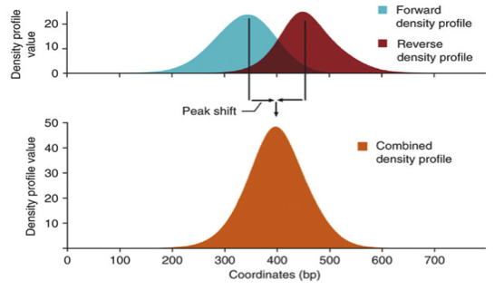
Chromatin Profiling: Peak Calling
Use programs like HOMER to identify genomic regions enriched for specific histone modifications.

Slide 12
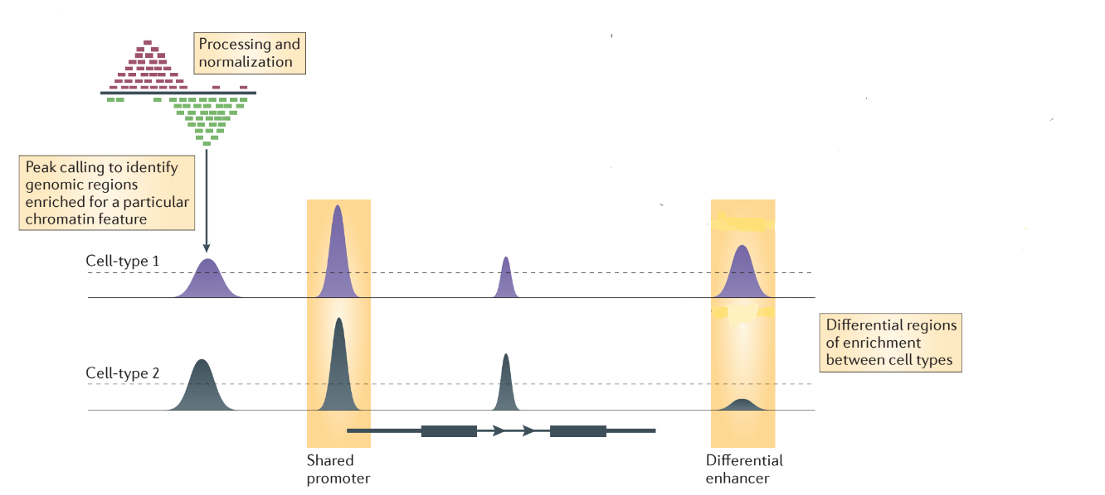
Chromatin Profiling: Identifying Differential Enhancers
H3K4me1 peaks -> enhancer sites
B
CD4
CD8
CLP
CMP
DC

Slide 13
Outline
A Primer on Chromatin Biology
Enhancer Profiles and Cellular Differentiation
The Algorithm

Slide 14
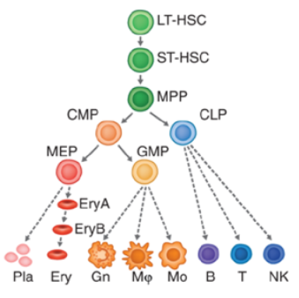
Cellular Differentiation
The process where a cell changes from one cell type to another, usually becoming more specialized.
How to distinguish between different cell types?
Cell markers: CD4, CD20, CD34… etc
Gene expression: mRNA transcripts
Enhancer profiles
Hematopoietic Cell Lineage

Slide 15
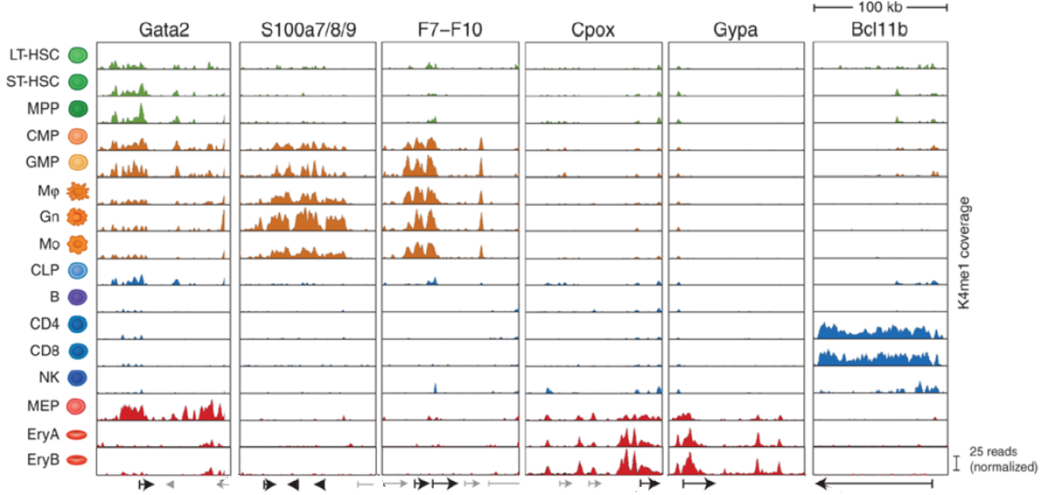
Different Cell Types have Distinct Enhancer Patterns
Representative examples of H3K4me1 signals in several loci. Displayed are normalized reads coverage in a 100 Kb region around the gene body.

Slide 16
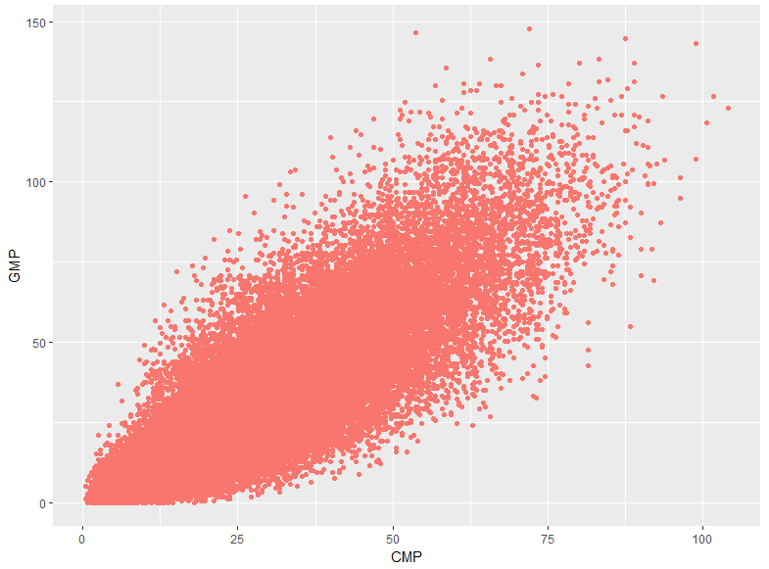
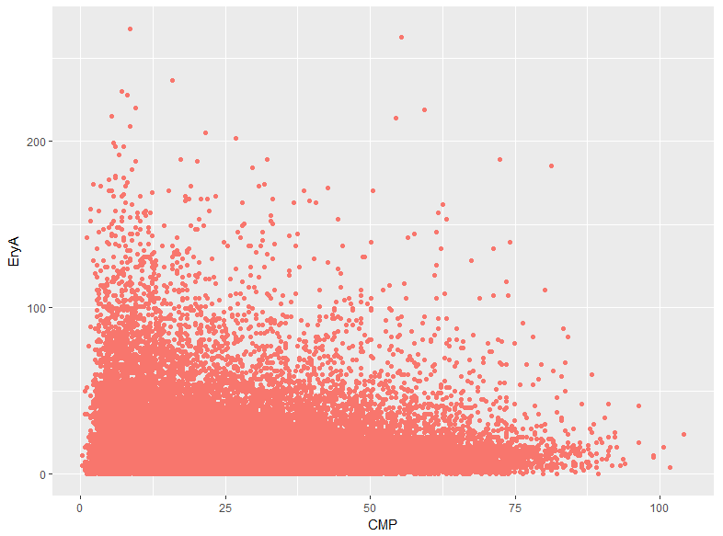
Closely Related Cell Types have Similar Enhancer Patterns
CMP vs GMP
CMP vs EryA

Slide 17
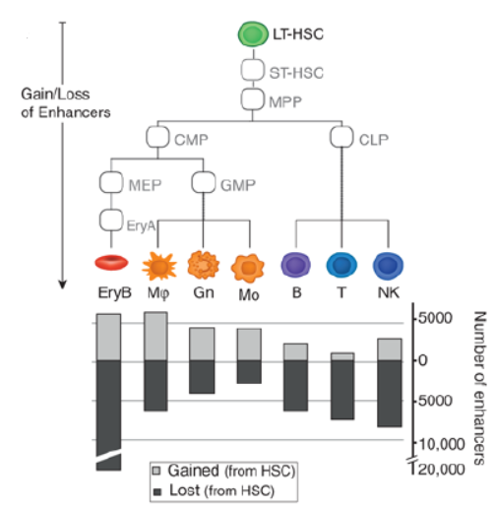
Enhancer Patterns Change During Cellular Differentiation
90% of enhancers identified across 16 stages of hematopoietic differentiation changed state (gain/loss).
The pattern is consistent with the currently accepted view of cellular differentiation: there is a progressive closing of the regulatory potential of the genome.

Slide 18
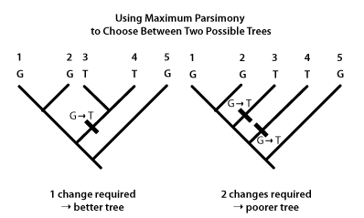
Maximum Parsimony (MP)
Assumes that the phylogenetic tree that requires the fewest evolutionary events (usually DNA base pair changes) is the most likely.

Slide 19
Inferring Cell Lineage Trees from Enhancer Profiles Using MP
Phylogenetic Trees
Cell Lineage Trees
DNA changes
Enhancer changes
Adhering to maximum parsimony, we would expect the optimal/correct cell lineage tree to have the least amount of total enhancer state changes.
Now that we have enhancer profiles of all cell types, we can compute enhancer state changes between each cell type pair and search for the optimal tree that minimize total changes.

Slide 20
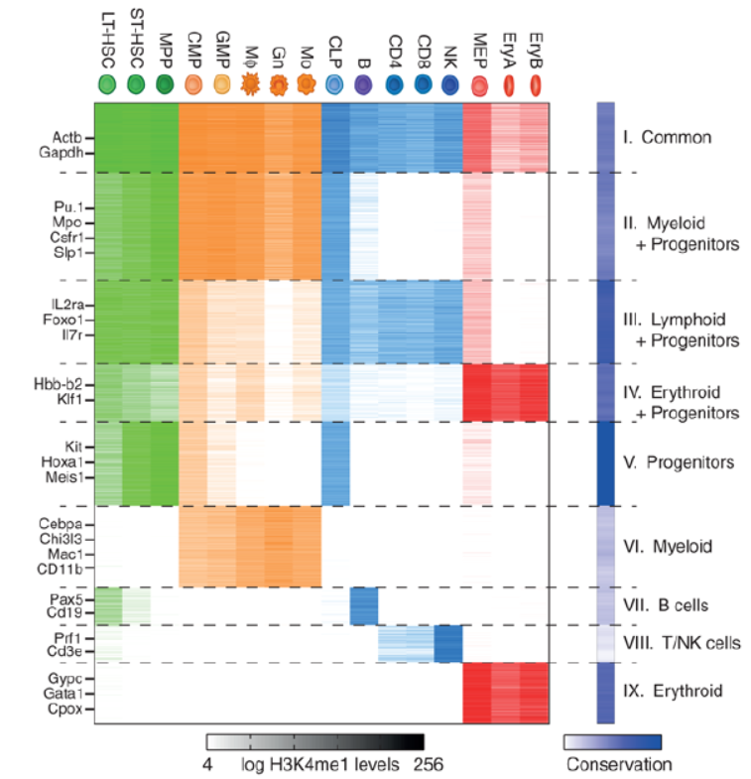
Can we devise an algorithm that computes the most likely cell lineage tree given the enhancer profiles (H3K4me1 signals) of different cell types?

Slide 21
Outline
A Primer on Chromatin Biology
Enhancer Profiles and Cellular Differentiation
The Algorithm

Slide 22
The Algorithm: Outline
Tree Representation
Scoring a Tree
Monte Carlo Simulations
Tree Generation
Choosing the Root Node
Adding Children
Growing the Tree
Demonstration
Results using 5 node Dataset
Future Directions

Slide 23
Representing Trees in a Computer: Adjacency Matrix
A
Node
A
Parent
B
C
A
B
D
Edge
B
C
C
E
Child
 | A | B | C | D | E
A | 0 | 1 | 1 | 0 | 0
B | 0 | 0 | 0 | 1 | 0
C | 0 | 0 | 0 | 0 | 0
D | 0 | 0 | 0 | 0 | 1
E | 0 | 0 | 0 | 0 | 0
 | A | B | C
A | 0 | 1 | 0
B | 0 | 0 | 1
C | 0 | 0 | 0
 | A | B | C
A | 0 | 1 | 1
B | 0 | 0 | 0
C | 0 | 0 | 0

Slide 24
The Algorithm: Outline
Tree Representation
Scoring a Tree
Monte Carlo Simulations
Tree Generation
Choosing the Root Node
Adding Children
Growing the Tree
Demonstration
Results using 5 node Dataset
Future Directions

Slide 25
Quantifying Enhancer State Changes
Enhancer Profiles
Enhancer profiles came in the form of peak intensities.
Possible metrics we can use: binary, Pearson, Spearman, Euclidean
Two closely related cell types -> low number of enhancer state changes -> high correlation in peak intensities => Pearson Correlation

Slide 26
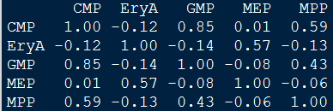
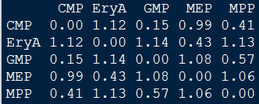




Scoring Trees Using Pearson Correlation
Compute Pearson Correlation values (r) for all possible combinations of cell types => correlation matrix.
Convert to distance matrix (1-r)
Score: 1.98
MPP
Correlation Matrix
$$D(MPP,CMP)=0.41$$
CMP
$$D(CMP,MEP)=0.99$$
$$D(CMP,GMP)=0.15$$
MEP
GMP
Distance Matrix (1-r)
$$D(MEP,EryA)=0.43$$
EryA
Values rounded to 2 decimals

Slide 27
The Algorithm: Outline
Tree Representation
Scoring a Tree
Monte Carlo Simulations
Tree Generation
Choosing the Root Node
Adding Children
Growing the Tree
Demonstration
Results using 5 node Dataset
Future Directions

Slide 28







It is infeasible to iterate through all possible tree structures
Catalan Number
$C_{n}= \frac{1}{n+1}\left({2n \atop n}\right)×n!=\frac{\left(2n\right)!}{\left(n+1\right)!}$
3 node => $\frac{\left(6\right)!}{\left(4\right)!}$ = 30 trees
5 node => $\frac{\left(10\right)!}{\left(6\right)!}$ = 5040 trees
17 node => $\frac{\left(34\right)!}{\left(18\right)!}$ = 4.6113022e+22 trees
MEP
MPP
CMP
GMP
EryA

Slide 29




Monte Carlo Approach
a broad class of computational algorithms that rely on repeated random sampling to obtain numerical results. Their essential idea is using randomness to solve problems that might be deterministic in principle.
Simulate binary tree building by computing a probabilistic model for edge adding based on the correlation matrix. Generate a large number of trees, and the tree that appears the most in the distribution should be the one that has the lowest distance score.
A
A
A
$$P_{B1}=0.4$$
$$P_{B1}=0.4$$
?
?
B
B
$$P_{C2}=0.2$$
$$P_{D2}=0.3$$
?
?
C
D
?
?
?
?

Slide 30
The Algorithm: Outline
Tree Representation
Scoring a Tree
Monte Carlo Simulations
Tree Generation
Choosing the Root Node
Adding Children
Growing the Tree
Demonstration
Results using 5 node Dataset
Future Directions

Slide 31
Choosing the Root Node: Intuition
We inferred that the optimal root node of a tree should have low variance in correlation values to other nodes.
Confirmed with the hematopoietic cell lineage dataset.
sd(MPP) = 0.47
sd(EryA) = 0.52
Compute standard deviations for each row (node) in the correlation matrix; the node with the lowest SD value should have the highest probability of being selected as the root node => Take inverse.
Root
Correlation Matrix
Child
Child
Child

Slide 32

Choosing the Root Node: Problems
The resulting probabilities of being selected as the root node do not differ much from each other.
Root Node Probabilities
The differences approaches 0 when including more nodes in the dataset
Need ways to enlarge the differences.

Slide 33
Choosing the Root Node: Proposed Solution
Instead of including all cell types in variance calculation, only account for those that has the lowest correlation values to the potential root node.
Low correlation values => more likely to be put at the bottom of the tree
Need to consider the total number of cell types to estimate the number of nodes at the bottom level
A
B
C
B | C | D | E | F | G
0.5 | 0.6 | 0.2 | 0.1 | 0.1 | 0.2
A
D
E
F
G

Slide 34
The Algorithm: Outline
Tree Representation
Scoring a Tree
Monte Carlo Simulations
Tree Generation
Choosing the Root Node
Adding Children
Growing the Tree
Demonstration
Results using 5 node Dataset
Future Directions

Slide 35

Adding Children: Intuition
Excluding itself, higher correlated nodes should have better chances of being added to the tree.
Each node gets two chances to select children.
After a children is selected, recalculate probabilities with the remaining nodes, and then select again.
CMP
?
?

Slide 36
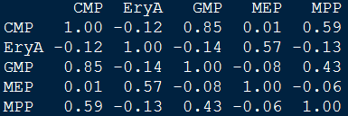
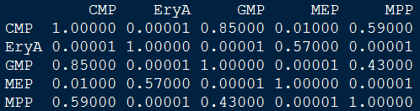
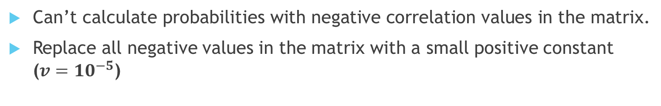
Adjusting the Correlation Matrix
Can’t calculate probabilities with negative correlation values in the matrix.
Replace all negative values in the matrix with a small positive constant ($v={10}^{−5}$)
Original Matrix
Adjusted Matrix
EryA | GMP | MEP | MPP
0.00001 | 0.85 | 0.01 | 0.59
CMP

Slide 37

The Null Probability
We want to explore different tree structures.
Need a probability of not adding any children to the parent.
Divide each correlation value by the number of available nodes (p), and then assign the remaining portion (1- sum of p) as the probability of not adding any nodes.
EryA | GMP | MEP | MPP | Null
2.5e-6 | 0.21 | 2.2e-3 | 0.15 | 0.64
CMP

Slide 38

Lowering the Null Probability
High null probability observed when there are few available nodes left – almost impossible to add edges.
Scaling the probabilities by the maximum value in each row can lower the null probability considerably
EryA | MEP | Null
5e-6 | 0.0045 | 0.995
EryA | MEP | Null
5.6e-4 | 0.50 | 0.49
CMP
CMP
Scaling by maximum correlation value doesn’t work when there’s only one node left to add- revert to the original method.
We’re still trying to find a more efficient way to model the null probability.
EryA | Null
1 | 0
CMP

Slide 39
The Algorithm: Outline
Tree Representation
Scoring a Tree
Monte Carlo Simulations
Tree Generation
Choosing the Root Node
Adding Children
Growing the Tree
Demonstration
Results using 5 node Dataset
Future Directions

Slide 40
Growing the Tree: Enlarging the Matrix
Initialize the adjacency matrix (adj.m) with the root node.
Calculate probabilities of adding edges to the root node.
Enlarge adj.m with the selected children and assign edges to them (0 -> 1)
Move on to the children and compute probabilities of adding edges to them.
Continue until all nodes are incorporated into adj.m
 | MPP | CMP
MPP | 0 | 1
CMP | 0 | 0
MPP
 | MPP
MPP | 0
MPP
MPP
CMP
?
?
CMP
?
?

Slide 41
Randomizing the Order of Edge Adding
Which node do we start adding edges to?
Need to randomize the order of nodes on the same level to avoid biases and maintain a balanced tree.
Implementation: queue-like data structure
A
D | E | F | G
B
C
Randomize
F | D | G | E
D
E
F
G
Dequeue first element
Add edges to F
?
?
D | G | E

Slide 42
The Problem of Incomplete Trees
Prematurely terminated trees will arise due to null probabilities.
Only 1768 trees out of 5000 simulations achieve completion using 5 node dataset (MPP, CMP, GMP, MEP, EryA).
Solution: force adding one node to the last node in the queue if no children was selected beforehand.
Remove the null probability
A
B
C
X
X
X
?
G
F
D
E
D | E | F | G
0.20 | 0.60 | 0.10 | 0.10
C

Slide 43
Simulation
Repeat tree generation many times (N = 5000)
Compute the distribution and obtain the top matrices that appears the most
Report the score, parse the matrices into data.tree objects and visualize the trees

Slide 44
The Algorithm: Outline
Tree Representation
Scoring a Tree
Monte Carlo Simulations
Tree Generation
Choosing the Root Node
Adding Children
Growing the Tree & Simulation
Demonstration
Results using 5 node Dataset
Future Directions

Slide 45
Demonstration
Correlation Matrix e
 | A | B | C | D | E
A | 1.0 | 0.8 | 0.2 | 0.1 | 0.1
B | 0.8 | 1.0 | 0.9 | 0.7 | 0.1
C | 0.2 | 0.9 | 1.0 | 0.2 | 0.2
D | 0.1 | 0.7 | 0.2 | 1.0 | 0.6
E | 0.6 | 0.1 | 0.2 | 0.1 | 1.0
Root Node Probabilities
A | B | C | D | E
0.6 | 0.11 | 0.10 | 0.10 | 0.10

Slide 46
Demonstration
 | A
A | 0
A
?
?
Selected:
A
B | C | D | E | null
0.25 | 0.06 | 0.09 | 0.13 | 0.47

Slide 47
Demonstration
 | A
A | 0
A
?
Selected:
X
B | C | D | E
0.67 | 0.17 | 0.08 | 0.08
A

Slide 48
Demonstration
 | A
A | 0
A
Selected:
X
B

Slide 49
Demonstration
 | A | B
A | 0 | 1
B | 0 | 0
A
B
?
?
Selected:
C | D | E | Null
0.33 | 0.26 | 0.08 | 0.37
B

Slide 50
Demonstration
 | A | B
A | 0 | 1
B | 0 | 0
A
B
?
Selected:
C
D | E | Null
0.50 | 0.07 | 0.43
B

Slide 51
Demonstration
 | A | B
A | 0 | 1
B | 0 | 0
A
B
Selected:
C
D

Slide 52
Demonstration
 | A | B | C | D
A | 0 | 1 | 0 | 0
B | 0 | 0 | 1 | 1
C | 0 | 0 | 0 | 0
D | 0 | 0 | 0 | 0
A
B
C
D
?
?
E | Null
0.20 | 0.80
C

Slide 53
Demonstration
 | A | B | C | D
A | 0 | 1 | 0 | 0
B | 0 | 0 | 1 | 1
C | 0 | 0 | 0 | 0
D | 0 | 0 | 0 | 0
A
B
C
D
?
?
E | Null
0.60 | 0.40
D

Slide 54
Demonstration
 | A | B | C | D | E
A | 0 | 1 | 0 | 0 | 0
B | 0 | 0 | 1 | 1 | 0
C | 0 | 0 | 0 | 0 | 0
D | 0 | 0 | 0 | 0 | 1
E | 0 | 0 | 0 | 0 | 0
A
B
C
D
E
Null
1
D

Slide 55
The Algorithm: Outline
Tree Representation
Scoring a Tree
Monte Carlo Simulations
Tree Generation
Choosing the Root Node
Adding Children
Growing the Tree
Demonstration
Results using 5 node Dataset
Future Directions

Slide 56
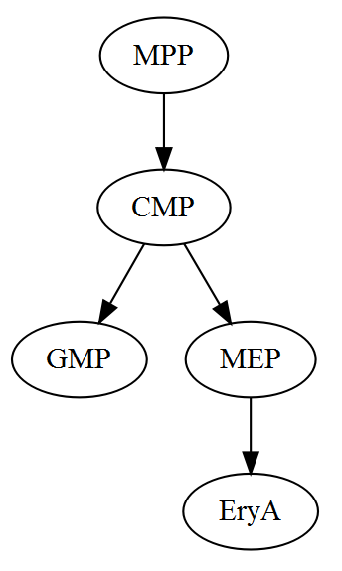
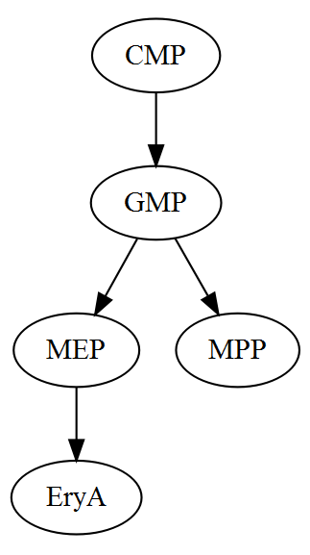
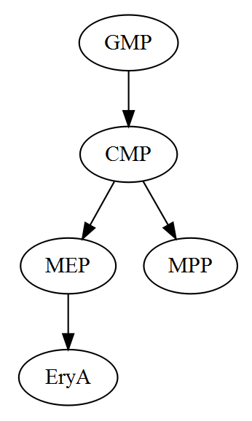
Results Using 5 Nodes Dataset
Top three trees generated after 5000 simulations.
198 => 3.96 %
184 => 3.68 %
177 => 3.54 %
Score: 1.98
Score: 1.98
Score: 2.23

Slide 57
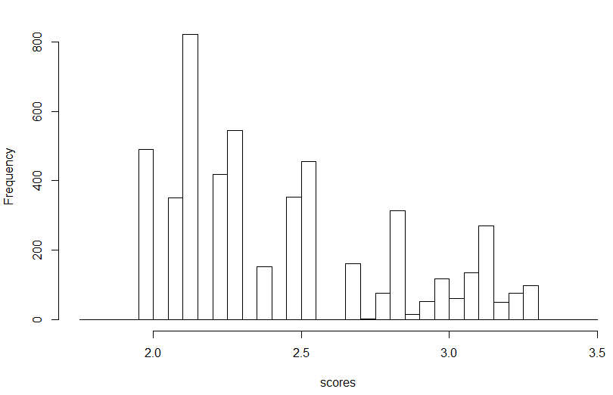
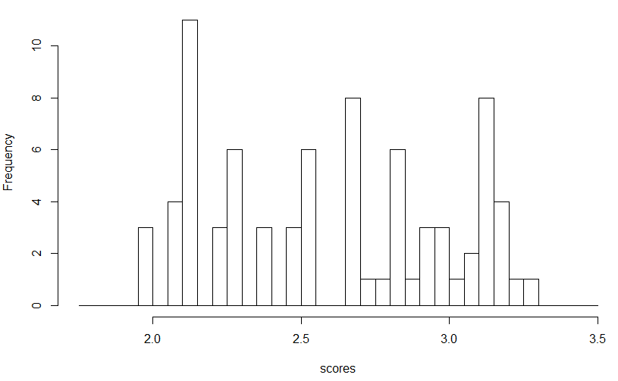
Results Using 5 Nodes Dataset
75 unique trees generated
5000 trees
75 unique trees

Slide 58

Future Directions
Implement the proposed solution for root node selection
Improve the model for computing null probability
Incorporate more hematopoietic cell types
Test with other datasets
Integration with other metrics (e.g. Spearman, Euclidean)
Improve user interface

Slide 59
Acknowledgments
Deborah R. Winter, PhD
Assistant Professor of Medicine (Rheumatology)
Northwestern University Feinberg School of Medicine
Driskill Graduate Program in Life Sciences (DGP)

Slide 60

Thank you! Happy Holidays!

