Slide 1
RevFlare
AI-Powered Sales Intelligence for Cloudflare
A single Cloudflare Worker powering deep account research, persona-curated outreach, competitive intelligence, threat monitoring, autonomous pipeline generation, MCP integrations, and compliant email execution.
Built by Arun Potta | Powered by Cloudflare Workers + AI

Slide 2
Business Value & ROI
RevFlare transforms how sales teams prospect, research, approve, and close deals.
WITHOUT
WITH REVFLARE
10x Faster Research
8 live probes in parallel. 45 min -> 10 sec per account.
45 min
10 sec
Research
Research
3x Higher Reply Rates
2%
6-8%
25 persona variants + AI chat refinement. Not templates.
Reply rate
Reply rate
100% Pipeline Coverage
Manual
1 click
AI agent auto-generates opps with realistic ACV.
Pipeline
Pipeline
Open Ecosystem
10+ tabs
1 platform
MCP client + server. Bring your own tools & agents.
Per prospect
Unified
Annual value: 10 reps x 7.5 hrs/week saved x 50 weeks x $75/hr = $281,250 in recovered selling time
CLOUDFLARE EDGE ARCHITECTURE
Workers
D1
Workers AI
Browser
KV
Cron
App server
29 tables
3 LLMs
Scraping
Cache
Auto-send

Slide 3
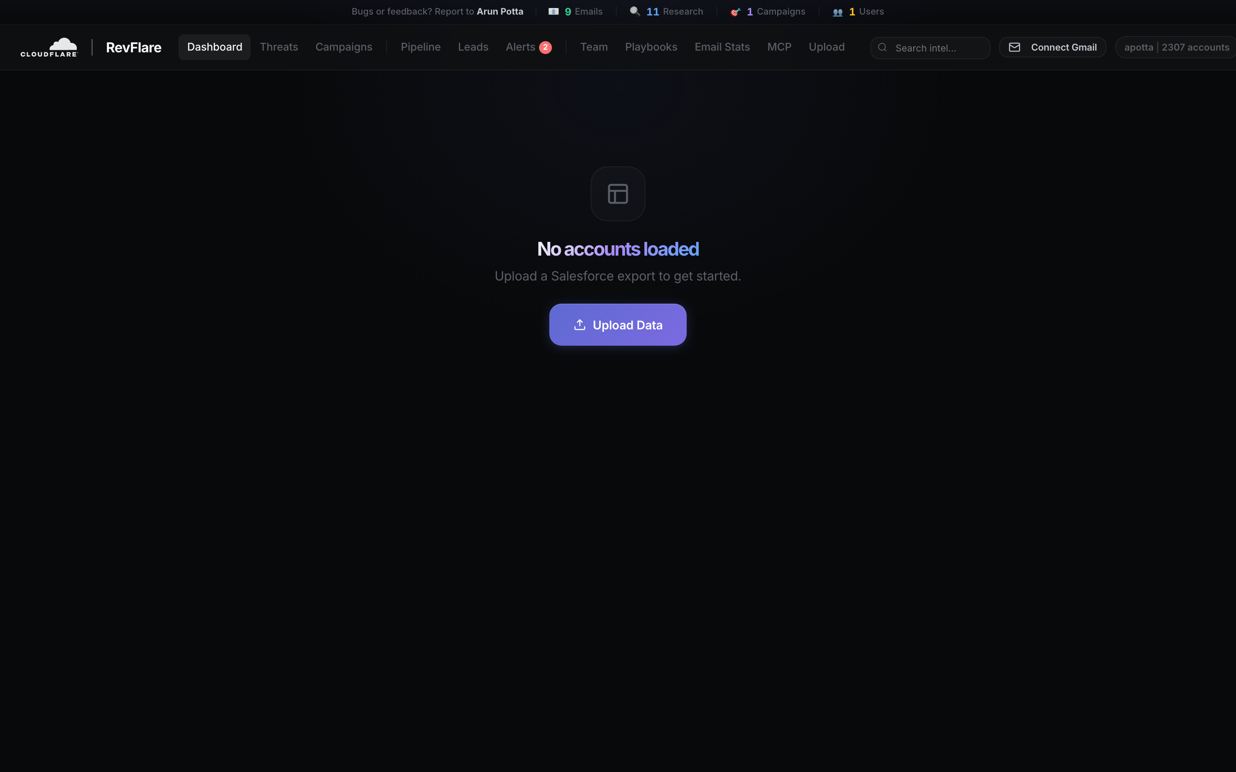
Account Intelligence Dashboard
2,307 accounts with IT spend, competitor stack, and engagement signals at a glance.

Slide 4
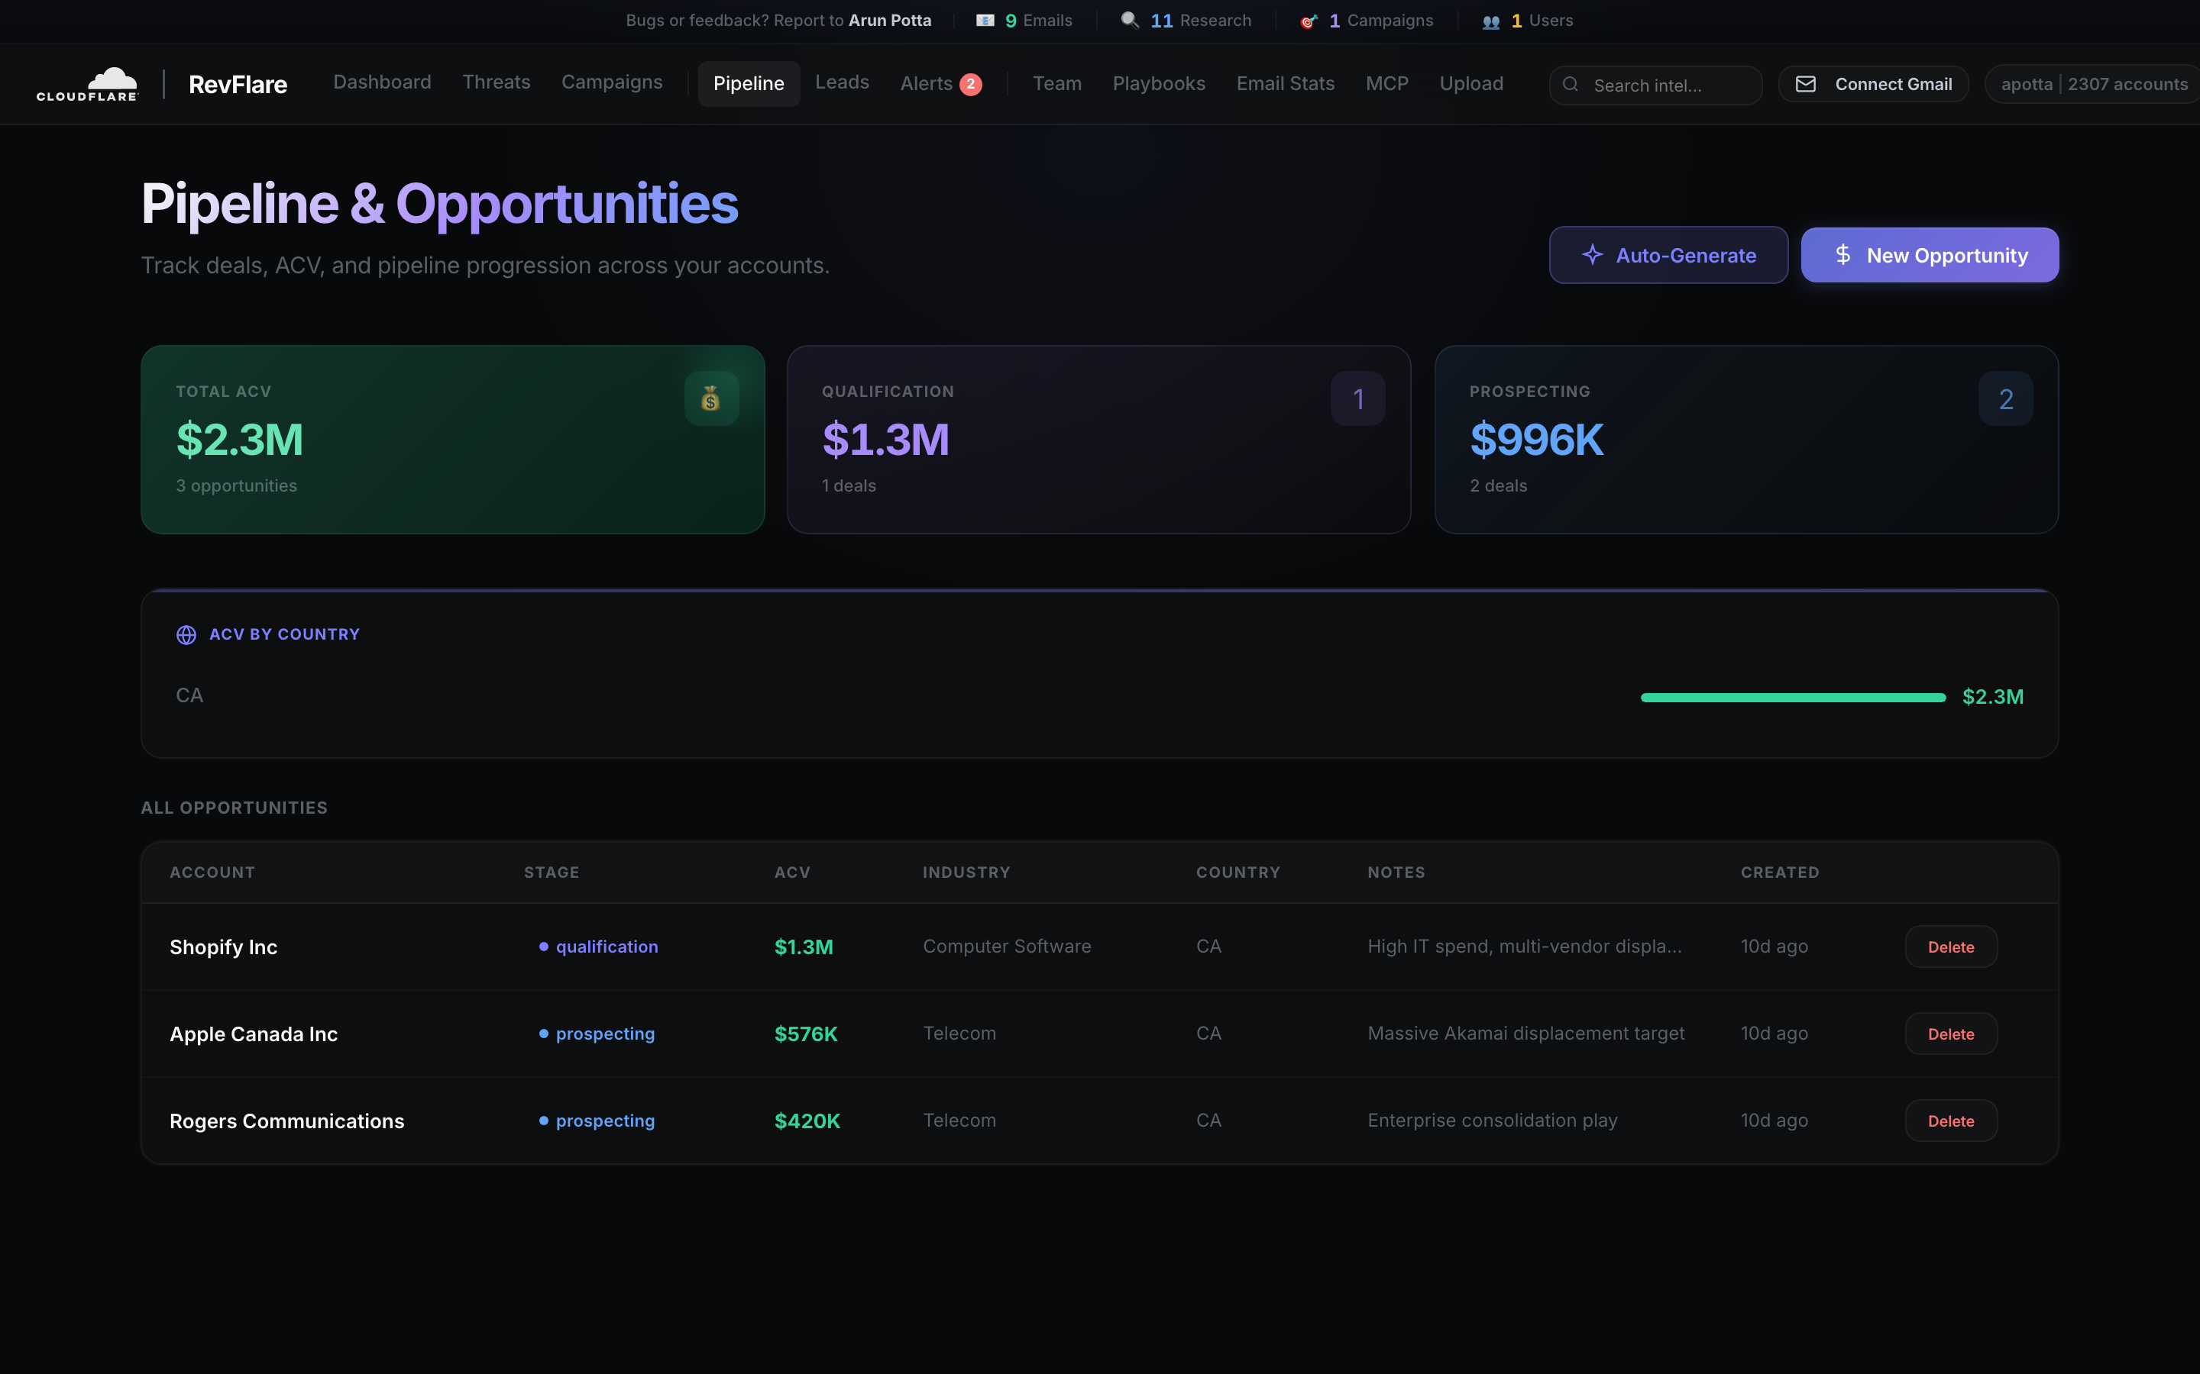
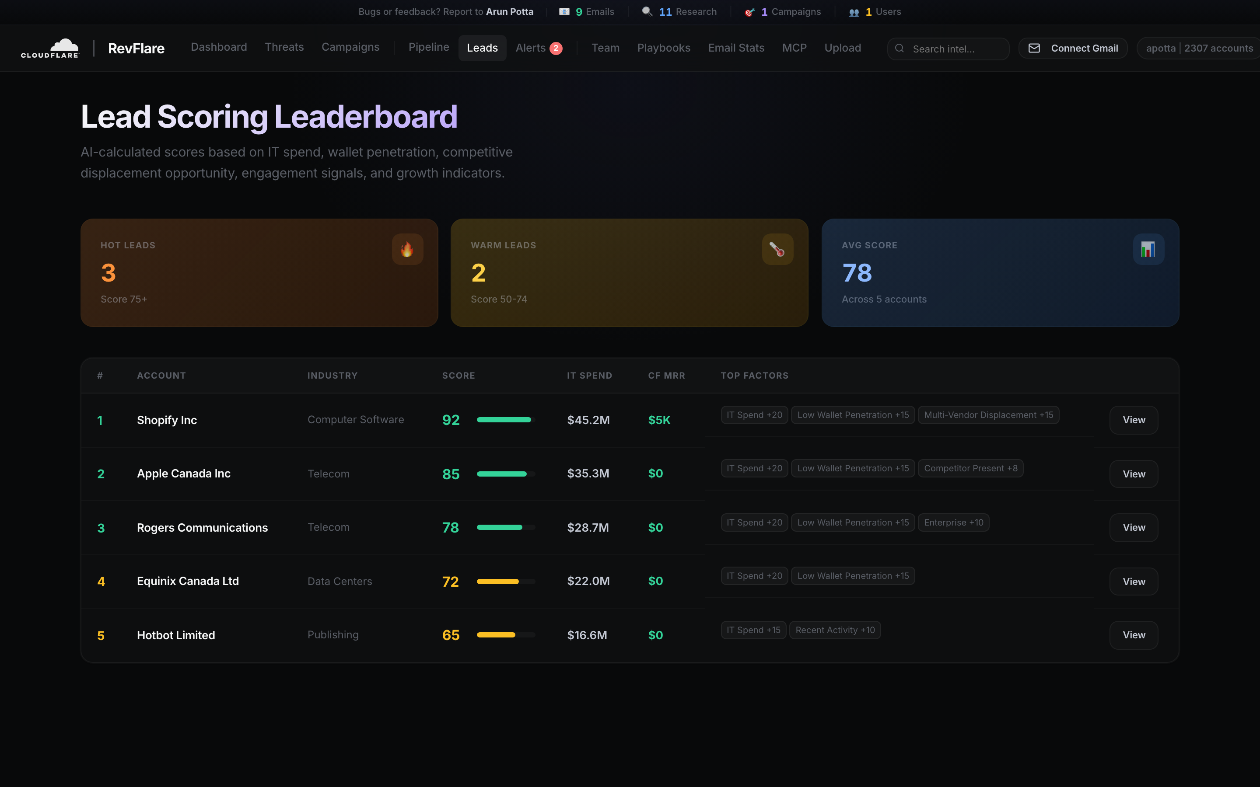
Pipeline & AI Lead Scoring
Left: AI Opportunity Agent auto-generates deals with ACV. Right: 8-factor lead scoring ranks every account 0-100.

Slide 5
20 Features + Competitive Intelligence
COMPETITIVE (12 CATEGORIES, 40+ RIVALS)
Lead Scoring
ROI Calc
Lookalikes
Meeting Prep
Sequences
AI 0-100
Savings est.
Match stack
Call brief
Auto-execute
CDN -- Akamai, CloudFront, Fastly
Change Detect
A/B Testing
Voice Notes
Alerts
Team Dash
WAF -- Imperva, AWS WAF, F5
Infra scan
2 variants
To email
+ AI products
Leaderboard
DDoS -- Prolexic, AWS Shield
Playbooks
Search
Pipeline
Win/Loss
Opp Agent
Zero Trust -- Zscaler, Palo Alto
Templates
AI-ranked
ACV track
Analysis
Auto gen
Edge Compute -- Lambda@Edge, Vercel
Email Approval
AI Chat Refine
Open Tracking
CAN-SPAM
MCP Gateway
DNS -- Route 53, NS1, Google
Review & gate
Rewrite in place
Pixel + stats
Unsubscribe
Client + server
THREAT INTELLIGENCE
26 RSS Feeds
GDELT + 5 News APIs
Auto-Match
Trigger Emails
Nightly Cron
Real-time incidents
Google, Bing, NewsAPI, GNews, MediaStack
By industry & country
Incident outreach
Daily scan + alerts
SECURITY & INTEGRATIONS (47 FIXES ACROSS 3 AUDIT ROUNDS)
Access JWT
AES-256-GCM
SSRF Block
XSS Escaped
SOQL Safe
CORS Locked
Gmail OAuth
SF OAuth
Share Links
MCP Secure

Slide 6
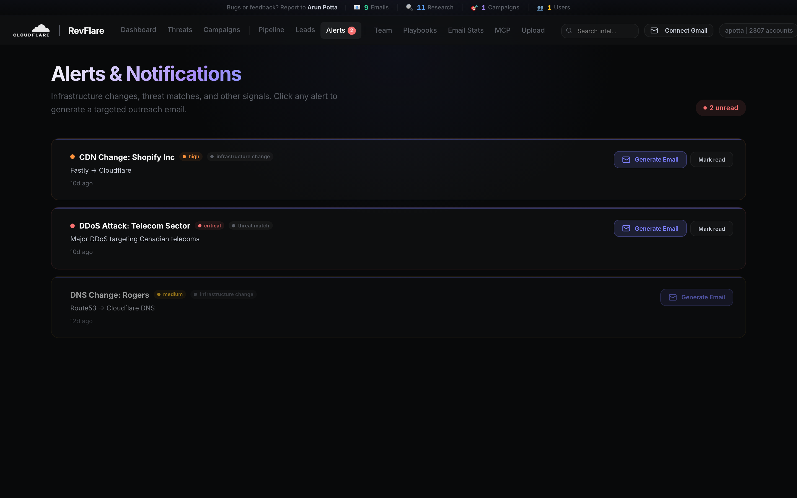
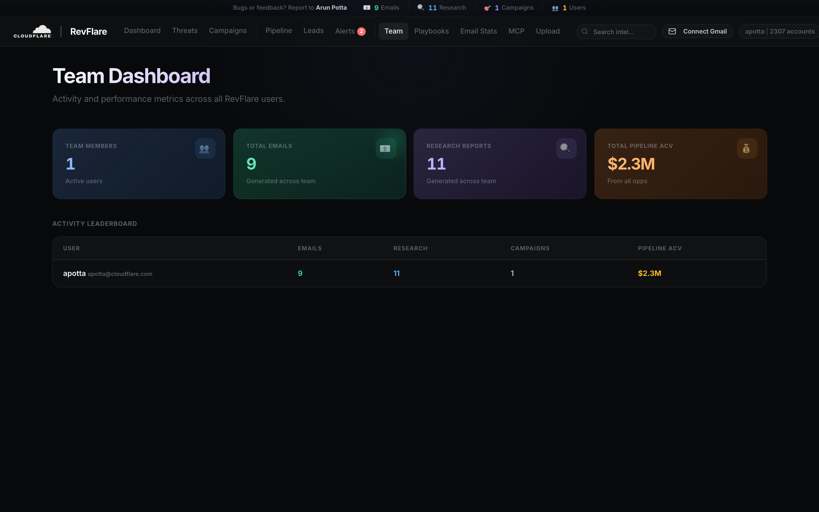
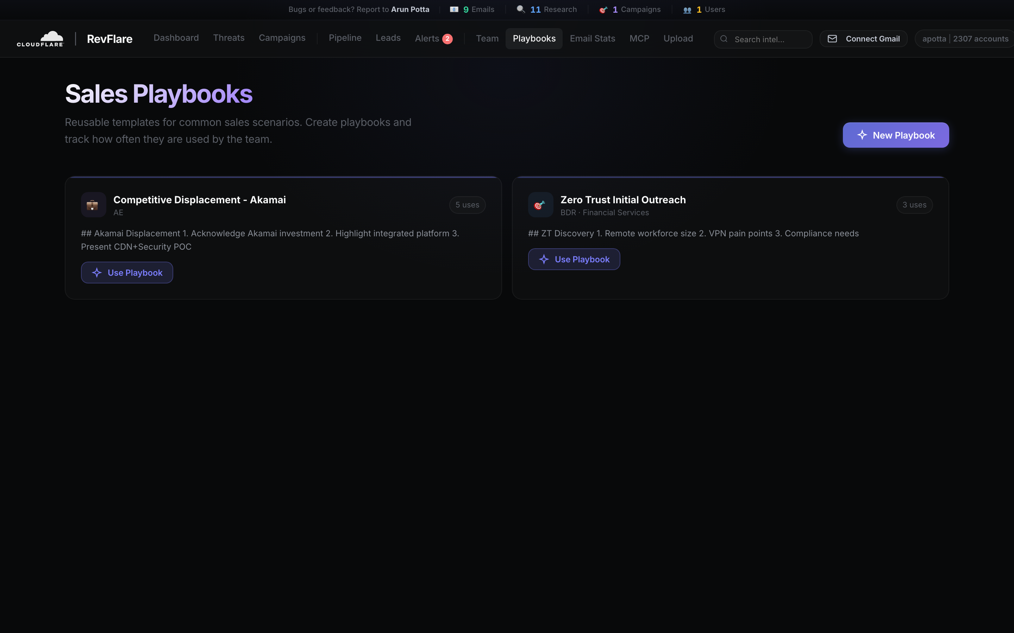
Alerts, Team & Playbooks
Real-time infrastructure alerts, team activity leaderboard, and reusable sales playbooks.

Slide 7
Open Ecosystem, Compliant Outreach, Conversational AI
Four new capabilities bringing RevFlare from standalone tool to enterprise platform.
MCP (Model Context Protocol)
AI Chat Email Refinement
Bi-directional. Client + Server.
Conversational rewrites. Full turn history.
AS CLIENT
AS SERVER
+ Plain-English instructions: "make it shorter, lead with ROI"
+ Netstrat (network + strategy)
+ lookup_account
+ Llama 3.3 70B multi-turn with context memory (20 prior turns)
+ Google Workspace (calendar, contacts)
+ get_lead_score
+ Wiki (internal knowledge)
+ get_account_research
+ Rewrites in place, resets to pending_approval for re-review
+ Jira (issue context)
+ get_pipeline
+ Full chat history persisted per message for auditability
+ Cloudflare Docs (product lookup)
+ get_alerts
+ Works on persona messages AND campaign emails
+ SSRF-hardened URL validator
+ get_email_stats
+ Subject line auto-extracted and updated alongside body
Email Tracking & CAN-SPAM
Email Performance Dashboard
Opens, unsubscribes, suppression - built in.
Funnel, trends, suppression - one screen.
+ 1x1 tracking pixel per email (unique tracking_id)
+ Sent / opened / replied rates per user
+ One-click List-Unsubscribe header + landing page
+ Daily send trend (last 14 days) with cap tracking
+ Per-user suppression list (bounces, complaints)
+ Per-campaign funnel (last 20 campaigns)
+ Auto-block of suppressed addresses before send
+ Suppression list management with remove button
+ Public endpoints bypass Access for deliverability
+ Today's usage vs 100/day cap (reputation protection)
+ Gmail signature auto-appended to every outbound
+ Per-message open count + reply flag on every email

Slide 8
RevFlare by the Numbers
~12,700
29
108
8
25
Lines of Code
DB Tables
API Endpoints
Live Probes
Email Variants
12
40+
26
5
$0
Competitive Cats
Competitors
Threat Feeds
Personas
Infra Cost
revflare.arunpotta1024.workers.dev
github.com/pottaarun/RevFlare
Built by Arun Potta | Powered by Cloudflare Workers + AI

