Slide 1
Sentiment Analysis of Tweets Using NLP
An End-to-End NLP Project (Group 5)

Slide 2
Problem Statement
This project aims to build a sentiment classification model using a dataset of tweets relating to Apple and Google Products applying Natural Language Processing (NLP) techniques
Dataset: ~9000 tweets
Value Proposition for this model:
Understanding Customer Sentiment
Monitoring Brand Reputation
Getting Product Specific Insights

Slide 3
Project Objectives
Convert: unstructured tweet text into structured input for modeling by applying text preprocessing and feature engineering.
Develop: an NLP-based classification model that categorizes tweet sentiments into Positive, Neutral or Negative using machine learning techniques.
Evaluate: and compare multiple classification algorithms such as Naïve Bayes, Random Forest and XGBand optimize performance using techniques like SMOTE and GridSearchCV.

Slide 4
Text Preprocessing
Data Cleaning and Text Preprocessing:
Removed null values, duplicates and columns
Lowercasing and removing special characters
Stopword removal
Tokenization using TweetTokenizer
Lemmatization with WordNetLemmatizer
Feature engineering: Product Category, Chars, Words
Exploratory Data Analysis: class distribution
Model Training & Evaluation:
Baseline Model: RandomForest Classifier
Tuning: using TF-IDF, SMOTE, GridSearchCV
Benchmarking: XGBClassifier, Naïve Bayes
Evaluation metrics: Accuracy, F1 Score, ROC-AUC Score
Reporting: Conclusions & Recommendations
Data Methodology

Slide 5
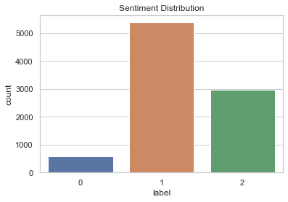
EDA: A Case of Class Imbalance

Slide 6
Model Training and Evaluation
Models Trained:
Random Forest Classifier (baseline)
Ensemble methods: XGB Classifier
Naïve Bayes Classifiers: Multinomial + Complement Naïve Bayes
Techniques used:
Pipelines – for consistent preprocessing and modeling
Vectorization techniques: CountVectorizer and TF-IDF
SMOTE – to balance class distribution
GridSearchCV – for hyperparameter tuning
Evaluation metrics: (Cross-validated) Accuracy, Weighted F1 Score, ROC-AUC Score

Slide 7
Results Comparison
Model | Accuracy (cross-validated) | F1 Score (Weighted) | ROC – AUC Score
Random Forest (Original Baseline) | 40.88% | 38.42% | 65.38%
Random Forest (New Baseline) | 55.09% | 45.53% | 68.19%
Tuned RF (Gridsearch) | 66.66% | 66.94% | 78.53%
XGB Classifier (no SMOTE) | 67.06% | 65.76% | 68.19%
XGB Classifier (SMOTE) | 67.25% | 64.28% | 76.64%
Multinomial Bayes | 60.03% | 57.56% | 55.53%
Complement Naïve Bayes | 67.06% | 63.51% | 76.06%

Slide 8
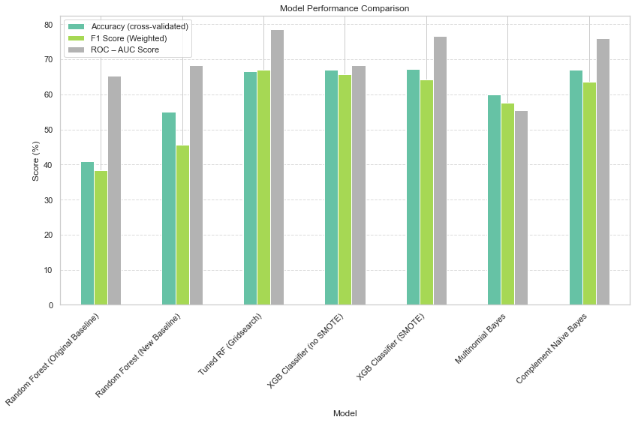
Model Comparison

Slide 9
Conclusion
Key Takeaways:
XGBClassifier is the best overall model by Accuracy
Tuned RF is the best by F1 Score and ROC-AUC Score: shows proof of good performance gains from hyperparameter tuning and feature engineering
SMOTE Benefit: increase ROC-AUC Score
Complement Naïve Bayes’ performance is second only to XGBClassifier and Tuned RF
Challenges Faced:
Handling noise and short text
Highly Imbalanced classes

Slide 10
Business Recommendations (Next Steps)
Use insights from positive tweets to identify what customers love and amplify those product features.
Implement a live dashboard or API port that uses the trained model to monitor twitter sentiment continuously.
Engage promptly with users who post negative sentiment tweets to resolve issues and protect brand reputation.

Slide 11
James wachira Tim Musungu Vivian Kwamboka Calvin Mutua Hashim Ibrahim
THANK YOU!

