Slide 1
Predicting the NFL

Slide 2
TABLE OF CONTENTS
01
03
05
ABOUT US
Change this
BUDGET
02
04
06
OVERVIEW
CONTENT PLAN
SUMMARY
Introducing the Analysts
Looking into the data utilized for analysis
Here you could describe the topic of the section
Exploring the questions asked and the data utilized for analysis
Here you could describe the topic of the section
Summarizing findings

Slide 3



About Us
Sami Abu-Douleh
Cory Potter
Morgan Tighe

Slide 4
Overview
Our team was interested in what factors affect the outcome of NFL games and the prediction of scores for betting statistics.

Slide 5
Questions and Answers
01
02
Does weather have an effect on the over/under of an NFL Game
Does the timing of the game impact total score?
Betting on the Over/Under involves looking at the predicted total points of both teams and guessing if it will be more or less than the prediction
03
Is there truly a home field advantage?

Slide 6
DATA DEEP DIVE
WHERE
Data was gathered using the Open Datasets on Kaggle.com
WHY
With the start of the NFL Season, NFL Data was trending
Each of us are NFL Fans, so this was interesting to our group
WHEN
Focused on 2002 – 2018, which was the last time divisions were set. We removed Playoff data to keep the number of games per team consistent (NFL Regular Season). 2019 had to be removed due to incomplete data

Slide 7
Data Utilized in Analysis
NFL Stadium Data
NFL Team Data
NFL Game Data
NFL stadiums, detail and their weather conditions
NFL teams over the years, NFC/AFC, and their divisions
All NFL Games played 1966 – 2018 including scores, weather, over/under, etc.
01
02
03

Slide 8
Does Weather Have an Effect on the Over/Under of an NFL Game

Slide 9
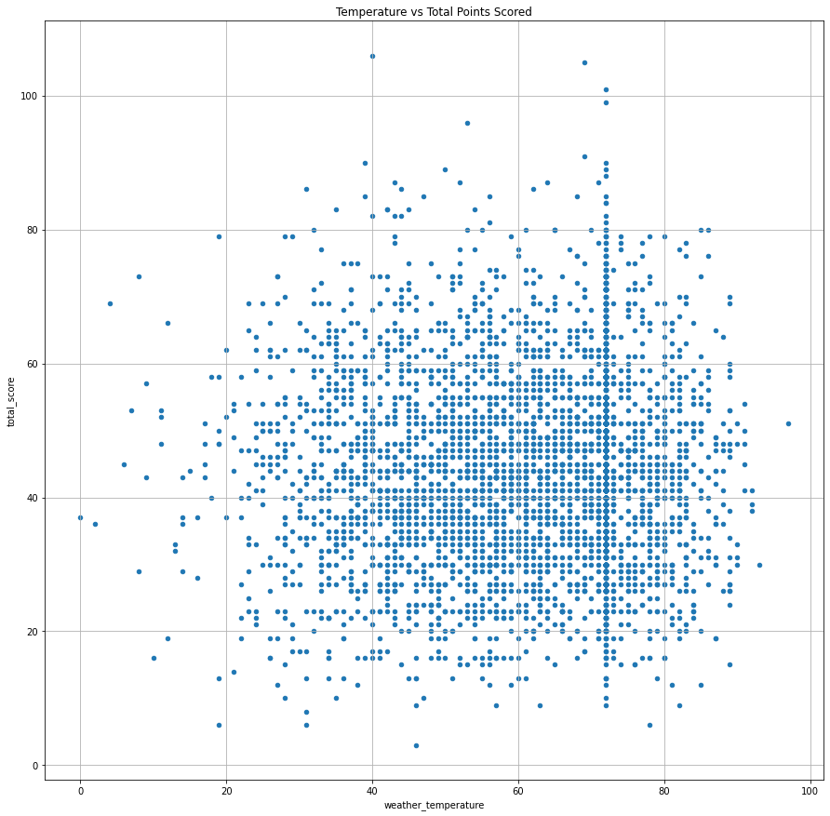
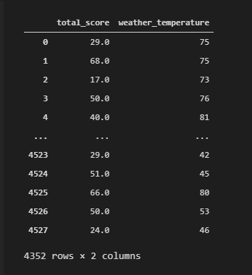
Temperature vs. Total Points Scored
Findings
Approximately 99% of games played in a dome are set to 72^{○F}
While scores vary based on temperature, the top 15 highest scoring games happened above freezing (32^{○F}) and averaged around 61^{○F} degrees.
Dataframe Created
If you want to modify this graph, click on it, follow the link, change the data and replace it

Slide 10
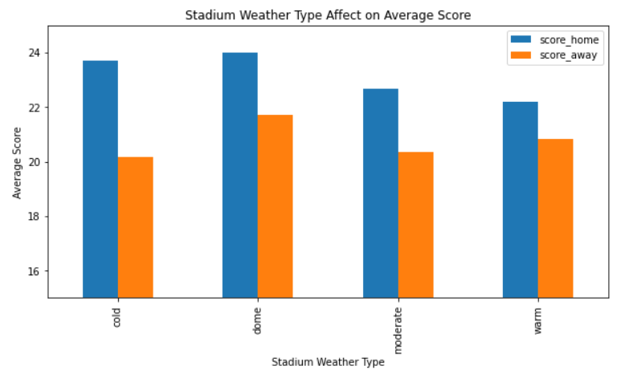
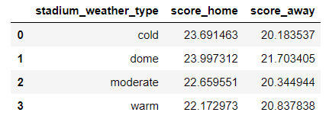
The Effect of Stadium Weather Type
Findings
Teams have a higher average score when playing at home than the away teams
Teams have the highest average score when playing in a dome, where the conditions are controlled

Slide 11
Does the timing of the game impact total score?

Slide 12
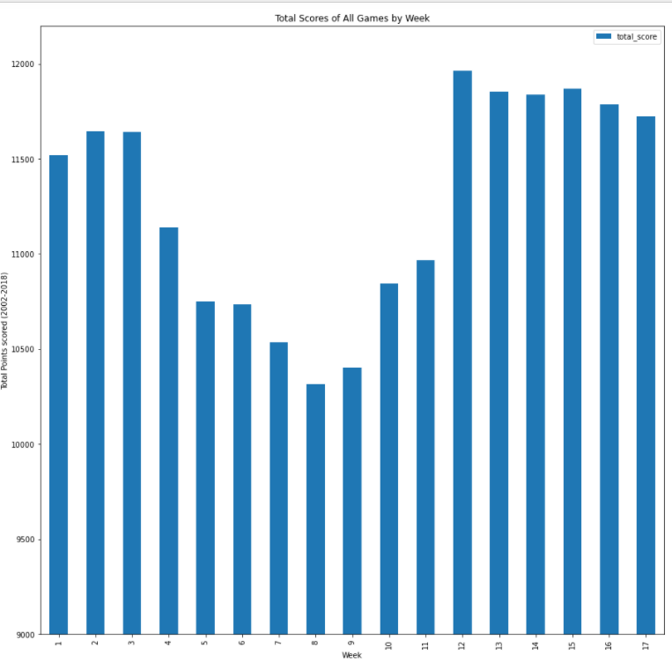
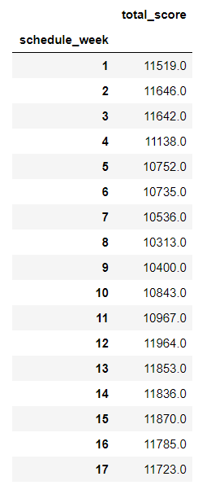
Total Scores of Games by Week

Slide 13
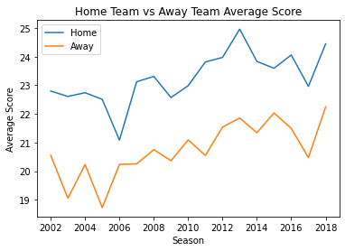
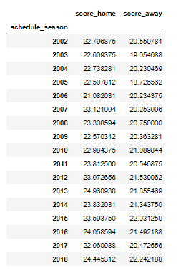
Score over the Seasons
Findings
On average, there is a steady incline on the average points scored by each team over the years
The point differential was the closest in the 2006 season
Notes:
This graph isn’t correct – Jan and Dec should be switched. Consider removing or fixing the graph.
Over the years, there has been a consistent, albeit slow, increase in scores.

Slide 14
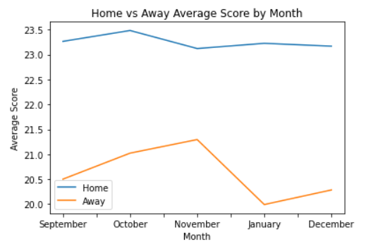
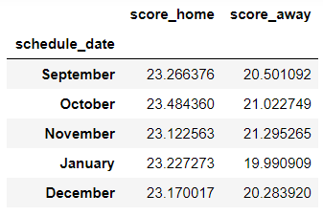
Does the timing of the game play a role?
Findings
Consider removing chart – graph is out of order
Notes:
This graph isn’t correct – Jan and Dec should be switched. Consider removing or fixing the graph.

Slide 15
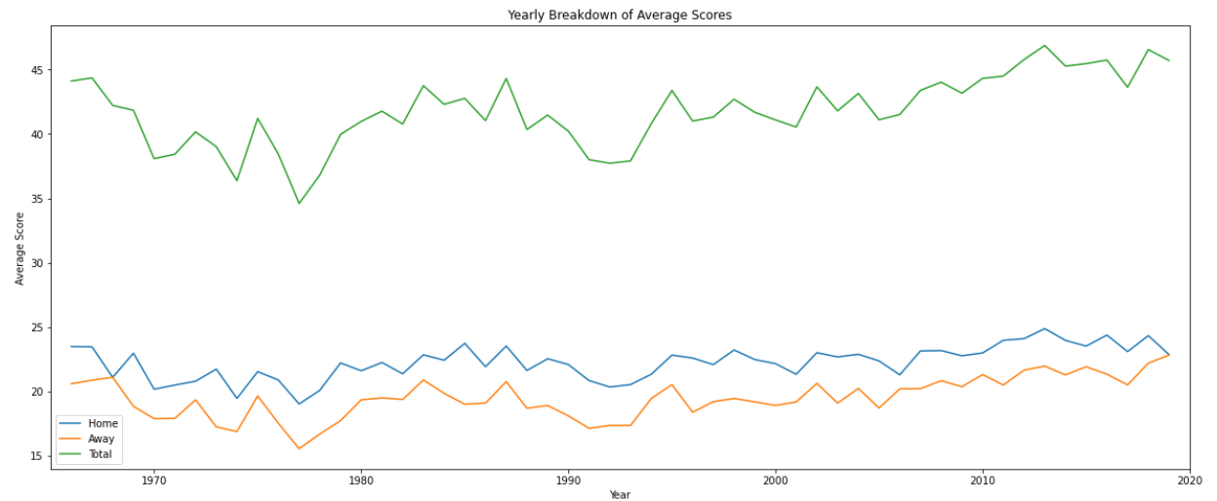
Yearly Breakdown of Scores
Notes:
While the most points are scored by home teams consistently, that doesn’t mean that the home team always wins. Some teams playing in the same week are experiencing blow out games, while others may have lost. However, on average, the home teams will always outscore the away teams.
Over the years, there has been a consistent, albeit slow, increase in scores.

Slide 16
Is there truly a home field advantage?

Slide 17
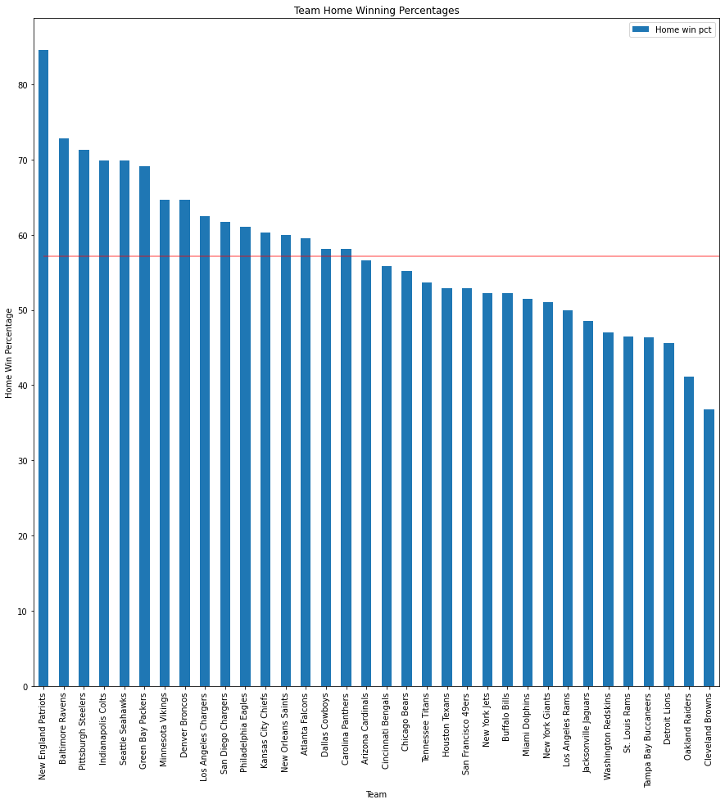
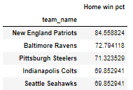
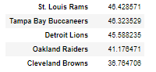
Winning Percentage at Home per Team
Findings
Average Home Win Percentage across NFL is ~57%,
New England Patriots win 84.6% of their home games which is over 11% higher than the next best team Baltimore Ravens

Slide 18
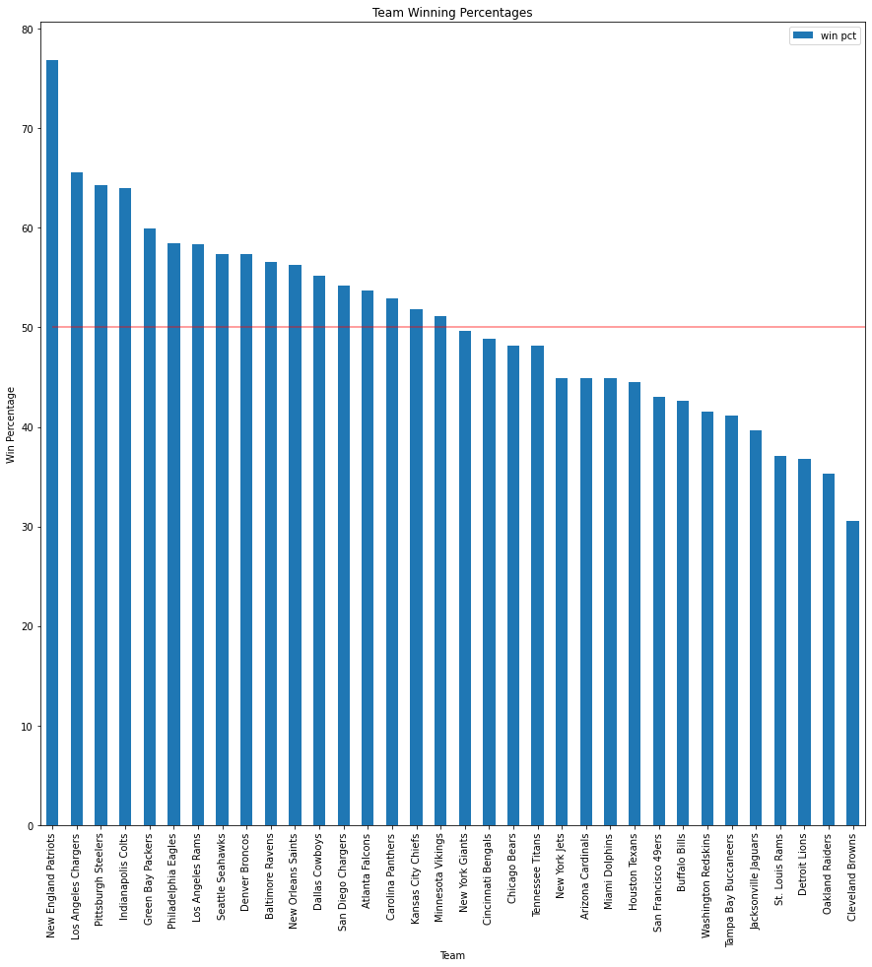
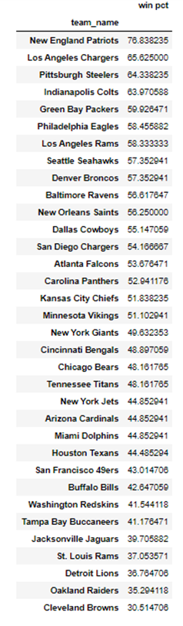
Winning Percentage at Home per Team
Findings
When the St. Louis Rams and the San Diego Chargers moved to Los Angeles, both teams improved winning % after the move(through end of 2018 season)
Baltimore Ravens are ranked 10th in winning percentage, but 2nd in home winning, meaning that this team is positively impacted by Home Field Advantage
Notes:
2015 last season for Rams in STL
2016 last season for SD

Slide 19
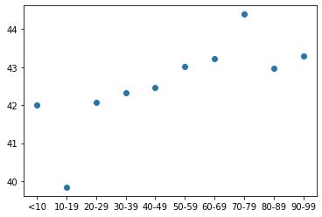
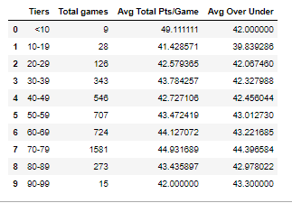
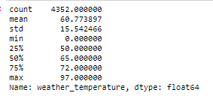
Weather vs. Average Over/Under
Findings
The most games were played between 70-79^{○F} (36% of all games)
The highest average over under is 44.4^{○F}, which falls within the 70-79 degree weather

Slide 20
Difficulties
Difficulties
Solutions
With so much data, we didn’t know where to start looking for correlations
By utilizing the plug in, Pandas Profiles, we were able to quickly see correlations
Missing data from some of the games
Scrubbed the data for null values
Divisions were shuffled in 2001, which impacted the 2002 season and beyond
Scrubbed the data for seasons 2002 to 2018
Teams shifted cities within the 2002 – 2018 timeframe
We were able to analyze the teams individually to see how the change in stadium affected the teams

Slide 21
What Would We Look at if We Had More Time?
Player Metrics
Rule Changes and Technology
With a wealth of player data available, specifically for Fantasy Football, Draft Kings, etc., how are individual players affected by these same factors?
With rules and technology constantly changing to keep the game fair and players safe, is the increase in score over the years impacted by these new factors?

Slide 22
SUMMARY
WEATHER
While the weather doesn’t largely impact scores, games played in the “sweet spot” between 70 – 79^{○F} do see a consistent increase in score.
TIMING
Over the years, there has been a consistent, albeit slow, increase in scores.
There is a noticeable decline in the scores of games played between weeks 3 and 8, and towards the end of the season- specifically for away teams.
HOME FIELD ADVANTAGE
There is evidence that indicates “Home Field Advantage” exists. While the teams with the highest and lowest winning percentages are hardly affected, it can make or break a game for average teams.

Slide 23
THANK YOU!
Questions?

