Slide 1
Predicting the NFL

Slide 2
TABLE OF CONTENTS
01
03
05
ABOUT US
DIFFICULTIES
FURTHER RESEARCH
02
04
06
OVERVIEW
DATA ANALYSIS
SUMMARY
Introducing the Analysts
The drawbacks and solutions when working with this data
What would we analyze if we had more time
Exploring the questions asked and the data utilized for analysis
Exploring the data and understanding the figures
Summarizing findings

Slide 3



About Us
Sami Abu-Douleh
Cory Potter
Morgan Tighe

Slide 4
Overview
Our team was interested in what factors affect the outcome of NFL games and the prediction of scores for betting statistics.

Slide 5
Questions and Answers
01
02
Does Weather Have an Effect on the Total Points of an NFL Game?
Does the timing of the game impact total score?
03
Is there truly a home field advantage?

Slide 6
DATA DEEP DIVE
WHERE
Data was gathered using the Open Datasets on Kaggle.com
WHY
With the start of the NFL Season, NFL Data was trending
Each of us are NFL Fans, so this was interesting to our group
WHEN
Focused on 2002 – 2018, which was the last time divisions were set. We removed Playoff data to keep the number of games per team consistent (NFL Regular Season). 2019 had to be removed due to incomplete data

Slide 7
Data Utilized in Analysis
NFL Stadium Data
NFL Team Data
NFL Game Data
NFL stadium details and their weather conditions
NFL teams over the years, NFC/AFC, and their divisions
All NFL Games played 1966 – 2019 including scores, weather, over/under, etc.
01
02
03

Slide 8
Difficulties
Difficulties
Solutions
With so much data, we didn’t know where to start looking for correlations
By utilizing the plug in, Pandas Profiles, we were able to quickly see correlations
Missing data from some of the games
Adapted dataset to exclude years with missing data
Divisions were shuffled which impacted the 2002 season and beyond
Scrubbed the data for seasons 2002 to 2018
Teams shifted cities within the 2002 – 2018 timeframe
We were able to analyze the teams individually to see how the change in stadium affected the teams

Slide 9
Does Weather Have an Effect on the Total Points of an NFL Game?

Slide 10
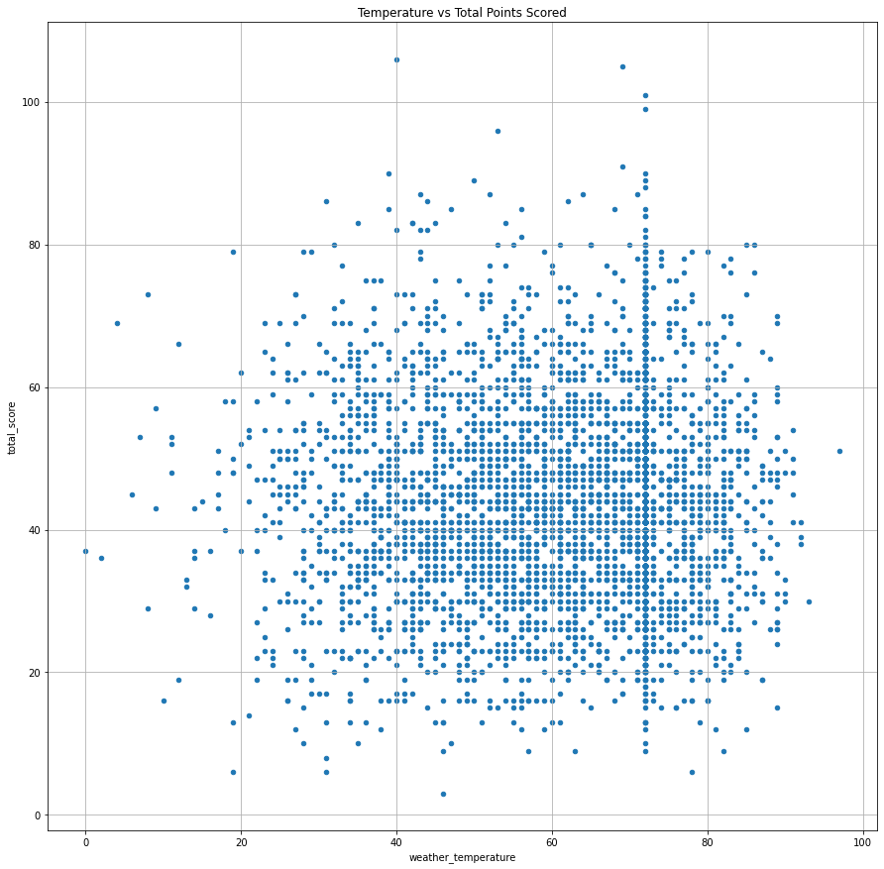
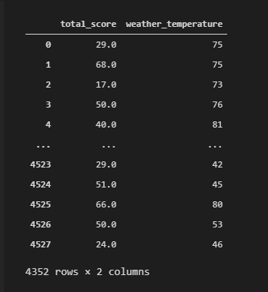
Temperature vs. Total Points Scored
Findings
Approximately 99% of games played in a dome are set to 72^{○F}
While scores vary based on temperature, the top 15 highest scoring games happened above freezing (32^{○F}) and averaged around 61^{○F} degrees.
Dataframe Created

Slide 11
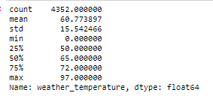
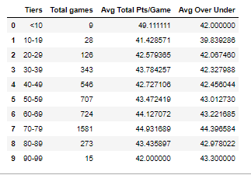
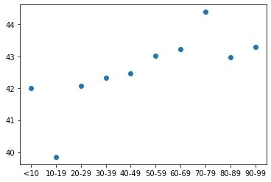
Weather vs. Average Over/Under
Findings
The most games were played between 70-79^{○F} (36% of all games)
The highest average over under is 44.4, which falls within the 70-79 ^{○F}
Notes:
Betting on the Over/Under involves looking at the predicted total points of both teams and guessing if it will be more or less than the prediction
While most Over/Under predictions are set in the forties, you can see that there is a steady increase as the weather gets warmer – especially within that 70-79 sweet spot

Slide 12
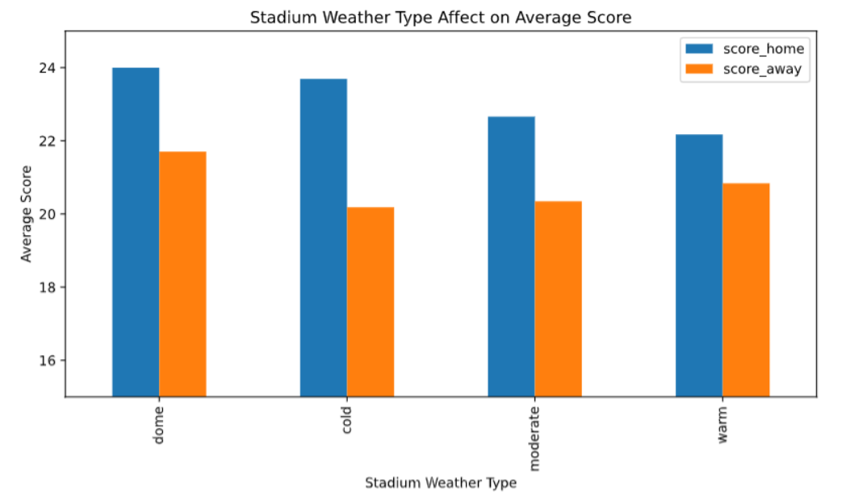
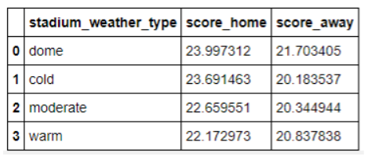
How Stadium Weather Type Affects Total Score
Findings
Teams have a higher average score when playing at home
Teams have the highest average score when playing in a dome, where the conditions are controlled

Slide 13
Does the timing of the game impact total score?

Slide 14
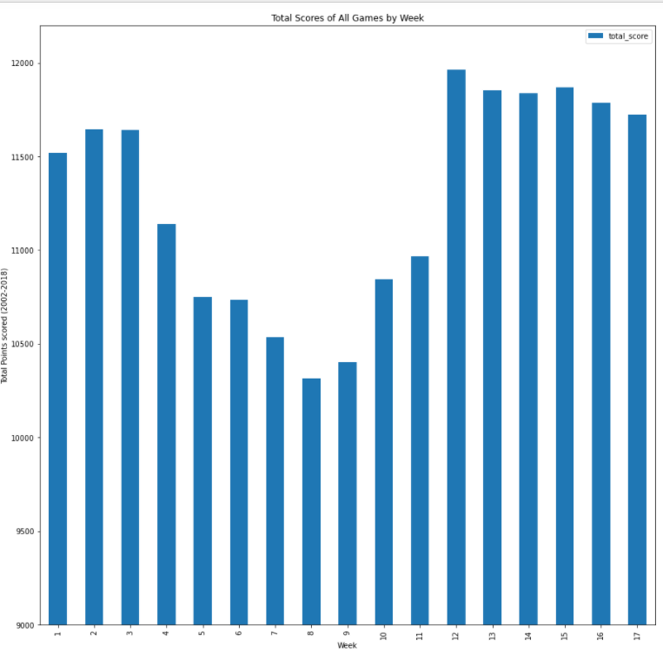
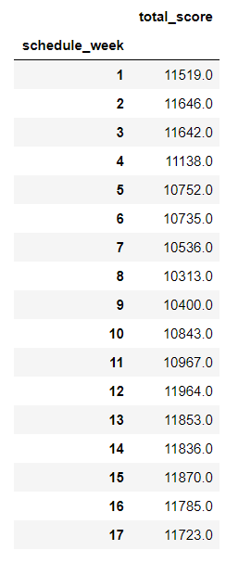
Total Scores of Games by Week
There is a noticeable dip in the scores of games played between weeks 4 and 11, and towards the end of the season- specifically for away teams.
Difference: ~12.5%
Notes:
There are 256 games per week
There is a difference of 1,651 between min and max

Slide 15
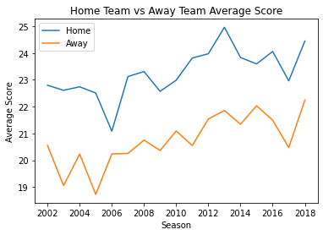
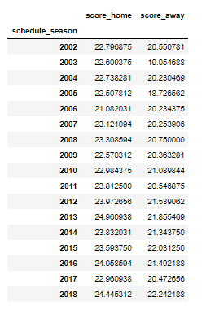
Score over the Seasons
Findings
On average, there is a steady incline on the average points scored by each team over the years
The point differential was the farthest in the 2005 season and the closest in the 2006 season
Notes:
Over the years, there has been a consistent, albeit slow, increase in scores.

Slide 16
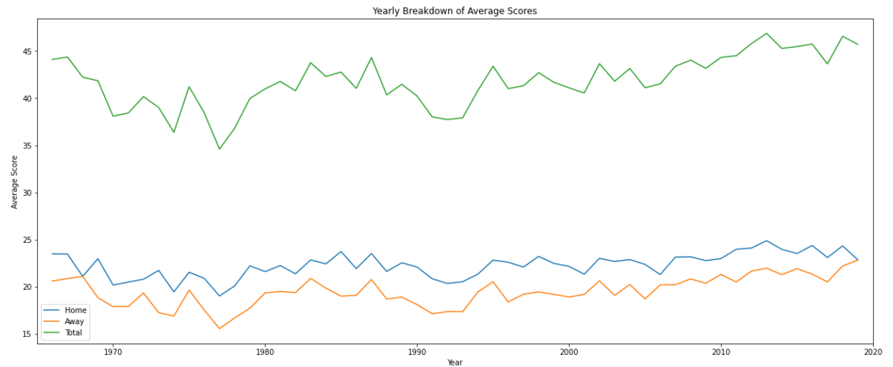
Yearly Breakdown of Scores
Notes:
While the most points are scored by home teams consistently, that doesn’t mean that the home team always wins. Some teams playing in the same week are experiencing blow out games, while others may have lost. However, on average, the home teams will always outscore the away teams.
We included all of the games in this dataset for this table

Slide 17
Is there truly a home field advantage?

Slide 18
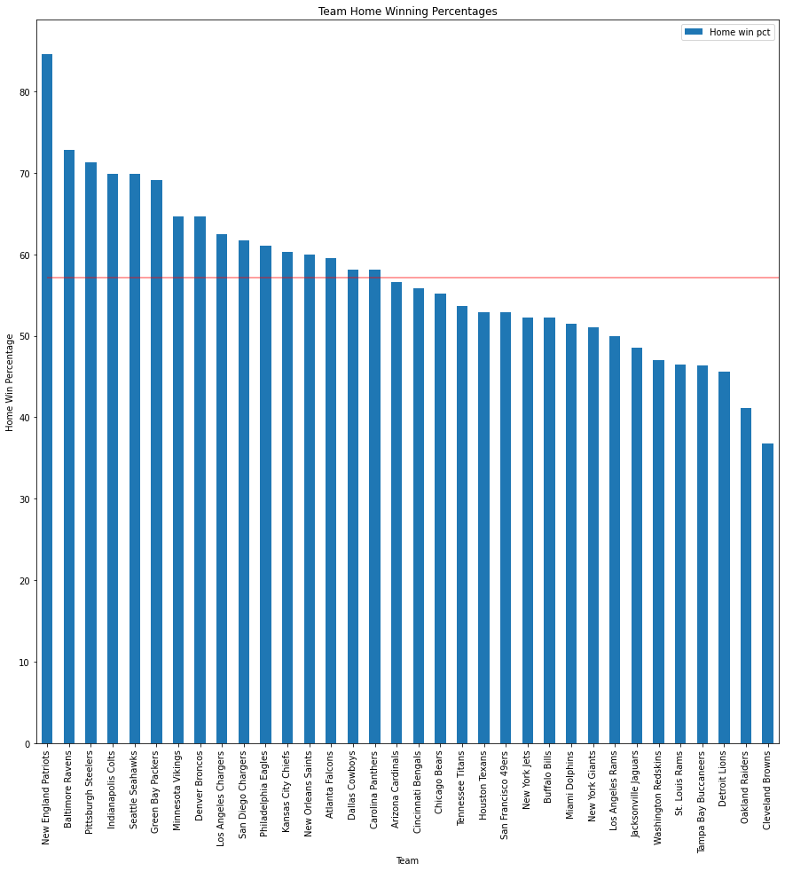
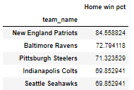
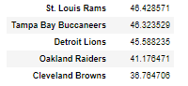
Winning Percentage at Home per Team
Findings
Average Home Win Percentage across NFL is ~57%,
New England Patriots win 84.6% of their home games which is over 11% higher than the next best team Baltimore Ravens
Notes:
Watch for the Ravens

Slide 19
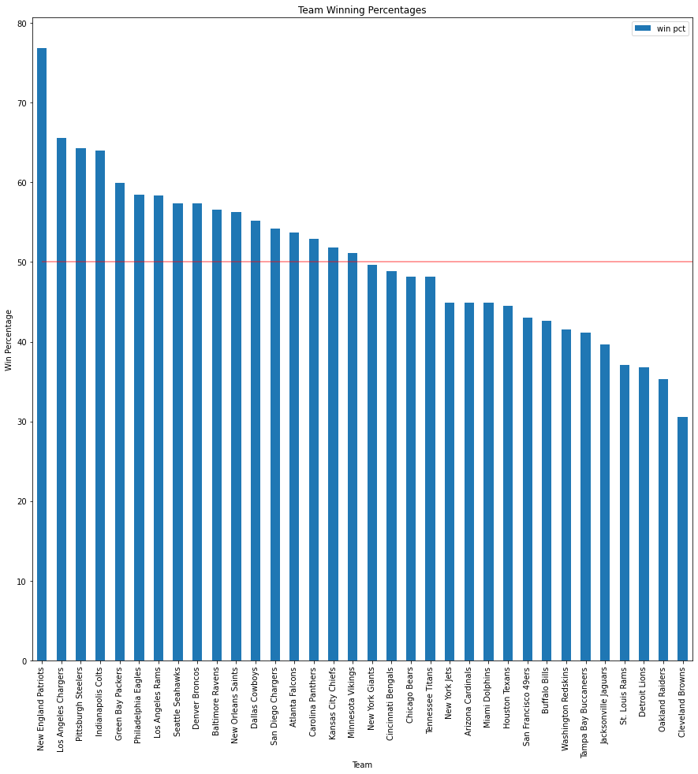
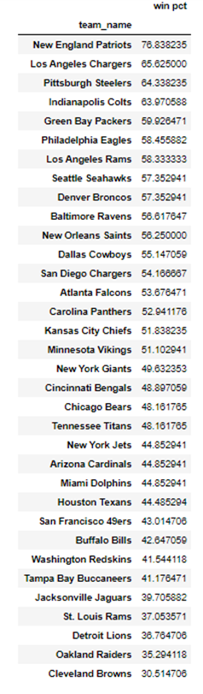
Overall Winning Percentage per Team
Findings
Baltimore Ravens are ranked 10th in overall team winning percentage, but they were ranked 2nd in home winning percentage
When the St. Louis Rams and the San Diego Chargers moved to Los Angeles, both teams improved winning % after the move(through end of 2018 season)
Notes:
Meaning that this team is positively impacted by home field advantage
2015 last season for Rams in STL
2016 last season for SD
Last point – nothing helps the Browns…

Slide 20
What Would We Look at if We Had More Time?
Player Metrics
Rule Changes and Technology
With a wealth of player data available, specifically for Fantasy Football, Draft Kings, etc., how are individual players affected by these same factors?
With rules and technology constantly changing to keep the game fair and players safe, is the increase in score over the years impacted by these new factors?

Slide 21
SUMMARY
WEATHER
The point differential between home and away teams gets larger as the weather gets colder.
TIMING
Between 2002 - 2018, there has been a consistent, albeit slow, increase in scores.
There is a noticeable dip in the scores of games played between weeks 4 and 11.
HOME FIELD ADVANTAGE
There is evidence that indicates “Home Field Advantage” exists. While the teams with the highest and lowest winning percentages are hardly affected, it can make or break a game for average teams.
Notes:
Games played in the “sweet spot” between 70 – 79^{○F} increase in score.

Slide 22
THANK YOU!
Questions?

