Slide 1
Canopy
Eric Potter / @pottereric
Aptera Software

Slide 2
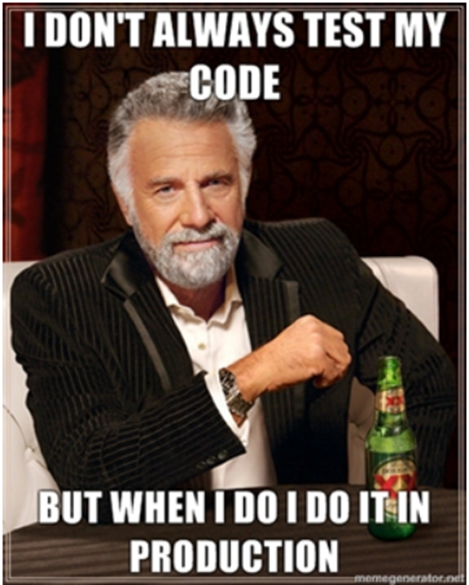

Slide 3

Canopy

Slide 4
Web Automation and Validation
F# DSL
CSS selectors
Selenium
Open Source
NuGet
Notes:
You don’t need to know much about F#.
It is a good gateway drug to F#
Works with Firefox, Chrome, and IE.
Works with Firefox out of the box.

Slide 5
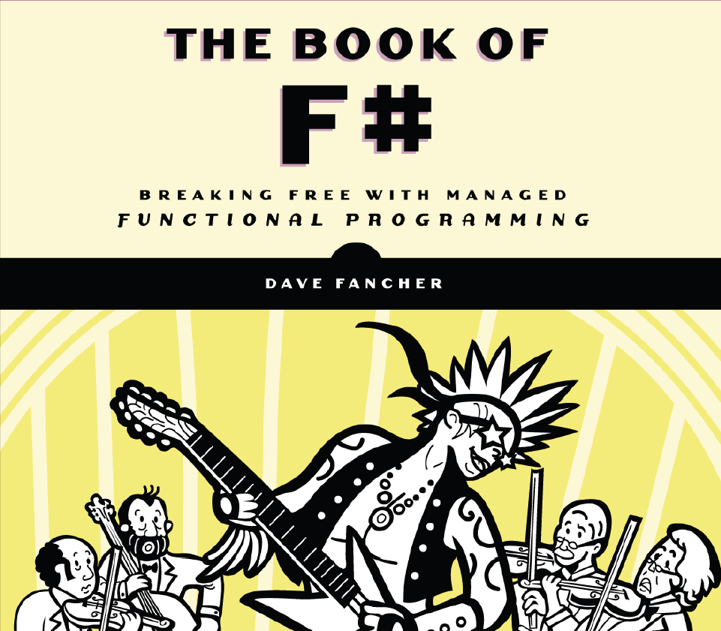

Slide 6
Automated Testing
Compliments unit testing and QA testing.
Provides Integration Testing
Enables testers to focus on high value work.
Notes:
The goal of automated testing is not to do all of the testing
The goal is to get to the high value testing faster (Story about Gary)
If the goal is speed, we should have a tool that allows us to move quickly
Ex: Smoke tests for multiple environments

Slide 7
Simple Test Demo
Notes:
Show invalid username test

Slide 8
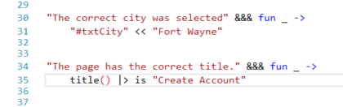
Validation Example
Notes:
TODO

Slide 9
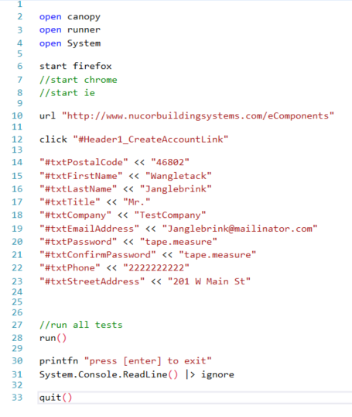
Automation Example
Notes:
Show that it works with all of the browsers

Slide 10
More Commands
screenshot
count
*=
*!=
Notes:
Show that it works with all of the browsers

