Slide 1

Analytics
On
E-Mobility

Slide 2
Project Steps:
Project Description
Data Description
Data Cleaning
Dashboard
Interpretations

Slide 3
Project Description:
We collected the data from various sources related to energy consumptions, other macroeconomic and energy related details across various countries. Then we are going to analyse the trends of the consumption, spends and other factors across countries primarily focusing on the E-Mobility and present as a dashboard.
Data is collected from the website IEA (International Energy Agency);
Total 24 datasets are collected and out of all those we selected one particular dataset which is relevant to our project objective.

Slide 4
Data Description:
In our dataset we have details of 4 different sectors :
Industries
Residential
Services
Transport
In our dataset we have data of different resources for each sector:
Energy
Emissions
Carbon Indicators
Energy Indicators
Overall we have made the data into 16 sheets i.e. resources data for each sector.
There are 61 unique countries data overall for the years :
2000,2005, 2010,2015,2016,2017,2018,2019 & 2020

Slide 5
Data Cleaning:
We have read the data of each sheet required into one separate variable. (16 variables :: 16 sheets)
Years are in columns , we changed them to a single column name year and all the years and their corresponding values to other column names values.
Then we found there are few missing values and dropped all the records with missing values.
We created a dim table for countries by getting all the unique countries from all sheets and given code to them.
Finally we saved these 16 variables with each data frame as csv files to make it input for the dashboard.
Note: I have made some custom functions in order to repeat the same steps and get the required output for all 16 data frames.

Slide 6




Columns in each dataset
ENERGY
EMISSIONS
Country , End Use, Product, Years ,Values
Country , End Use, Product, Years ,Values
Country , Mode/Vehicle, Product, Years ,Values
Country , Mode/Vehicle, Product, Years ,Values
Country , End Use, Product, Years ,Values
Country , End Use, Product, Years ,Values
Country , Subsector, Product, Years ,Values
Country , Subsector, Product, Years ,Values
ENERGY INDICATORS
CARBON INDICATORS
Country , End Use, Indicator, Years ,Values
Country , End Use, Indicator, Years ,Values
Country , Mode/Vehicle, Indicator, Years ,Values
Country , Mode/Vehicle, Indicator, Years ,Values
Country , End Use, Indicator, Years ,Values
Country , End Use, Indicator, Years ,Values
Country , Subsector, Indicator, Years ,Values
Country , Subsector, Indicator, Years ,Values

Slide 7
Steps performed in PowerBI:
We loaded all the 16 datasets and country dim table csv into powerbi.
Used first row as header, converted the columns into correct data types as required.
For each sheet we made new measure i.e. the average value.
Plotted the data of all countries on map with bubble size based on average value.
Added functionalities to filter the data by year, subsector/ product/ vehicle type as applicable for the dataset.
We can also find the min and max countries with corresponding values, sector and measures.

Slide 8
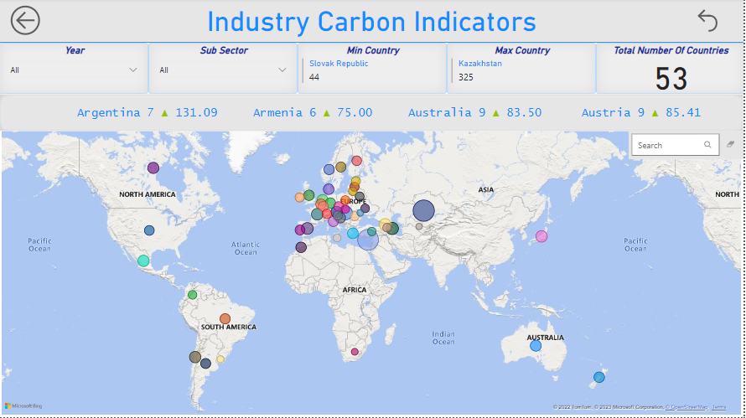
Sample picture from PowerBI report
Button to go to
Home Page
Button to Reset Filters
Year :
From the dropdown we can select particular or multiple years and find relevant data.
Sub sector:
We can also filter based on the required subsector
Min/Max Country:
Will display the country name and value as per the filtered conditions
From the above image we can see that there are 53 countries data for all the years together in Industry Carbon Indicators
Click or hover on the map or the bubble to see the country name, and value

Slide 9
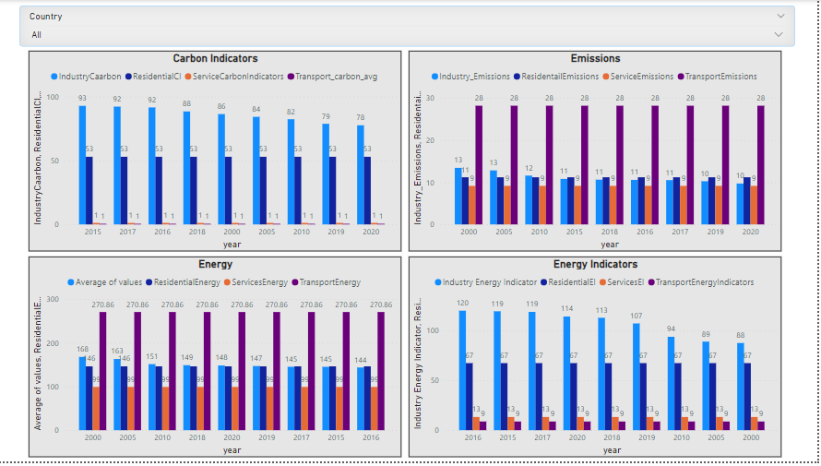
From this plot we can see how are the values of each measure
Carbon/Energy Indicators , Energy, Emissions average value for different years by different sectors.
We can filter out by country wise and look into these factors and finally decide or conclude weather it’s a good choice or not to work or establish plants for manufacturing EV vehicles etc.

Slide 10


