Slide 1

FINAL REVIEW ON POWER QUALITY IMPROVEMENT IN GRID CONNECTED WIND ENERGY SYSTEM USING UPQC
PRESENTED BY
A.LAVANYA 124P1A0203
P.MRUDUBHASHINI CHOWDARY 123G1A0209
K.DILEEP 124P1A0216
D.VISWAKANTH BABU 124P1A0208
Y.GOPALA KRISHNA 124P1A0245
Under the esteemed guidance of Mr.M.LAKSHMIKAANTH REDDY M.Tech,(Ph.D) Associative professor & HOD
DEPARTMENT OF ELECTRICAL & ELECTRONICS ENGINEERING
YOGANANDA INSTITUTE OF TECHNOLOGY AND SCIENCE (Approved by AICTE, New Delhi & Affiliated to JNTUA, Ananthapur) MOHANREDDY NAGAR, ELAMANDAYAM (V), RENIGUNTA(M),TIRUPATI-517 520, A.P. 2012 – 2016

Slide 2
PROJECT TITLE:
Power quality improvement in grid connected wind energy system using UPQC
1

Slide 3
CONTENTS
Introduction
Objective
Abstract
Existing methods
Proposed method
Control strategy
Advantages
References
2

Slide 4
OBJECTIVE
To deal with various power quality problems such as current and voltage harmonics and voltage sag/swell.
To maintain the power quality of distribution line in grid connected Wind Energy System (WES) using UPQC.
3

Slide 5
ABSTRACT
Interconnection of wind Energy Source (WES)generation with the Grid leads to Power Quality problems due to wind fluctuations.
This project proposes the Unified Power Quality Conditioner(UPQC) which can handle the PQ problem effectively.
The proposed UPQC can compensate the, harmonic current, voltage sag and swell, and voltage interruption.
The Battery Energy Storage System(BESS) is integrated to suppoet the real power source under fluctuating wind power.
The performance of the proposed system will be analyzed through MATLAB/SIMULINK.
4

Slide 6
INTRODUCTION
Power quality problems can be classified into two main categories:
The first is steady-state problems such as voltage and current harmonics.
The second is transient problems such as voltage disturbances, voltage sag/swell, and interrupts.
5

Slide 7
WIND POWER - What is it?
All renewable energy (except tidal and geothermal power), ultimately comes from the sun
The earth receives 1.74 x 10¹⁷ watts of power (per hour) from the sun
About one or 2 percent of this energy is converted to wind energy (which is about 50-100 times more than the energy converted to biomass by all plants on earth
Differential heating of the earth’s surface and atmosphere induces vertical and horizontal air currents that are affected by the earth’s rotation and contours of the land → WIND.
6

Slide 8
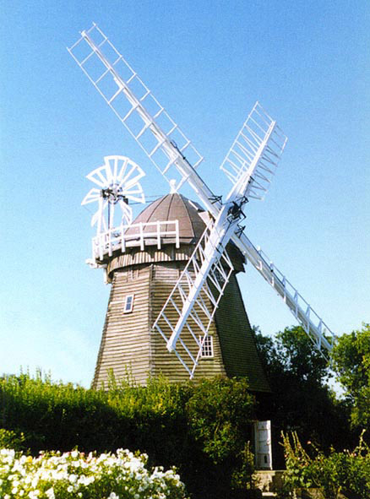
WINDMILL DESIGN
A Windmill captures wind energy and then uses a generator to convert it to electrical energy.
The design of a windmill is an integral part of how efficient it will be.
When designing a windmill, one must decide on the size of the turbine, and the size of the generator.
7

Slide 9
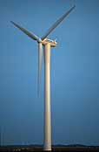

WIND TURBINES
LARGE TURBINES:
Able to deliver electricity at lower cost than smaller turbines, because foundation costs, planning costs, etc. are independent of size.
Well-suited for offshore wind plants.
In areas where it is difficult to find sites, one large turbine on a tall tower uses the wind extremely efficiently.
8

Slide 10
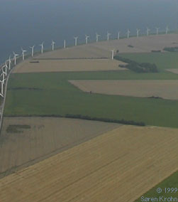
SMALL TURBINES:
Local electrical grids may not be able to handle the large electrical output from a large turbine, so smaller turbines may be more suitable.
High costs for foundations for large turbines may not be economical in some areas.
Landscape considerations
9

Slide 11
WIND TURBINE GENERATORS
Wind power generators convert wind energy (mechanical energy) to electrical energy.
The generator is attached at one end to the wind turbine, which provides the mechanical energy.
At the other end, the generator is connected to the electrical grid.
The generator needs to have a cooling system to make sure there is no overheating.
10

Slide 12
SMALL GENERATORS:
Require less force to turn than a larger ones, but give much lower power output.
Less efficient
i.e.. If you fit a large wind turbine rotor with a small generator it will be producing electricity during many hours of the year, but it will capture only a small part of the energy content of the wind at high wind speeds.
LARGE GENERATORS:
Very efficient at high wind speeds, but unable to turn at low wind speeds.
i.e.. If the generator has larger coils, and/or a stronger internal magnet, it will require more force (mechanical) to start in motion.
11

Slide 13
PROBLEMS EFFECTING THE POWER QUALITY
The main problems affect the power quality are
Transients
Voltage variations
Voltage sag/swells
Harmonics in current and voltages
In order to overcome the above problems many devices were designed.
12

Slide 14
EXISTING METHODS
Active power filters
DSATCOM
Surge arrestors
Fault current limiter
Energy storage systems
But the above devices may not deal with all power quality problems simultaneously.
13

Slide 15
PROPOSED METHOD
In order to handle the above problems UPQC is the better solution due to following reasons.
Eliminates the harmonics in the supply current thus improves the power quality for non linear loads.
UPQC maintains load end voltage at the rated value even in the presence of supply voltage sag.
The voltage injected by UPQC to maintain the load end voltage at the desired value is taken from the same dc link.
14

Slide 16
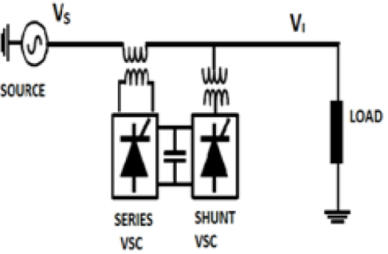
BLOCK DIAGRAM FOR UPQC
Fig 1: Block diagram for UPQC
15

Slide 17
SHUNT CONTROL OBJECTIVES OF UPQC
To balance the source currents by injecting negative and zero sequence components required by the load.
To control the power factor by injecting the required reactive current (at fundamental frequency).
16

Slide 18
SERIES CONTROL OBJECTIVES OF UPQC
To isolate the load bus from harmonics present in the source voltages by injecting the harmonic voltages.
To regulate the magnitude of the load bus voltage by injecting the required active and reactive components (at fundamental frequency) depending on the power factor on the source side.
17

Slide 19
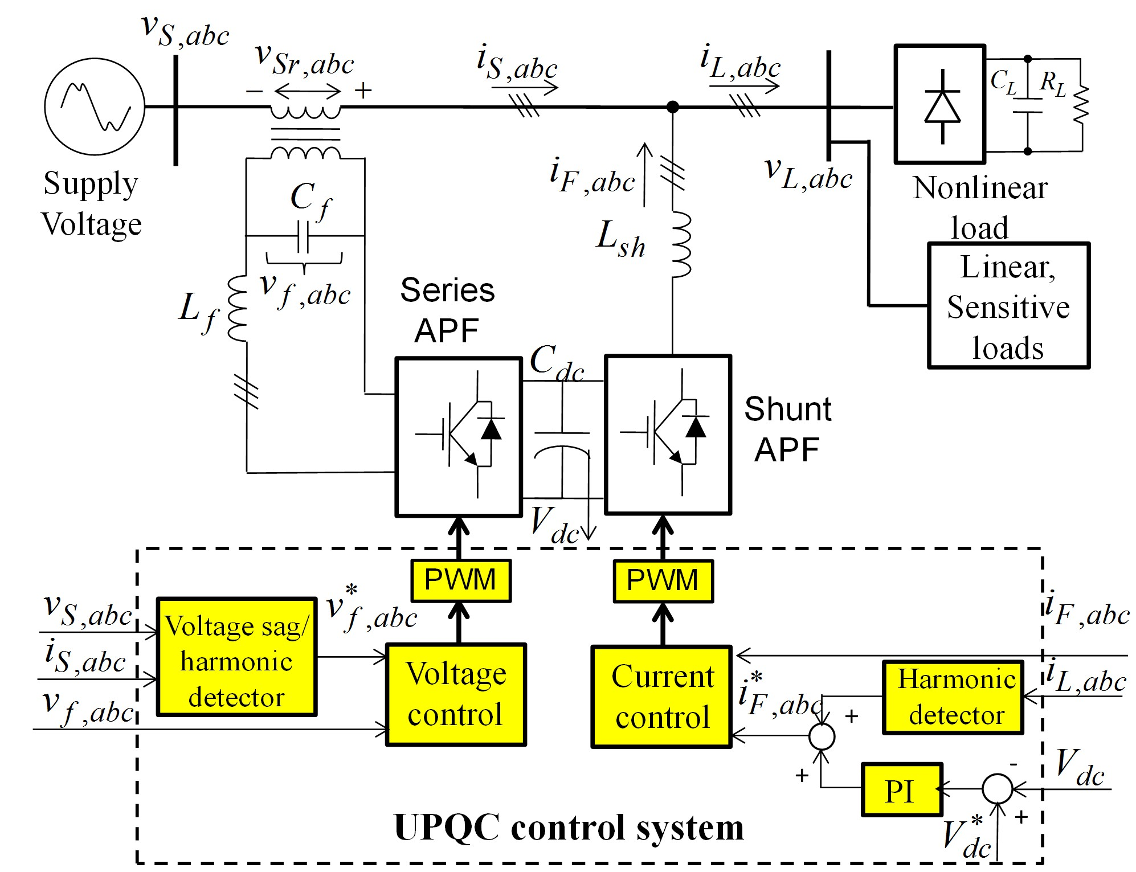
Control strategy for UPQC
18
Figure 2. control system of the UPQC

Slide 20
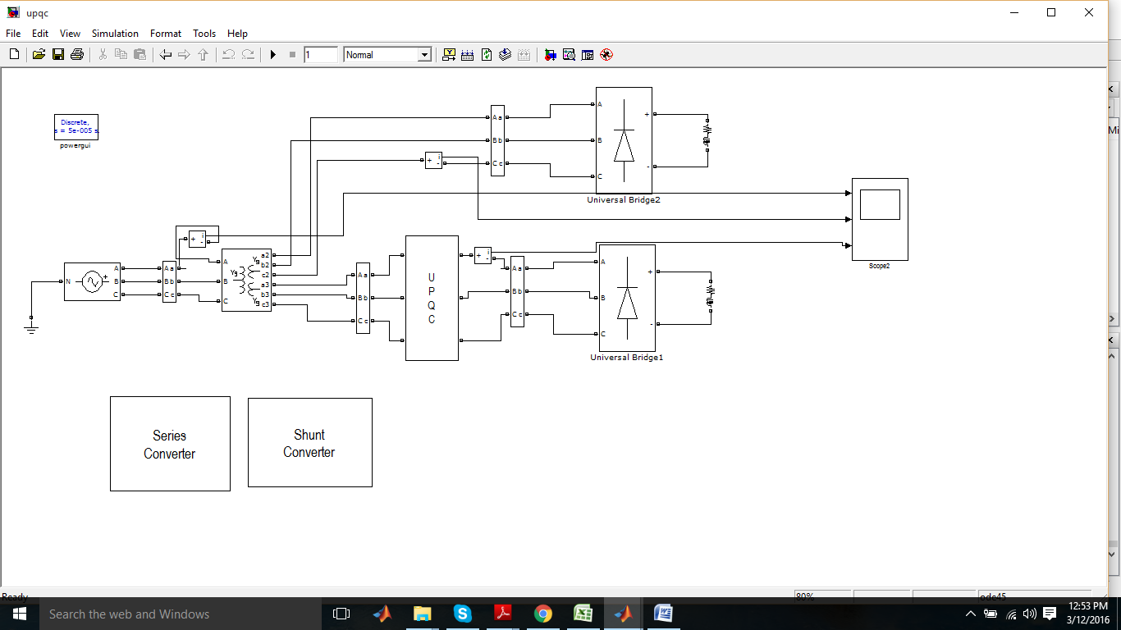
SIMULATION BLOCK DIAGRAM
Fig 3: Simulation block diagram
19

Slide 21
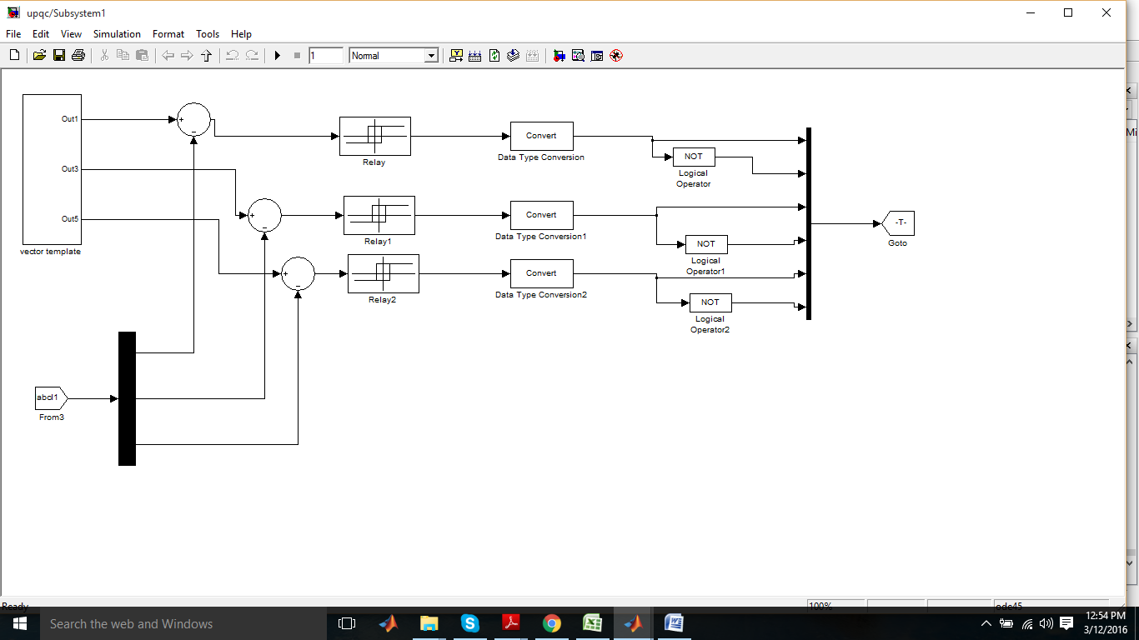
CONTROL STRATEGY OF SERIES CONVERTER
Fig 4: Series converter
20

Slide 22
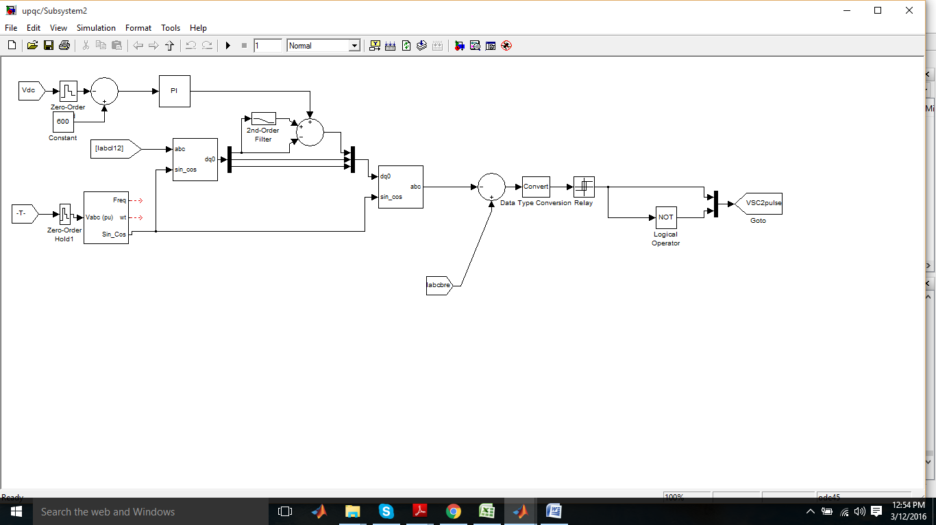
CONTROL STRATEGY OF SHUNT CONVERTER
Fig 5: Shunt converter
21

Slide 23
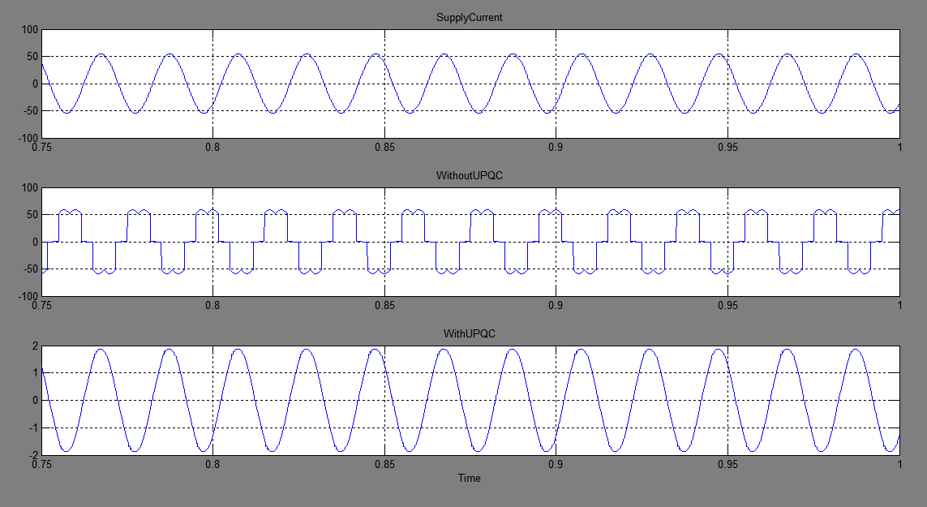
SIMULATION RESULTS
Line Current
22

Slide 24
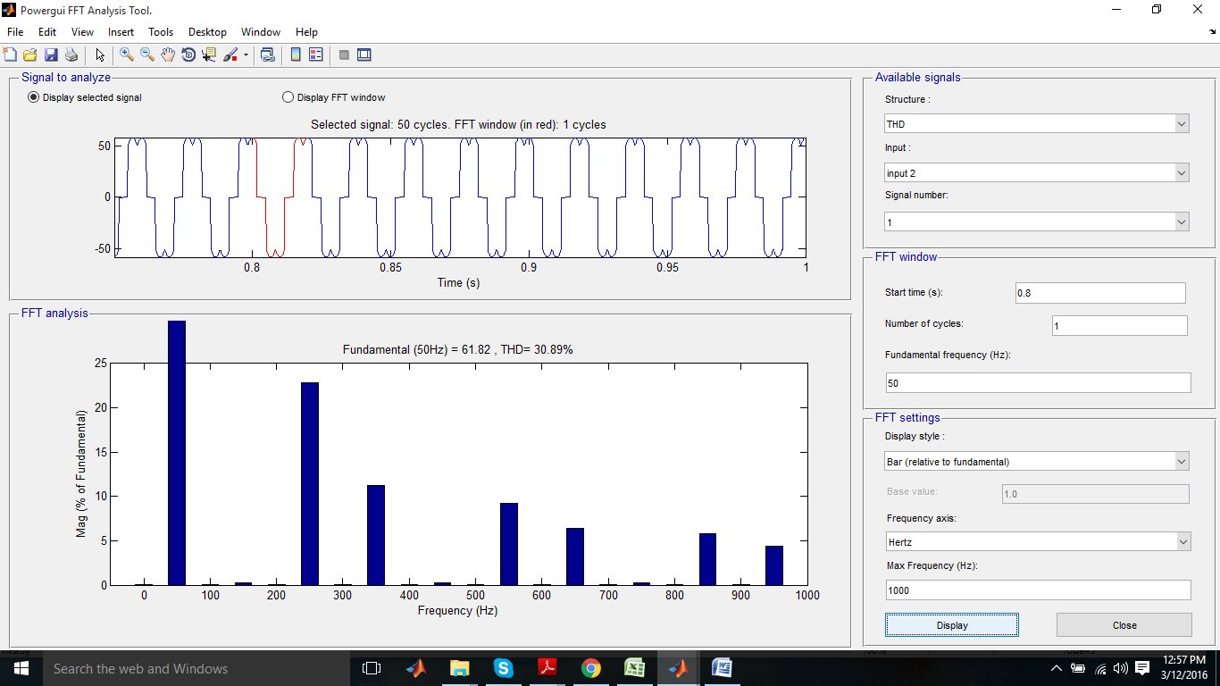
THD analysis Without UPQC
23

Slide 25

THD analysis With UPQC
24

Slide 26
ADVANTAGES
UPQC can compensate voltage related problems such as
voltage harmonics,
voltage sags/swells,
voltage flicker and
Current related problems like
reactive power compensation,
power factor correction,
current harmonics and load unbalance compensation.
17

Slide 27
CONCLUSION
From the expected results, the following conclusions can be drawn
It has a capability to cancel out the harmonic parts of the load current.
It maintains the source voltage and current in-phase and support the reactive power demand for the grid.
25

Slide 28
FUTURE SCOPE
Although various power quality problems have been successfully tackled by the proposed control methods for the UPQC in this work,there are some possibilities in the future research. They can be suggested as
Developing intelligent and adaptive control for UPQC to optimize control objectives under different conditions of supply voltage and loads.
Investigating the operation of UPQC for the power quality enhancement in the micro-grid system.
26

Slide 29
REFERENCES
[1]. H. Hingorani, “Introducing Custom Power” IEEE Spectrum, Vol.32, Issue: 6, Page(s): 41-48, June 1995.
[2]. Juan W. Dixon, Gustavo Venegas and Luis A. Moran, “A Series Active Power Filter Based on a Sinusoidal Current-Controlled Voltage-Source Inverter” IEEE Transactions on Industrial Electronics, Vol. 44, Issue: 5, Page(s): 612 - 620, October 1997
[3]. Yash Pal, A. Swarup, and Bhim Singh, “A Review of Compensating Type Custom Power Devices for Power Quality Improvement” 2008 Joint International Conference on Power System Technology (POWERCON) and IEEE Power India Conference New Delhi, India.
[4]. Mojtaba Nemati, Hesam Addin Yousefian and Rouhollah Afshari, “Recognize the Role of DVR in Power Systems, International Journal of Recent Trends in Engineering, Vol. 2, Page(s): 13 - 15, November 2009.
[5]. J. Barros, M. de Apraiz, and R. I. Diego, “Measurement of Subharmonics In Power Voltages”, Power Tech, IEEE Lausanne, Page(s): 1736 – 1740, 2007.
27

Slide 30
QUIERIES?
28

Slide 31
THANK YOU
29

