Slide 1

WebKit
open source web browser engine

Slide 2
What is it?
It's not a web browser
It's the engine for web browsers
Fork of KHTML by Apple
Composed of 2 sub libraries
  WebCore (HTML rendering engine)
  JavaScriptCore (JavaScript engine)
Open source software (BSD and GNU LGPL)
Follows standards (HTML, CSS, Acid tests)

Slide 3
Web Technologies
HTML 4 and 5
CSS 1,2 (almost complete) and 3 (incomplete)
DOM (via JS, C++ and other languages)
SVG (animations and partial webfonts)
XML, XSLT (through libxslt)
JavaScript

Slide 4









Used by
Browsers
OS
Applications

Slide 5







Toolkits
Gtk
WxWidgets
Cocoa OS X
Adobe AIR

Slide 6
Implementation
Written in C++
Bindings available in
  C/C++ (Gtk) / Objective-C (Cocoa)
  Perl, Python, Ruby, Vala
  Glib introspection
HTTP layer
  cURL
  libsoup (Gtk)
  Qt
  Chromium

Slide 7
GObject 101
Objects in C
Simple inheritance
API is language bindings friendly
Introspection
Objects have
  Property (signal 'notify::PROPERTY-NAME')
  Signals
  Methods
  Constructors

Slide 8
Gtk2::WebKit
Simple API integrated with Gtk2
Bindings in XS (rafl - Florian Ragwitz)
Advantages
  API very “Perlish”
Disadvantages
  Some functions are not available
  Some objects are not available

Slide 9
Example - Gtk2::WebKit
# Simple WebKit window - my first browser
use Gtk2 -init; # Initialize Gtk2
use Gtk2::WebKit; # Load WebKit
my $window = Gtk2::Window->new();
my $scrolls = Gtk2::ScrolledWindow->new();
my $view = Gtk2::WebKit::WebView->new(); # WebKit instance
$scrolls->add($view);
$window->add($scrolls);
$window->show_all();
$window->signal_connect(destroy => sub { Gtk2->main_quit() });
$view->load_uri('http://ba.pm.org/en'); # Load a page
Gtk2->main(); # Main loop

Slide 10
Glib Introspection
Perl bindings auto generated through GIR
The future of GObject and its by products
Advantages
  API coverage automatic
  Generated at run-time (no compilation required!)
Disadvantages
  API not always very “Perlish” (getting closer)
  Start up can be slow

Slide 11
Gtk3::WebKit
Simple API integrated with Gtk3 (or Gtk2!)
Bindings through GIR
Advantages
  Automatically generated at runtime
  All functions and objects are available
Disadvantages
  Nothing to complain so far, all works!

Slide 12
Example – Raw Introspection
use Glib::Object::Introspection;
Glib::Object::Introspection->setup(
basename => 'Gtk',
version => '2.0',
package => 'Gtk2');
Glib::Object::Introspection->setup(
basename => 'WebKit',
version => '1.0',
package => 'Gtk2::WebKit');
Gtk2::init();
my $window = Gtk2::Window->new('toplevel');
my $scrolls = Gtk2::ScrolledWindow->new();
my $view = Gtk2::WebKit::WebView->new(); # WebKit instance
$scrolls->add($view);
$window->add($scrolls);
$window->show_all();
$window->signal_connect(destroy => sub { Gtk2->main_quit });
$view->load_uri('http://ba.pm.org/en'); # Load a page
Gtk2->main(); # Main loop

Slide 13
Example – Introspection (bis)
use Gtk3 -init;
use Gtk3::WebKit;
my $window = Gtk3::Window->new('toplevel');
my $scrolls = Gtk3::ScrolledWindow->new();
my $view = Gtk3::WebKit::WebView->new(); # WebKit instance
$scrolls->add($view);
$window->add($scrolls);
$window->show_all();
$window->signal_connect(destroy => sub { Gtk3->main_quit() });
$view->load_uri('http://ba.pm.org/en'); # Load a page
Gtk3->main(); # Main loop

Slide 14
My examples
WebKit through GIR (Gtk3::WebKit)
Bindings for libsoup through GIR (HTTP::Soup)
Code and examples in github
  https://github.com/potyl/Webkit
  https://github.com/potyl/perl-Gtk3-WebKit
  https://github.com/potyl/perl-HTTP-Soup

Slide 15
What can we do with WebKit?
Another web browser ...
Graphical interfaces with HTML
Web page profiling
Automation through WebKit
  JavaScript interaction
  Network manipulation (via libsoup)
  DOM manipulation
  Screenshots

Slide 16
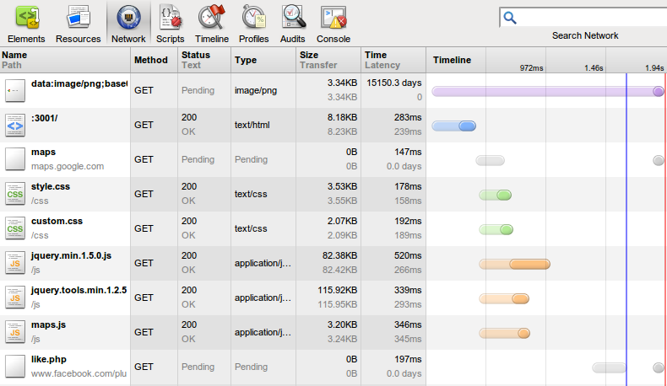
We can automate this

Slide 17
Code
Examples

Slide 18
Execute JavaScript
# Execute a JavaScript commad as soon as the page is loaded.
$view->signal_connect('notify::load-status' => sub {
# Wait for the page to be loaded
my $uri = $view->get_uri or return;
return unless $view->get_load_status eq 'finished';
# Let's call jQuery (the page must have jQuery loaded already)
$view->execute_script(q{
$('img').hide();
});
});

Slide 19
Screenshots (pdf through gtk3)
# Grab a screenshot through Cairo as soon as the page is loaded
$view->signal_connect('notify::load-status' => sub {
# Wait for the page to be loaded
return unless $view->get_uri and ($view->get_load_status eq 'finished');
# Use Cairo to grab a PDF (we can also use SVG, PostScript or PNG)
my ($width, $height) = ($view->get_allocated_width, $view->get_allocated_height);
my $surface = Cairo::PdfSurface->create($filename, $width, $height);
my $cr = Cairo::Context->create($surface);
$view->draw($cr);
});
# With Gtk3 we can use offscreen rendering!
my $window = Gtk3::OffscreenWindow->new();
$window->add($view);
$window->show_all();
# Run with xvfb-run --server-args="-screen 0 1024x768x24" screenshot.pl "$@"

Slide 20
Resource tracking
# Load the bindings for libsoup
use HTTP::Soup;
# Get the session that's responsible for all HTTP access made by WebKit
my $session = Gtk3::WebKit->get_default_session();
# Track all new download requests
$session->signal_connect('request-started' => sub {
my ($session, $message, $socket, $resources) = @_;
# A new download request
my ($uri, $start) = ($message->get_uri->to_string, time);
# Track the when the download time
$message->signal_connect('finished' => sub {
my $end = time;
my $elapsed = $end - $start;
my $status_code = $message->get('status-code') // 'N/A';
printf “%s in %.2f seconds; code: %s\n", $uri, $elapsed, $status_code;
});
});

Slide 21
Nanny
my $allowed_host_port = URI->new($uri)->host_port;
# Intercept all web pages requests and reject all requests that will bring us to an external web
# site. This works only for the iframes and links that have been clicked by the user.
# JavaScript and CSS are not blocked!
$view->signal_connect('navigation-policy-decision-requested' => sub {
my ($view, $frame, $request, $action, $decision) = @_;
# Accept the request only if we stay in the same site
my $host_port = URI->new( $request->get_uri )->host_port;
return FALSE if $host_port eq $allowed_host_port; # Default behavior: download!
# Going to a different site
print "Access denied $host_port\n";
$decision->ignore(); # We reject the download request
return TRUE;
});

Slide 22
Super Über Nanny
my $allowed_host_port = URI->new($uri)->host_port;
# Block ANY resource that goest to an external site. This works for all kinds of resources.
# Even for resources that are built at runtime through JavaScript.
$view->signal_connect('resource-request-starting' => sub {
my ($view, $frame, $resource, $request, $response) = @_;
my $host_port = URI->new( $request->get_uri )->host_port;
return if $host_port eq $allowed_host_port;
# Download any request to an external URI. WebKit doesn't download resources that
# point to 'about:blank'
print "Access denied $host_port\n";
$request->set_uri('about:blank');
});

Slide 23
</end>
Questions?

