Slide 1
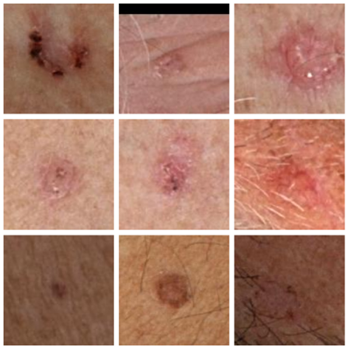
Skin Cancer Detection with 3D-TBP
Attila Nemes (B6RYIK), Csaba Potyok (OZNVQ4) Peter Arany (U4VQHM)
IsIcTeam2024

Slide 2
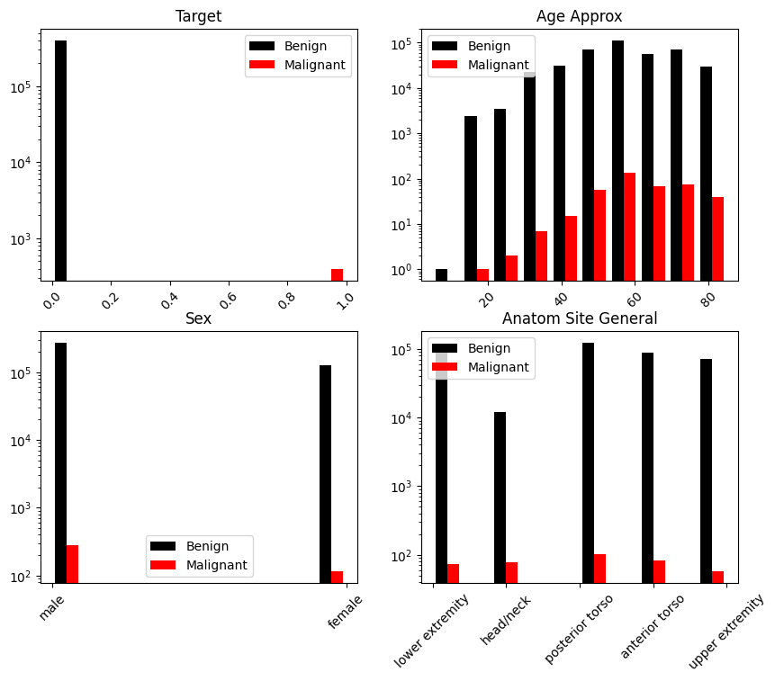
About the challenge
Stored in ZIP (Dropbox)
Images + metadata (hdf5 format + csv)
Classification task + computer vision
Benign vs. Malignant
Unbalanced dataset

Slide 3
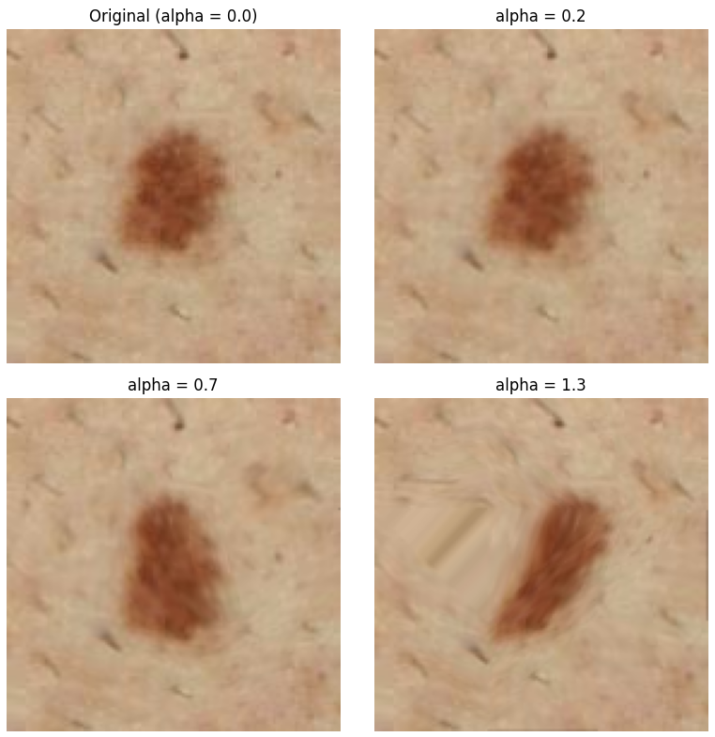
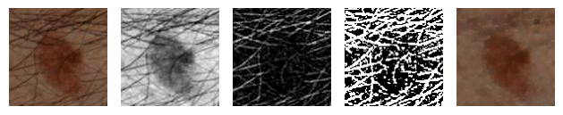
Preprocessing the dataset
PytorchLightningDatamodule for dataloading
Data augmentation with transforms
Resampling and balancing dataset
75-75 positive and negative samples in test
75-75 positive and negative samples in validation
resampled and balanced samples in train
Squeeze algorithm (Shinde R. etal.)
Free-form deformation

Slide 4
Related works
Review about solutions (Naqvi, M., etal. (2023). Skin Cancer Detection Using Deep Learning-A Review.)
AlexNet, MobileNet, ResNet, etc.
Hair removing (Shinde, R. K., etal. (2023). Squeeze-MNet: Precise Skin Cancer Detection Model for Low Computing IoT Devices Using Transfer Learning.)
Squeeze algorithm + MobileNet
Data preprocessing (Thomas W. Sederberg and Scott R. Parry. 1986. Free-form deformation of solid geometric models)
Balancing dataset (Yun-Chun Wang, Ching-Hsue Cheng, A multiple combined method for rebalancing medical data with class imbalances, Computers in Biology and Medicine)
etc.

Slide 5
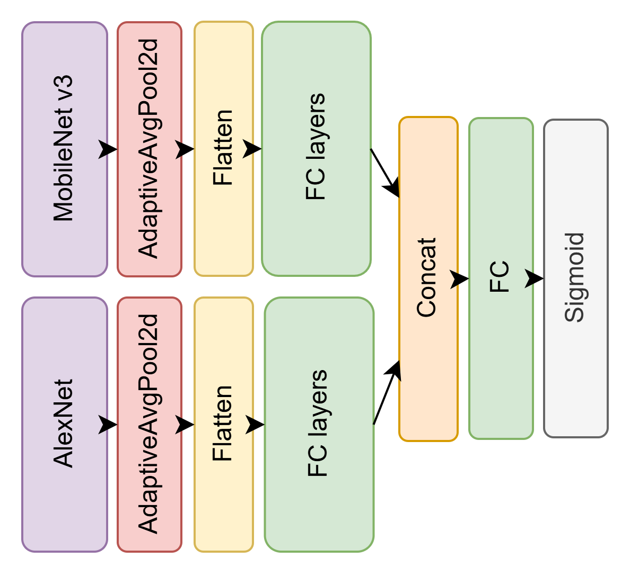
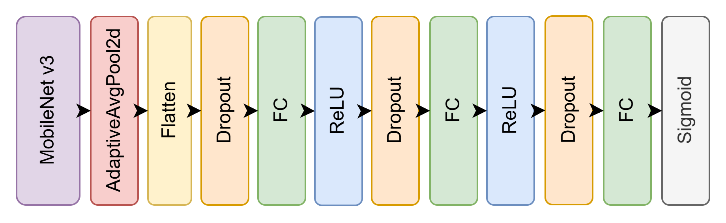
Architecture I.
MobileNetv3-based
combined models

Slide 6
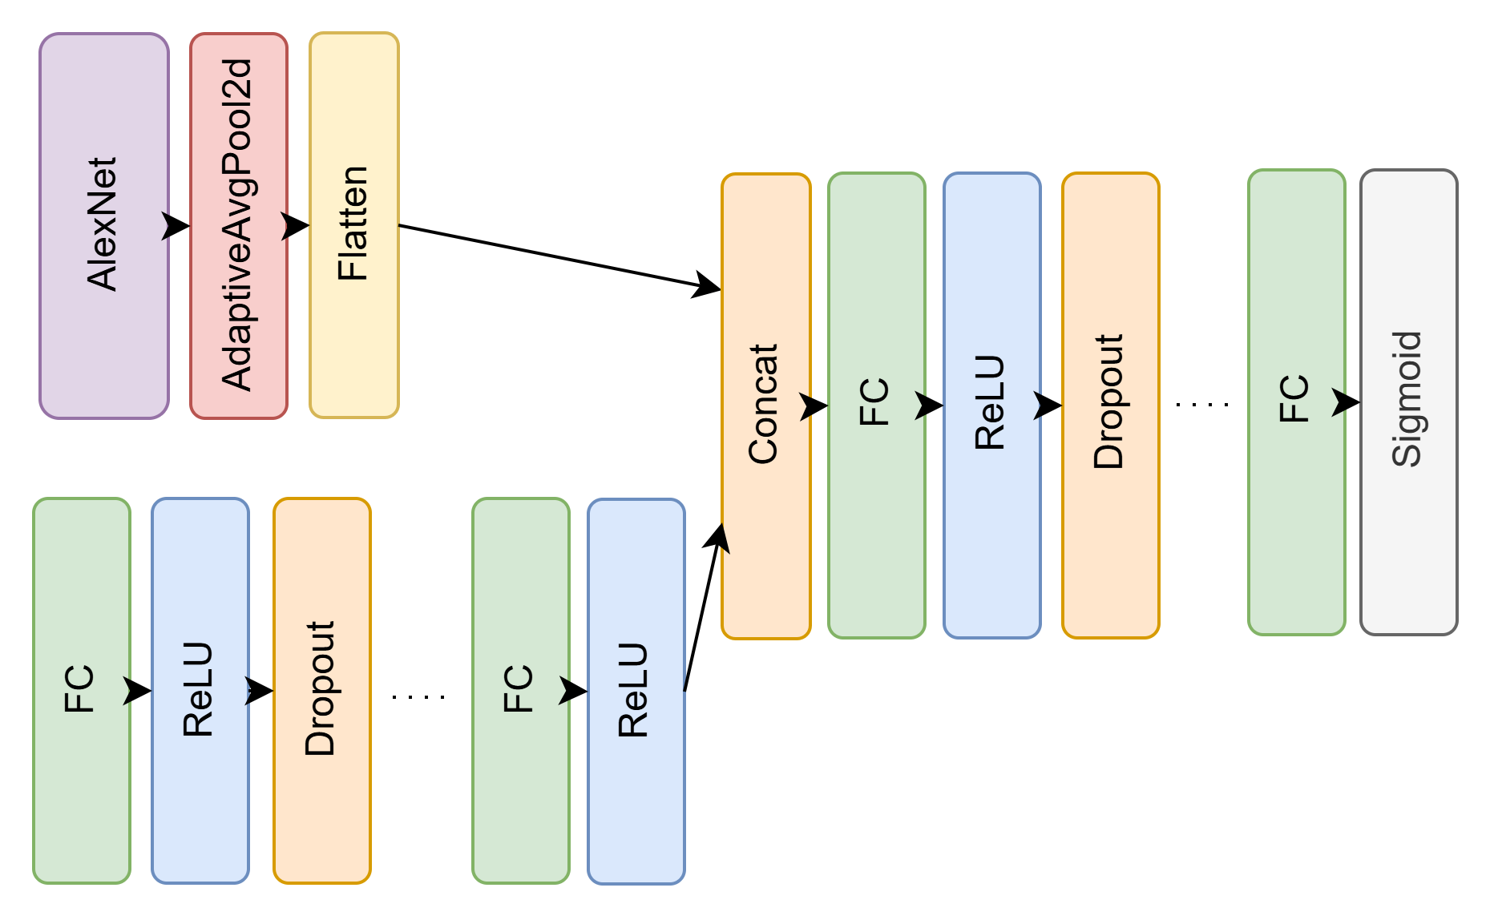
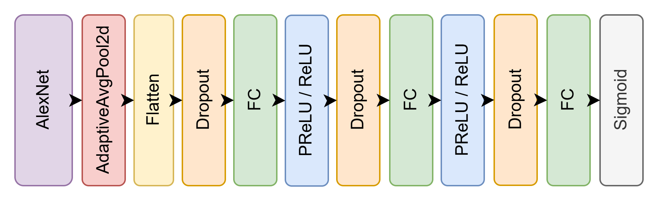
Architecture II.
AlexNet-based
model for images and tabular data

Slide 7
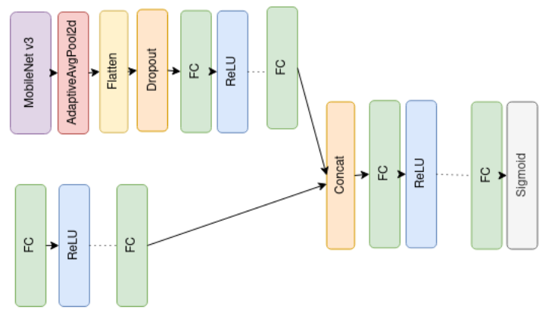
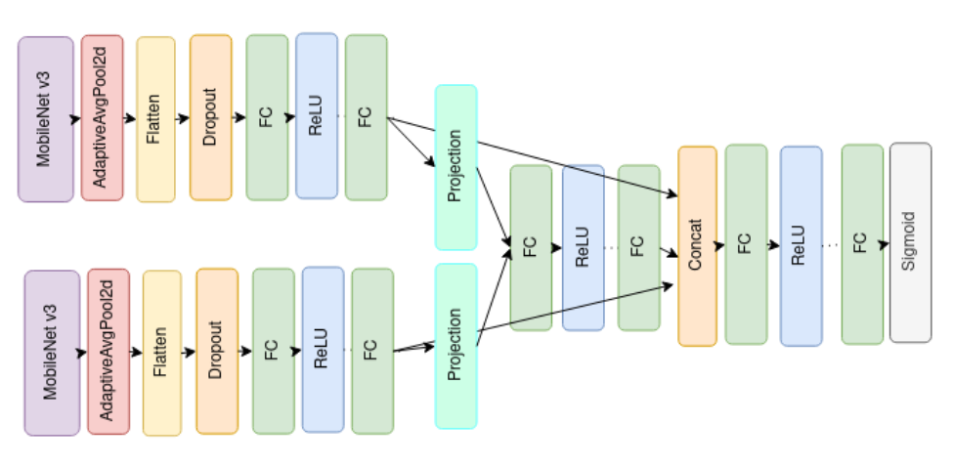
Architecture III.
MobileNet-based complex
combined model with tabular data

Slide 8
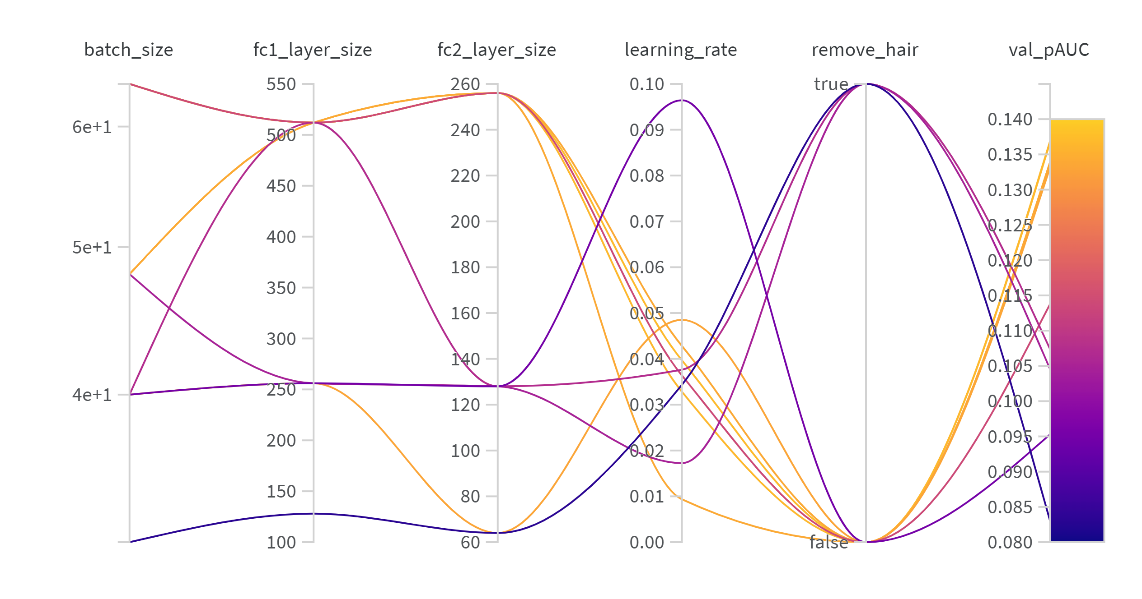
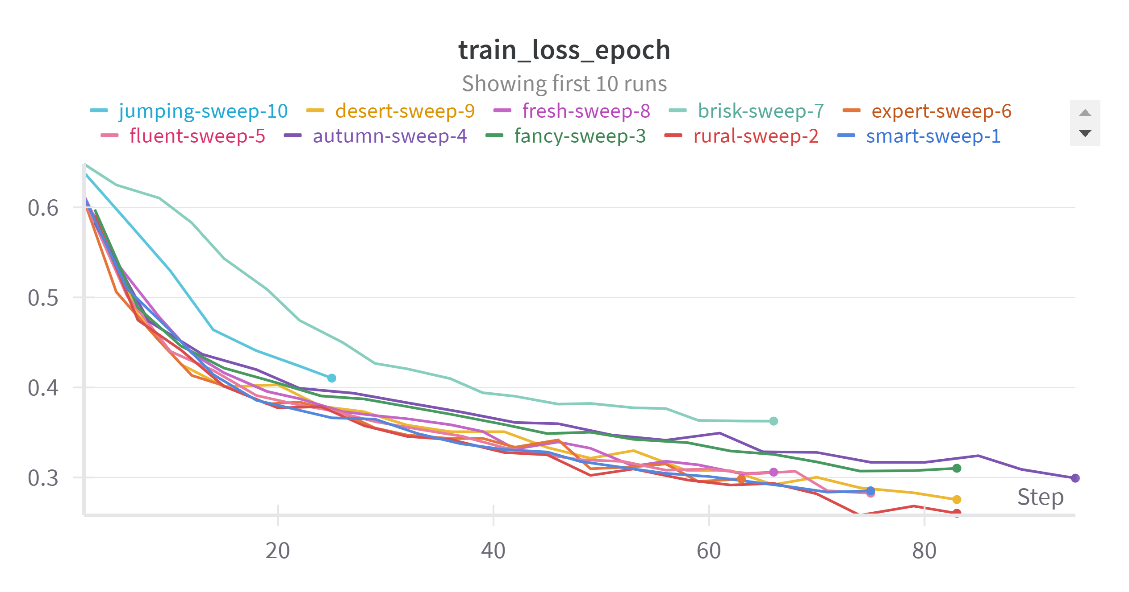
Train and hyperopt
PytorchLightning for making pipeline
Wandb for hyperopt (Bayesian and random)
EarlyStopping + ModelCheckpoint
Running on Colab

Slide 9
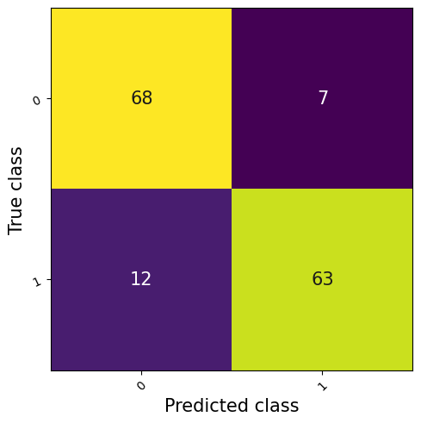
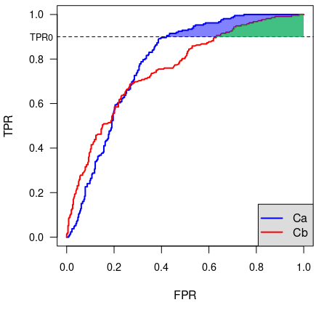
Results
Model | pAUC | recall | precision | f1-score | loss
Baseline | 0.077 | 0.573 | 0.860 | 0.688 | 0.574
AlexNet based | 0.116 | 0.800 | 0.822 | 0.811 | 0.434
MobileNetv3 based | 0.159 | 0.760 | 0.950 | 0.844 | 0.445
Combined (AlexNet + MobileNet v3) | 0.134 | 0.840 | 0.900 | 0.869 | 0.455
Complex (images + tabular data) | 0.125 | 0.840 | 0.851 | 0.846 | 0.446
Complex (images + tabular data MobilNetv3) | 0.151 | 0.600 | 0.918 | 0.725 | 0.503
Combined + tabular data | 0.086 | 0.773 | 0.734 | 0.753 | 0.537

Slide 10
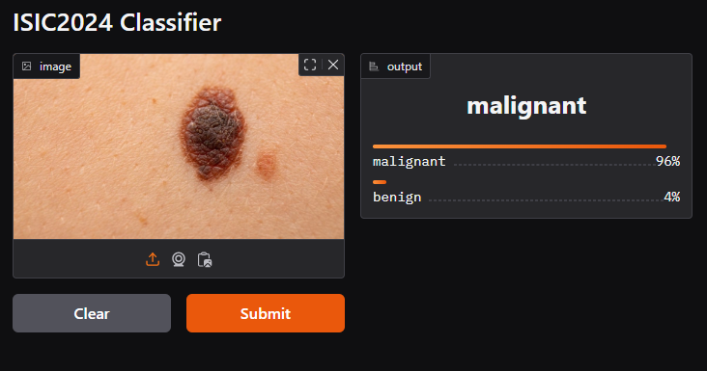
Conclusion
Tried several methods
Learnt a lot about computer vision
Got correct results (we can improve them)
Made a working AI service (with Gradio)
AI service on Huggingface

