Slide 1
Exploratory Data Analysis of Consumer Complaint Patterns and Company Responsiveness (2020-2025)
Call Center Data: Consumer Financial protection Bureau
Deepali Poudel

Slide 2
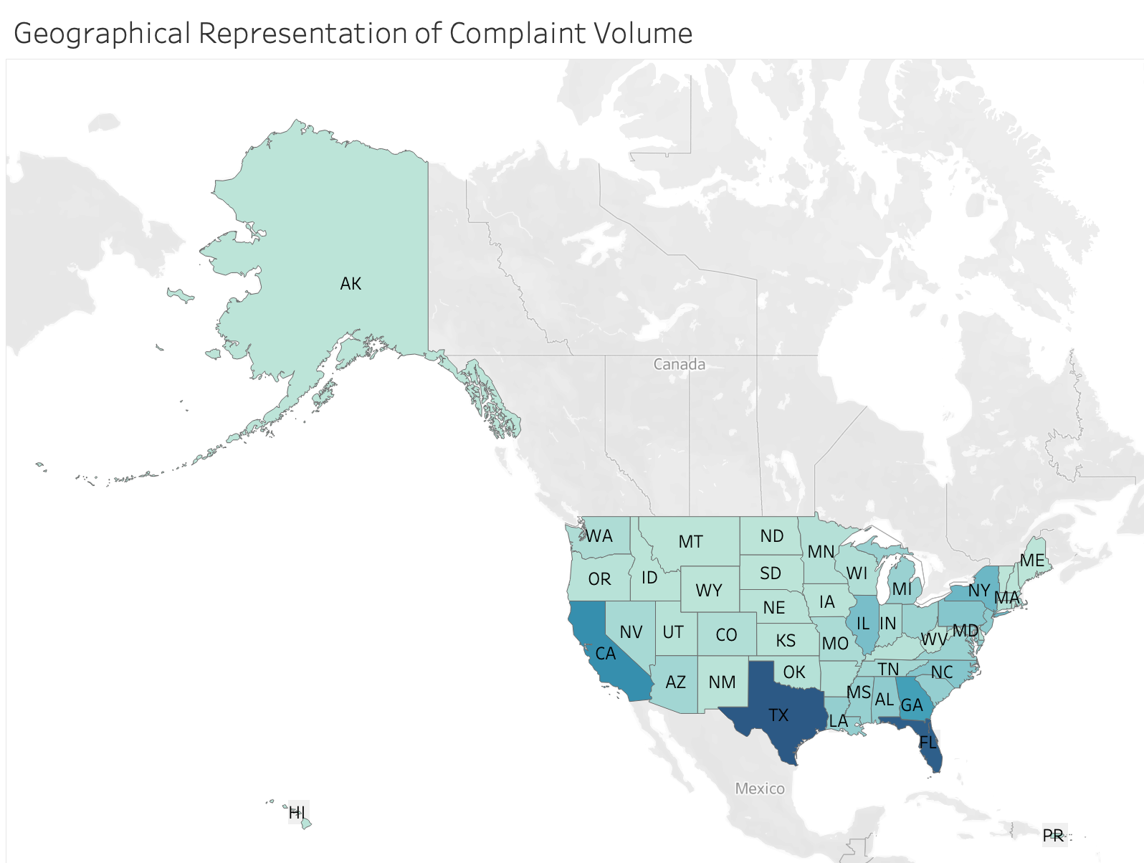
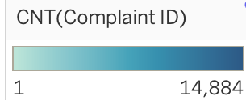
Screenshot from: Tableau

Slide 3
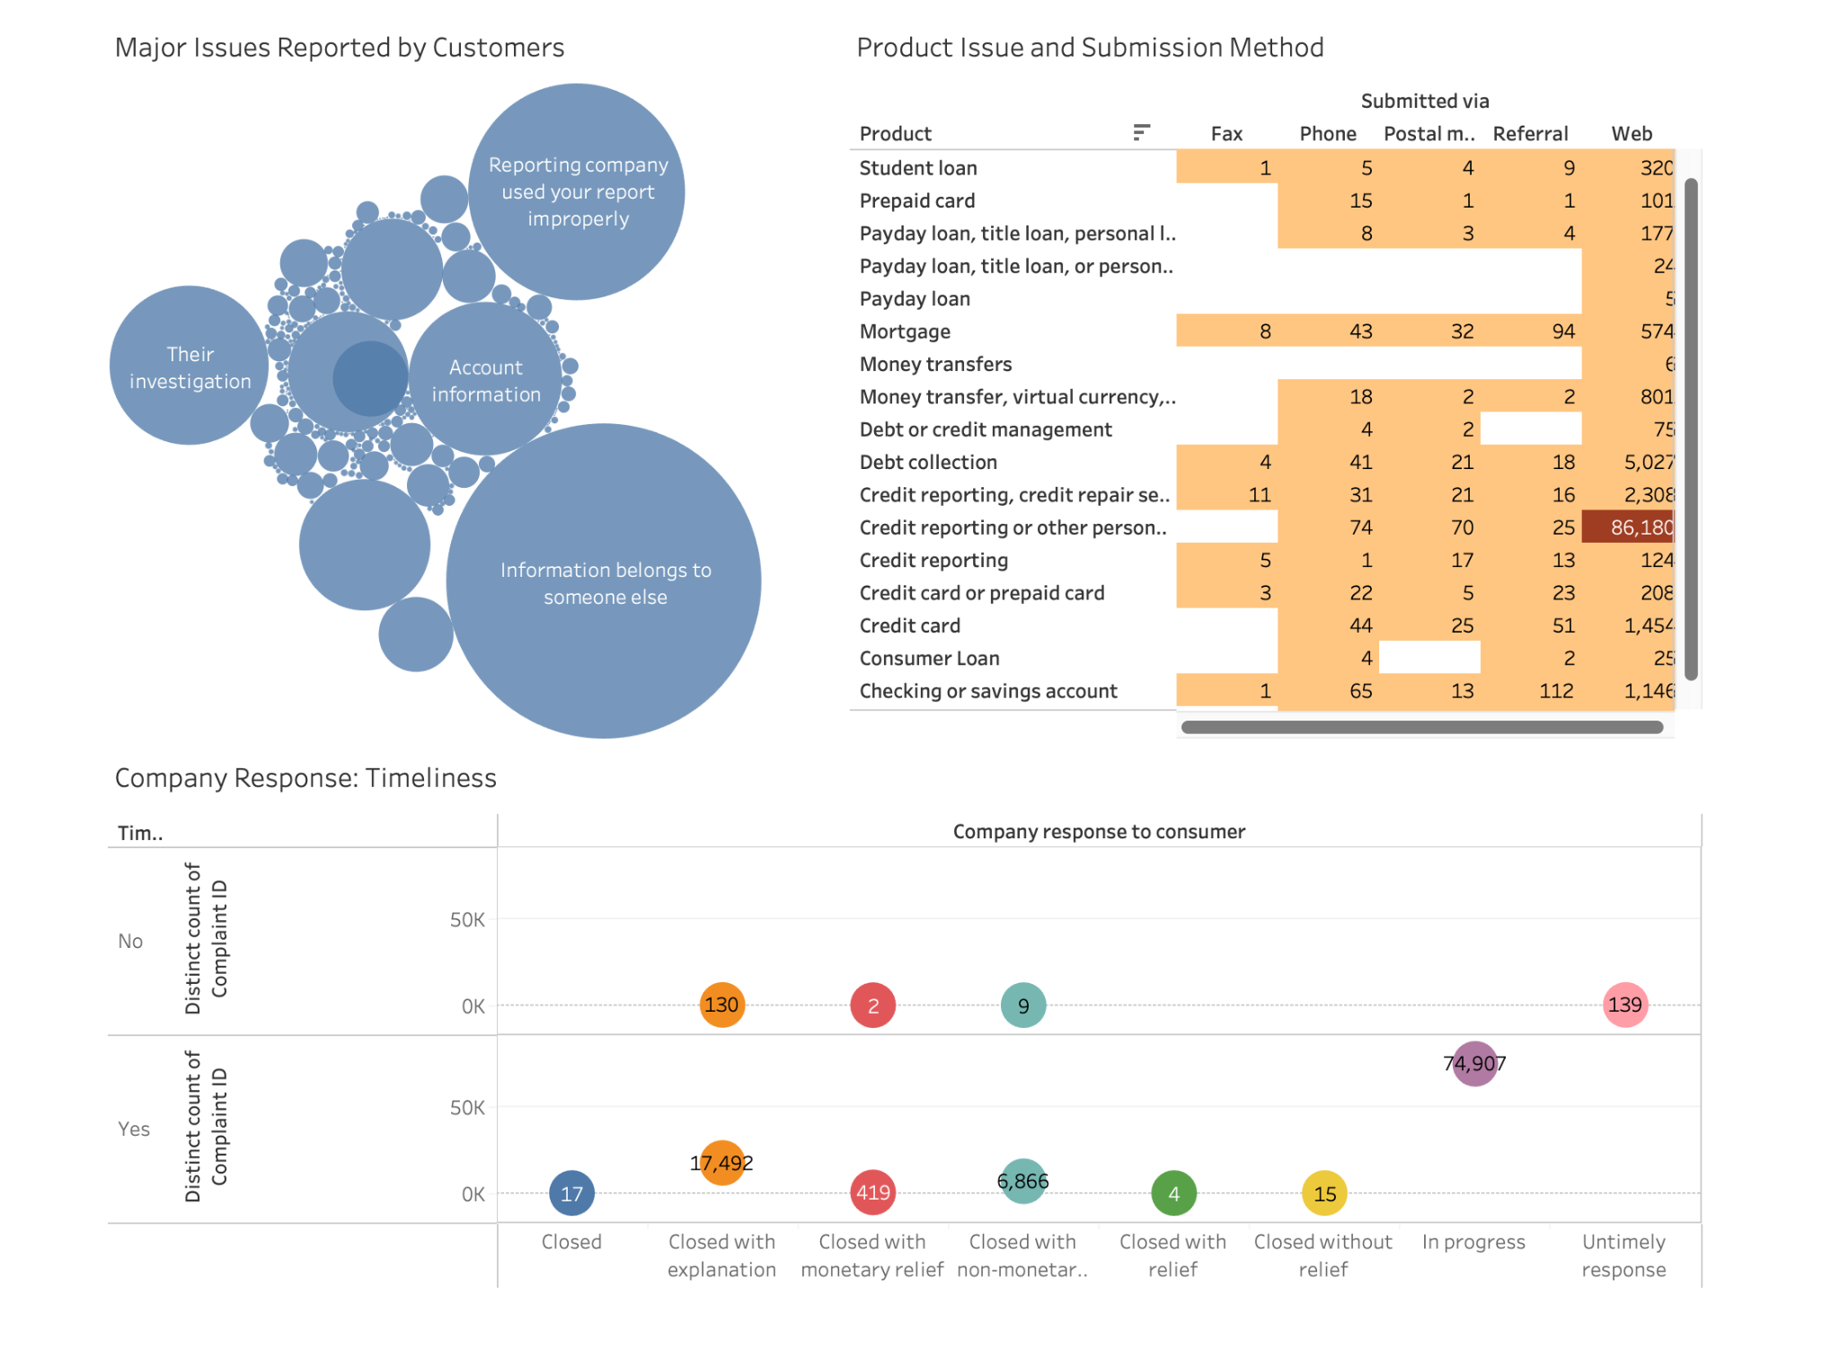
Dashboard Screenshot
from: Tableau

Slide 4
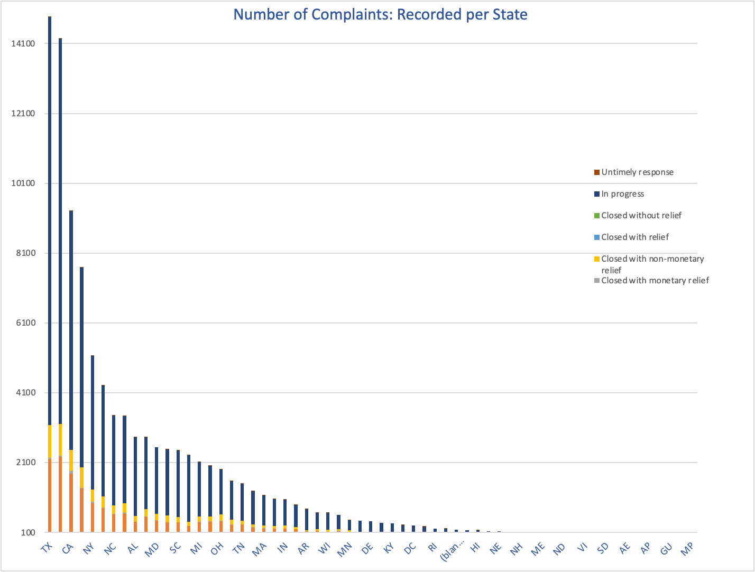
Legend: Solution Provided
by Companies

Slide 5
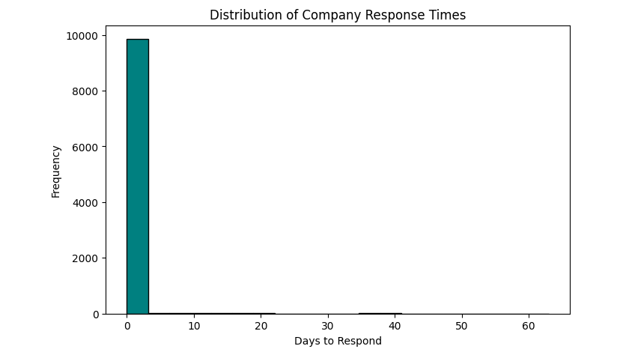
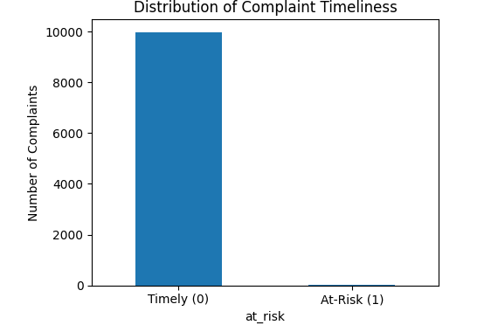
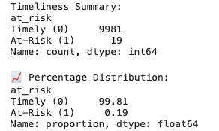
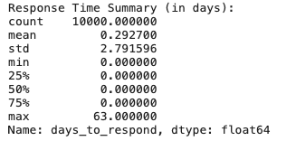
Consumer Complaint - Company Response Timeliness

Slide 6
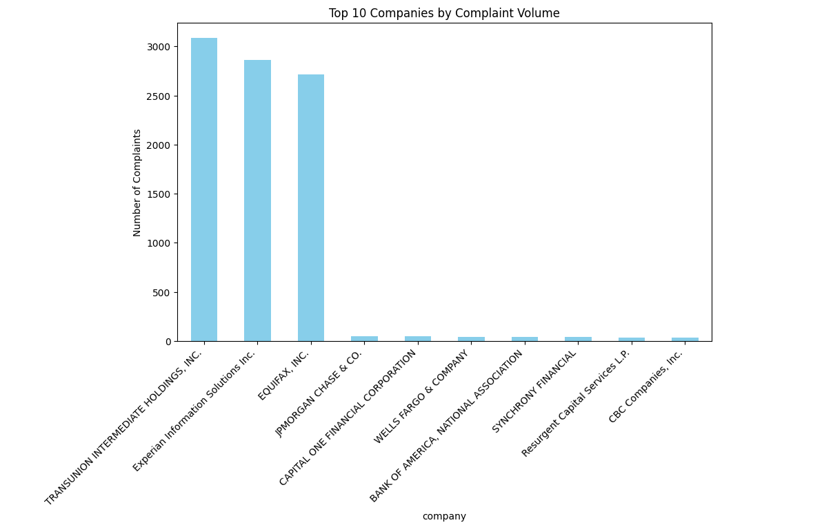
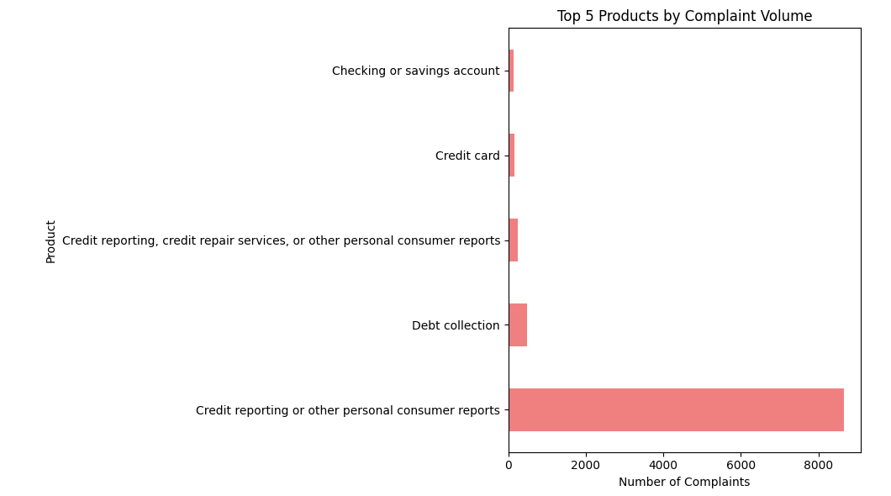
Majority in Companies and Product Dissatisfaction

Slide 7
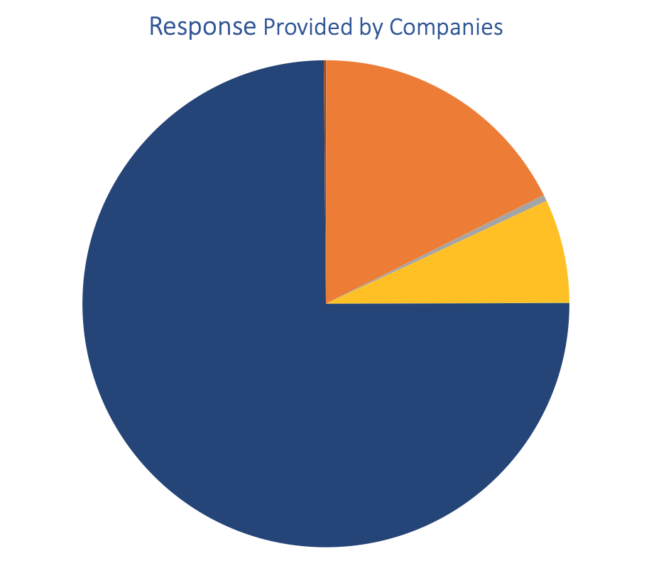
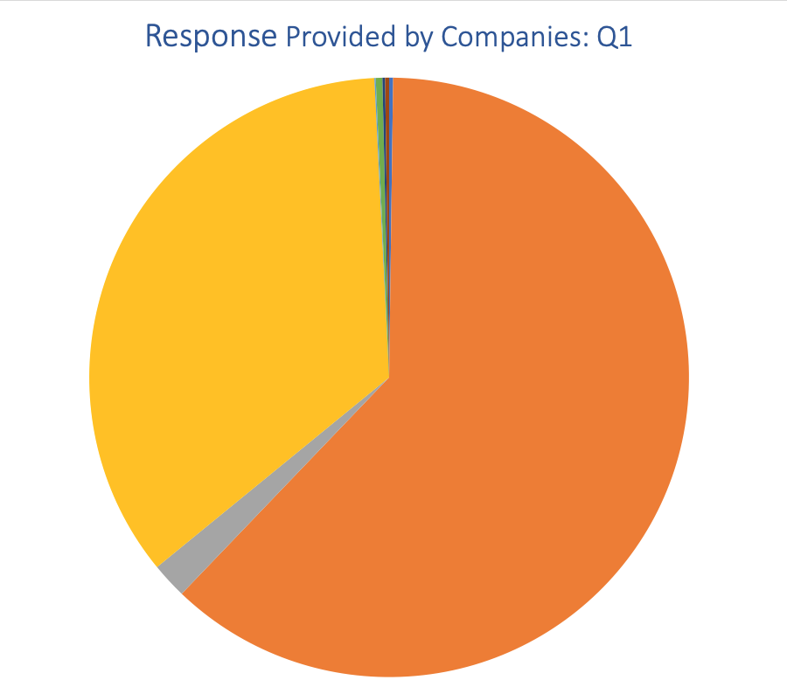
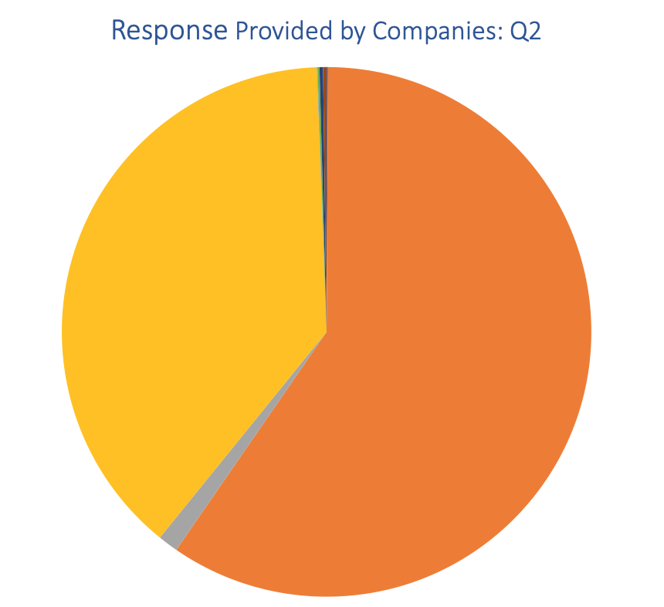
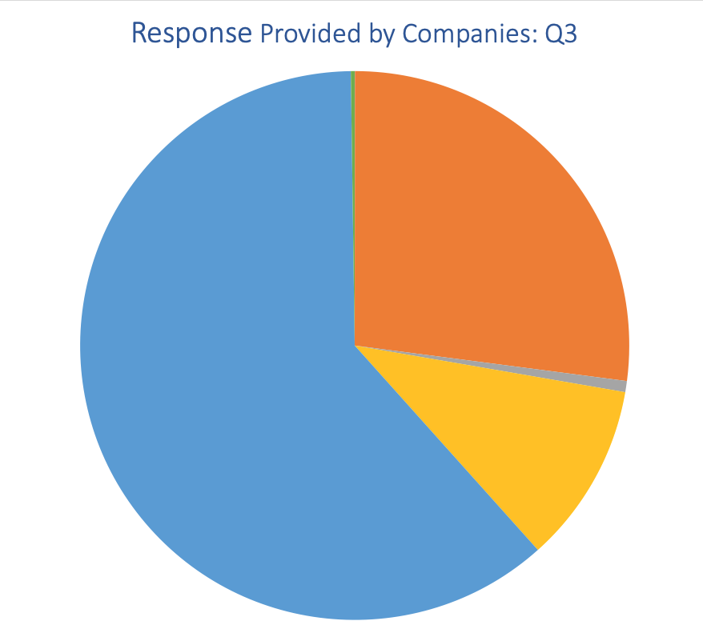
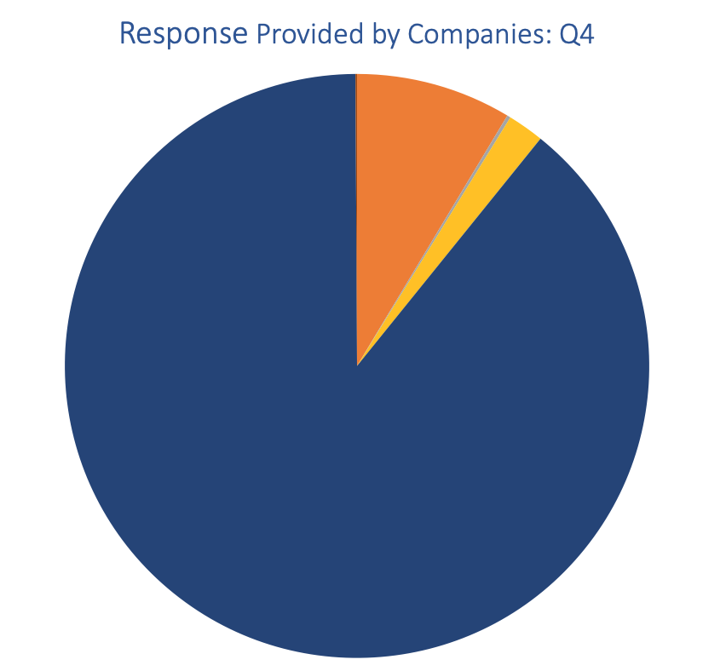
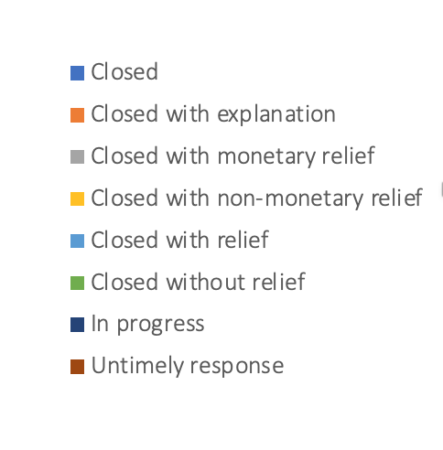
Solution Provided by Companies: Quarterly

Slide 8
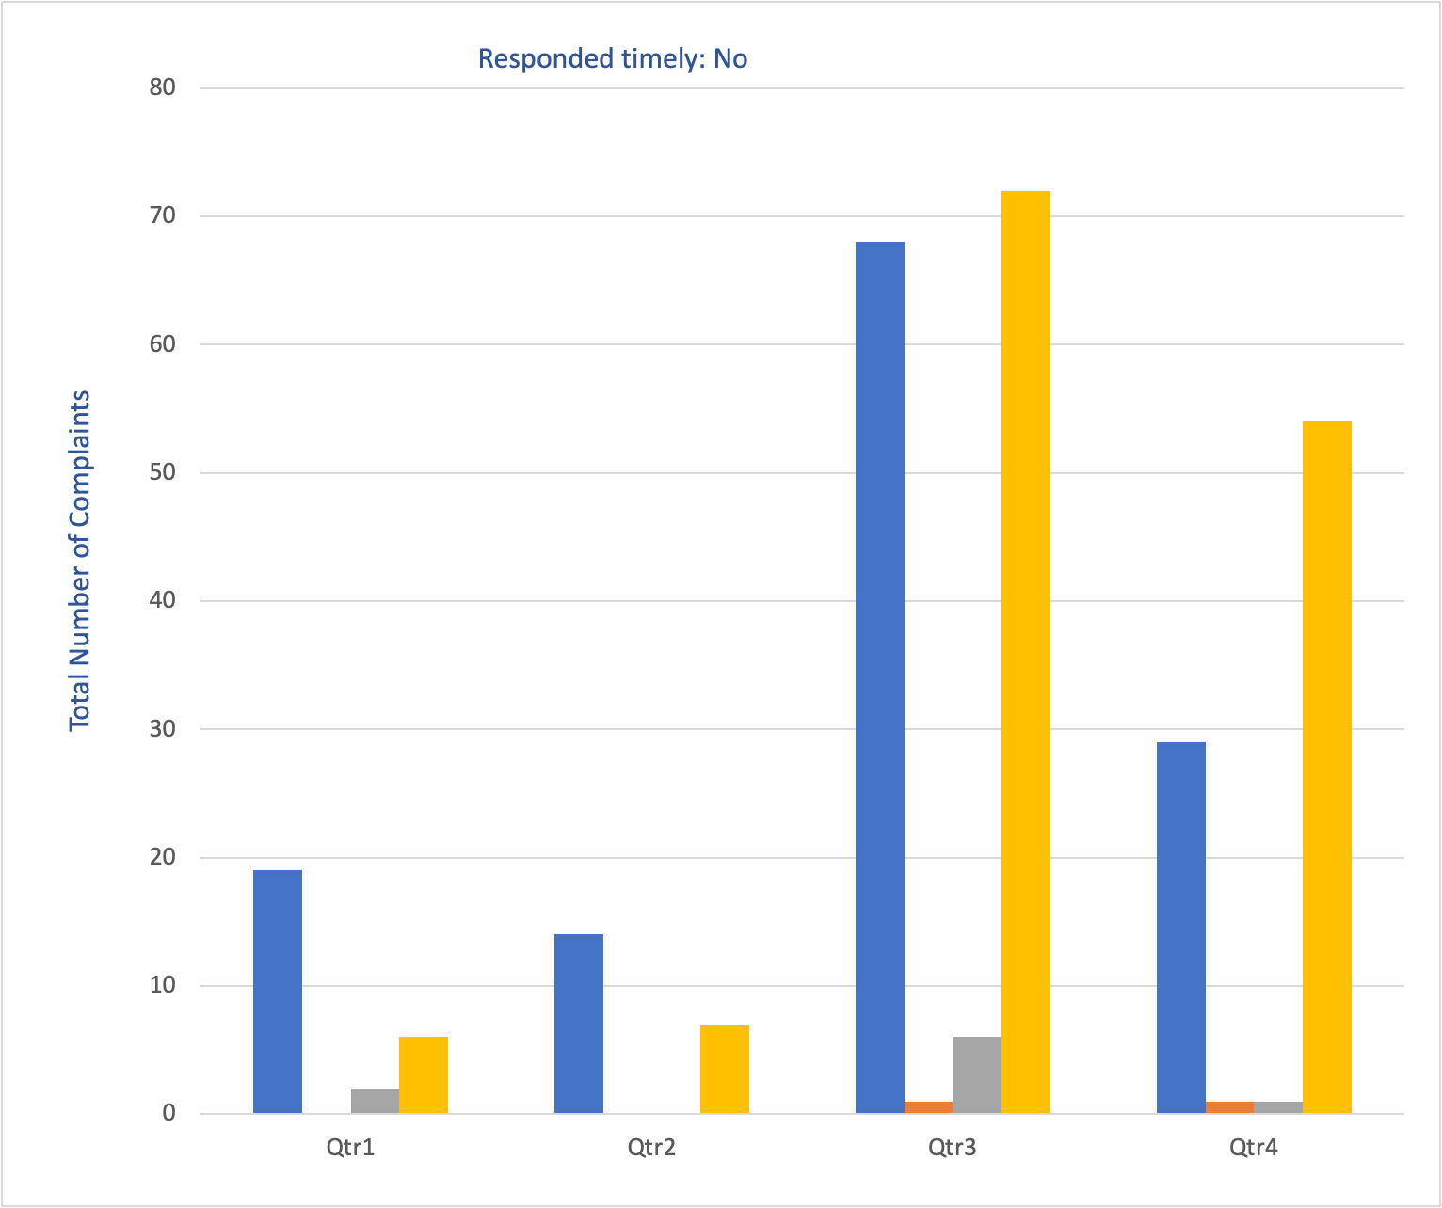
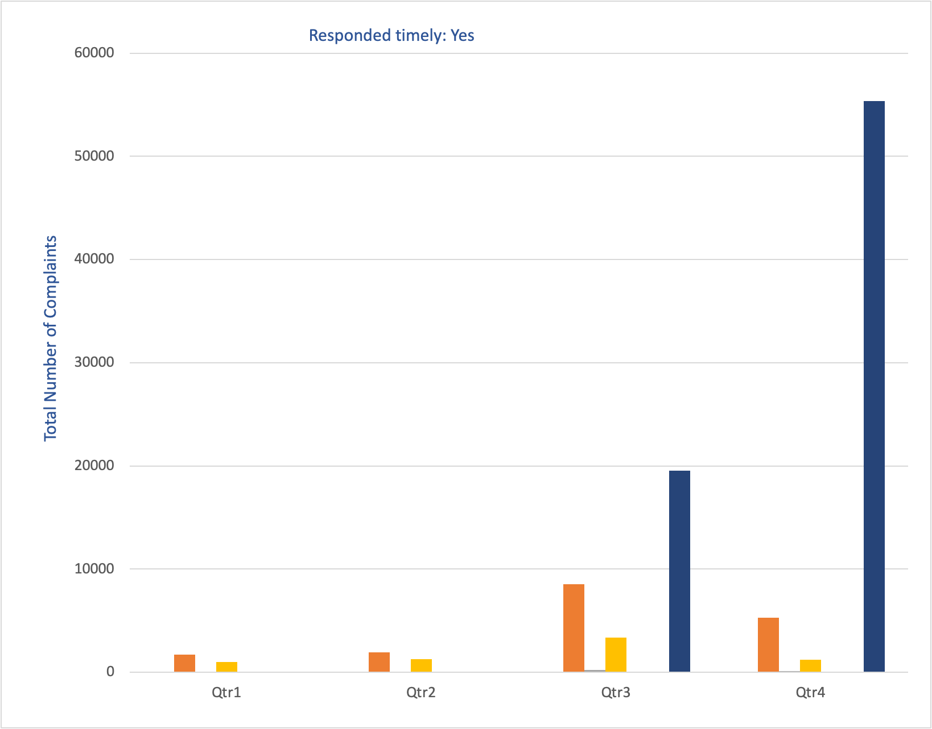
Solution Provided by Companies: Quarterly

Slide 9
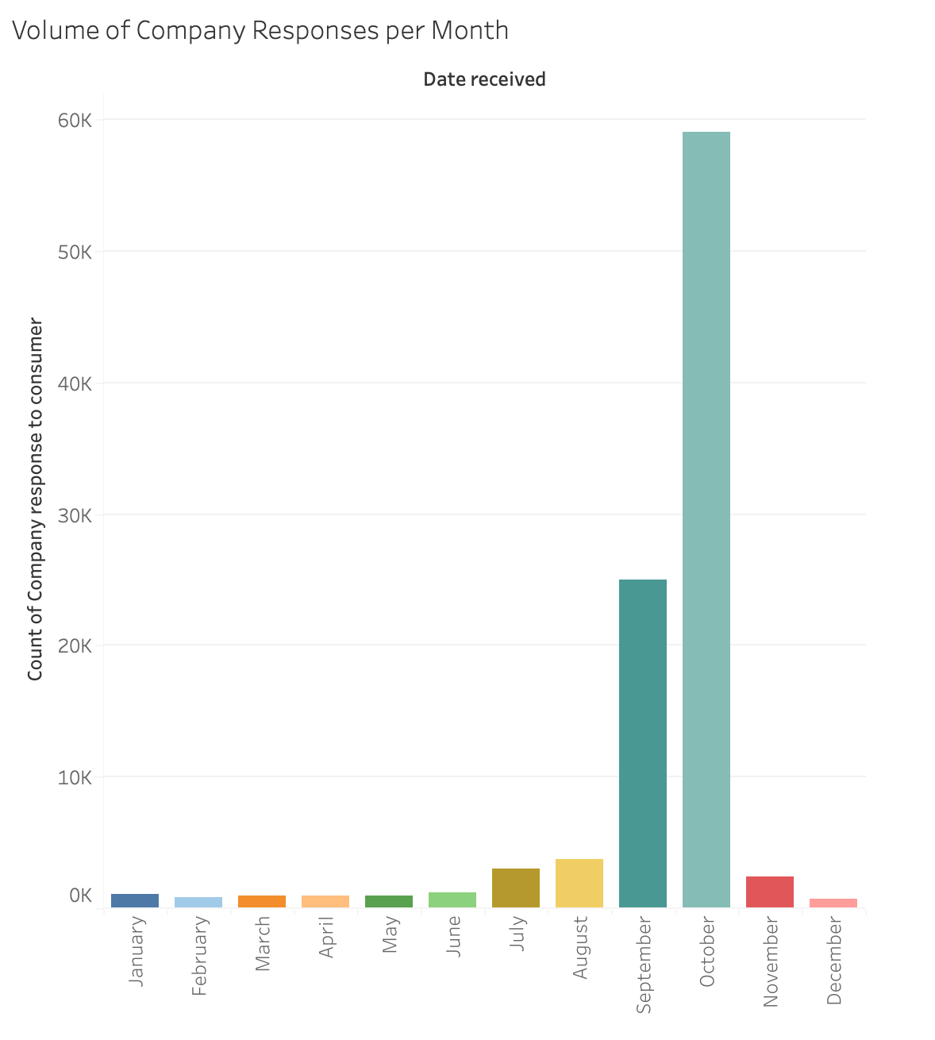
Solution Provided by Companies
Analysis: Monthly

Slide 10
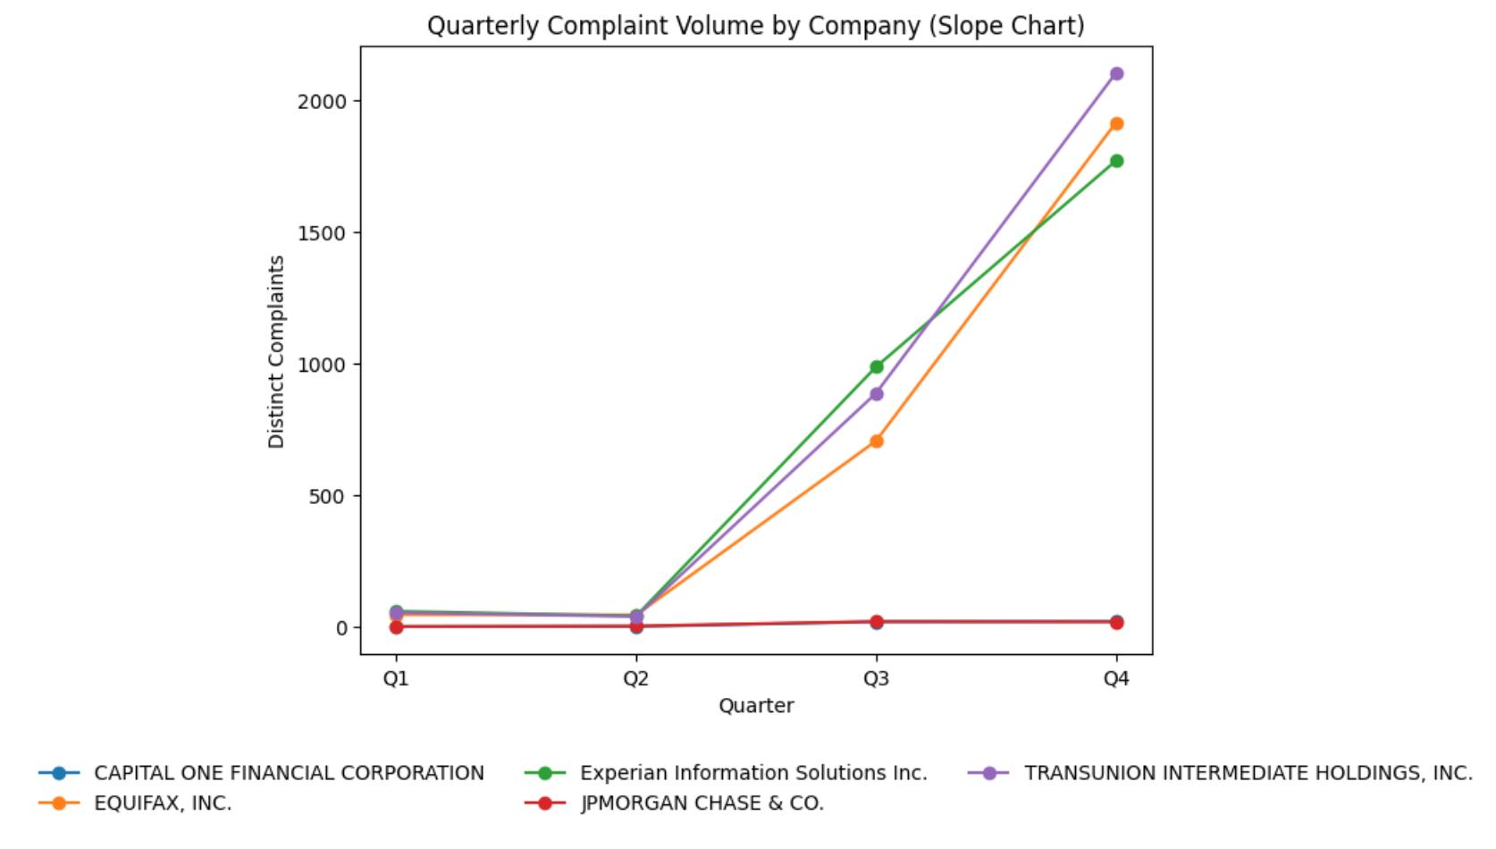
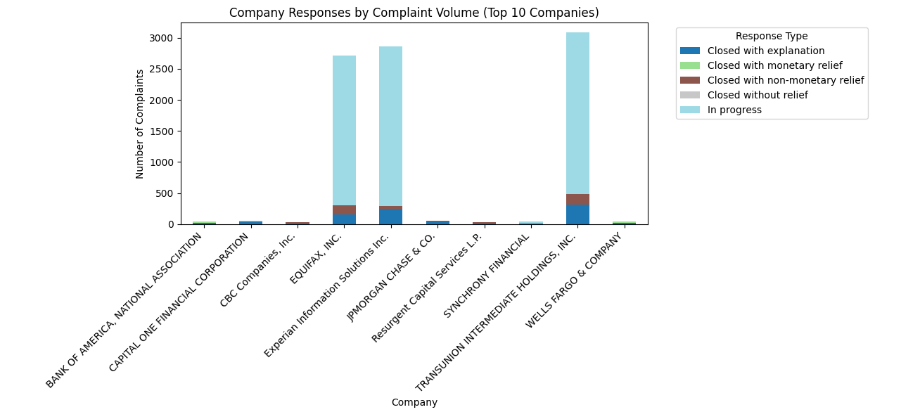
Solution Provided by top 10 Companies

Slide 11
Key Findings-Complaint Analysis
Credit Reporting Dominates Complaints Over 85% of total consumer complaints were related to credit reporting and credit repair services, primarily involving Experian, Equifax, and TransUnion — indicating ongoing dissatisfaction in credit data accuracy and dispute handling.
Web is the Primary Submission Channel The majority of complaints were submitted online, suggesting consumers prefer fast, digital methods for dispute resolution. Fax and referral submissions are almost obsolete.
Geographic Concentration in High-Population States States such as Texas, Florida, and California recorded the highest complaint volumes, mirroring their population density and higher consumer activity levels.
Company Response Patterns Show Consistency Most companies resolve cases as “Closed with explanation”, while a minimal share involve monetary relief or remain in progress. This suggests that explanations are the predominant method of dispute closure, but not necessarily full consumer satisfaction.
Quarterly Analysis Shows Stability in Response Trends Across quarters, the proportion of response types remains consistent, with Q3 showing a slight spike in complaint volume — likely due to cyclical financial activities (e.g., midyear credit updates or loan cycles).
Consumer Frustration Themes Are Repetitive The top reported issues — “incorrect information,” “account belonging to someone else,” and “investigation delays” — reveal that systemic data handling issues persist, not isolated cases.

Slide 12
Strategic Recommendations and Next Steps
1. Strengthen Data Accuracy Controls
2. Improve Resolution Transparency
3. Optimize Digital Complaint Channels
4. Monitor High-Volume States Proactively
5. Sustain Timely Responses Through Automation
6. Shift Metrics from Resolution to Prevention
7. Foster Cross-Industry Collaboration

