Slide 1



Loan Default Risk
Introduction Data Source/Analysis Data Merging/Cleaning Data Visualization/Correlation Conclusion
Aman Panwar
Anurag Sharma
Dinesh Poudel

Slide 2
Loan Default Risk
Introduction Data Source/Analysis Data Merging/Cleaning Data Visualization/Correlation Conclusion
Background
$14 trillion consumer debt in 2018*
Loan delinquency/Loan default
Financial strain on loan lending organizations
*New York Federal Reserve
Notes:
New York Federal Reserve
Lending primarily to people with little or no credit history

Slide 3
Loan Default Risk
Introduction Data Source/Analysis Data Merging/Cleaning Data Visualization/Correlation Conclusion
Objectives
Financial inclusion of unbanked population
Positive and safe borrowing experience
Processed dataset
Machine learning model
Identify the high-risk behavior

Slide 4
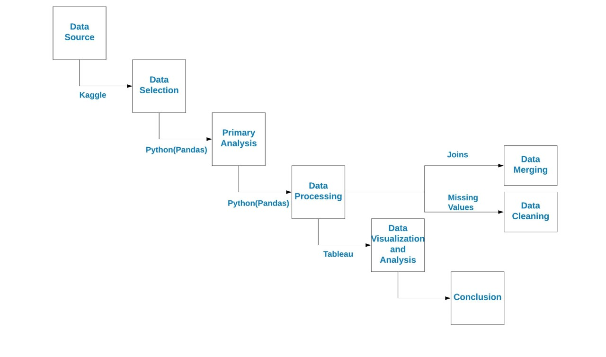
Loan Default Risk
Introduction Data Source/Analysis Data Merging/Cleaning Data Visualization/Correlation Conclusion
Flowchart

Slide 5

Loan Default Risk
Introduction Data Source/Analysis Data Merging/Cleaning Data Visualization/Correlation Conclusion
Data Source/Analysis of Data
Loan application
Credit Bureau
Previous application history
Credit balance

Slide 6
Loan Default Risk
Introduction Data Source/Analysis Data Merging/Cleaning Data Visualization/Correlation Conclusion
Datasets
Total 30 variables
Data type: Continuous and Categorical
Most common Dependent variable
- “Target” Variable(Risky(1), Non-Risky(0))

Slide 7

Loan Default Risk
Introduction Data Source/Analysis Data Merging/Cleaning Data Visualization/Correlation Conclusion
Data Merging/Cleaning
All data in CSV format
Common elements: SK_ID_CURR
Bureau, credit balance and previous application data
Issues:
- Multiple rows with same SK_ID_CURR
- Multiple Categorical Data within same column

Slide 8
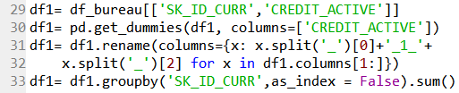
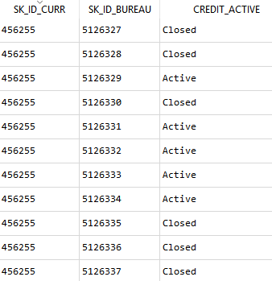

Loan Default Risk
Introduction Data Source/Analysis Data Merging/Cleaning Data Visualization/Correlation Conclusion
Resolution:
Original Issue:
Steps:
Convert each unique category to new column
Find total count for each ID for each category
Final output:

Slide 9
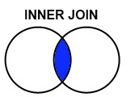
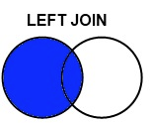
Loan Default Risk
Introduction Data Source/Analysis Data Merging/Cleaning Data Visualization/Correlation Conclusion
Join 4 datasets:
Two different outputs:
- Inner Join-Data for common ID’s- 74,611 rows
Issues: Do not account for all data in application
- Left join- Application Data- 307,511 rows
Issues: Missing values for applicant with no prior credit history.

Slide 10
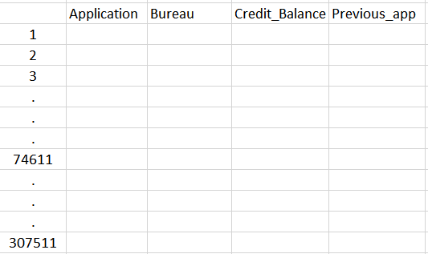
Loan Default Risk
Introduction Data Source/Analysis Data Merging/Cleaning Data Visualization/Correlation Conclusion
Slicing:

Slide 11
Loan Default Risk
Introduction Data Source/Analysis Data Merging/Cleaning Data Visualization/Correlation Conclusion
Join 4 datasets:
Assign mapping values to distinguish missing
applicant’s record vs missing values.
- Assign “-1” for Missing Bureau Record
- Assign “-2” for Missing Credit Balance Record
- Assign “-3” for Missing Prior Application Record

Slide 12

Loan Default Risk
Introduction Data Source/Analysis Data Merging/Cleaning Data Visualization/Correlation Conclusion
Filling Missing Values:
Occupation Type
- Replace with “unknown”
Goods Price(for which Loan was requested)
- Replace with mean of goods price
Number of Credit Requests(Per year)
- Replace with 0
Number of Family Members
- Replace with mean of family members count

Slide 13
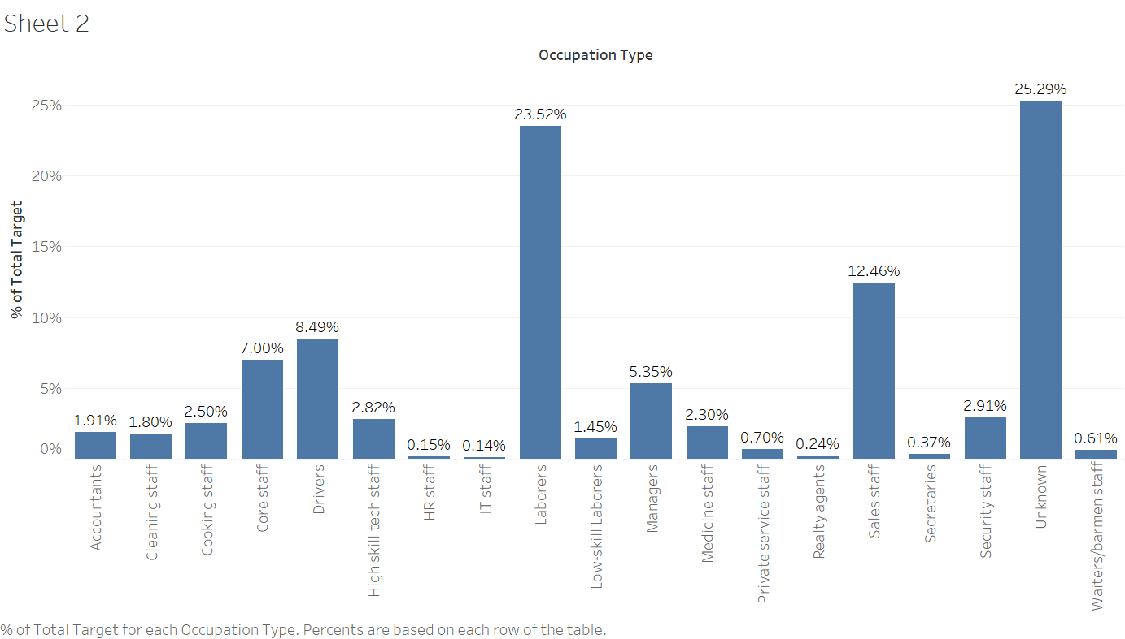
Data Visualization/Correlation
Cramér’s V correlation, r= 0.08

Slide 14
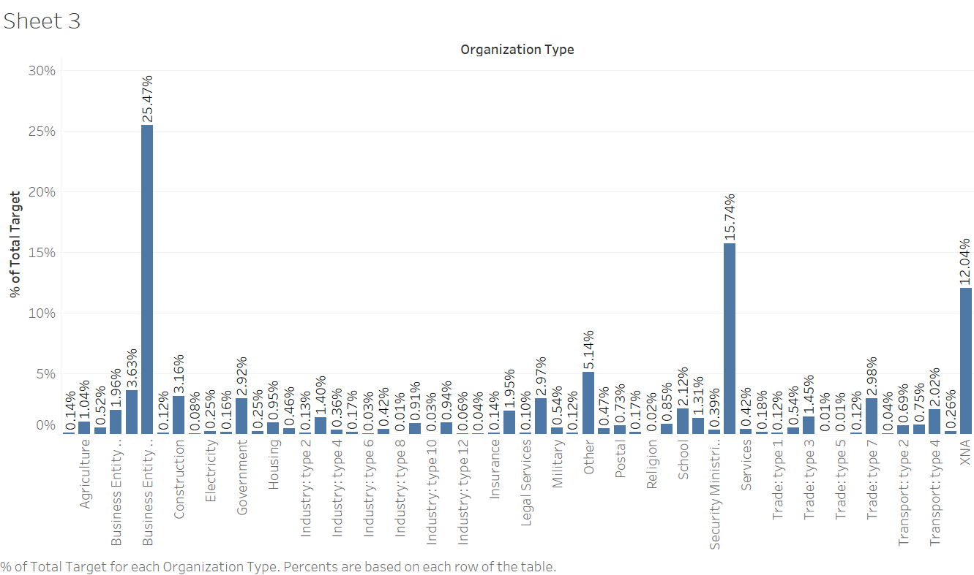
Data Visualization/Correlation
Cramér’s V correlation, r= 0.07

Slide 15
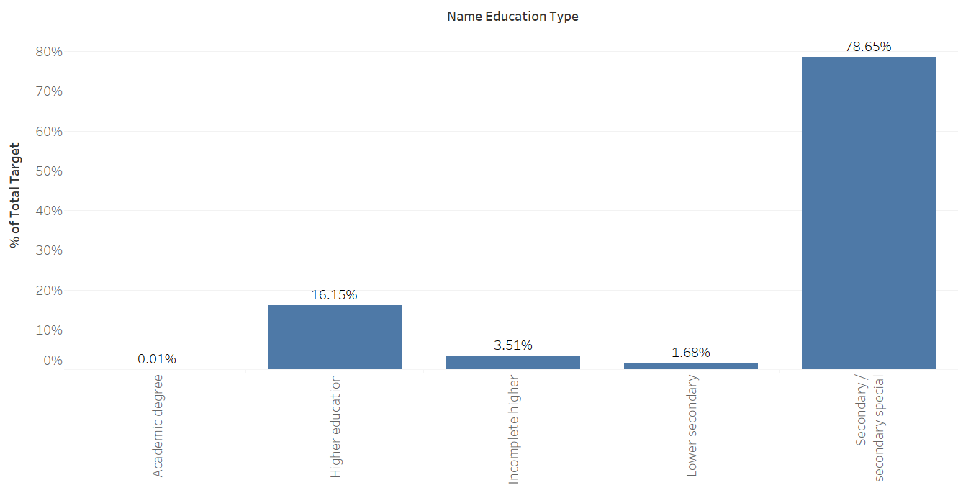
Data Visualization/Correlation
Cramér’s V correlation, r= 0.06

Slide 16
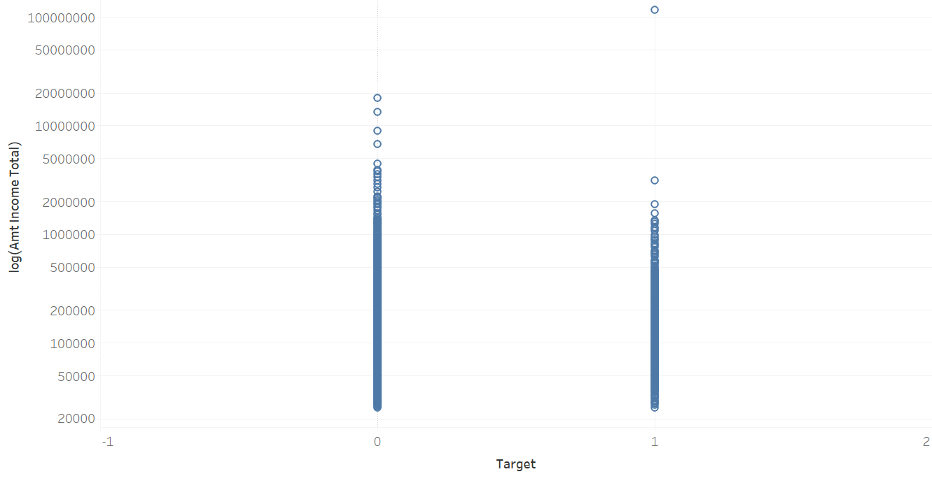
Data Visualization/Correlation
Point Biserial correlation, r= -0.004

Slide 17
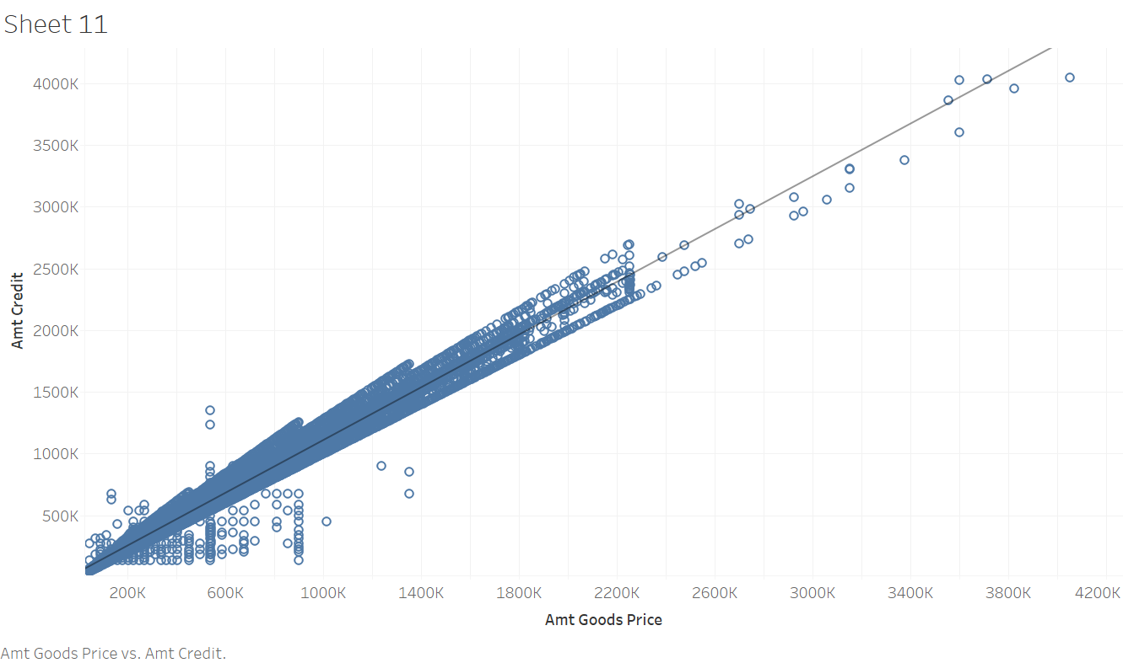
Data Visualization/Correlation
Pearson correlation, r= 0.98

Slide 18
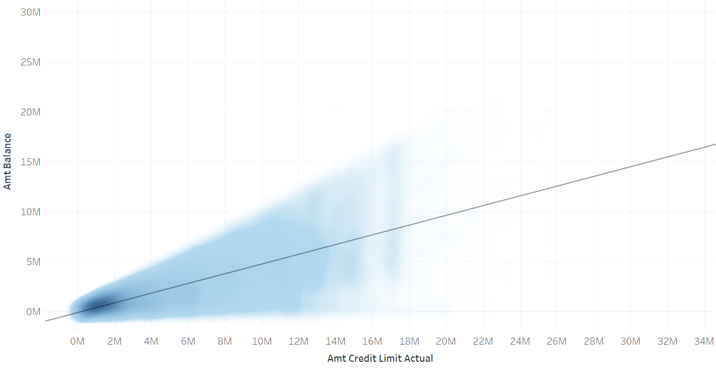
Data Visualization/Correlation
Pearson correlation, r= 0.78

Slide 19

Loan Default Risk
Introduction Data Source/Analysis Data Merging/Cleaning Data Visualization/Correlation Conclusion
Conclusion and Recommendations:
Linear regression model unsuitable
Additional screening for the cases with high risk factors
Remove one variable from pair of highly correlated
variables for ML model

