Slide 2
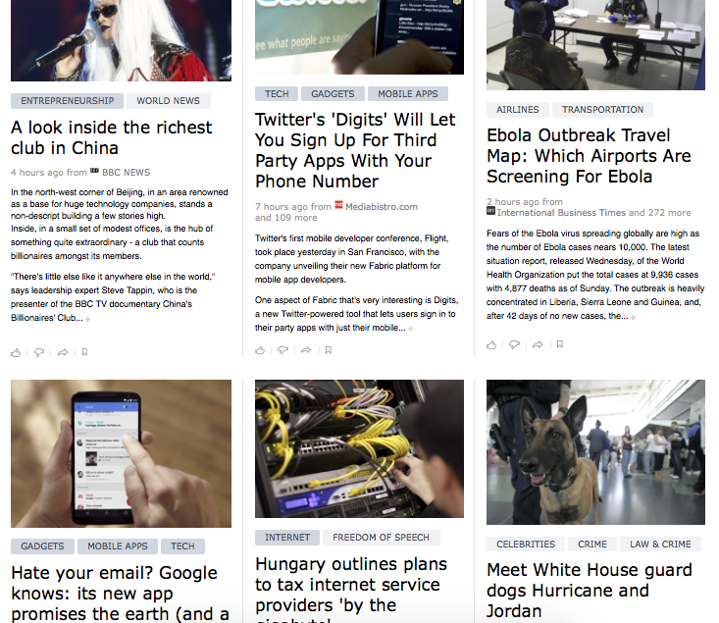
Nice Grid but Hard to Focus!

Slide 3



Things are always better with Friends

Slide 4
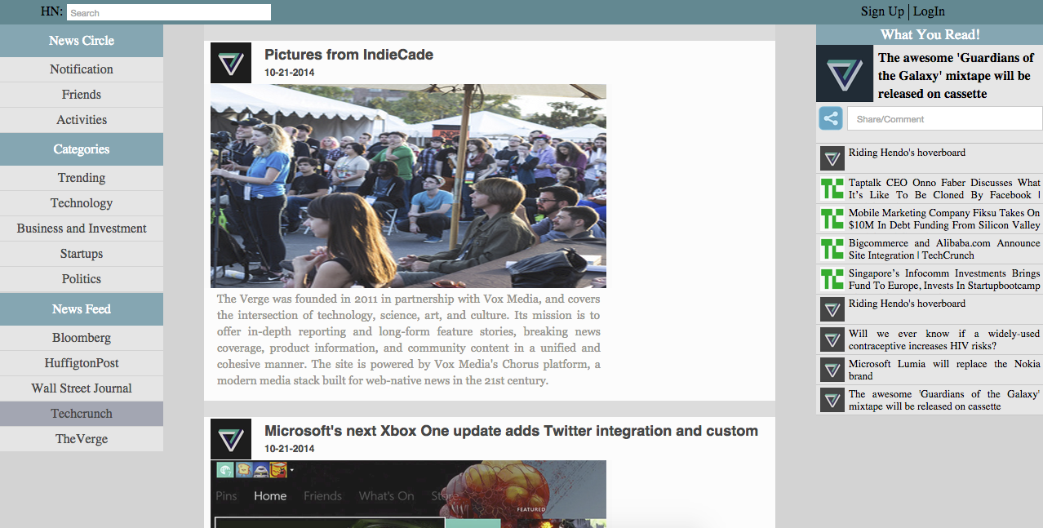
. What did your friends shared with you?
. What did they like and recommend you?
History
. Single column News Feed
. Never Stumble at same news ever again

Slide 5
Why?
Don’t be annoyed with recurring news feed
Analyze what you read and when you read
Discuss news with friends, read what they like/recommend, recommend good news
Never miss a thing: News/ Blog
Can be a good way to save links when carrying out research

